Slide 1
Aligning Risk to Mission
Tyson Olson
Idaho National Laboratory
Tyson.Olson@inl.gov

Slide 2
Principles of Enterprise Risk Management
Governance Framework is Important
Managers Own the Risk
Transparency Supports Informed Decision Making
Forums for Discussing Risk are Important
Diversity of People and Thought Aids Risk Management
Risk Management Should Be Integrated into Key Agency Processes
Planning Fosters a Culture of Resilience
Source: Playbook: Enterprise Risk Management for the U.S. Federal Government

Slide 3
ERM at INL
Enterprise Risks are identified using Laboratory processes (MRMs, Senior MRMs, KPIs, Assessments, Etc) as well as top down insights from INL Leadership (e.g., portfolio review meetings, or strategic planning meetings)
Risks are categorized under the following categories based on their primary nature: Strategic, Research/Mission, Operations, Finance, People
Risks are tied to the Laboratory Agenda.
Risks are ranked according to a common probability and consequence framework.
A strategy of monitor, mitigate, or avoid is decided.
Risks and associated actions are tracked through a common software tool.
The Enterprise Risk Register informs the Integrated Priority List (IPL) process for funding decisions.
Risks and the associated actions and strategy are reviewed and updated quarterly as part of the Senior MRM.

Slide 4
INL Mission
“Discover, demonstrate and secure innovative nuclear energy solutions, clean energy options and critical infrastructure.”

Slide 5
INL Mission Organizations
Nuclear Science & Technology
Energy and Environmental Science & Technology
National and Homeland Security Science & Technology
Advanced Test Reactor
Materials and Fuels Complex

Slide 6
Mission Enabling Initiatives
1.1. Nuclear Energy Competitiveness and Leadership
1.2. Integrated Fuel Cycle Solutions
1.3. Advanced Integrated Energy Systems
1.4. Advanced Design and Manufacturing
1.5. Enduring Control Systems Cybersecurity Innovation Capabilities
2.1. Transform How We Perform and Manage Work
2.2. Build INL's Future Workforce
2.3. Modernize and Mature INL Information Systems and Services
2.4. Optimize Cost Management
2.5. Revitalize Security and Enabling Infrastructure
2.6. Achieve Leadership in Safety to Enable Cutting Edge S&T
2.7. Advance INL's Stewardship of its Environmental Legacy
2.8. Advance INL's Security
3.1. INL is a High Value Partner Nationally and in Community, State, and Region
Science & Technology
Laboratory Support
Community Engagement

Slide 7
Mission Enabling Initiatives

Slide 8
Mission Enabling Initiatives

Slide 9
Risk Integration

Slide 10
Risk In Performance Reporting

Slide 11
Risk In Performance Reporting

Slide 12
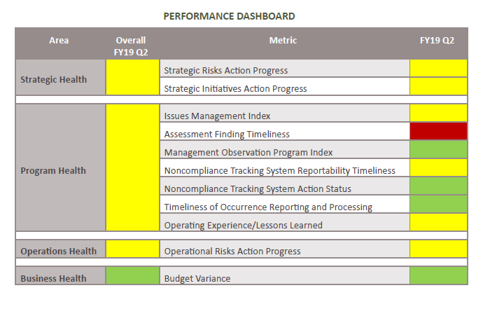
Risk In Performance Reporting

Slide 13
ERM Structure
Sr MRM
& Enterprise Risk Register
SLT
F&SS
Tech Support Services
Applied Engineering
EES&T
Sitewide Utilities
Power Maintenance
Life Safety Systems
Directorate MRMs
& Risk Register
Customized

Slide 14
ERM Tool

Slide 15
Enterprise Risk Register
1.1. Nuclear Energy Competitiveness and Leadership
Excessive financial burdens from other INL and/or DOE mandates takes resources from the NSUF core mission funding.
MFC User-Facility Model Implementation
SMR Investments and Deployment
1.2. Integrated Fuel Cycle Solutions
Advanced Fuel Cycle Funding and Policy Uncertainty
Internal Spent Nuclear Fuel Management
Spent Nuclear Fuel Impasse with Idaho AG
2.4. Optimize Cost Management
DOE and INL misalignment for accounting practices
Increasing construction costs
2.5. Revitalize Security and Enabling Infrastructure
Aging infrastructure not positioned to support future R&D
Competition for construction human capital resources
Deficiency in strategic infrastructure planning
Shortage of funding to support enabling infrastructure

Slide 16
Performance Reporting Risk Register
Business
Aging telephony infrastructure
Competition for construction human capital resources
Cyber Researcher Human Capital
Deficiency in advanced manufacturing expertise
Increasing competition for human capital
Shortage of Cyber Security Operations Personnel
Shortage of funding to support enabling infrastructure
Timeline of Safeguards and Security personnel onboarding
Operational
Aging enterprise systems and IT infrastructure
Aging infrastructure not positioned to support future R&D
Business systems infrastructure increasing fraud risks
DOE and INL misalignment for accounting practices
ESL Systems Integration Lab Upgrades
Failure to meet SCMS Backlog Treatment Commitments
High Hazard Safety
Increasing construction costs

Slide 17
Risk Register Alt
HIGH
Failure of the ATR Warm Waste Treatment System
Failure to Meet Idaho State Settlement Agreement (ISA) Resulting in Fines and Impacts to INL Mission
MEDIUM
Advanced Design and Manufacturing customer funding risks
Adverse Impacts to Significant Cultural Resources or Numerous Repetitive Type 2 Impacts
Aging enterprise systems and IT infrastructure
Aging infrastructure not positioned to support future R&D
Business systems infrastructure increasing fraud risks
VERY LOW
Deficiency in strategic infrastructure planning
Programmatic diversity creates funding obstacles
Strengthening CRMO Performance Through Transition to ES&S

Slide 18
Risk Register Alt
B000 ENERGY & ENVIRONMENT S&T
Computational and Mathematical obstacles
Deficiency in advanced manufacturing expertise
ESL Systems Integration Lab Upgrades
ThermoLoop funding and construction
C000 NUCLEAR SCIENCE AND TECHNOLOGY
Advanced Design and Manufacturing customer funding risks
Advanced Fuel Cycle Funding and Policy Uncertainty
Political uncertainties related to advanced design and manufacturing prioritization
SMR Investments and Deployment
Spent Nuclear Fuel Impasse with Idaho AG
L000 PARTNERSHIPS, ENGAGEMENT & TECH DEPLY
Lack of engagement from SLT in supporting reputation-building activates
Relationships with academic stakeholders
SLT engagement of key stakeholders

Slide 19
Risk Register Alt
H000 ES&H&Q
High Hazard Safety
Lab-wide Safety Risks
Risks to INL's Environmental Legacy
H500 ENVIRONMENTAL SUPPORT & SERV
Failure to Meet Regulatory/Contractual Commitments or INL Mission Due to Staffing Retirements, Transfers, or Promotions
Failure to Meet Regulatory/Contractual Commitments or INL Mission Due to Work Planning and Control
H510 PROJECT & PROGRAM SUPPORT
Failure of the ATR Warm Waste Treatment System
Failure to Maintain Building/Painted Surfaces at ATR, CFA, & MFC Resulting in PCB Releases & Non-Compliance
Failure to Meet Idaho State Settlement Agreement (ISA) Resulting in Fines and Impacts to INL Mission
Release of Radionuclides from ATR Evap Ponds Above Permit or Regulatory Limits from Liner Leak
H530 REGULATORY & MONITORING SERV
Adverse Impacts to Significant Cultural Resources or Numerous Repetitive Type 2 Impacts
Failure to Maintain Accurate IRC Radionuclide Inventory and Emissions
Failure to Meet NEPA & CRMO Commitments
Legacy Deficiencies in Cultural Resource Management
Strengthening CRMO Performance Through Transition to ES&S
H540 WASTE MANAGEMENT PROGRAM
Failure of Flour to Meet INL Needs for Characterization and Disposal of TRU Waste
Failure to meet SCMS Backlog Treatment Commitments
Significant deficiencies in INL TRU Program impacting INL’s ability to dispose of TRU waste at WIPP

