Slide 1
Procurement Engineering
Chair: Spencer Daw
Vice-Chair: John Hendricks
Secretary: Open
Fall Virtual Conference – November 14-17, 2022

Slide 2
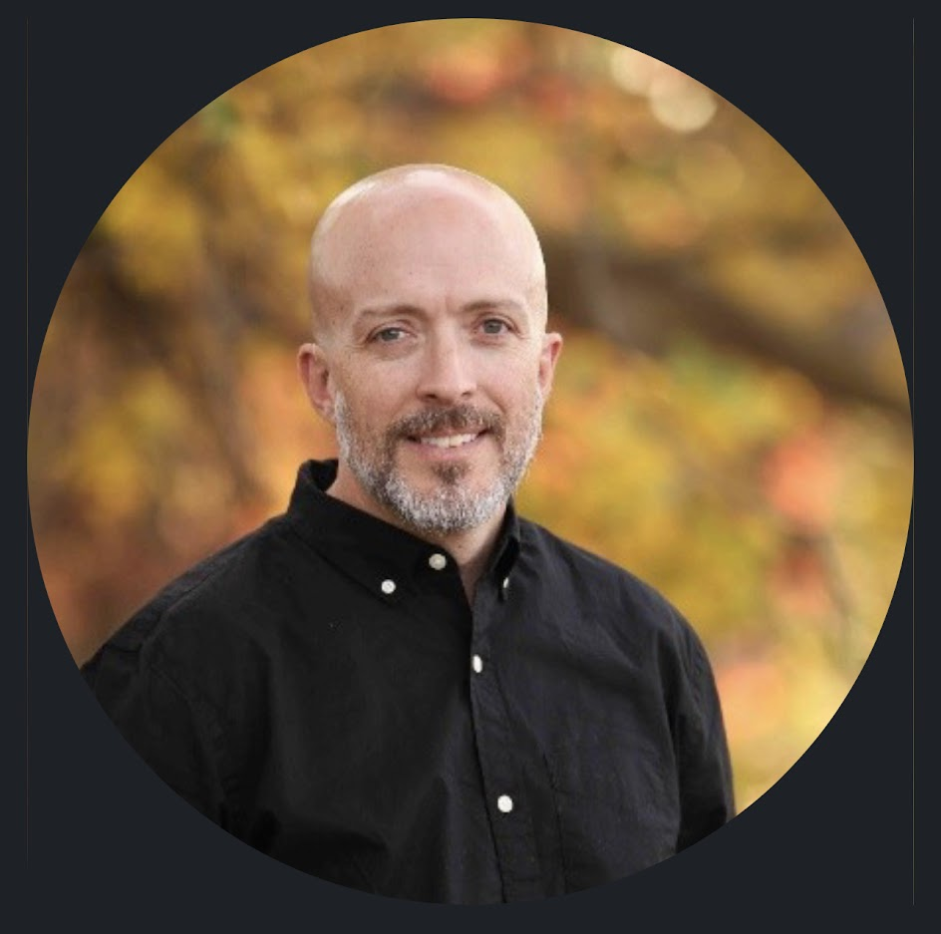
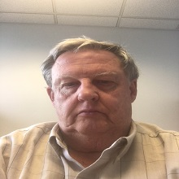
Procurement Engineering Task Team Leadership
Spencer Daw
John Hendricks
Open
Chair
Vice-Chair
Secretary
EFCOG PE Web site

Slide 3
CHARTER
Task Group Purpose:
The EFCOG Procurement Engineering Task Team is comprised of industry experts in engineering and procurement. This groups primary focus is to identify opportunities for improvement with regards to the procurement engineering processes, such as commercial grade dedication (CGD), and develop best practices and lessons learned based on those identified opportunities.

Slide 4
Scope
The scope of the Procurement Engineering Task Group is to facilitate seamless integration through engineering, quality, procurement and supply chain partners throughout the DOE complex. Areas of focus to accomplish this are:
engineering specifying technical and quality requirements
procurement specification/commercial grade dedication development and approval approaches
acquisition planning
vendor selection
vendor oversight
product acceptance/delivery
obsolescence evaluations and mitigation approaches
supply chain analysis and improvement (e.g., vulnerabilities in supply chain performance and improvement actions (e.g., welding), foreign national company issues for weapons materials, techniques to better utilize commercial vendors for nuclear safety fabrications, etc.)

Slide 5
Detailed Schedule for PE Wednesday, Nov. 16
Time EST | Topic | Presenter(s)
10:30 | Greeting - Review Charter WebEx “Rules of the Road” | Spencer Daw (INL) Jenn and Jeanne (CW)
10:45 1 hr | Procurement of Items and Services from Non-Nuclear Suppliers Using Part I of NQA-1 (Presentation of white paper and discussion) | (Team) Spencer Daw, Mike Genoni, Chris Hartz, Allen Davidson
11:45 3/4 hr | Application of UL (ISO-17065) in the CGD process (Presentation of white paper) | John Hendricks (CW)
12:30 | LUNCH
1:00 ¾ hr | Improving Material Traceability and CMTR Requirements in Procurement Documents (Presentation) | Steve O’Connor (SRS)
1:45 3/4 hr | Application of testing and calibration laboratories (ISO-17025) in the CGD process (Presentation of white paper) | John Hendricks (CW)
2:30 | BREAK
2:45 | Frequently Asked Questions (FAQ) Procurement Engineering Task Team FAQ – EFCOG.org | Paul Nielsen (INL)
3:30 | End of Day wrap up | Spencer Daw (INL)
EST 10:30am | CST 9:30am | MST 8:30am | PST 7:30am

Slide 6
Detailed Schedule for PE Thursday, Nov. 17
Time EST | Topic | Presenter(s)
10:30 | Greeting - Review Charter WebEx “Rules of the Road” | Spencer Daw (INL) Jenn and Jeanne (CW)
10:35 | Application of Embedded Digital Device Considerations in the CGD Process (Technical Paper Presentation) | John Hendricks (CW)
11:45 | Voice of the Regulator (Regulator Overview / Question & Answer) | Chris Beaman (HQ)
12:15 | Review proposed white paper on alternate like-for-like definition for use within the DOE (White Paper) | Spencer Daw (INL)
1:00 | LUNCH
1:30 | National Reactor Innovation Center Overview (Presentation) | Spencer Daw (INL)
2:00 | NQA-1 Committee Update | Spencer Daw (INL)
2:15 | Discussion of Existing Tasks and Future Desired Tasks | Group
2:30 | PE Task Review and Fall Meeting Preparation / Plus Delta on Spring Meeting | Group
3:30 | End of Day wrap up | Spencer Daw (INL)
EST 10:30am | CST 9:30am | MST 8:30am | PST 7:30am

Slide 7
Enjoy your lunch!
WE WILL RESUME AT 1PM EST
EST 1:00pm | CST 12:00pm | MST 11:00am | PST 10:00am

Slide 8
Break
WE WILL RESUME AT 2:45PM EST
EST 2:45pm | CST 1:45pm | MST 12:45pm | PST 11:45am

Slide 9
Parking lot
Method 1 Lessons learned and best practices
Method 2 Lessons learned and best practices
Method 3 Lessons learned and best practices

Slide 10
THANK YOU!
EFCOG PE Task Team

