Slide 1

Procurement Engineering
Chair: Spencer Daw
Vice-Chair: John Hendricks
Secretary: Jen Davlin
Spring Virtual Conference – May 1-4, 2023

Slide 2
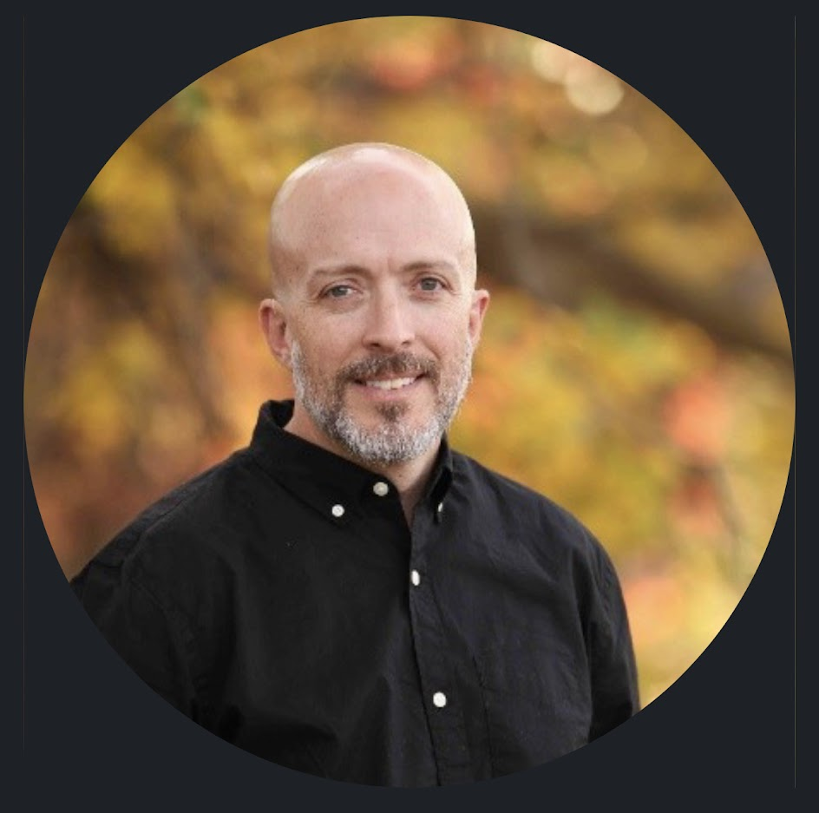
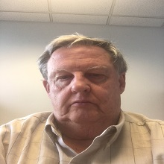

Procurement Engineering Task Team
Leadership
Spencer Daw
John Hendricks
Jen Davlin
Chair
Vice-Chair
Secretary
EFCOG PE Web site

Slide 3
CHARTER
Task Group Purpose:
The EFCOG Procurement Engineering Task Team is comprised of industry experts in engineering and procurement. This groups primary focus is to identify opportunities for improvement with regards to the procurement engineering processes, such as commercial grade dedication (CGD), and develop best practices and lessons learned based on those identified opportunities.

Slide 4
Scope
The scope of the Procurement Engineering Task Group is to facilitate seamless integration through engineering, quality, procurement and supply chain partners throughout the DOE complex. Areas of focus to accomplish this are:
engineering specifying technical and quality requirements
procurement specification/commercial grade dedication development and approval approaches
acquisition planning
vendor selection
vendor oversight
product acceptance/delivery
obsolescence evaluations and mitigation approaches
supply chain analysis and improvement (e.g., vulnerabilities in supply chain performance and improvement actions (e.g., welding), foreign national company issues for weapons materials, techniques to better utilize commercial vendors for nuclear safety fabrications, etc.)

Slide 5
Detailed Schedule for PE WEDNESDAY, MAY 3rd
Time EST | Topic | Presenter(s)
10:30 | Greeting - Review Charter WebEx “Rules of the Road” | Spencer Daw (INL) Jen and Jeanne (CW)
10:45 | General EFCOG Update | Spencer Daw (INL)
11:00 | High Temperature Gas Reactors | Paolo Balestra (INL)
12:00 | New Reactor Technology / MARVEL | Yasir Arafat (INL) Jen Davlin (INL)
12:45 | BREAK
1:00 | New Reactor Technology / TerraPower | Nick Smith (INL)
1:45 | New Reactor Technology / eVinci by Westinghouse | Anthony Schoedel (WEC)
2:30 | BREAK
2:45 | National Reactor Innovation Center Test Bed | Mike Fish (INL) Spencer Daw (INL)
3:30 | End of Day wrap up | Spencer Daw (INL)
EST 10:30am | CST 9:30am | MST 8:30am | PST 7:30am

Slide 6
Detailed Schedule for PE Thursday, May 4th
Time EST | Topic | Presenter(s)
10:30 | Greeting - Review Charter WebEx “Rules of the Road” | Spencer Daw (INL) Jenn and Jeanne (CW)
10:35 | CGD for EPC (e.g., SPL, DOME) | Jennifer Davlin (INL) Spencer Daw (INL)
11:00 | Break
11:30 | Voice of the Regulator (Regulator Overview / Question & Answer) | Chris Beaman (HQ)
12:15 | Frequently Asked Questions (FAQ) Procurement Engineering Task Team FAQ – EFCOG.org | Paul Nielsen (INL)
12:50 | Break
1:00 | EPRI Parts Quality Initiative (PQI) | Marc Tannenbaum (EPRI)
1:15 | Seismic Isolators and CGD | Justin Coleman (INL)
2:15 | EFCOG Supply Chain Initiative: Glovebox Subcommittee | Scott Gustafson (Merrick)
2:45 | Break
3:00 | PE Task Review and Fall Meeting Preparation / Plus Delta on Spring Meeting | Group
3:45 | End of Day wrap up | Spencer Daw (INL)
EST 10:30am | CST 9:30am | MST 8:30am | PST 7:30am

Slide 7
Enjoy your lunch!
WE WILL RESUME AT 1PM EST
EST 1:00pm | CST 12:00pm | MST 11:00am | PST 10:00am

Slide 8
Break
WE WILL RESUME AT 2:45PM EST
EST 2:45pm | CST 1:45pm | MST 12:45pm | PST 11:45am

Slide 9
Parking lot
Method 1 Lessons learned and best practices
Method 2 Lessons learned and best practices
Method 3 Lessons learned and best practices

Slide 10
THANK YOU!
EFCOG PE Task Team

