Slide 1
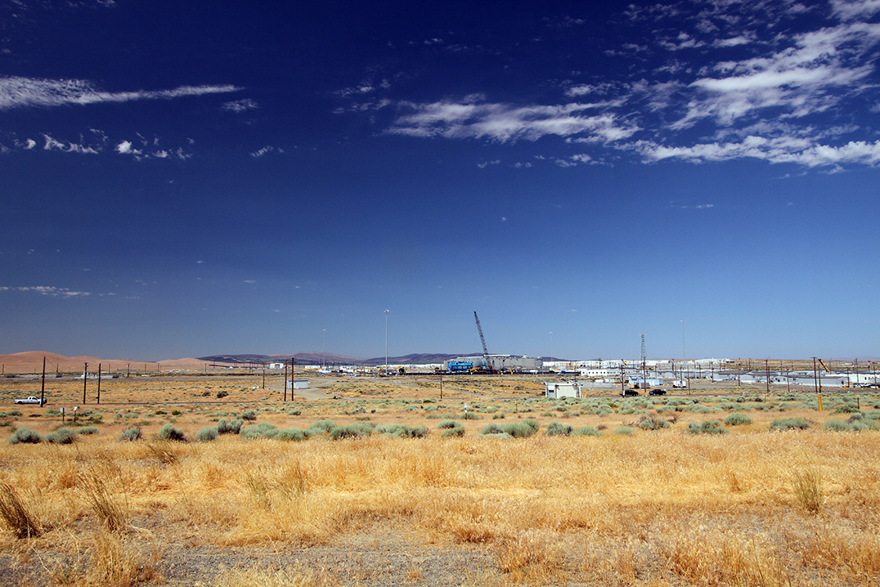
Occurrence Reporting and Processing System (ORPS) Task Group
EFCOG ISM/QA Joint Session
November 7, 2017

Slide 2
Occurrence Reporting and Processing System (ORPS) Task Group
2017 Activities
Monthly conference call focus areas (2017)
Status of order revision
Clarification of order requirements
Discussion/consensus on reporting questions
February Meeting (2 day session)
Line by line walk through of order revision
Path forward discussion
Review and feedback provided on DOE ORPS training modules

Slide 3
Occurrence Reporting and Processing System (ORPS) Task Group
Fall Meeting Wednesday, November 8 – all day session
Morning Session
Discussion of challenges, concerns, feedback, and lessons learned from DOE O 232.2A implementation
Path forward
Development of new tasks/deliverables
Approach to currently identified tasks

Slide 4
Occurrence Reporting and Processing System (ORPS) Task Group
Afternoon Session – Task work sessions
2.1: Review existing Best Practices and support products. Determine if revisions are necessary or if the documents are still relevant.
2.2: Develop a method for capturing/documenting Frequently Asked Questions and Answers (FAQs) generated via the ORPS Task Team correspondence and discussions.

