Slide 1
EFCOG
ISM & QA Task Groups
Fall Meeting 2020
Darlene Murdoch, Director
Operational Excellence and Quality Assurance
Savannah River Nuclear Solutions, LLC

Slide 2
EFCOG Fall 2020
Welcome to All / Logistics
Safety Topic
Leadership Expectations
Discussion of Accomplishments and Future Annual Plan Activities

Slide 3

DOE-EFCOG
ISM & QA
Fall 2020
Tricia Allen
November 9, 2020

Slide 4
Agenda
Expectations Focus Areas Strategic Priorities COVID-19 Lessons Learned

Slide 5

Expectations
All activities are approved by the EFCOG Board of Directors and DOE
Support your leadership team in completing the activities outlined in the goals for FY21
  If a new activities is identified – ensure that the activity gains approval BEFORE you work it!

Slide 6

FY21 Focus Areas
ISM Revitalization
Work Planning and Control
Safety Culture
Contractor Assurance
QA Surveillance/Inspection
Stress

Slide 7
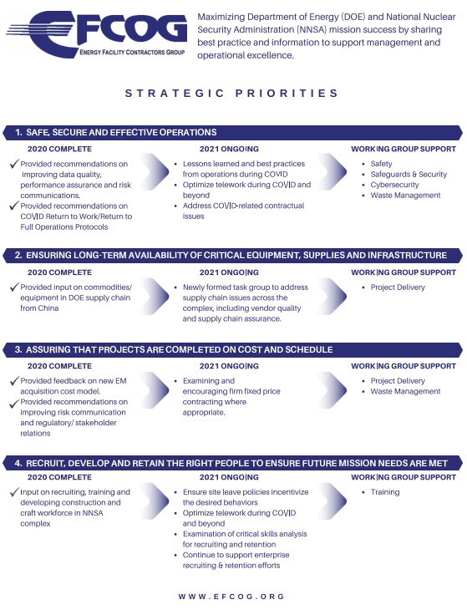

FY21 Strategic Priorities

Slide 8

COVID-19 Lessons Learned
Challenging Situations
Organizational Impacts
  Psychological
  Stress
  Work Environment
New Workspaces

Slide 9

COVID-19 Lessons Learned
Error-likely situations
  Distractions
  Stress
  Fatigue
Bottom Line – We need to be attentive to each other and be more conscious of staying in contact with peers.

Slide 10

DOE Activities & Expectations for EFCOG
Dr. Pat Worthington
November 9, 2020

Slide 11

Performance and reliability
Rizwan “Riz” shah
November 9, 2020

Slide 12
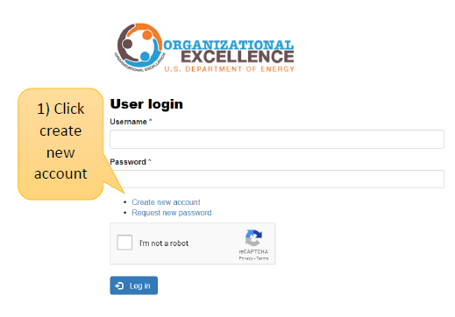
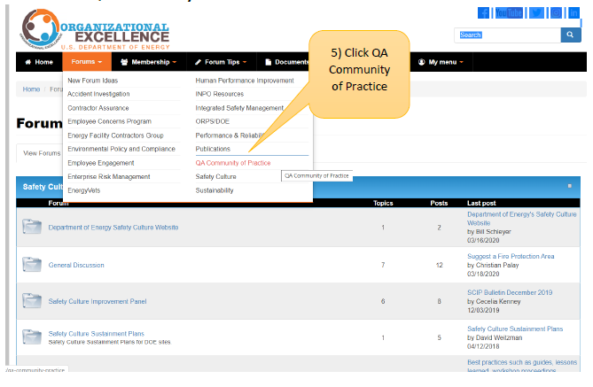
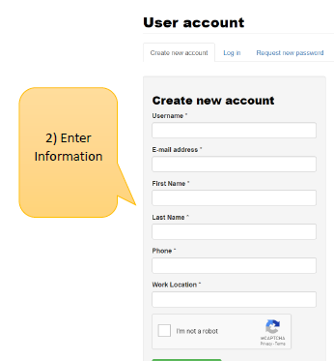
DOE Organizational Excellence Forums
https://orgex.energy.gov/
3

Slide 13

Quality assurance
Christian Palay
November 9, 2020

Slide 14
Updates for theEFCOG Quality Assurance Subgroup from the Office of Quality Assurance & Nuclear Safety Management Programs
Christian Palay
09 November 2020

Slide 15
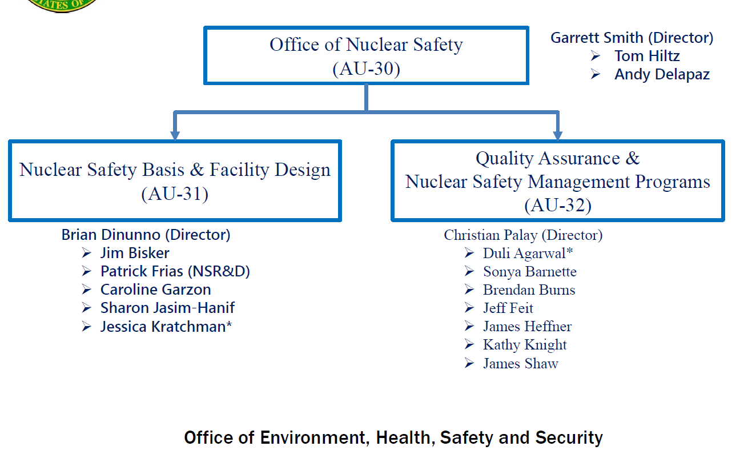
AU-30 Organization Updates

Slide 16
DOE Order 414.1D
Quality Assurance
Issued on 15 September 2020
This limited change was part of the project initiated by the Directives Review Board
Create a new section that lists all invoked standards
Specifies that TQP standards are no longer specifically invoked as requirement standards

Slide 17
Other Policy Updates
DOE Guide G 414.1-4A, Software Quality Assurance Guide for Use with DOE O 414.1D, Quality Assurance
•DOE-STD-3020-2015, Specification for HEPA Filters Used by DOE Contractors
•DOE-STD-3025-2007, Quality Assurance Inspection and Testing of HEPA Filters
Office of Environment, Health, Safety and Security

Slide 18
More Updates
New Safety Software Central Activities are on hold pending revaluation
Existing information on toolbox codes is still available on energy.gov
QA Community of Practice Website is available for all DOE federal and contractor employees
Office of Environment, Health, Safety and Security

Slide 19
Challenges
Remote quality assurance oversight
  Is there a policy need?
Software Quality Assurance
Need for new Quality Assurance Standards
  Recent ASME activities
  Apply to all work beyond nuclear scopes
  Not competitive to ISO, but rather an alternative for work not applicable to NQA-1
Office of Environment, Health, Safety and Security

Slide 20

Priorities
Issuing the DOE Guide G 414.1-4A (Software QA Guide)
Hiring more quality assurance oriented federal staff
DOE Order 414.1, Quality Assurance
  Work with stakeholders to determine the need for revision
  If stakeholders believe that revision is needed, obtain authorization from the Directive Review Board
Quality Assurance Program for Office of Nuclear Safety
Nuclear & Facility Safety Programs Workshop
Office of Environment, Health, Safety and Security

Slide 21
Contact Information
Christian Palay
Director
Office of Quality Assurance & Nuclear Safety Management Programs
Office Number: 202-586-7877
Email address: christian.palay@hq.doe.gov
Office of Environment, Health, Safety and Security

Slide 22
And Now This

