Slide 1

EFCOG
ISM & QA Task Groups
SPRING Meeting 2022
Darlene Murdoch, Director
Operational Excellence and Quality Assurance
Savannah River Nuclear Solutions, LLC

Slide 2

Thanks for joining us and thanks for making the Spring Joint Meeting a success. Continued, unprecedented attendance and engagement in virtual environment are key for success.
We invite you to share, listen, ask, and take back to your site as many practices or ideas as you can.
Then keep the momentum going.
EFCOG provides the forum for continued improvement across the complex

Slide 3

EFCOG/Safety Working Group
Vision & Focus
ISM&QA Joint Subgroup Meeting
Jan Preston, SWG Chair
Fluor Mission Solutions
April 25, 2022

Slide 4
FIRST: In Appreciation...
You in the SWG have been on the front lines these past 24 months
You kept it (the mission, our community) together despite all the challenges
Your insights and innovations are helping evolve the complex’s work approaches into an effective “new normal”
On behalf of the EFCOG Board, SWG Leadership, and our Client – THANK YOU!

Slide 5
Special Appreciation from the SWG Chair
Despite the challenges presented by a global pandemic, the following Team was able to continue supporting the EFCOG mission, as well as staging a series of highly successful virtual meetings, with record attendance and participation:
    Vicki Pope
    Spencer Daw
    Mathew Alt
    Bill Wingfield
    Omar Cardona-Quiles
WELL DONE!

Slide 6
UPDATES

Slide 7
New SWG Client Liaison
Garrett Smith, Director, EHSS-30, Office of Nuclear Safety, has assumed Pat Worthington’s role as SWG Liaison
Kevin Dressman is the new Director, EHSS-10, Office of Health & Safety
We look forward to effective collaborations with both Garrett and Kevin

Slide 8
New SWG Leadership
Bill Mairson, LANL/Triad, has taken on the Vice-Chair role upon Tricia Allen’s retirement
Frances Alston, BWXT, became Secretary after Jonathan Fortkamp took a new job with a non-EFCOG company
Please start keeping Bill and Frances in the loop, and considering them resources
for your SWG efforts

Slide 9

REFRESHER: EFCOG WORKING GROUPS/SUBGROUPS/SPECIAL TASK TEAMS

Slide 10
EFCOG WORKING GROUPS/ SUBGROUPS/TASK TEAMS
Cybersecurity Task Team (Bridgitte Mase)
Project Delivery (Amy Basche)
  Project Controls
  Project Management
Safeguards & Security (Ray Hubbs)
  Information Security
  Material Control & Accountability
  Physical Protection

Slide 11
EFCOG WORKING GROUPS/ SUBGROUPS/TASK TEAMS
Supply Chain Task Team (Jason Eaton)
Training (Shayne Eyre)
  Course Efficiency
  Training Process Efficiency
  Training Collaboration
Waste Management (Renee Echols)
  Decontamination & Decommissioning
  Challenging Waste
  Packaging & Transportation

Slide 12
SAFETY WORKING GROUP SUBGROUPS/TASK TEAMS
Engineering Practices (Grant Ryan, Julia Minton-Hughes, Tobin Oruch)
Integrated Safety Management (Darlene Murdoch, Linda Collier)
  Contractor Assurance System
  Human Performance Improvement
  Occurrence Reporting

Slide 13
SAFETY WORKING GROUP SUBGROUPS/TASK TEAMS
Nuclear & Facility Safety (Jeff Buczek, Tinh Tran, Alyssa Kersting)
  Accident Analysis
  Criticality Safety
  Nuclear Safety Research & Development
  Safety Basis
  Unreviewed Safety Questions

Slide 14
SAFETY WORKING GROUP SUBGROUPS/TASK TEAMS
Quality Assurance (Vince Grosso, Matthew Alt, Michael Russell)
  Policies & Procedures
  Procurement Engineering
  Supply Chain Quality
  Software QA
Regulatory & Enforcement (Kathy Brack, Barry Thom)

Slide 15
SAFETY WORKING GROUP SUBGROUPS/TASK TEAMS
Sustainability & Environment (Catherine Hurley, Suzanne Belmont)
Worker Safety & Health (Mary Flora, Dina Siegel, Mark Brynildson)
HRP Designated Psychologists
Industrial Hygiene, Safety & Chemical Management
Occupational Medicine
Electrical Safety
Laser Safety
Radiation Protection

Slide 16
FOCUS & VISION – EFCOG

Slide 17
EFCOG Strategic Priorities
Safe, secure, and effective operations
Ensuring long-term availability of critical Supply Chain - equipment, supplies, and infrastructure
Assuring that Projects are completed within cost and schedule
Recruit, develop, and retain the critical skills to ensure future mission needs are met

Slide 18
How EFCOG gets things done
Pursuing Board level initiatives – most often jointly with DOE/NNSA
Setting/steering Working Group priorities
Populating and focusing Task Teams
Regularly refreshing the EFCOG organization to maximize value
All of these are informed by active engagement with the DOE/NNSA client

Slide 19
What benefits does EFCOG provide?
Be the “one voice” of the Contractor community for the Client
Work issues/solve problems across the Contractor complex
Capture best practices for the benefit of all (cost savings, efficiency, effectiveness, etc.)
Sponsor practitioner/SME forums for collaboration and sharing
Provide professional and leadership development opportunities for Contractor staff

Slide 20
2020-2021 EFCOG Efforts
Facilitated Joint COVID Lessons Learned Workshops
Analyzed/reported on COVID-related policy variations across the complex – site access controls, leave and pay administration, telework accommodations
Provided solicited (and unsolicited) input on proposed DOE/NNSA policies and implementation strategies
Elevated emerging challenges and unintended consequences, while proposing solutions
Continued to support ongoing EFCOG Working Group initiatives and collaborations

Slide 21
FOCUS & VISION – SWG

Slide 22
Safety Working Group Mission
Advocate for strong, effective implementation of ISM
Seek out, develop, and promote best practices
Facilitate the exchange of operating experiences and information (lessons learned)
Design studies and develop position and technical papers
Provide DOE/NNSA and member companies access to a network of SMEs
Identify opportunities for improvement/efficiency; and
Enhance the competency of safety professionals

Slide 23
2020-2021 SWG Efforts
Continued collaborations virtually
Issued numerous Best Practices, White Papers, and Lessons Learned
Re-energized the Work Planning & Control Task Team (the foundation of ISM)
Issued guidance for DOE/Corporate Review of Contractor Assurance Systems
Supported an “Early Career Task Team” focused on Nuclear & Facility safety-related careers

Slide 24
2020-2021 SWG Efforts (cont.)
Actively supported maintenance and expansion of the Master Approved Supplier List (MSL) and the Nuclear Security Enterprise Supply Base
Developed a Laser Near Miss & Accident database
Continued wide-spread assistance to the DOE National Training Center (NTC)
Provided SME review on a variety of DOE Technical Standards/Guides
Supported the virtual Safety Culture Improvement Panel Annual Meetings (2020 and 2021)

Slide 25
Our Challenges
The need to collaborate virtually will continue – we need to get really good at it!
COVID, and what it has wrought, will dominate our focus for a while longer
There should be regular focus on succession and creation of development opportunities
Evolution and change are part of “the new normal” – receptiveness and agility are key

Slide 26


Slide 27
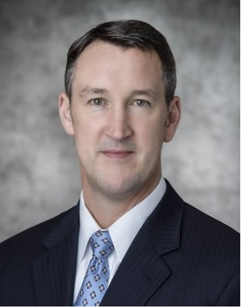
ISM UPDATE
Kevin Dressman
DOE office of health and safety
April 25, 2022
(No slides used)

Slide 28
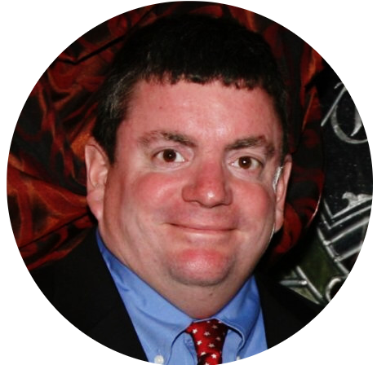
Garrett Smith
April 25, 2022
(No slides used)

Slide 29
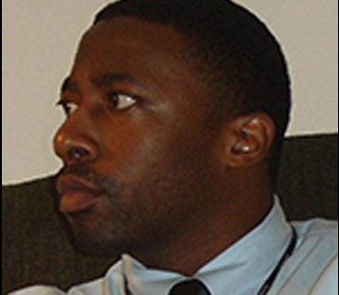
Aleem Boatright
April 25, 2022
Office of Enterprise Assessments: Enterprise-Wide Assessment of
Software Quality Assurance Process Implementation

Slide 30
Jacob Miller
April 25, 2022
Office of Enforcement

Slide 31
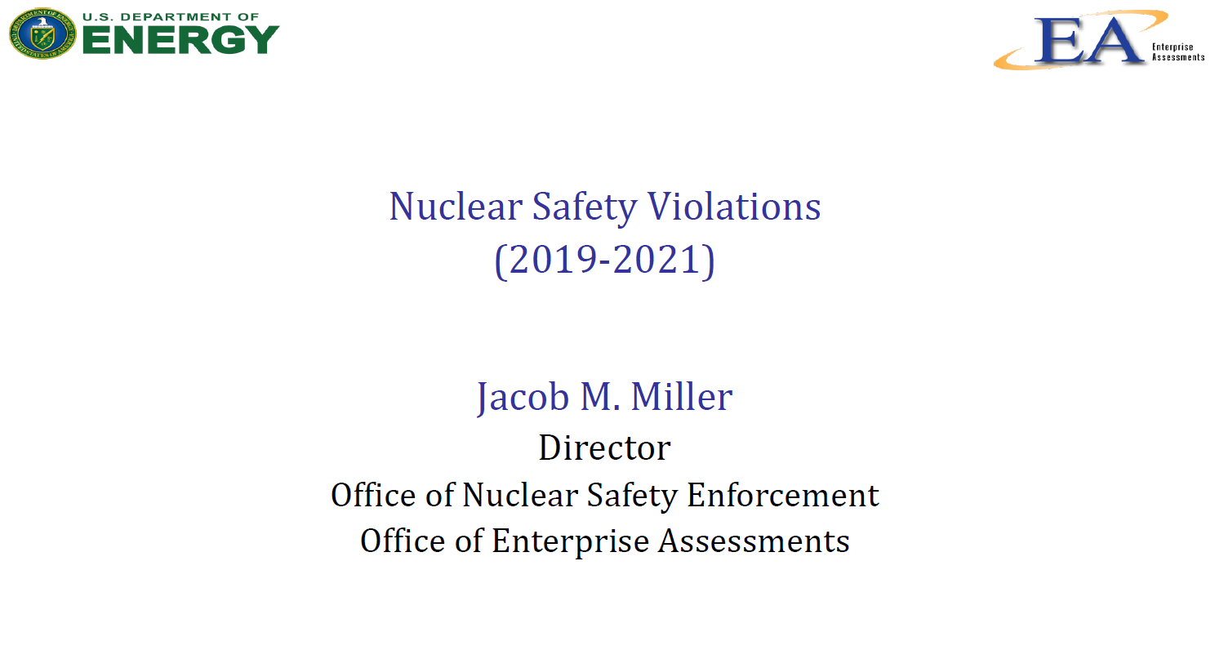

Slide 32
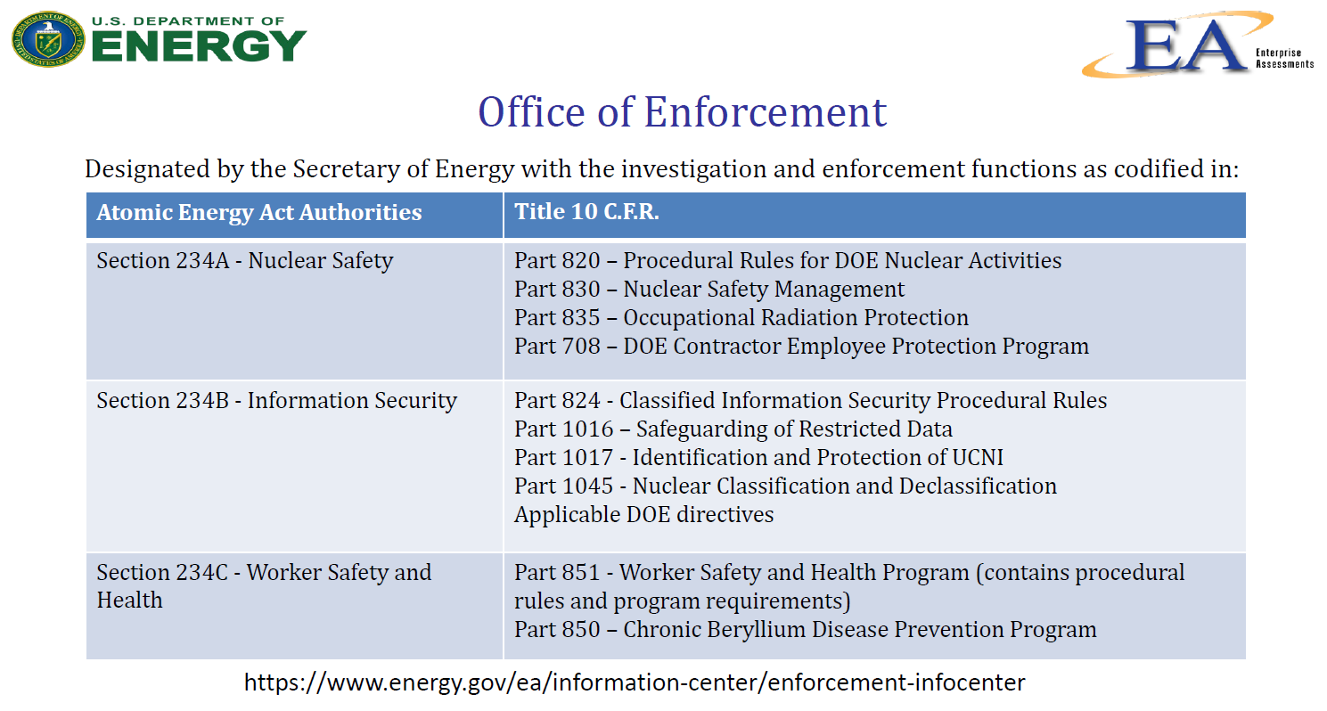

Slide 33
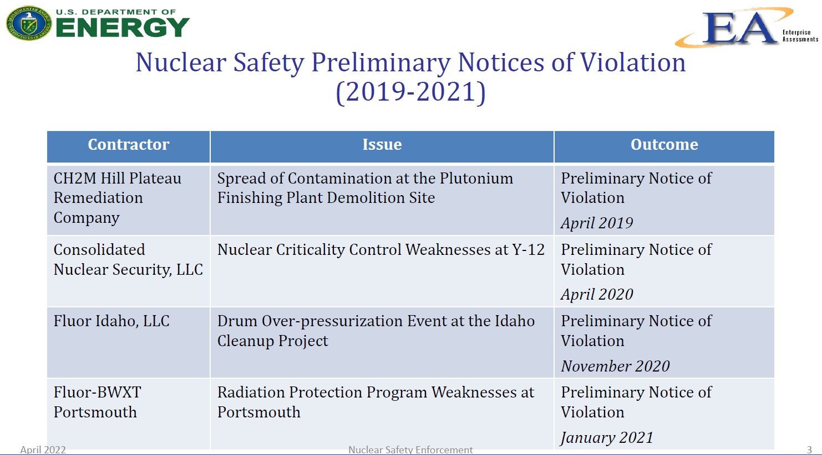

Slide 34
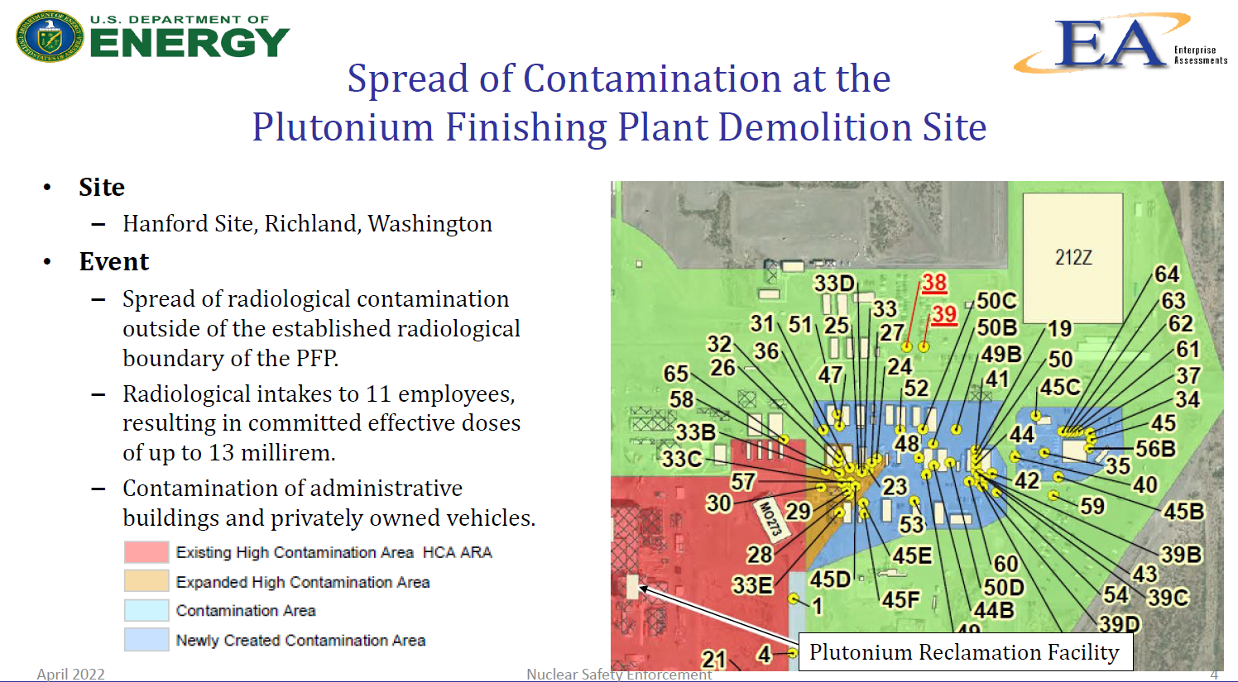

Slide 35
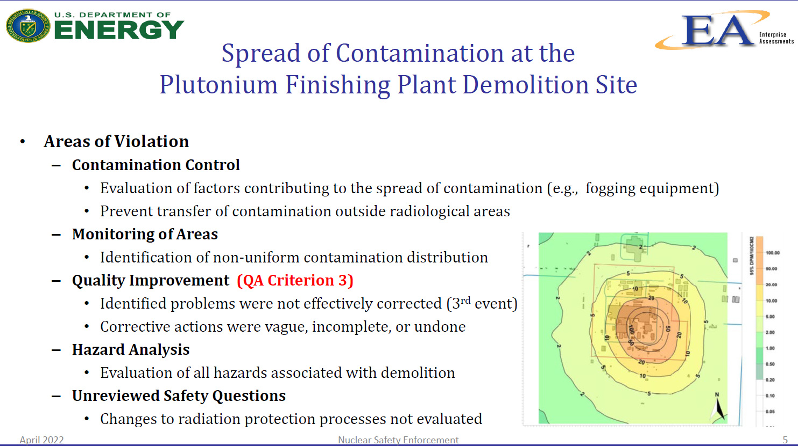

Slide 36
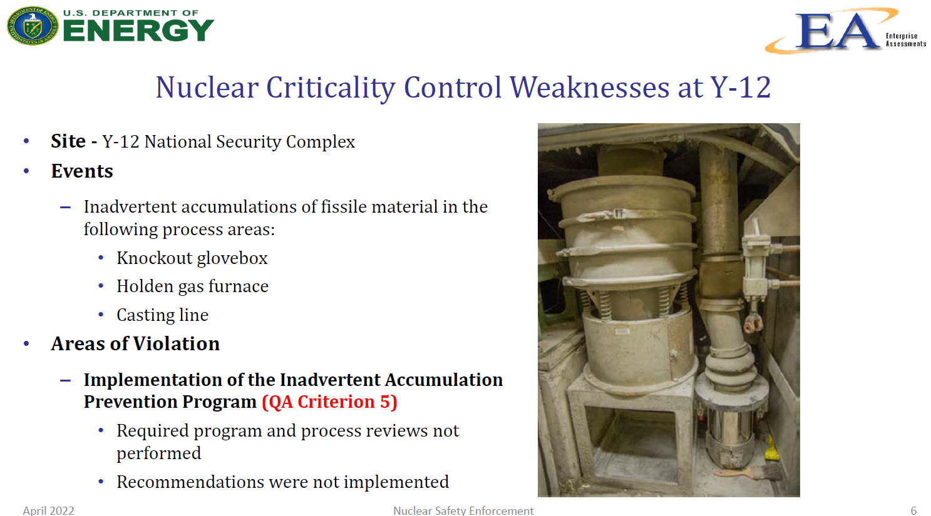

Slide 37
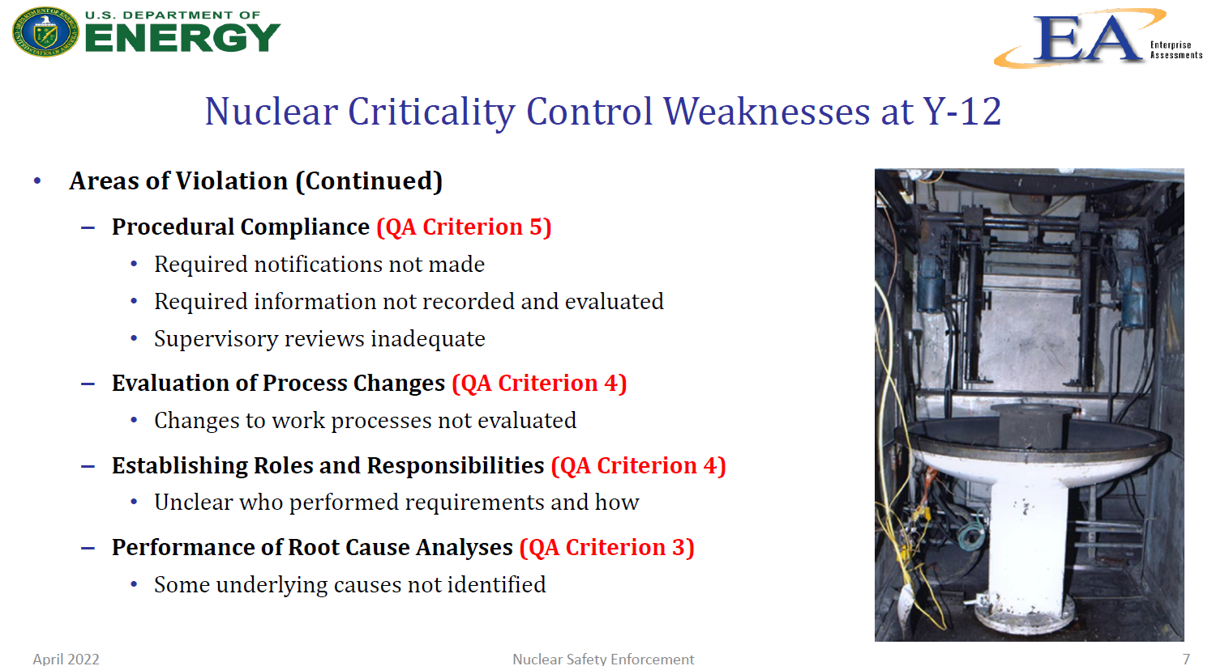

Slide 38
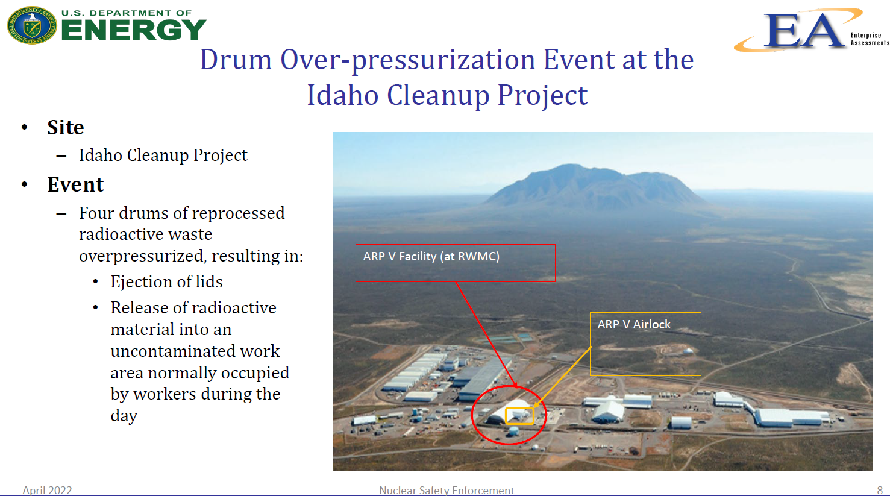

Slide 39
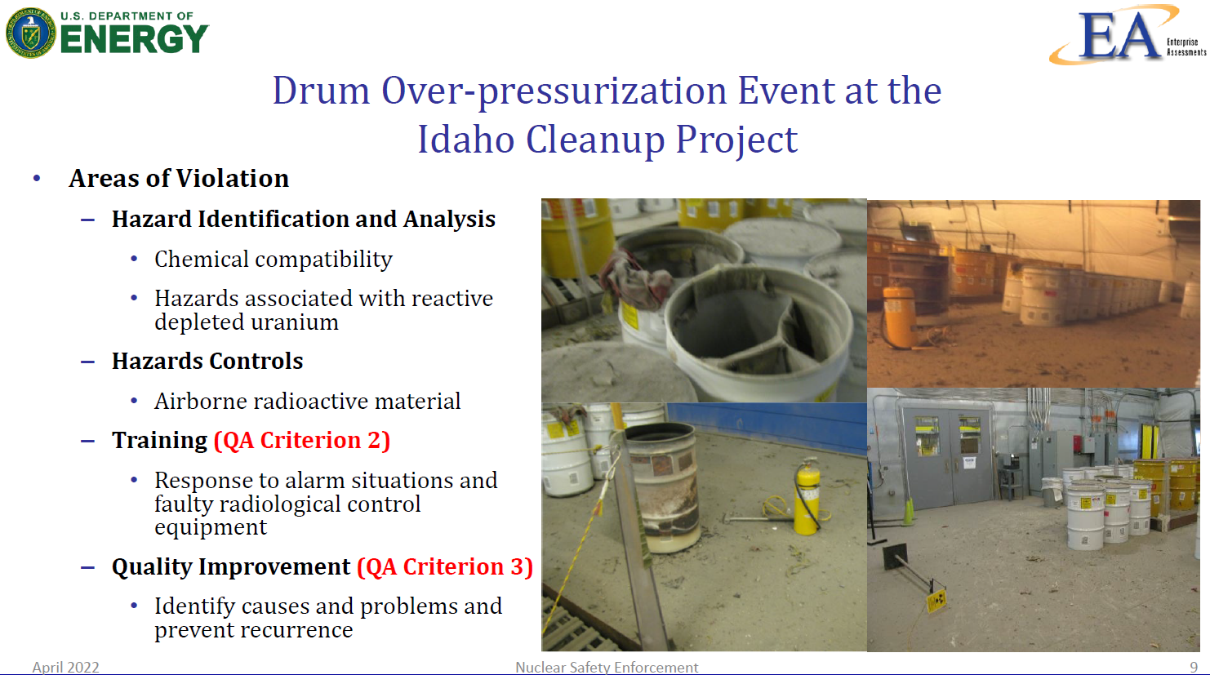

Slide 40


Slide 41
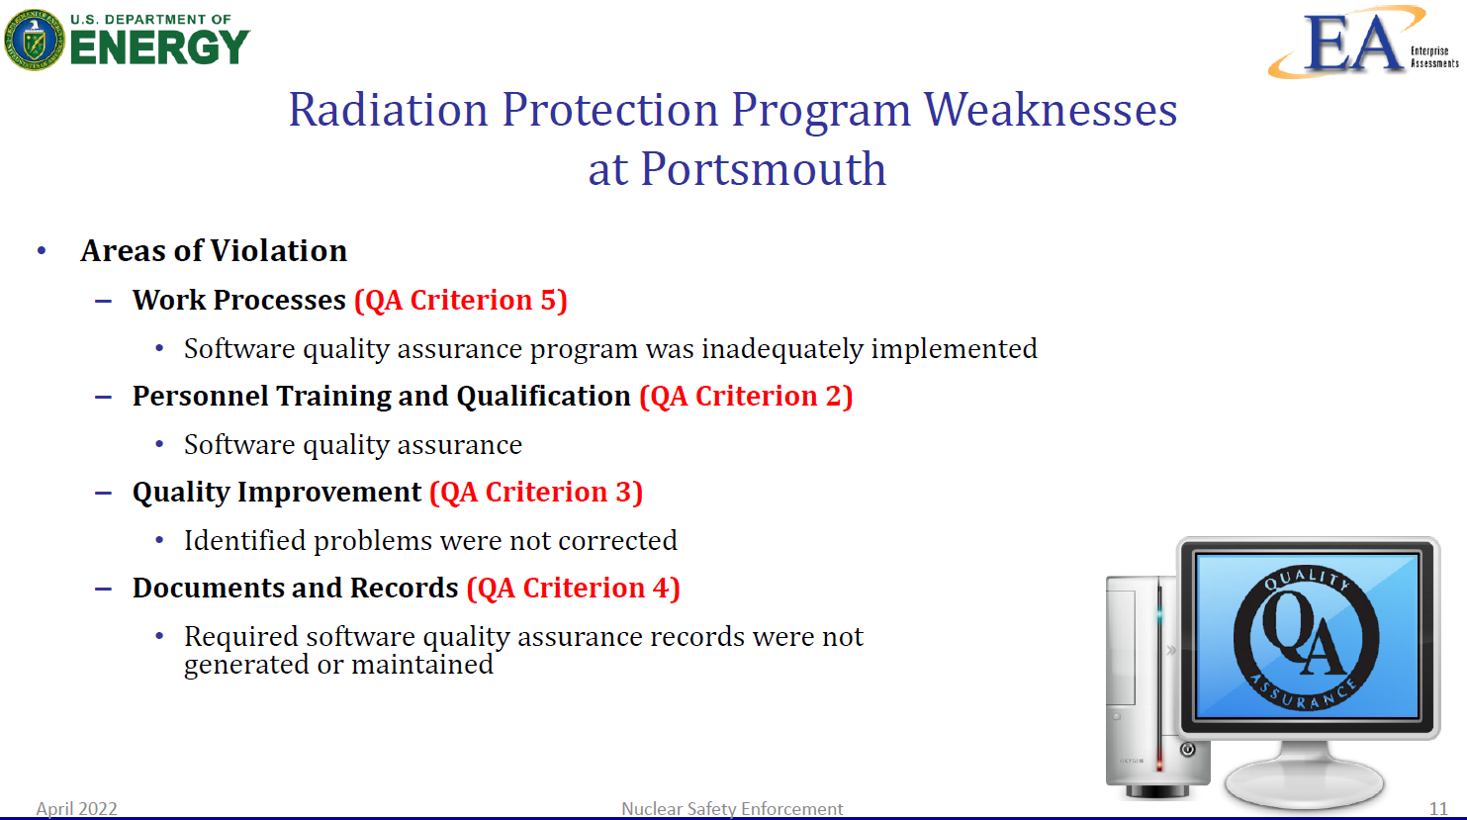

Slide 42
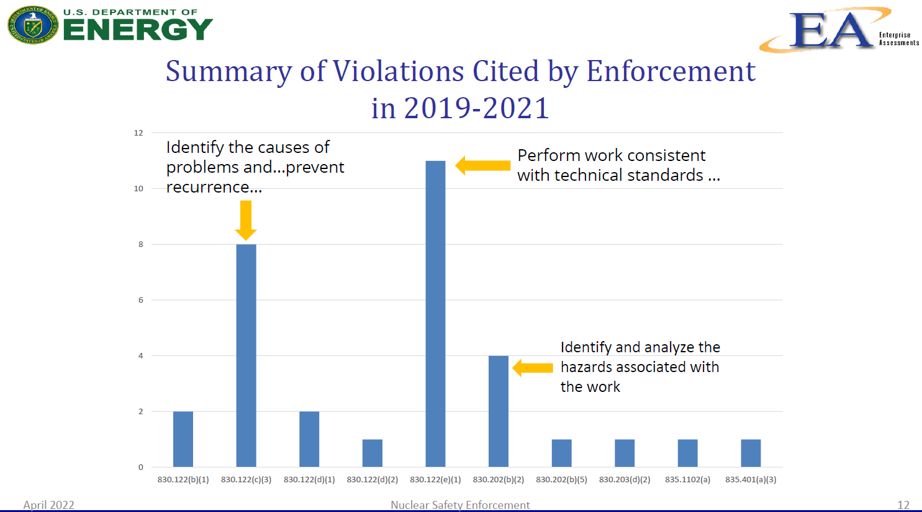

Slide 43
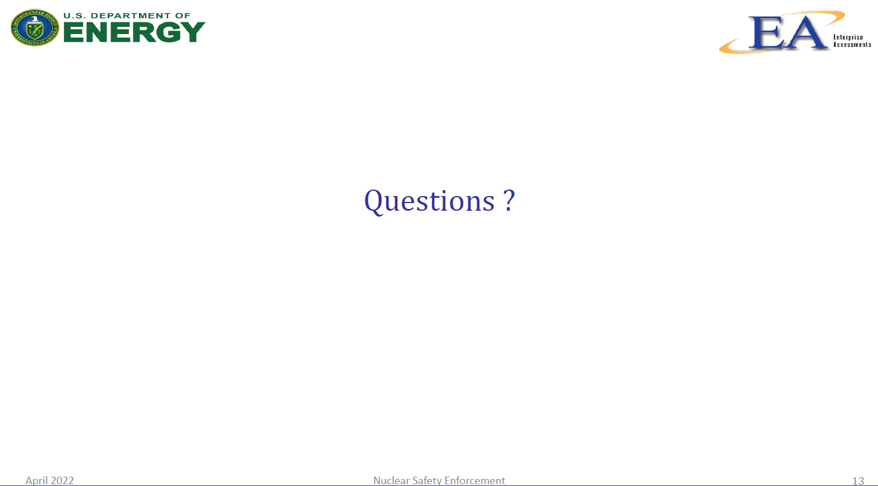

Slide 44

Break

