Slide 1
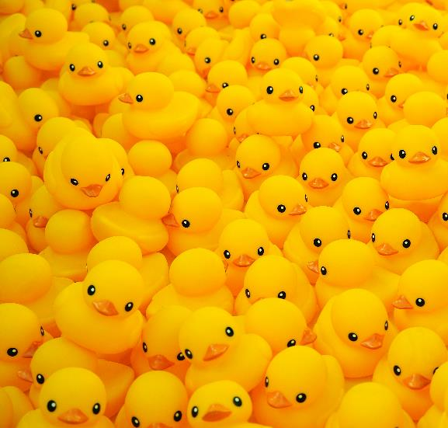
Get Your Ducks in a Row
Presented by:
Kristy Kistner, ORISE
Notes:
Even if organization isn’t your thing, you can apply these tips to become more organized.

Slide 2
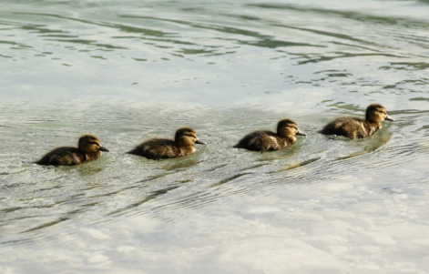
Agenda
Benefits.
Interruptions and multi-tasking.
System and routine.
Prioritization.
Write things down.
Everything in its place.
File organization.

Slide 3
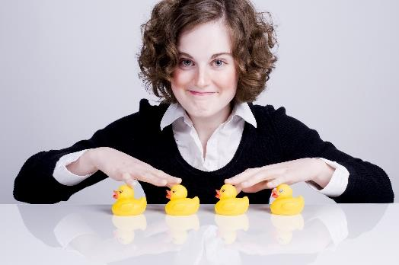
Benefits
Be more productive.
Reach your goals.
Reduce stress.
Make life easier.
Notes:
The more organized you are, the more productive you are.
Organization helps you manage your time – you’ll spend less time searching for things.
You’ll be better able to get things done and reach your goals.
Being organized helps reduce stress and feeling overwhelmed.
It just makes life easier.
NOTE: This is how I organize things. It’s not the only way.
Do what works for you.
You might be able to take something I do and make it your own.

Slide 4
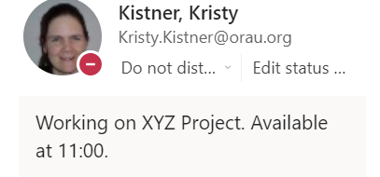
Interruptions and Multi-Tasking
Manage interruptions.
Multi-tasking
is a myth.
Notes:
Interruptions happen.
Some you can avoid; others are part of your job.
You need to manage them.
Multi-tasking is a myth.
Rapidly switching between/among tasks.
Doing both/all poorly.
Study at Institut National de la Santé et de la Recherche Médicale (INSERM) in Paris.
Participants completing two tasks at the same time while undergoing functional magnetic resonance imaging (fMRI).
When attempting two simultaneous goals, the brain “splits in half” with one side working on each.
If you add something else – like an interruption – it completely overwhelms your brain.
Multi-tasking causes us to forget details and make more mistakes.
Applies more to complex tasks – can simultaneously perform familiar tasks like walking and chewing gum.
Single tasking instead.
Focus on one task at a time.
Set aside time for complex work by:
Blocking your calendar.
Turning off email and other notifications.
Setting your status to Do Not Disturb.

Slide 5
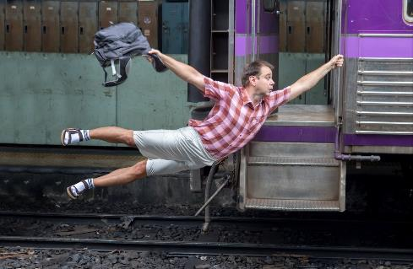
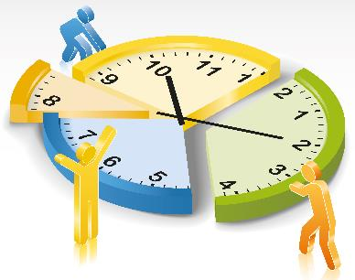
System and Routine
Capture tasks.
Decide on actions.
Prioritize.
Regular reviews.
Set deadlines.
Notes:
System helps you get organized. May want to set up a system in one area of your life and practice it before applying to other areas.
Capture all tasks in central location(s) – if you’re just starting, block time to write down all of your tasks
Decide what to do about each.
Prioritize what to do next.
Routine help you maintain your system.
Review tasks, actions, priorities, system regularly.
Specific day/time each week/month.
When something derails your routine, regroup and start over.
Daily routine – get enough sleep, take breaks (set alarms if necessary).
If you know what you need to get done, it’s easier to adapt to interruptions.
Good deadlines.
“By when do you need this?”
Work backwards from due date.
Reminder enough ahead that you avoid last minute – when you need to start vs. when it needs to be done.
It’s probably going to take you longer than you think.
For recurring due dates, set new reminder when you complete something.

Slide 6
Prioritization
Q1 – Urgent + Important: Do it now.
 | Urgent | Not Urgent
Important | Quadrant 1 (Q1) | Quadrant 2 (Q2)
Not Important | Quadrant 3 (Q3) | Quadrant 4 (Q4)
Q2 – Not Urgent + Important:
Decide when to do it.
Set a reminder.
Q3 – Urgent + Not Important:
Is it your responsibility?
Can you delegate it?
Q4 – Not Urgent + Not Important: Skip it.
Notes:
Multiple prioritization systems based on two questions:
Is it urgent?
Is it important?
Q3
Don’t fill vacuums – just because something needs to be done doesn’t mean you need to do it.
Can you delegate it? If not, don’t let it take over:
Set aside uninterrupted time – save Q3 tasks for times when you are very low on energy rather than putting them first thing in the morning.
Is it really urgent or are you feeling overwhelmed?
Not sure whether it’s urgent? Ask your supervisor for input – “I have to do a, b, and c; what’s your priority?”
Q4
Skip it or do it in moderation
Social media or surfing the web
Can you batch similar tasks?
Financial tasks – require specific type of thinking.
For instance, to avoid switching between financial and writing tasks.

Slide 7
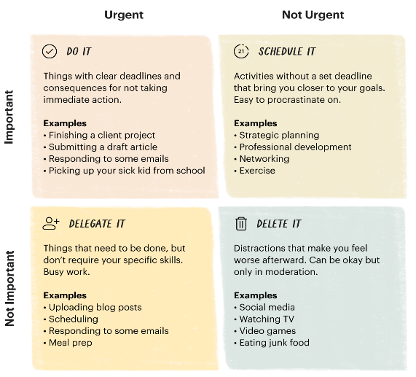
Prioritization: Eisenhower Matrix
Notes:
General/President Dwight Eisenhower used this method to prioritize.
Eisenhower Matrix (aka Time Management Matrix, Eisenhower Box, Eisenhower Method, Urgent-Important Matrix).

Slide 8
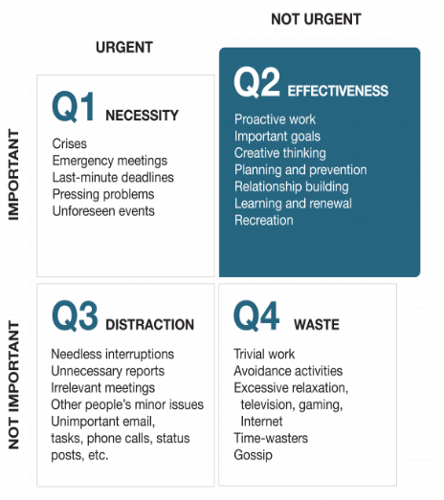
Prioritization: 7 Habits
Notes:
7 Habits of Highly Effective People by Stephen Covey.
Habit 3: Put First Things First.

Slide 9
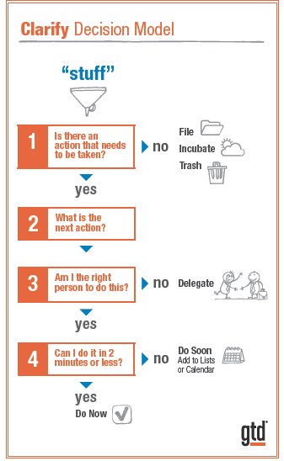
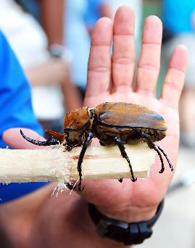
Prioritization: Getting Things Done
Notes:
Slightly different from matrix approaches to prioritization: Getting Things Done: The Art of Stress-Free Productivity by David Allen (aka GTD).
Capture all tasks in central location(s).
Decide if action is needed.
Decide next action.
Decide if you need to do it.
Do it now if it will take 2 minutes or less.
Another approach I use is called “Eat the Elephant Beetle.”
Refers to completing challenging tasks when most productive.
You know what your Elephant Beetle is: that task that you keep putting off – the one that haunts you and sits on your shoulder all day long, reminding you that it needs to get done no matter how much you don’t want to do it.
If you make it your priority to get it done first thing, the sense of relief at having gotten rid of the burden will carry you through the rest of the day regardless of what else is thrown at you.

Slide 10
Write Everything Down
Get it out of your head.
Reuse information.
Reference documents.
Notes:
Getting things out of your head keeps you from forgetting things and worrying about forgetting them.
Reuse information from one project on another – wrote content for one proposal; can repurpose it for another. Saved on shared drive so others can also use it.
Reference documents:
Document infrequent tasks (e.g., something you do annually).
Refer back to past projects.
Consider situations where you couldn’t find something. Why couldn’t you find it?
What steps would prevent that?
Especially important if files aren’t searchable (pdf image vs text).
How can I get back here if I need to?

Slide 11
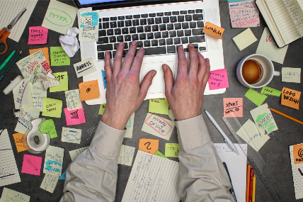
Everything Has Its Place
Common tool(s).
Central location.
Easy reference.
Notes:
Keep specific things in specific places to avoid forgetting, having trouble finding them.
Use the same tool for specific things.
Already talked about capturing all tasks in central location – same for information, files. For example:
Chat in Teams; tasks in email.
AnyList for groceries.
Planner:
All tasks.
Categorize, set due dates, priority levels.
Also for reference.
Trello:
Personal lists (reminders, books, projects).
List of dates (medication history).
Password hints – desktop, network back-up, copy on iPhone.

Slide 12
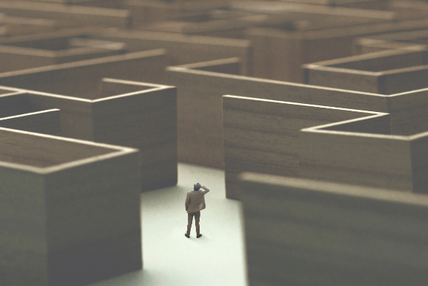
File Organization: Why?
Productivity.
Reduced stress.
Easy reference.
Notes:
Avoid spending time searching for files.
Work faster if you can easily find information.
Reduce the stress of “Where did I put that?”

Slide 13
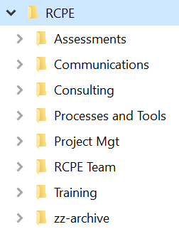
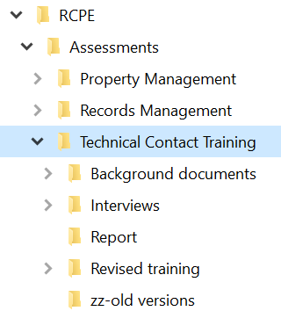
File Organization: How?
Categorize.
Naming convention.
Common setup.
Notes:
Network not desktop, C drive, My Documents.
Use desktop when anticipate connectivity issues, but save to network as soon as able.
Broad categories of information.
Naming convention.
Use meaningful names: Document 1
Date format (e.g., 06JUN2022).
DRAFT.
FINAL.
Standard folders, sub-folders for each project.
One file – one folder, shortcuts from other folders.
Old versions folder - keep through project in case you need to refer back to something you changed.
Same setup in email, network drive, Teams, SharePoint.
Use as email categories to organize emails.

Slide 14
File Organization: End State
Centralization.
Standardization.
Avoid duplication.
Maintain version control.
Easy reference.
Notes:
Everything in specific place.

Slide 15
Recap
Manage interruptions Multi-Tasking
System to organize Routine to maintain
Capture tasks Prioritize Set deadlines Write everything down Everything has its place
Network vs desktop File organization
Categorize Naming convention
Standard folders Easy reference

Slide 16
Notes:
Related website – One Productive Minute
https://www.youtube.com/watch?v=_NWNQboElDI

Slide 17
What’s Next
Notes:
How will you apply this information?
Questions?

