Slide 1
Controlled Unclassified Information (CUI) Briefing
2024/Conference

Slide 2
DOE CUI Program Timeline 2022-2024
November
DOE CUI Program
Executive Order 13556
Establishes Controlled Unclassified Information Program
Requires Executive Agencies to develop internal CUI Policy
2024
Conducted first DOE Self-Assessment of CUI Programs
Developing guidance on Misuse, Challenges & Decontrolling of CUI. Ensuring offices are aware of guidance in accordance with DOE O 471.7, CUI Program Policy
2010
32 CFR §Part 2002
Executive branch's CUI regulations were established
Standardizes how information requiring protection is handled
Published CUI Marking Playbook
Established DOE O 471.7, CUI Program Policy
Launched CUI-100DE Learning Nucleus
Established CUI Community and DECO’s
Developed DOE’s CUI marking approach
Implemented CUI Labeling for EITS Desktop
Services
2016
2022/23​
September
DOE CUI Program

Slide 3
What is CUI?
Controlled Unclassified Information(CUI) is defined as:
Information the Government creates or possesses, or an entity creates or possesses for or on behalf of the Government, that a *LRGWP requires or permits an agency to handle using safeguarding or dissemination controls.
* Law, Regulation, or Government wide Policy

Slide 4
How Do I Know if its CUI?
(3 Things To Ask Yourself)
The information must be safeguarded marked and disseminated as CUI if….
Am I creating or have access to CUI information owned by the U.S Government?
Is protection of this information permitted or required by a Law, Regulation, or Government wide policy (LRGWP)?
Is the “Safeguarding and/or Dissemination Authority” cited in the CUI Registry for the category applicable Government wide or DOE specific?
1
2
3

Slide 5
Types of CUI: CUI Basic vs CUI Specified
CUI Basic - CUI Basic applies when the authorizing law, regulation, or Government-wide policy requires protection, but does not set out specific handling or dissemination controls.
CUI Specified - CUI Specified has an underlying authority that spells out the controls for CUI Specified information.
Both CUI Basic and Specified are handled according to the uniform set of controls in 32 CFR Part 2002 and the CUI Registry.
CUI Basic
CUI Specified
Note: CUI Specified is NOT a “higher level” of CUI, it is simply more defined. Both subsets of information require same level of system and network security controls.

Slide 6
Which CUI Category is right for my information?
DOE CUI Category List published on Powerpedia currently contains 53 categories that have DOE authorities that align to the CUI information handled by DOE
DOE reviewed the NARA CUI Registry and analyzed the authorities to compile the current categories that are authorized for DOE use
If you feel we are missing a CUI category, please send an email with the requested category along with justification to DOECUI@hq.doe.gov

Slide 7
DOE CUI Marking in EITS services
What are CUI markings?
CUI labels are also known as the CUI markings. CUI markings must be applied when a document containing CUI is created or re-used for DOE business.
Where are the CUI Markings located?
CUI marking labels are configured in the sensitivity tool in the Microsoft tool bar (Word, Excel, PowerPoint, etc.)
Labels are also located within the Protect/Select function...a Microsoft Sensitivity Label function for PDFs.
How do you apply the labels?
Categories can be applied by clicking on the Sensitivity button and scrolling through the 52 categories. Once the category is found, simply click on the category to apply the marking.
DOE marking requirements are provided in DOE O 471.7 and DOE CUI100DE training in the Learning Nucleus which are consistent with the CUI Marking Handbook on the CUI Registry and DOE O 471.7. DOE has posted a list of DOE CUI categories here:

Slide 8
Marking CUI Documents
How do I mark documents containing CUI?
All CUI must be marked with a CUI Banner Marking. The primary control marking for all CUI at DOE is the “CUI” acronym which must be centered when feasible and appear in CAPITALIZED bold black text at the top of each page of any document that contains CUI. The CUI Banner Marking must be inclusive of all CUI within the document and must be the same on each page. Structure the CUI Banner Marking as follows:
Separate the CUI control marking with double forward slash (//) before the Category Acronym
Include category acronym for all CUI contained in document as follows: Basic – DOE has the option to mark a document that contains CUI basic is “CUI”, or the “Alternative Banner Marking for Basic Authorities” published on the CUI Registry for categories DOE has the authority to use. Specified – Category acronym preceded by SP and a dash “SP-”
Alphabetize and separate multiple categories with a single forward slash (/) on each page. Example of CUI Banner Markings:
CUI Basic: CUI//PROPIN
CUI Specified: CUI//SP-PROPIN

Slide 9
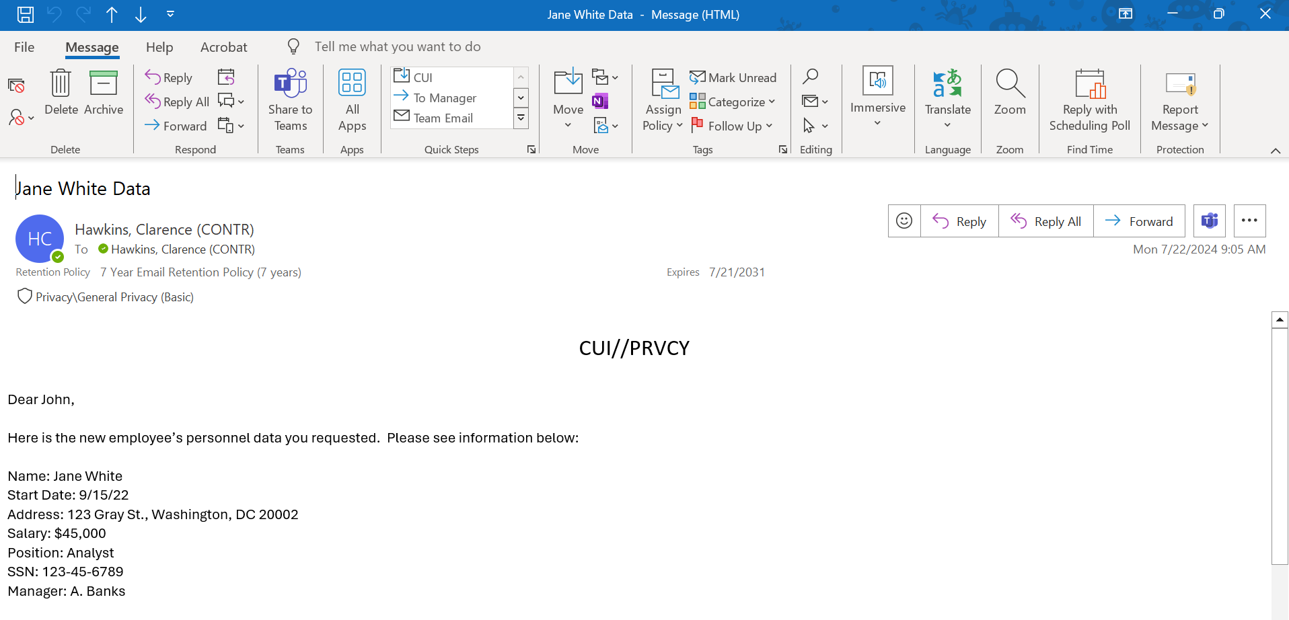
Example of a Marked CUI Email

Slide 10
Acceptable & Unacceptable Non-CUI Markings
The terms below are NOT CUI markings but are acceptable to be placed on documentation:
Pre-decisional
Draft
Deliberative
Final
The terms below are NOT CUI markings and are NOT accepted to be placed on documentation:
Internal use only
Do not distribute
Close Hold
Official Use Only (OUO)
For Official Use Only (FOUO)

Slide 11
Acceptable & Unacceptable Non-CUI Markings
32 CFR part 2002.1(c):
All unclassified information throughout the executive branch that requires any safeguarding or dissemination control is CUI. Law, regulation (to include this part), or Government-wide policy must require or permit such controls. Agencies therefore may not implement safeguarding or dissemination controls for any unclassified information other than those controls consistent with the CUI Program
https://www.ecfr.gov/current/title-32/part-2002#p-2002.1(c)

Slide 12
Dos & Don'ts for Marking CUI Documents
Do:
Determine if the information is CUI before marking a document
If the document contains multiple CUI categories, each CUI category marking should be listed in alphabetical order
Utilize the Sensitivity button to apply one marking and edit as needed to apply multiple markings via (Outlook, Word, PowerPoint, etc.)
Only use DOE authorized categories identified in the CUI Categories list to determine the appropriate marking
Don’t:
Do not use any markings that attempt to protect the content of the document except for the CUI markings
Do not use legacy markings, such as OUO
Never remove a CUI marking from a document without first speaking to the originating authorized holder
Don’t leave CUI unprotected
For more information on marking CUI please visit Controlled Unclassified Information - Introduction to Marking (youtube.com)

Slide 13
Safeguarded Destruction
How to properly dispose of CUI material?
For paper destruction, one of two methods must be used: single-step paper destruction or multi-step paper destruction methods.
For the single-step paper destruction method, agencies must use a crosscut shredder that produce particles that are 1mm by 5 mm ensure the CUI documents are destroyed in an unreadable, indecipherable, and irrecoverable manner and in accordance with the National Institute of Standards and Technology (NIST) SP 800-88
The second method is locating an approved Controlled Unclassified Information destruction bin to deposit your CUI materials.
Do not print CUI unless absolutely necessary
Never use trash cans or recycling bins to dispose of CUI
For more about CUI destruction:
Controlled Unclassified Information - Destruction of CUI (youtube.com)
Check with your IT Service provider for ordering information:
NSA EPL PaperShreddersAPR2024

Slide 14
Updates coming to the CUI Program in 2024
The CUI Program is developing three additional guidance products this year that are required by the DOE O 471.7:
Misuse
Misuse of CUI occurs when someone uses CUI in a manner not in accordance with 32 CFR 2002, the CUI Registry, this policy, or the applicable laws, regulations, and Government-wide policies that govern the affected information.
Challenges
Authorized holders of CUI who, in good faith, believe that its designation as CUI is improper or incorrect, or who believe they have received unmarked CUI.
Decontrolling
DOE must decontrol as soon as practicable any CUI designated by DOE that no longer requires safeguarding or dissemination controls
Please stay tuned! As the program develops these guidance products, we will be reaching out to the CUI community for feedback.

Slide 15
CUI FAQ’s
Is CUI Training mandatory for all employees?
Yes, CUI training is required bi-annually for all employees (Federal and Contractors). The course is accessible through the Learning Nucleus, Course ID: CUI-100DE. In addition, below are links to view information related to CUI requirements.
Controlled Unclassified Information (doe.gov)
eCFR :: 32 CFR Part 2002 -- Controlled Unclassified Information (CUI)
Who can I contact to learn more about CUI beyond my site program?
The CUI Program, we are available by email at doecui@hq.doe.gov. You can also check out our PowerPedia page at Controlled Unclassified Information - Powerpedia (energy.gov)
Am I required to mark emails containing CUI?
Yes. Email messages must include a Banner Marking to indicate that the email contains CUI. If the message itself is not CUI but contains an attachment with CUI, the message must indicate that the attachment is CUI and that when separated the email does not contain CUI. The attachment must have all required CUI markings. DOE O 471.7 Section 4.e.17.

Slide 16
CUI Program helps DOE offices to……
Ensure offices identify CUI contacts for their organizations, either a DECO, a CUI Liaison, or both
DECO – Departmental Element Designated CUI Official
Train/educate office personnel on CUI in addition to the Learning Nucleus CUI Training
CUI training is required bi-annually, this training can be located on the Learning Nucleus
Controlled Unclassified Information - Powerpedia (energy.gov)
Help offices to analyze new documentation and identify CUI categories and handling requirements
Work with offices to identify legacy markings used within their programs and begin the crosswalk of the information to a CUI category
Answer any questions submitted to doecui@hq.doe.gov mailbox.

Slide 17
Questions?
Additional questions? That’s ok! Email us
doecui@hq.doe.gov

Slide 18
Resources
CUI Executive Order: Federal Register :: Controlled Unclassified Information
CUI Program Office Mailbox: doecui@hq.doee.gov
NARA Training Links: CUI Training | National Archives
CUI Registry: CUI Implementing Registry: Federal Register :: Controlled Unclassified Information
DOU CUI Policy: New - DOE O 471.7, Controlled Unclassified Information — DOE Directives, Guidance, and Delegations
NIST 800-171 Rev 2:SP 800-171 Rev. 2, Protecting Controlled Unclassified Information in Nonfederal Systems and Organizations | CSRC (nist.gov)

