Slide 1
HOP & QA
Rizwan Shah
Organizational Culture Advisor

Slide 2
Agenda
Goals
Handbooks
HOP Defined
Messaging

Slide 3
Goals
adapt to change and to anticipate and drive change
creating a resilient and agile organization
transform how individuals think
enhance the collective mindset
cultivate openness to new ideas and collaboration
This approach helps organizations to not only survive but thrive in an increasingly complex and dynamic business environment.

Slide 4
DOE-HDBK-1028-2009
Human Performance Improvement Handbook Volume 1: Concepts and Principles Human Performance Improvement Handbook Volume 2: Human Performance Tools for Individuals, Work Teams, and Management (Written in June 2009)
They have become the core reference documents for many users both within and outside the DOE complex.
Department of Transportation
Institute of Nuclear Power Operations
nuclear power generation plants
power distribution grid utilities
medical provider organizations to name a few.

Slide 5
Informed Change
Since these Handbooks were issued the science and methodology in Human Performance Improvement have changed significantly.
An evolutionary change in the way we view safety, to a concept now called “Safety 2.”
Safety-1 Defined by the absence of accidents and incidents.
Consequently, safety management has usually been on unsafe system operation rather than on safe operation.
Safety-2 Defines safety as the ability to succeed under changing conditions.
It incorporates resilience into day-to-day operations where focusing on the system and what it does well informs its safety performance.
Neuroscience has also yielded more revolutionary insights into the functions of the human brain that would be reflected in the updated Handbooks.

Slide 6
Performance and Safety: A Vital Connection
Safety is the foundation of performance.
Cutting corners in safety undermines long-term success.
Safety enhances productivity, morale, and efficiency.
Notes:
The Relationship Between Organizational Performance and Safety Outcomes

Slide 7
What is HOP?
Safety Systems
Processes
People
Shifts focus from blaming individuals to understanding systems.
Encourages speaking up about risks.
A culture of shared responsibility, building trust and resilience.
Notes:
Adopting Human and Organizational Performance (HOP)

Slide 8
HOP Defined
Human and Organizational Performance (HOP) is a framework that focuses on optimizing the performance of individuals and organizations in complex and high-risk environments. It involves understanding the interactions between humans, technology, processes, and organizational systems to enhance overall performance and safety outcomes.

Slide 9
HOP Defined (Human and Organizational)
-- Human Performance: Human performance refers to the abilities, skills, knowledge, and behaviors of individuals within an organization. It encompasses decision-making, problem-solving, communication, teamwork, situational awareness, and physical and mental capabilities. Human performance ensures that individuals carry out their tasks and responsibilities effectively while maintaining safety and productivity.
-- Organizational Performance: Organizational performance refers to the effectiveness and efficiency with which an organization achieves its goals and objectives. It involves assessing and improving various aspects of an organization, including its culture, leadership, management systems, processes, and structures. Organizational performance is closely linked to the performance of individuals within the organization and how they work together as a team.

Slide 10
Fundamental Principles of HOP (1 & 2)
1. Systems Thinking: Viewing the organization as a complex system with interconnected components and understanding how changes in one part can impact the overall performance. By adopting a systems-thinking perspective, HOP aims to identify potential weaknesses, dependencies, and interactions that can impact performance.
2. Learning Culture: HOP promotes continuous learning and improvement. It encourages organizations to view errors and incidents as opportunities. It emphasizes open communication, information sharing, feedback mechanisms, and organizational learning from successes and failures. It promotes a culture where individuals are encouraged to share ideas and best practices and report errors and near-misses without fear of punishment, enabling organizations to learn from mistakes and improve.

Slide 11
Fundamental Principles of HOP (3 & 4)
3. Risk Management: HOP focuses on error prevention through the understanding of risk rather than solely on error detection and correction. It seeks to identify and address the underlying factors contributing to errors or failures. This can involve proactive measures such as risk assessment, human factors engineering, training and competency development, and designing resilient systems and processes.
4. Resilience Engineering: Focusing on building organizational resilience by anticipating and adapting to changing conditions, managing risks, and effectively responding to disruptions.

Slide 12
The Intersection of HOP and Defenses
HOP focuses on understanding and influencing human behaviors within systems to strengthen defenses.
Human errors are inevitable, but defenses can be designed to catch or mitigate the impact of those errors.
Organizational performance improves when defense mechanisms are adaptable to human variability rather than rigidly procedural.
Management support for planning, organization, resources, direction, and control is essential to quality assurance (QA)
Performance and quality improvement require thorough, rigorous assessments and effective corrective actions
Proactive problem-solving and open communication in teams can strengthen administrative defenses.

Slide 13
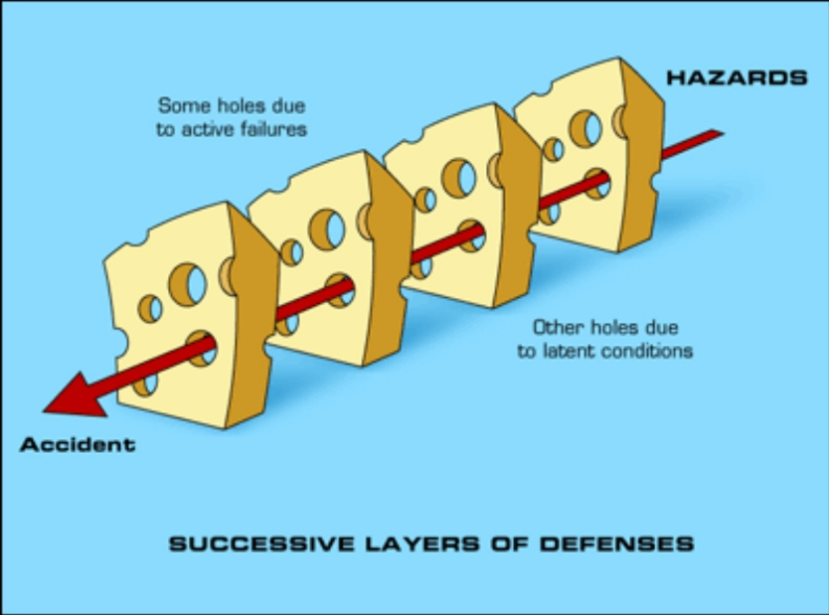
What Are Defenses in Quality Assurance?
Defenses refer to barriers, safeguards, and controls designed to prevent errors or mitigate consequences when they occur.
Layers of defenses (e.g., physical barriers, administrative procedures) are essential to system resilience.
Quality assurance policies aim to maintain and strengthen these defenses over time.
Notes:
Reason: A "Swiss Cheese" model showing how weaknesses in defenses can align, leading to failures.

Slide 14
Strengthening Defenses with HOP Principles
Use HOP to identify “error traps” where defenses might fail due to human factors (e.g., fatigue, stress, cognitive overload).
Foster a culture of learning from near misses and incidents to enhance defenses over time.
Engage workers at all levels in identifying system vulnerabilities and proposing solutions.
Use defenses as opportunities to build trust and collaboration between teams.
HOP Principles
Administrative Defenses
Physical Defenses
Resilient Organization

Slide 15
Moving Forward: Embedding HOP in Quality Assurance Practices
Integrate HOP concepts into existing quality assurance policies to make them more human-centered and adaptable.
Focus on continual learning, systems thinking, and feedback loops to enhance defense effectiveness.
Encourage leadership to adopt HOP as part of the organizational culture for long-term improvement.
…a system where humans are the key to success, the defenses must evolve to protect both performance and people.

Slide 16
Learning Organization
prioritizes the continuous learning and development of its members
fostering an environment where innovation and improvement are integral to its culture
Peter Senge popularized the concept in his book, The Fifth Discipline.
learning is embraced as a core component of daily activities, not just in response to specific problems.
using the systems thinking method in order to convert companies into organizations that learn to create results that matter as an organization.

Slide 17
Why Learning Matters
Innovation
Safety
Learning
Continuous learning leads to safety innovation.
Mistakes are opportunities to grow.
People are continually learning how to learn together.
Notes:
Creating a Learning Organization

Slide 18
Three Core Themes
The Relationship Between Organizational Performance and Safety Outcomes
Creating a Learning Organization
Adopting Human and Organizational Performance (HOP)
Notes:
Core Themes

Slide 19
Key Takeaways from Today
QA is foundational for performance.
Adopt HOP for better teamwork and reduced risks.
A learning organization drives continuous safety improvement.
Notes:
Key Takeaways

Slide 20
Outcomes
These updates will help expand the scope of the Department's HPI programs by encompassing Human and Organizational Performance (HOP).
The Handbooks will form the foundation of HOP courses that will be created to assist individuals, work teams, and management with incorporating organizational factors, job-site conditions, individual behavior, and results into systems thinking to create a new perspective on improving performance and reliability.

Slide 21
Questions?

