Slide 1

Electronic Nonconformance Report (NCR) Process
EFCOG 2026 Spring session

Slide 2
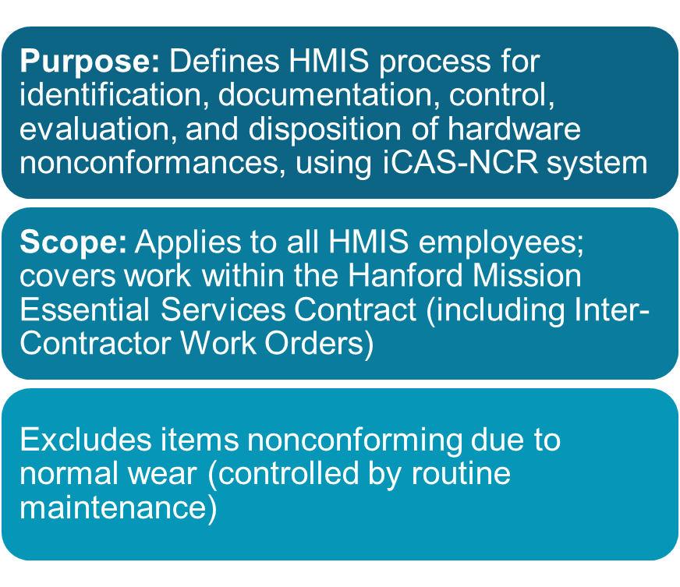

Slide 3
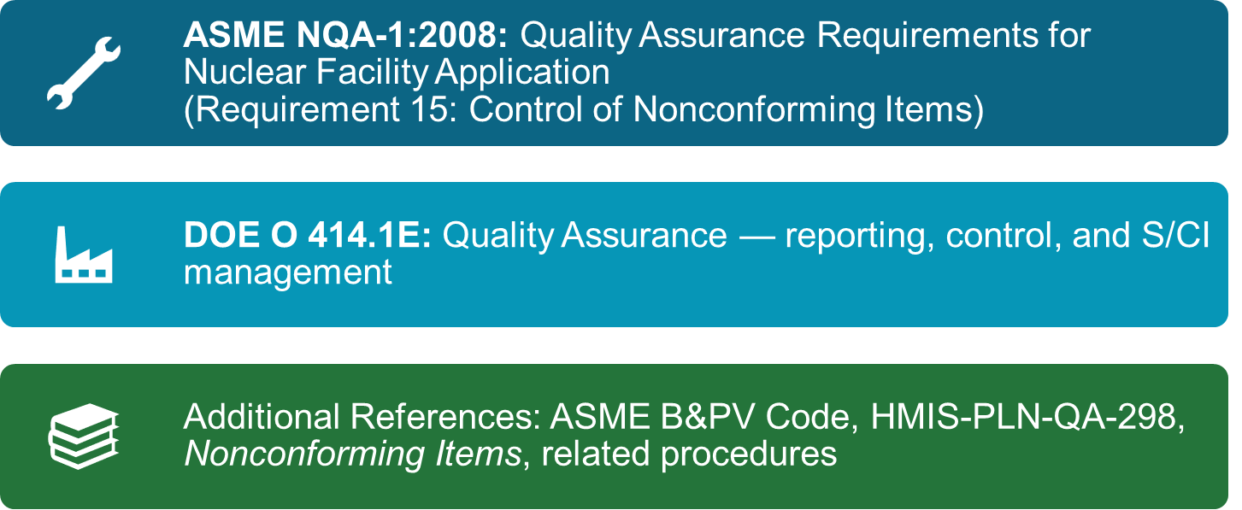
References

Slide 4
What does the term nonconformance mean?
Per ASME-NQA-1: 2008 a nonconformance is:
  A deficiency in characteristic, documentation, or procedure that renders the quality of an item or activity unacceptable or indeterminate.

Slide 5
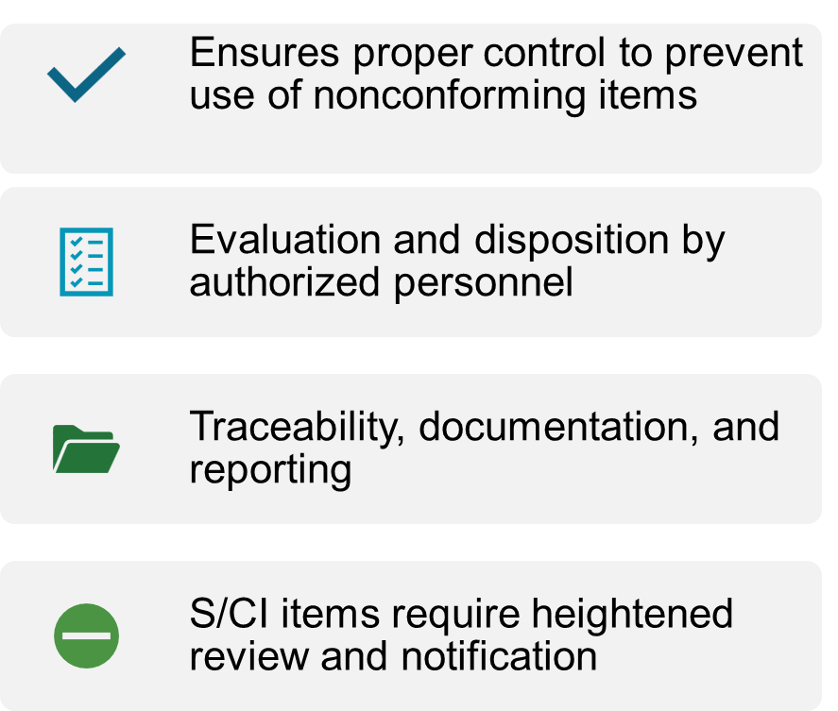
Why use an electronic NCR process?

Slide 6
iCAS-NCR: HMIS’ System for Managing Nonconformances
  Initiation, validation, disposition, concurrence, closure
  Automated role notifications (DA, QA, S/CI, ASME POC, PAAA, USQ, etc.)
  Supports records retention process
iCAS (Integrated Contractor Assurance System)

Slide 7
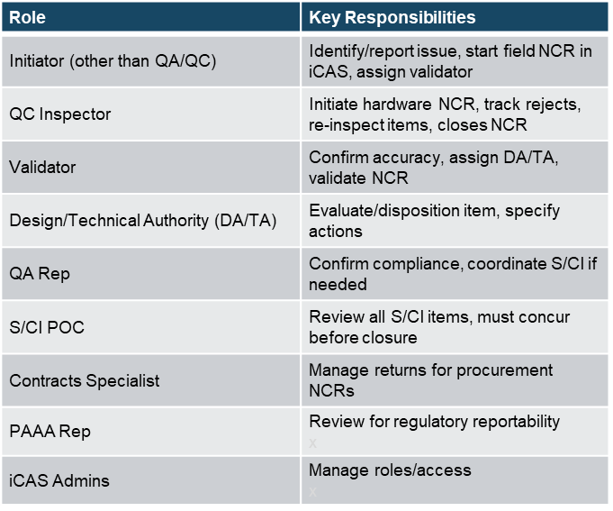
Roles & Responsibilities (Summary)

Slide 8
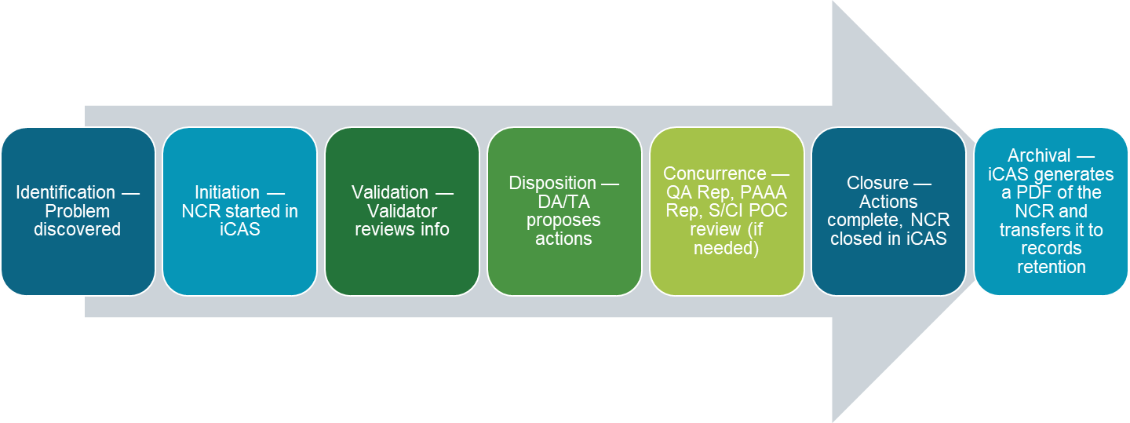
NCR Process Flowchart

Slide 9
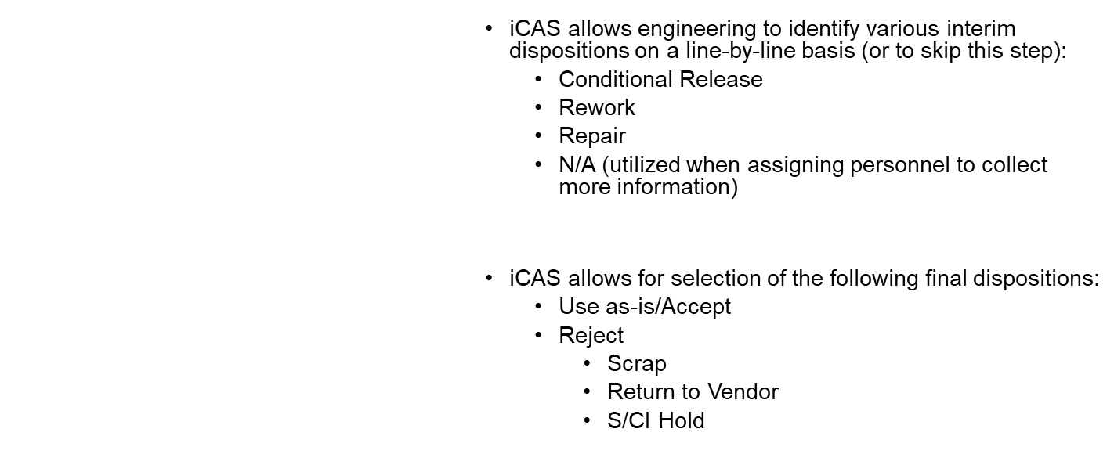
iCAS NCR available dispositions
Notes:
There is a technical justification field within both the interim and final disposition steps to be filled out by the DA/TA.

Slide 10
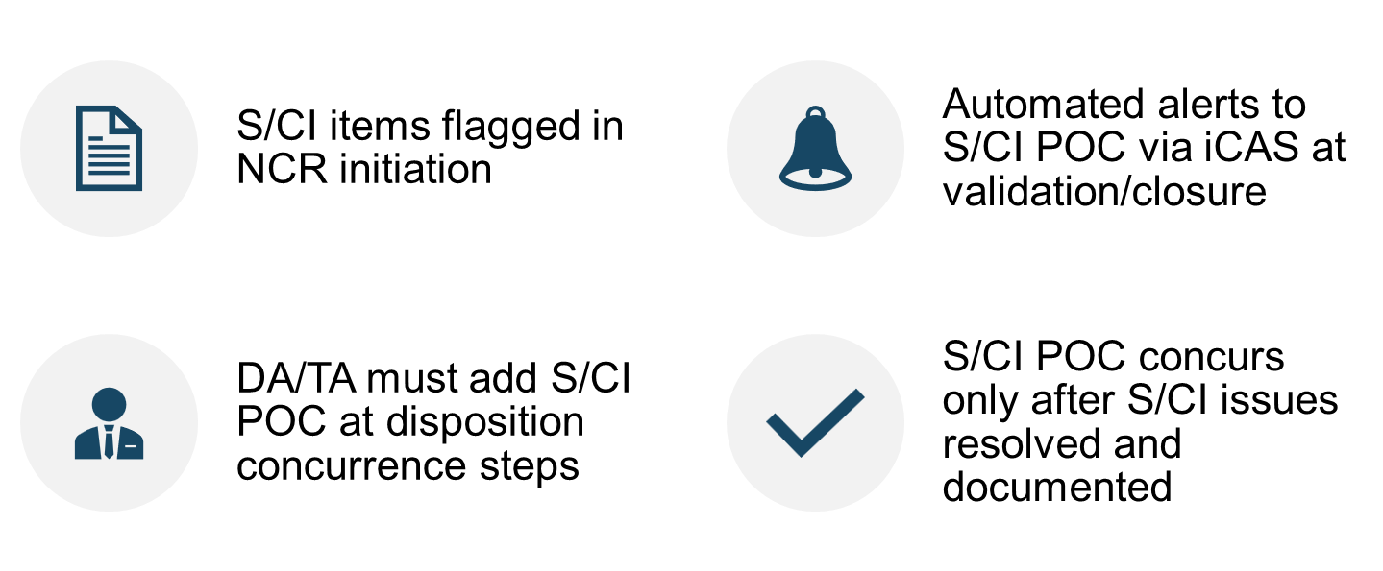
S/CI (Suspect/Counterfeit Items) Focus

Slide 11
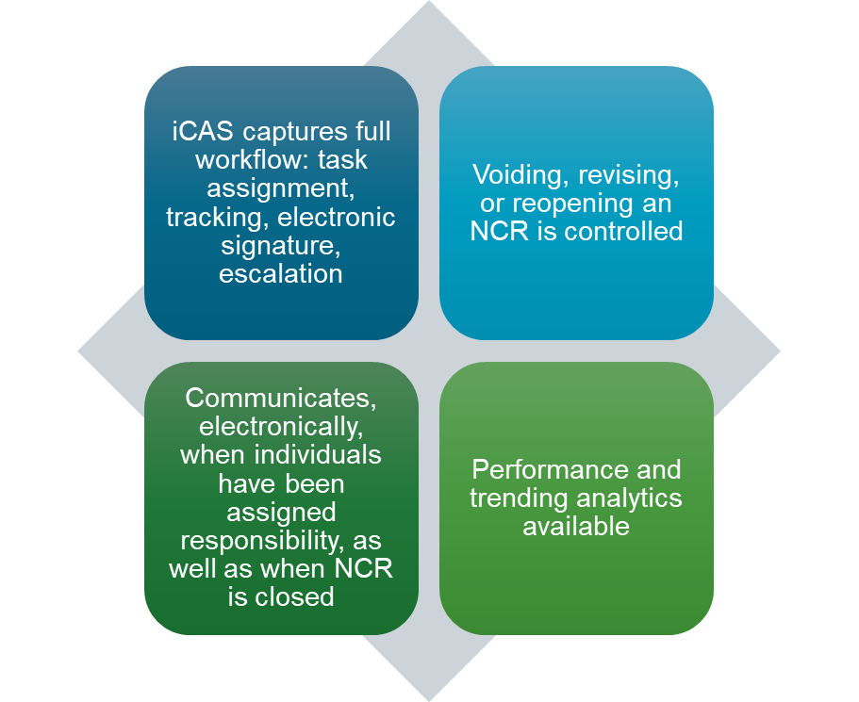
Use of iCAS for NCR Tracking & Management

Slide 12
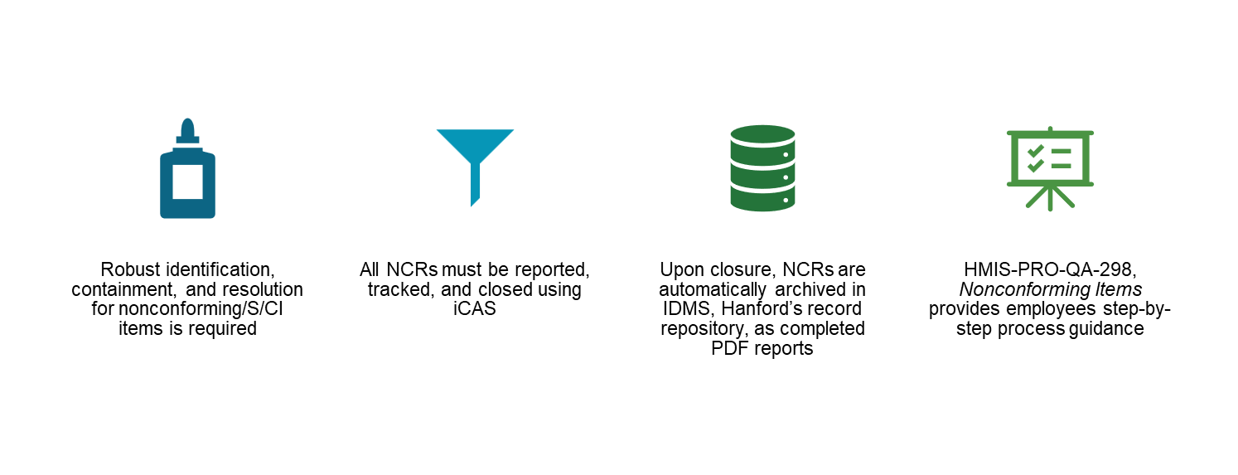
Summary/Best Practices

Slide 13
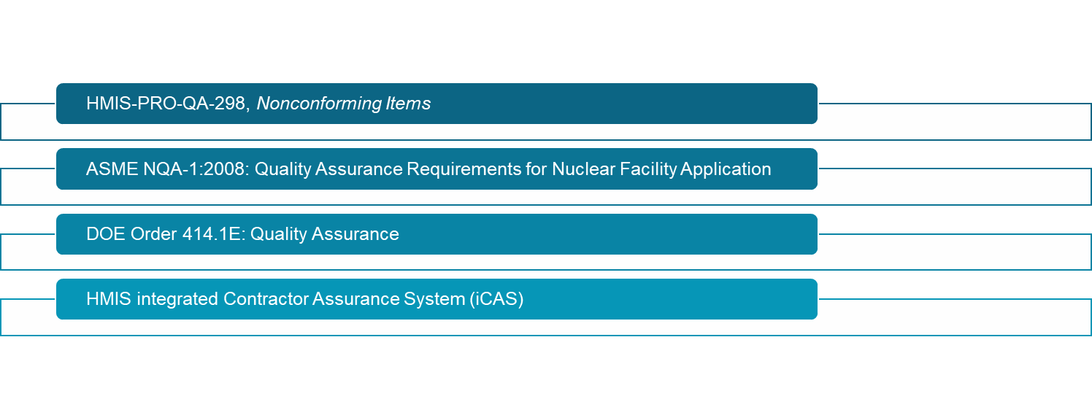
Resources & References

Slide 14
Thank you for attending!

