Slide 1

Elevating Quality Maturity
Presented by: Prachi Verma, PMP®
April 29, 2026

Slide 2

About The Speaker
Prachi Verma – IT Portfolio & Strategic Governance Executive
18+ years of IT experience across financial services, utilities, and public infrastructure domains
Leading enterprise portfolios and multi-billion-dollar programs
Expertise in strategy execution, digital transformation, and governance
Board VP-I (Durham College Alumni Association Board of Directors); Women in Data Science Ambassador (WiDs International); Global Mentor (The PMO Leader)

Slide 3
Session Objectives
Differentiate compliance-driven vs. strategy-driven quality
Apply frameworks to advance organizational maturity
Identify opportunities where quality drives competitive advantage
Connect quality to business outcomes
Develop actionable steps to embed quality into culture
Learning Take-aways

Slide 4
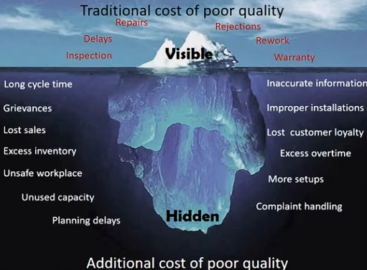
Introduction
Quality is the degree to which outcomes meet customer, regulatory, and business expectations - consistently.
Cost of Conformance
Investments made to do things right
Prevention, Appraisal, assurance
Cost of Non-Conformance
Lost trust, missed opportunities
Customer dissatisfaction, regulatory exposure
Rework, defects, delays
COPQ Pyramid (Lean Six Sigma )

Slide 5
The Compliance Trap
Why Quality Often Fails to Deliver Value
COMPLIANCE
Level 1
PROCESS CONTROL
Level 2
STRATEGIC ADVANTAGE
Level 3
Focus on audits, checklists, and standards
Compliance-driven quality often disconnected from strategy
Missed opportunities to link quality to measurable business outcomes

Slide 6
Beyond Compliance
Shifting from Compliance to Strategic Quality
Compliance ≠ Performance
Embed quality into strategy, leadership, and culture
Quality Informs strategic trade-offs, not just controls
Define OKRs focusing on value creation, innovation, and resilience
Governance focuses on value flow, not documentation volume
Align quality metrics/KPIs to business outcomes, not just audits
Tie back Quality KPIs to end results like customer impact, speed, and experience

Slide 7

Benefits of Strategic Quality
Why It Matters
Competitive differentiation & customer loyalty
Accelerated innovation and agility
Resilient processes and culture
Tangible business outcomes tied to quality

Slide 8
Frameworks That Enable Strategic Quality
Frameworks Don’t Create Value — Decisions Do
Framework | Strategic Use (Not Definition)
Baldrige | Aligns leadership, strategy, and results at enterprise scale (Organizational performance excellence)
Lean | Exposes waste hidden by compliant processes (Eliminate waste, improve flow)
Agile | Enables fast learning/feedback without sacrificing control (Adaptive, iterative improvement)
PMI Value Delivery | Forces explicit linkage between investment and outcomes (Connect project outcomes to strategy)

Slide 9
Practical Application
How Strategic Quality Shows Up in Practice
Governance
Quality embedded into portfolio and funding decisions
Delivery
Quality metrics integrated into sprint and release planning
Risk managed continuously, not at phase gates
Leadership
Executives hold teams accountable for outcomes and learning, not only adherence to process
Entry/exit criteria tied to value readiness, not artifact
Use quality signals to shape strategic trade-offs, not just confirm compliance

Slide 10
Transformations Examples
How Organizations Succeed
The Toyota Way (Formalised in 2021) : Based on Muda, Mura, Kaizen
What Toyota Did
Embedded quality into daily work, leadership behavior, and decision-making
Designed systems to prevent defects, not inspect them later
Empowered teams to stop production to protect customer value
Measured Impact
Defect rates reported at 10–50 PPM, vs industry averages historically in the hundreds of PPM
Inventory levels reduced by 60–75% through Just-In-Time and built-in quality
Warranty and rework costs consistently significantly lower than industry peers
Faster issue detection → problems addressed at the source, in real time

Slide 11
Transformations Examples
How Organizations Succeed
Amazon: Quality Embedded into Decision-Making at Scale
What Amazon Did
Defined quality through customer outcomes, not internal compliance
Embedded quality metrics directly into product, engineering, and leadership reviews
Designed systems to detect failures early and learn fast
Measured Impact
Every 100ms of latency estimated to cost ~1% in sales → quality directly tied to revenue
Deployment frequency at scale with lower incident rates than industry peers
Continuous improvement culture enables thousands of deployments per day
Amazon treats quality as a real-time business signal — not a post-delivery audit.

Slide 12

Leadership’s Role
Driving Strategic Quality Starts with Leadership
Quality maturity reflects leadership as well as organizational maturity.
Model quality-focused decision-making (Deciding whether quality is reactive or predictive)
Align teams and incentives with outcomes (Rewarding high quality deliveries)
Foster a culture of continuous improvement (Assessing if frameworks are used for control or insight)

Slide 13
Call to Action
Turning Quality into Advantage
Assess your organization: compliance vs. strategic quality
Adopt frameworks that fit your culture and goals
Start small, measure impact, scale success
“Quality is never an accident; it is always the result of intelligent effort.” – John Ruskin

Slide 14

Q&A
Thankyou for your attention and engagement
Floor is Open for Q&A
Your questions are welcome!
Please feel free to connect: prachi.verma11@gmail.com
https://www.linkedin.com/in/prachi-verma-56ba3214/

