Slide 1
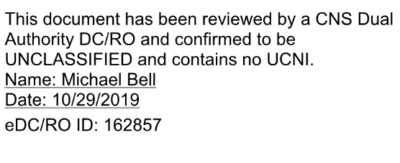
Cyber Security Requirements Versus SQA
Tony Hickey
antonio.hickey@cns.doe.gov
Cyber Security Authorizations Manager/
Alternate Information System Security Manager

Slide 2
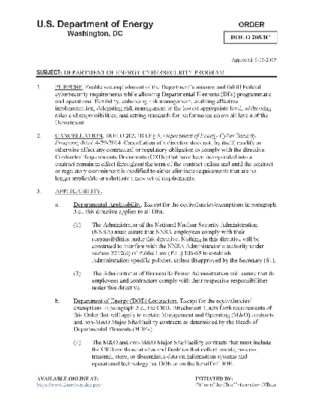
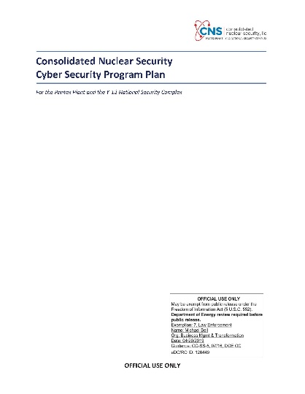
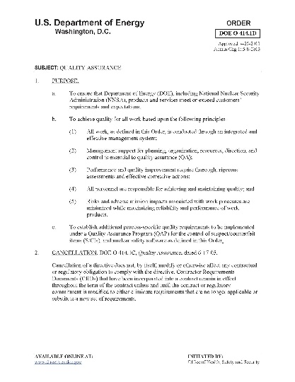
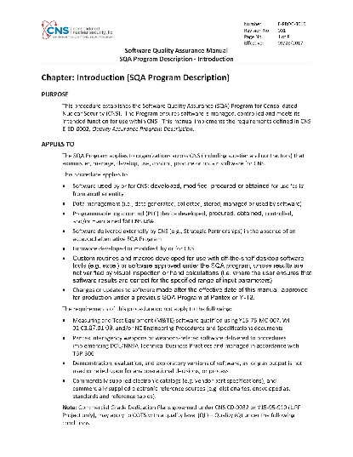
Software Quality Assurance Versus Cyber Approval
Federal Requirements:
DOE O 205.1C, DOE Cyber Security Program
Does Not Mention Quality Assurance Program Guidance
Lays out NPO Authorizing Official (AO) Cyber Approval to Operate (ATO)
Risk-Based Approach Utilizing Risk Management Framework (RMF)
Requirements Flowed Down in Tactical CNS Guidance (CSTS, CSPP, ECPP, ITSO)
Risk Captured in Information System Security Plan (ISSP)
DOE O 414.lD, Quality Assurance
Does Not Mention Cyber Security Program Guidance
Defines Quality Levels (QL)
Applies Graded Approach
Requirements Flowed Down in E-PROC-3015 SQA Tactical Execution Guidance
Defines Cybersecurity Involvement (directs Preliminary RA and Controls/Testing, COOP, Potentially a Full RA)

Slide 3
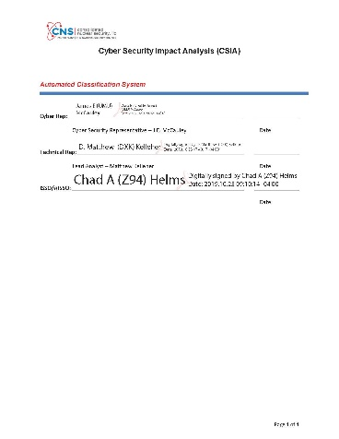
Software Quality Assurance Versus Cyber Approval
Cyber Approval:
Information Systems Must Have an Approved Information System Security Plan (ISSP)
ISSP Security Controls are Defined by NIST (Unclassified) or CNSSI 1253 (Classified)
ISSP Attempts to Balance Confidentiality, Integrity and Availability (CIA) Based on Mission Requirements
ISSP is Sent to NPO for Approval in the Form of an Approval to Operate (ATO)
ATO is Federal Formal Acceptance of Risk for All Hardware/Software in the System
Hardware/Software Additions After Approval of the ISSP Require Cyber Security Impact Analysis (CSIA) and Potential for Threat Model and Risk Assessment (TMRA)
CSIAs and TMRAs Evaluate and Mitigate New Risk
Cyber Evaluation of Changes to ISSP Begins with CSIA
CSIA Documents Hardware/Software Deployment
Security Significant Features are Described
NPO AO’s Major Concerns are Evaluated Against Deployment
Low Risk Deployments are Closed Out Here
Higher Risk Deployments are Forwarded to Cyber Review Board (CRB)

Slide 4
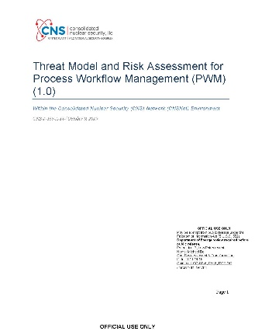
Software Quality Assurance Versus Cyber Approval
Cyber Approval (cont.):
CRB Determines if Threat Model and Risk Assessment (TMRA) is required
TMRAs Examine Risks From Threats Defined in CNS Cyber Security Threat Statement (CSTS)
External Attackers
Insider Threats
Information Technology Suppliers
Natural/Environmental Events
TMRAs are Good for Three Years or Until Deployment Changes
Re-evaluated Every Three Years
Risks Absorbed into ISSP During Re-Authorization?
What About Cloud Applications (SaaS)?:
Cyber Requirements are the Same, with a Few Exceptions
Cloud Solutions Will Have an ISSP
Cloud Solution Providers (CSP) Must Have FedRAMP Certification
Under FedRAMP, Cloud Application Will Have an ATO from the Federal Government
Security Controls Within the Cloud Will be Inherited
Monthly Continuous Monitoring Reports Sent to Agencies Using Service
FedRAMP Relies Heavily on Reciprocity
ISSO Will Validate Inherited Controls
NPO ATO and Acceptance of Risk is Required
CNS Currently Working Office 365 ISSP

