Slide 1
EFCOG Presentation on Software Limitations and potential impacts on Engineering Analysis
Notes:
Hong Kong island waterfront design and supervision of the central reclamation project.

Slide 2
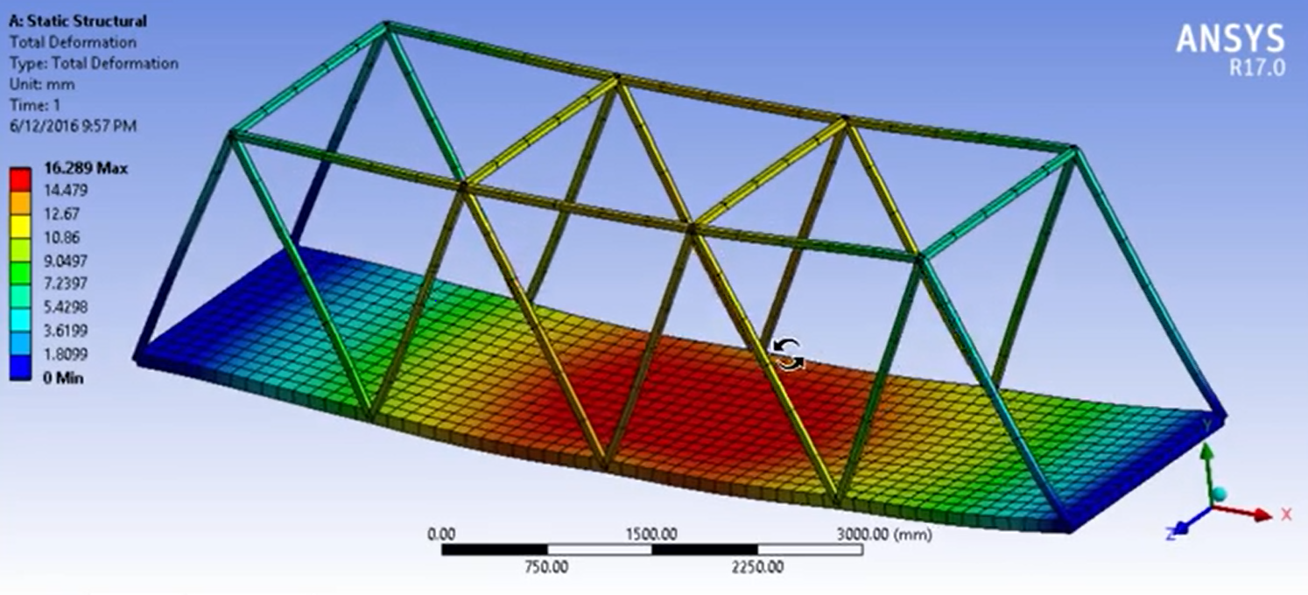
ANSYS Class 3 Error 2017-01
INISTATE data for high order beam and pipe elements with KEYOPT(3) = 2 or 3 produces incorrect results when temperatures are non-zero. (First incorrect version Release 13.0)
Notes:
INISTATE is the command for initializing structure

Slide 3
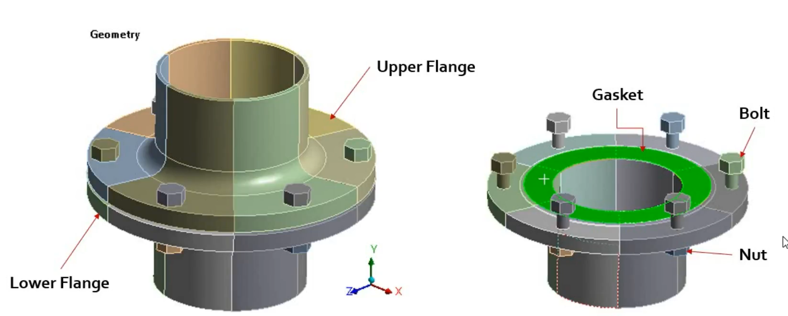
ANSYS Class 3 Error 2017-05
Gasket material in tension may produce incorrect results when unloading data is not provided. When the gasket material is first loaded in compression and then the reverse load is applied the last compression stiffness is used in tension instead of the tension stiffness defined by the user.

Slide 4
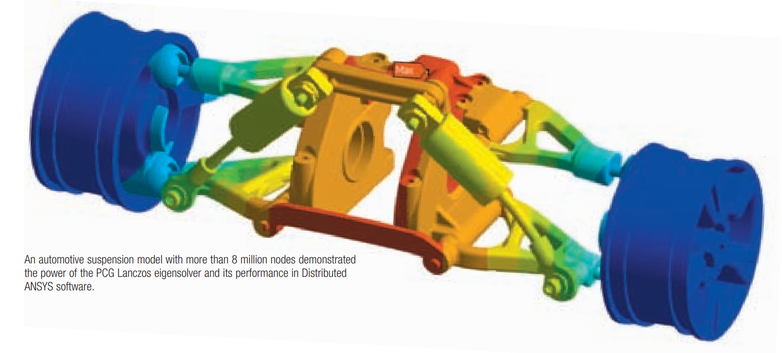
ANSYS Class 3 Error 2018-03
When comparing nodal solutions using the RSTMAC command, the MAC values may be incorrect when the PCG Lanczos (Method=LANPCG on MODOPT command) was used to obtain the solutions. In this case, the diagonal of the mass matrix used in the MAC calculation is incorrect.
Notes:
RSTMAC allows user to compare mode shapes between two difference meshes. The MAC (Modal Assurance Criterion) is used by ANSYS to determine which modes are the same between different rotational speeds. The Lanczos algorithm is used to find the most useful (highest/lowest) eigenvalues and eigenvectors. Geometrically, an eigenvector, corresponding to a real nonzero eigenvalue, points in a direction in which it is stretched by the transformation and the eigenvalue is the factor by which it is stretched.

Slide 5
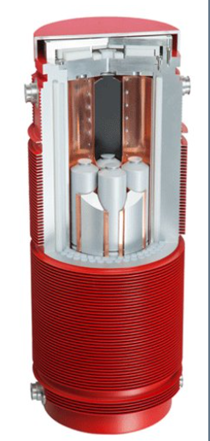
MICROSHIELD 3.3
Thick walled geometries with homogeneous material and activity distribution
The MicroShield® results for different build-up factors in otherwise constant conditions differ by factor 4.
The MCNP® results are either under-estimated by factor 0.5 or over-estimated by factor 2 by the MicroShield® results.

