Slide 1
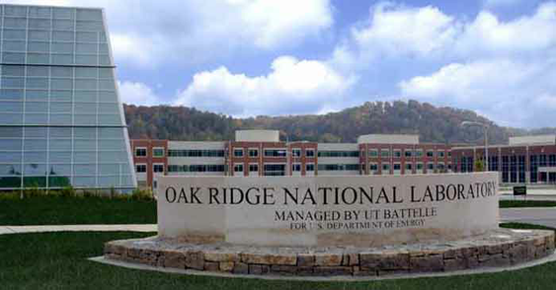
EFCOG Fall 2019 – Oak Ridge, TN
EFCOG SQA Task Group – Strategic Planning
Nathaniel Hein
Oct 2019

Slide 2
EFCOG Mission Statement
EFCOG promotes excellence in all aspects of the operation, management, and integration of DOE facilities in a safe, environmentally sound, efficient and cost-effective manner through the ongoing exchange of information on lessons learned.

Slide 3
SQA Task Group Charter Statement
The Software QA Task Group (SQATG) serves EFCOG and its members by identifying, analyzing, assessing, and recommending methods that support effective implementation of Software Quality Assurance (SQA) requirements and resolve SQA program performance issues.
In particular, the SQATG focuses on cross-cutting issues across DOE sites or across SQA functions. Accordingly, the group engages in regularly planned meetings to report on performance, assess and categorize issues, and prepare initiatives responsive to this charter. The SQATG measures may include interpreting complex-wide requirements, deriving techniques and tools, disseminating lessons learned, and establishing best practices.

Slide 4
SQA Charter (summarized)
Identify, analyze, assess, and recommend methods that:
support effective implementation of SQA requirements
resolve SQA program performance issues
Focus on cross-cutting issues across DOE sites or SQA functions.
Engage in regularly planned meetings to:
report on performance
assess and categorize issues
prepare initiatives responsive to this charter
SQATG measures may include:
interpreting complex-wide requirements
deriving techniques and tools
disseminating lessons learned
establishing DOE SQA best practices

Slide 5
Strategic Planning
Strategic planning focuses what the SQATG should be engaged in. This includes specific effort in SQA areas identified as needing improvement DOE-wide.
What is the SQATG vision? What is the SQATG here to produce?
Is the SQATG maximizing its efforts by staying focused upon things that only the SQATG can accomplish?
Are SQATG work projects filtered through the Charter?

Slide 6
SQATG Strategic Planning initiatives
Strategic initiatives are general, high-level areas of focus.
Provide standardization DOE complex-wide for SQA processes, deliverables, training (for SMEs and SQA in general), etc.
Provide leadership to achieve excellence in SQA – right-sizing the program is a big part of achieving excellence; making processes easy to follow, understand, and still remain compliant.
Simplify SQA processes and deliverables (such as providing easy-to-use templates), what goes into the inventory, etc.
Possible revisions to document-centric standards (DOE O 414.1D, NQA-1, etc.) which lead to over-emphasis on documentation vs. performance-based assessments. (Vicki’s upcoming discussion)

Slide 7
Questions and Comments

