Slide 1
Software Engineering Program at the High Flux Isotope Reactor Integrating Cyber Security and Software Quality Assurance
Presented to
EFCOG Integrated Safety Management & Quality Assurance Meeting
SQA Task Group
Kevin Shaw
Software Engineering Lead
Research Reactors Division
Oak Ridge, TN
October 30, 2019

Slide 2
HFIR Software Engineering Program
10 CFR 830.120
DOE Order
414.1D
DOE Guide
414.1-4
UT-B Contract
FISMA
2002
DOE Order 205.1B
UT-B Contract
Software QA
FIPS 199
FIPS 200
Cyber Security
NIST
SP 800-53
SP 800-82
Common Control Classes
AC
AT
AU
CA
CM
CP
IA
IR
MA
MP
PE
PL
PM
PS
RA
SA
SC
SI
DOE O 205.1C
DEPARTMENT OF ENERGY
CYBER SECURITY PROGRAM
DOE O 414.1D
QUALITY ASSURANCE

Slide 3
Standards-Based Management System

Slide 4
ORNL
Oak Ridge National Laboratory
Thomas Zacharia, Laboratory Director
Office of Integrated Performance Management
Independent Oversight
Performance Analysis and Quality
Requirements, Documents, and Records Management
Project Management
Michelle Buchanan Deputy for Science and Technology
Jeff Smith Deputy for Operations
Computing and Computational Sciences
Energy and Environmental Sciences
National Security Sciences
Neutron Sciences
Nuclear Science and Engineering
Physical Sciences
Computational Sciences and Engineering Division
Computer Science and Mathematics Division
National Center for Computational Sciences Division
Biosciences Division
Environmental Sciences Division
Electrical and Electronics Systems Research Division
Energy and Transportation Sciences Division
Cyber and Data Analytics Division
Field Intelligence Element Division
National Security Emerging Technologies Division
Nuclear Nonproliferation Division
Neutron Scattering Division
Neutron Technologies Division
Research Accelerator Division
Research Reactors Division
Fusion Energy Division
Nonreactor Nuclear Facilities Division
Isotope and Fuel Cycle Technology Division
Reactor and Nuclear Systems Division
Transformational Challenge Reactor Program
Center for Nanophase Materials Sciences
Chemical Sciences Division
Materials Science and Technology Division
Physics Division
Business Services
Environment, Safety, and Health
Facilities and Operations
Human Resources
Accounting Operations Division
Business Operations Division
Contracts Division
Information Technology Services Division
Engineering Management Division
Environmental Protection Division
Health Services Division
Nuclear and Radiological Protection
Office of Technical Training Division
Safety Services Division
Transportation and Waste Management Division
Facilities Management Division
Integrated Operations Support Division
Laboratory Modernization Division
Laboratory Protection Division
Logistical Services Division
Utilities Division
Compensation
Diversity and International Office Division
Employee Benefit Programs Division
Employee and Organizational Development Division
Information and Process Management
Labor Relations Division
Talent Acquisition Division

Slide 5
ORNL
Information Technology Services Division
Chief Information Officer
Cyber Policy Team
Performance Analysis and Quality
CISO
Strategic Platform & Operations
Cyber Security Operations & Engineering
Program Management & Compliance
Financial Management Applications
Assessment and Event Analysis
Client & Service Management
Datacenter & Network Engineering
Research & Mission Support Applications
Human Capital Management Applications
Safety and Security Regulatory Program
R&D Systems Engineering
Web Services Applications
Quality Management
Software QA
Cyber Security

Slide 6
HFIR Software Engineering Program
10 CFR 830.120
DOE Order
414.1D
DOE Guide
414.1-4
UT-B Contract
SBMS: Software
Quality Assurance
FISMA
2002
DOE Order 205.1B
(PM) Program Mgmt.
(PL) Planning
(CM) Configuration Mgmt.
(MA) Maintenance
UT-B Contract
(a) Project Mgmt. & QP
(c) Configuration Mgmt.
(i) Problem Reporting & CA
FIPS 199
SBMS Management System: IT
(e) Requirements ID & Mgmt.
FIPS 200
SBMS Subject Area: Cyber Security
(f) Design & Implementation
NIST
SP 800-53
SP 800-82
(SC) System & Comm.
(PE) Physical & Enviro.
(SI) System & Info Integrity
(PS) Personnel Security
(AC) Access Control
(IA) ID & Authentication
(AU) Audit & Accountability
(h) Verification & Validation
ORNL Cyber Security Plan
Common Control Classes
AC
AT
AU
CA
CM
CP
IA
IR
MA
MP
PE
PL
PM
PS
RA
SA
SC
SI
Common Control Classes
AC
AT
AU
CA
CM
CP
IA
IR
MA
MP
PE
PL
PM
PS
RA
SA
SC
SI
(CP) Contingency Planning
(IR) Incident Response
(SA) Systems & Services
(d) Procurement
(MP) Media Protection
(RA) Risk Assessment
(CA) Assmt. & Author.
(b) Risk Management
(g) Safety Analysis
(AT) Awareness & Training
(j) Training
Cyber Requirements
QA Requirements

Slide 7
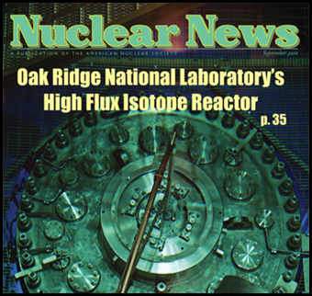
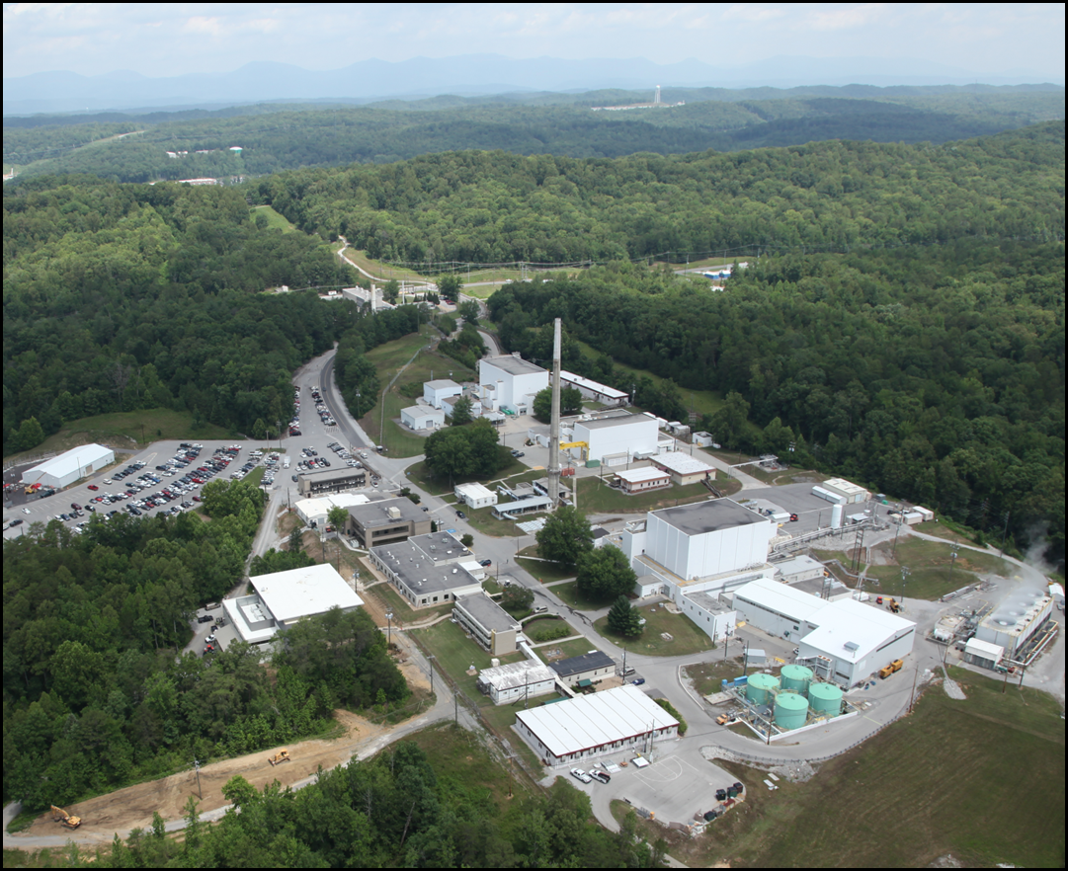
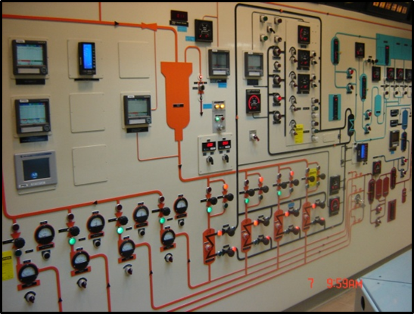
High Flux Isotope Reactor

Slide 8
Research Reactors Division
Director
Plant Manager
Maintenance
Operations
Business Management Services
Environment, Safety, Health, & Quality
Nuclear Safety & Experiments
Systems Engineering, Design, & Fabrication
Cold Source
Design Basis
Electrical/I&C Engineering
Fuel & Component Fabrication
Mechanical Engineering
Software Engineering

Slide 9
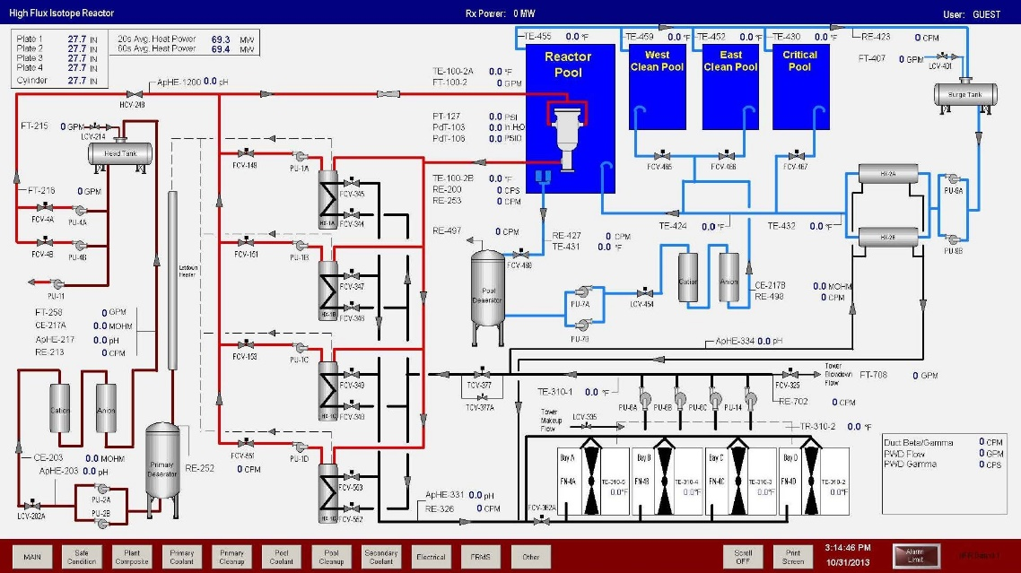
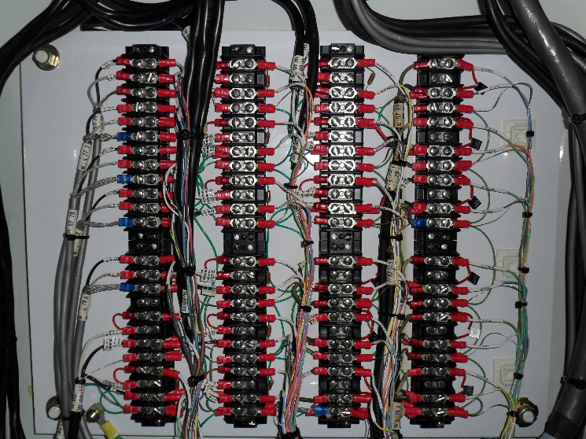
Industrial Controls Systems Software

Slide 10
Software Engineering
The software engineering program has been developed to comply with the general quality requirements of 10CFR830 and the safety software requirements of DOE O 414.1D.
Research Reactors Division
Communication
● Team Meetings Begin
● Discussions on Functionality and General Design
Software Engineering
Prototype Phase -
Upon communication of a new project, a software system design is initiated, and a software/hardware prototype is built to validate the design.
Design
● Purchase Hardware for Evaluation
● Setup Network
● General HMI Development
Build
Prototype
Customer
Evaluation
● Classification & Categorization per SBMS Procedure
● Begin Quality Planning
● Complete Software Task Checklist
● Review Lessons Learned & Defect Tracking Information
Design Phase -
Once the customer and software engineer are satisfied with
the design, workflow jumps off the prototype circle and the waterfall begins with formal requirements gathering and software quality assurance and umbrella activities.
Requirements
Gathering
● Write FD & SQA Plan
● Write Cyber & SQA Umbrella Documents
Design
● Write SRS
● Perform Requirements Structured Walkthrough
● Functional Audit by QA Group
Implementation Phase -
After the software requirements have been formally documented, work begins
on writing code, simulation & component testing, installation, and maintenance activities.
Implementation
● Write Code
● Code Structured Walkthrough
Validation
● Write SRL and Test Plans
● Perform Testing
● Final Audit by QA Group
SQA Umbrella Documents – Process activities are complemented by a number of umbrella activities, which are applicable across the entire software process. These activities and documents include: Risk Analysis, Security Plan, Backup & Recovery Plan, Change Evaluation, Tracking Matrix, Compliance Matrix, Procurement Tracking, Safety Evaluation, Training, Work Control, Document Control, etc.
Goal
deliver high
quality,
defect free
software
Installation & Maintenance
● Write Backup/Recovery Plan
● Write Work Package
● Work Closeout
Functional Description (FD) – Defines and documents the user requirements and operational characteristics for the software system, in a readable manner to facilitate common understanding of the system.
Structured Walkthrough – a formal review during the development process to ensure completeness and consistency, whereby the task leader certifies that work performed has satisfied requirements and the process may continue.
Software Requirements Specification (SRS) – Defines and documents the inputs, outputs, interfaces, and processing logic in a technical format to facilitate software design and development.
Verification Activities - Reviews, Inspections, Assessments, and Testing performed throughout the software development process to ensure the software satisfies system requirements. (Example: FD requires an algorithm to calculate flow rate. Review code to ensure algorithm is included in the program.)
Validation Activities - Reviews, Inspections, Assessments, and Testing performed at the end of the software development process to ensure the software performs correctly. (Example: FD requires an algorithm to calculate flow rate. Test the program to ensure algorithm produces correct answer.)
Software Requirements List – Sequentially identifies each unique software requirement to aid in the development of a simulation test.
Guidance Documents - Establishes guidelines and requirements for software design and development.
Process Confidence –
a certitude of excellence in all aspects of production, from initial specification through to the finally commissioned system

Slide 11
HFIR Software Engineering Program
10 CFR 830.120
DOE Order
414.1D
DOE Guide
414.1-4
UT-B Contract
SBMS: Software
Quality Assurance
FISMA
2002
DOE Order 205.1B
SQA-HFIR-001
Software Engineering
Program Guide
SPMP
SQAP
Change Evaluations
Tracking Matrix
Compliance Document
(PM) Program Mgmt.
(PL) Planning
(CM) Configuration Mgmt.
(MA) Maintenance
UT-B Contract
(a) Project Mgmt. & QP
(c) Configuration Mgmt.
(i) Problem Reporting & CA
FIPS 199
SQA-HFIR-002
Software Requirements Management Guide
SBMS Management System: IT
(e) Requirements ID & Mgmt.
Functional Description
Software Req’ts Spec.
FIPS 200
SQA-HFIR-003
Software Design Guide
SBMS Subject Area: Cyber Security
(f) Design & Implementation
Design Analysis
NIST
SP 800-53
SP 800-82
SQA-HFIR-004
Software V&V Guide
V&V Plan
Software Req’ts List
Test Plans
Reviews & Audits
(SC) System & Comm.
(PE) Physical & Enviro.
(SI) System & Info Integrity
(PS) Personnel Security
(AC) Access Control
(IA) ID & Authentication
(AU) Audit & Accountability
(h) Verification & Validation
ORNL Cyber Security Plan
SQA-HFIR-005
Software System Protection Guide
Common Control Classes
AC
AT
AU
CA
CM
CP
IA
IR
MA
MP
PE
PL
PM
PS
RA
SA
SC
SI
Common Control Classes
AC
AT
AU
CA
CM
CP
IA
IR
MA
MP
PE
PL
PM
PS
RA
SA
SC
SI
System Security Plans
SQA-HFIR-006
Software Incident Response Guide
(CP) Contingency Planning
(IR) Incident Response
Backup & Recovery Plan
(SA) Systems & Services
SQA-HFIR-007
Software Acquisition Guide
(d) Procurement
Procurement Tracking
SQA-HFIR-008
Software Media Protection Guide
(MP) Media Protection
Software Inventory
(RA) Risk Assessment
(CA) Assmt. & Author.
SQA-HFIR-009
Software Risk Management Guide
System Risk Analysis
Failure Analysis
(b) Risk Management
(g) Safety Analysis
(AT) Awareness & Training
SQA-HFIR-010
Software Training Guide
Training
Qualification
(j) Training
Cyber Requirements
QA Requirements
Guides
SEP-0233
Program Guides

Slide 12
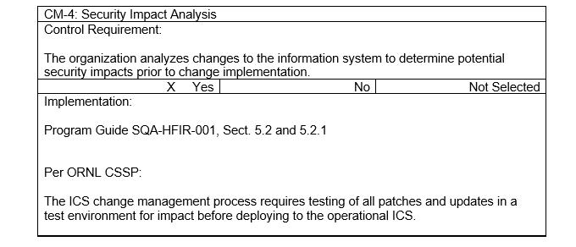
From NIST SP 800-53
From SQA-HFIR-001

Slide 13
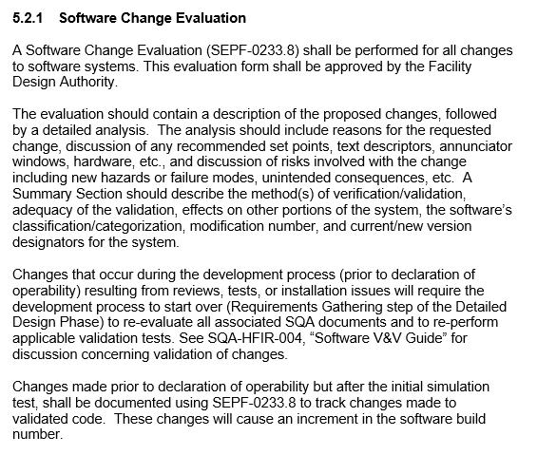
From SQA-HFIR-001
.1
.1

Slide 14
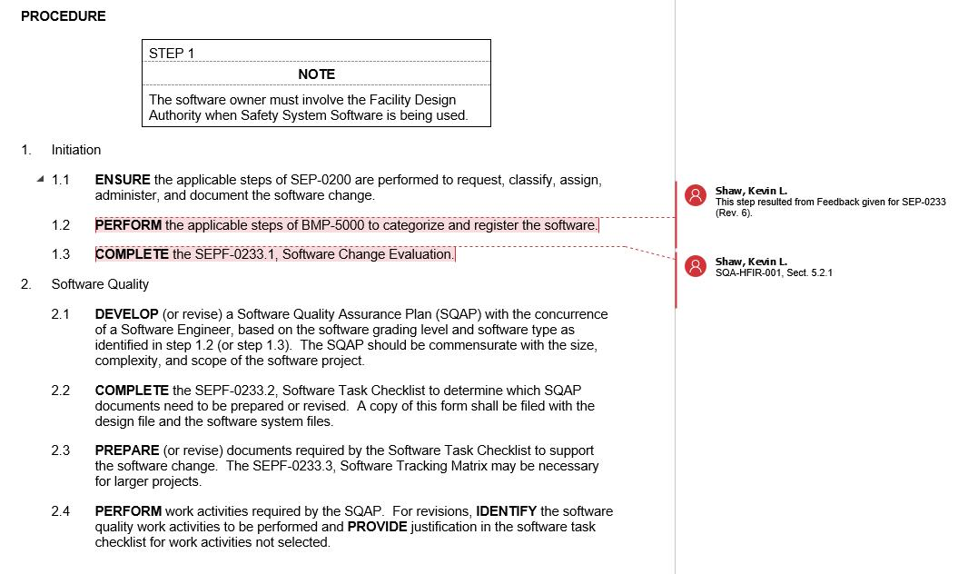
From SEP-0233

Slide 15
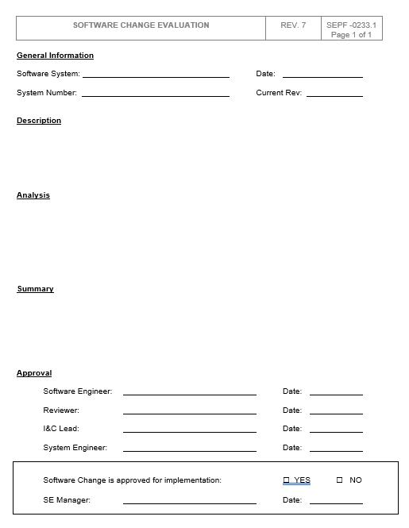
From SEP-0233

