Slide 1
Runner Safety During Covid-19

Slide 2
Tips to Run Safely
Running may or may not be your favorite way to exercise. If you already enjoy running, there’s potentially the “runner’s high” to experience. If you dislike running, there’s the “runner’s low,” which may be basically every time you run. But with the COVID-19 coronavirus putting many other types of exercise on hold, running may currently be one of your best options to keep physically active.
After all, running doesn’t require teammates, a field, a gym, or any special equipment, except for perhaps appropriate shoes and clothes. Regardless, you still have to take precautions with the severe acute respiratory syndrome coronavirus 2 (SARS-CoV2) continuing to spread.

Slide 3
Precaution 1: Stay at least 12 feet away from others.
According to the Centers for Disease Control and Prevention (CDC), social distancing means staying at least six feet from other people. However, six feet is a minimum in general. A study showed how simply saying the words “stay healthy” could spew forth droplets from your mouth. Typically, you breathe faster and harder when you are running than when you are standing or sitting, unless, of course, you are watching TV while sitting or standing. Such panting may mean that you exhale respiratory droplets in greater quantities and project them farther. Therefore, you may want to at least double your distance when exercising. Two Denzel Washington's away from others, which is 12 feet, assuming that Washington is six feet tall, will provide more of a safety buffer.

Slide 4
Precaution 2: Keep your eyes ahead on the path to anticipate who or what may be coming.
Keep your eyes scanning forward, and keep planning where exactly you will be running next. View your running course like you would a football field, where you have to avoid getting too close to others. Pretend that you are weaving down the field. If you are running along a narrow path and someone else is coming the opposite direction, one of you will have to yield and get off the path early enough to avoid a collision of respiratory droplets and faces.

Slide 5
Precaution 3: Be clear with your communication with others.
When you do appear headed for a direct encounter with someone else, this is not the time to play a game of chicken. Instead, signal very clearly who should move where. Typically, it is best to do this with both your voice and gestures with your hands and arms. After all, the person may not be able to hear you, especially if you are wearing a mask. Your gestures should be clear.

Slide 6
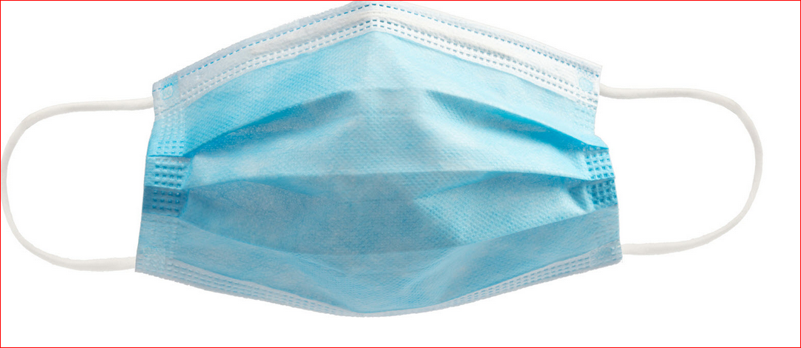
Precaution 4: Wear a mask if you are going to be anywhere near people.
When you do appear headed for a direct encounter with someone else, this is not the time to play a game of chicken. Instead, signal very clearly who should move where. Typically, it is best to do this with both your voice and gestures with your hands and arms. After all, the person may not be able to hear you, especially if you are wearing a mask. Your gestures should be clear. Don’t turn this into charades. Eleven words, first word rhymes with “sweat,” is not the way to communicate when you want to say, “get the heck out of the way, I am coming though.” Semaphores or smoke signals are not very practical because then you have to carry flags or kindling wood while running.

Slide 7
Precaution 5: Consider wearing a mask if you are going to be anywhere near people.
A face covering may block at least some of the respiratory droplets that may spew from your mouth and nose. Make sure that the face covering is dry and not wet.
Check to see what your community, town, or city is requiring. They may be asking you to wear a face covering in any public area. You don’t want to be faced with a situation where you didn’t realize that your face needs to be covered.

Slide 8
Precaution 6: Don’t run immediately where others have just run.
The wind outside can help disperse respiratory droplets so that they are less concentrated. That can make transmission of the virus less likely outdoors. However, respiratory droplets with viruses may still hang in the air for a bit. So treat a person’s exhaling while running.

Slide 9
Precaution 7: Avoid touching shared objects.
Even objects bathed in the wind, sun, or rain can remain contaminated with the virus if someone contagious previously touched, coughed on, sneezed on, or panted on it. If you do touch something that may be contaminated, clean your hands thoroughly and immediately. The chances of you inadvertently touching your face during running is very high.

Slide 10
Precaution 8: Know when and where to run.
Pay attention to local warnings and regulations and follow them. Yellow “Police Line Do Not Cross” tape does not mean “Jump Over This” or “Use This As A Limbo Bar.” Even though fewer people are outside, continue to avoid running in areas and during times that are typically not safe. Always keep in mind where you would go if you needed to seek help immediately.
For safety sake, never run the same route, this is an open invitation for thieves. If you can get an alarm that sets off a high pitch alarm much like when vehicles safety system. There are affordable options on Amazon. This would also work if you trail run, maybe not so much with bears but if you encounter a mountain lion or other animal the high pitch would scare them away.

Slide 11
Precaution 9: Ease into running.
If you haven’t been running regularly, your body may not be used to it. Don’t think that you can immediately go from the couch to running marathons. Start very slowly. Each day you go out, gradually increase your distance and speed. Listen to your body. If your body says, what the bleep are you doing, slow down. Make sure that you stretch before and after running.

Slide 12
Precaution 10: Mix it up and have fun.
With fewer options available, it may be more difficult to cross train, to work out different parts of your body. Constantly pounding the same parts of your body with repetitive motions could lead to injury and over-development of some body parts and underdevelopment of others. To prevent this problem, consider mixing things up every now and then with different ways of running such as incorporating high-knees (running so that your knees go as high as you can), skipping, side-stepping, and Gangham Style. Consider interspersing some push-ups, sit-ups, juggling, and other ways to work the rest of your body. Be creative.

