Slide 1
EFCOG SQA Group Meeting
February 19, 2020
Chair: Vicki Pope (pope13@llnl.gov)
Vice Chair: Teri Vincent (teri.vincent@cns.doe.gov)
Secretary: Marylou Apodaca (marapod@sandia.gov)

Slide 2
Agenda
Announcements and Updates
EFCOG SQA Page Web Site Changes
Agenda for Spring Meeting
DOE O 414.1E Update Brainstorm – Definition of “Software”
Task Group Updates & Members
Next Steps

Slide 3
Spring 2020 Meeting:
NEW DATE: March 31-April 2, 2020
Sandia; Albuquerque, NM
3
Announcements
and
Updates
REVCOM of DOE Guide 414.1-4 Revision Still Delayed
Toolbox Qualification of RESRAD Code Delayed Until Summer
Email Marylou Apodaca for Meeting Attendance
(Meeting credit for recertifications)
Any site Announcement or concerns?

Slide 4
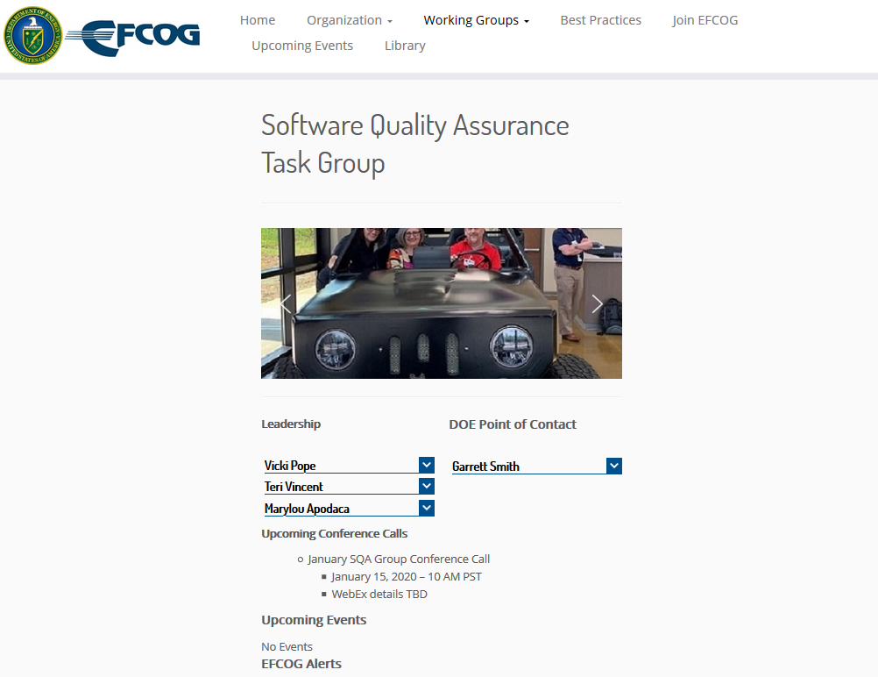
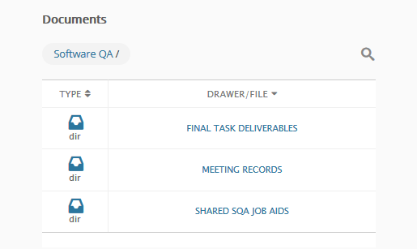
EFCOG SQA Web Site Changes
https://efcog.org/safety/quality-assurance-subgroup/software-quality-assurance-task-group/
Having problems with pictures and side bars (hope to have that resolved this month)
New content has not yet been posted
Updates to Firmware paper (cover included)
Archived material from Pre-2015 EFCOG SQA and old SQAS group
Scroll down to page bottom

Slide 5
Central Registry Toolbox Qualification: RESRAD
Assessment team: 4-5 Feds/Consultants + 2 SQA SMEs from Labs (requested from LANL, LLNL, PNNL, SNL for this particular code)
Code: RESRAD, Produced by Argonne National Lab
Time Commitment:
Assessment Activities Over 3-4 Months
Late January through Early May
Document Review and On-Site Interviews in March
SQA SMEs responsible for
Configuration Management
Requirements
Design
Testing/Verification and Validation (“Fed” team members to V&V model used)
Lead in assessing and writing results for their assigned section(s)
Expenses/Costs – paid by team members’ sites

Slide 6
DOE O 414.1E: Definition of “Software”
DOE O 414.1D (Quality Assurance Order) Definition:
“Computer programs and associated documentation and data pertaining to the operation of a computer system. (ASME NQA-1-2008 with the NQA-1a-2009 addenda)” (NOTE: The 2005 DOE 414.1-4 Guide includes “procedures” in the definition of software.)
DOE O 200.1A (Information Technology Order) Definition:
“All software or software customized for DOE use, proposed for use, under development, or being maintained and used, whether that software was developed in-house, licensed from a commercial vendor for customized use, obtained from another organization, or otherwise acquired. The type of software includes, but is not limited to:
a. administrative/business-oriented software,
b. scientific/engineering software,
c. manufacturing-oriented software, and
d. process control (e.g., programmable logic control instructions).
Definition suggested by Sid Ailes at Fall 2019 Meeting: “Quality affecting software…”

Slide 7
DOE O 414.1E: Definition of “Software” (cont)
IEEE 610.12, Standard Systems and Software Engineering Vocabulary (now ISO/IEC/IEEE 24765-2017 ):
“1. computer programs, procedures and possibly associated documentation and data pertaining to the operation of a computer system [IEEE 828-2012, SCM] 2. all or part of the programs, procedures, rules, and associated documentation of an information processing system [IEEE 828-2012, SCM; ISO/IEC 19770-1:2012 IT] 3. program or set of programs used to run a computer [ISO/IEC 26514:2008 Systems and software engineering]
Current Merriam-Webster Definition:
“Something used or associated with and usually contrasted with hardware: such as
a. Programs for a computer accounting software
b (dated): The entire set of programs, procedures, and related documentation associated with a mechanical or electronic system and especially a computer system
c: Materials for use with audiovisual equipment (NOTE: )
d: The programs that run on a computer and preform certain functions
Fun Fact: the term “software” was first used in 1958
Sid Ailes’ Definition at Fall 2019 Meeting:
“Quality affecting software…”

Slide 8
Task Updates
Toolbox Qualification Recommendations (Vicki Pope)
SW Checklists for Audits (Kary Cook)
EFCOG Zip File Review (Ashley Toth)
SQA Group Strategic Planning (Nathaniel Hein)
SCRUM to Work Activities Mapping (Stella McKirdy)
Cloud-based Hosting Whitepaper (Russell Swannack)
How to Manage Configurable Devices (Veronica Camarillo-Morris)
Matrix of SW-Effecting Orders and Policies (Gary Heidel)

Slide 9
Task Team Members
SQA Checklists
Kary Cook, PNNL (lead)
Yevonne Deaton, DOE EM
Kevin Shaw, ORNL
Cloud-based Hosting Software
Russell Swannack, PNNL (lead)
Vicki Pope, LLNL
Ashley Toth, Hanford
SQA Strategic Planning
Nathaniel Hein, LANL (lead)
Marylou Apodaca, SNL
James Hylko, Paducah
Greg Smith, LANL
Teri Vincent, Y-12 / Pantex
EFCOG Zip File Review
Ashley Toth, Hanford (lead)
Kary Cook, PNNL
Dave Thoman, AECOM
Toolbox Qualification
Vicki Pope, LLNL (lead)
Cliff Glantz, PNNL
Roger Lanning (Hanford)
Keith Morrell, NNSS
Carol Olijar, ANL
Russell Swannack, PNNL
Dave Thoman, AECOM
Ashley Toth, Hanford
Configurable Devices
Veronica Camarillo-Morris, LANL (lead)
Lance Abbott, SRS
Christy Renner, PORTS
SW-Effecting Orders
Gary Heidel, ETTP (lead)
Clyde Armstrong, Tru Project
Vicki Pope, LLNL
SCRUM to WA Mapping
Stella McKirdy, INL (lead)
Sid Ailes, Atkins
Kary Cook, PNNL

Slide 10
CNS SW Checklist Presentation

Slide 11
Next Steps
Volunteer to present your site’s tool/process
10 minutes or less (contact Vicki, Teri or Marylou)
Task Groups to meet prior to February WebEx
Don’t forget to post your Task products to Box
Volunteer for Sub-Task Groups
Load sharable document templates, job aids, and SQA-related job postings to Box site
Register for Spring 2020 Face-to-Face

Slide 12
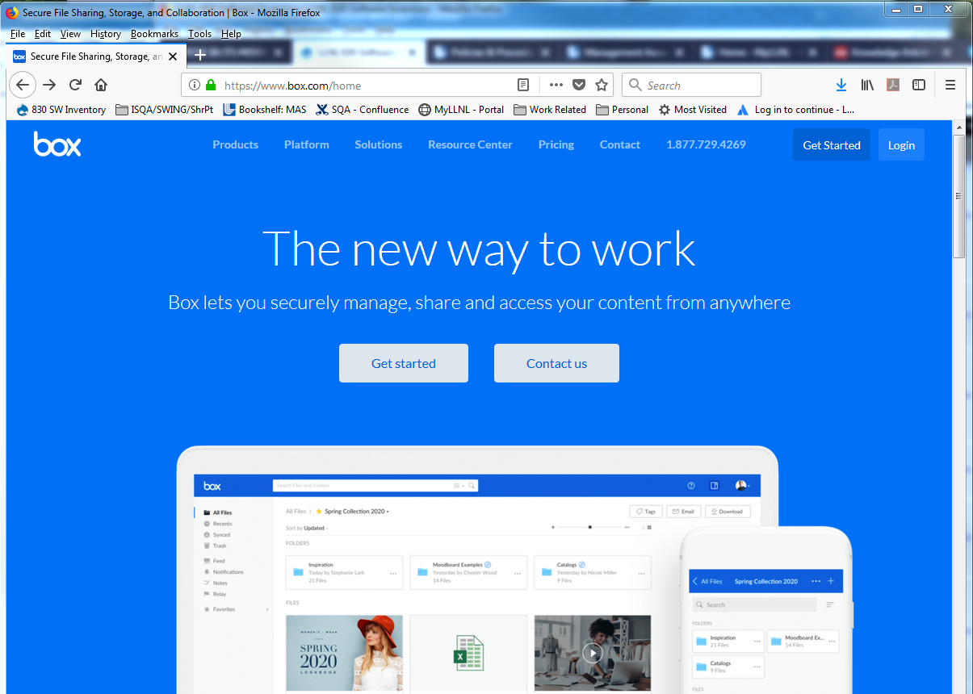
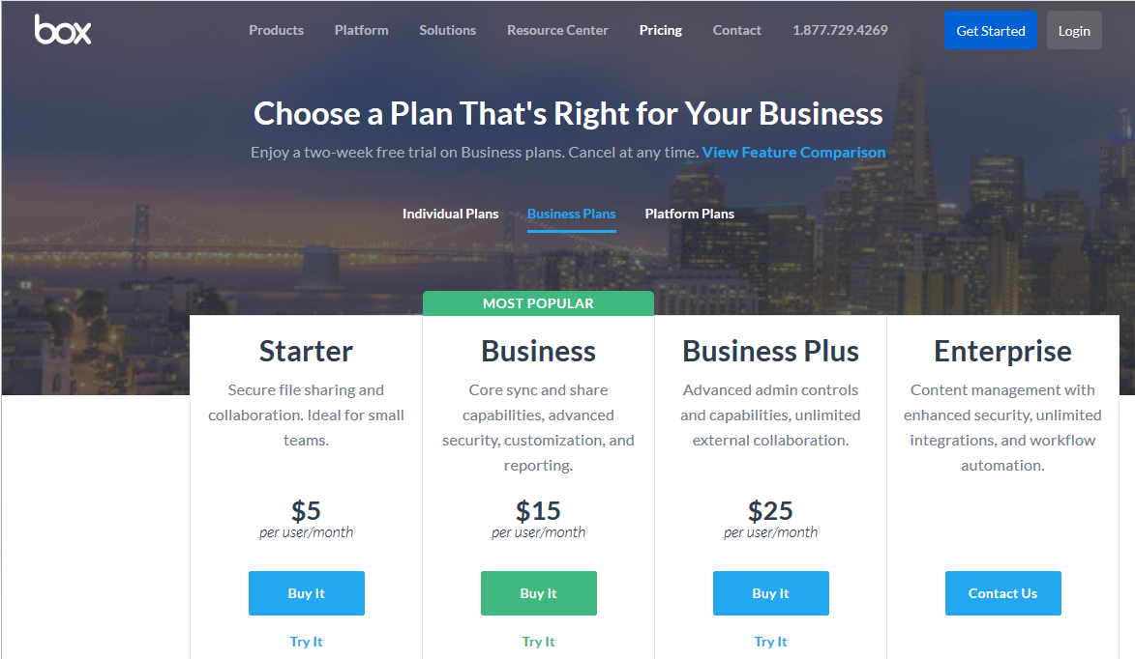
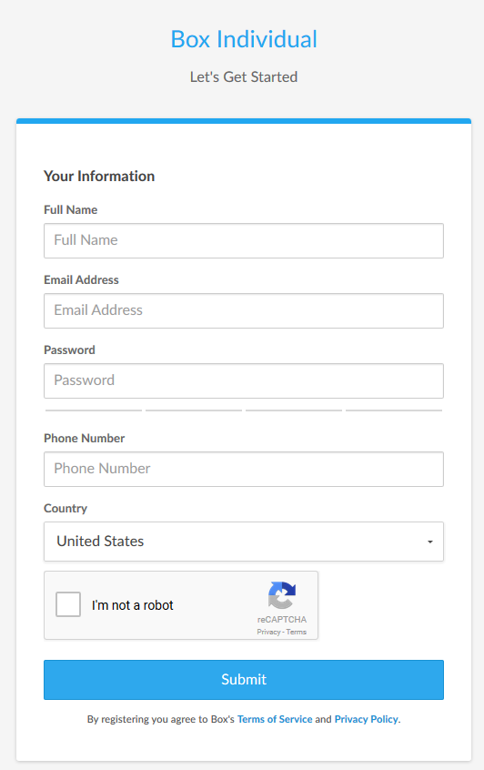
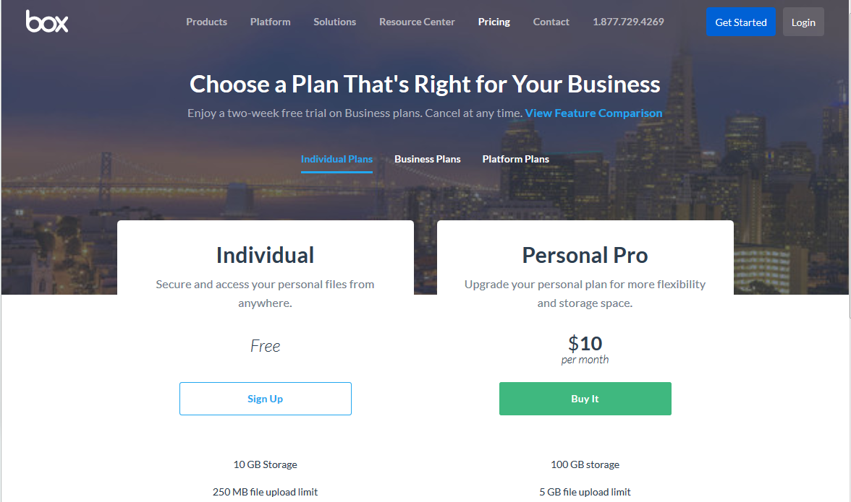
Create your BOX account in 6 Steps
12
1
Go to URL: https://www.box.com/home
Click on the “Get Started” button
Select “Individual Plans”
2
3
5
Complete the form
Send your user ID/email to:
cschultz@anl.gov *
4
6
* You may need to ask your IT group to grant you special access through
your site’s firewall to Box

Slide 13
We do quality software,
and we can prove it.
Chair: Vicki Pope (pope13@llnl.gov)
Vice Chair: Kary Cook (kary.cook@pnnl.gov)
Secretary: Bob Daudt (robert.daudt@pnnl.gov)

