Slide 1
EFCOG SQA Group Meeting
February 19, 2020
Chair: Vicki Pope (pope13@llnl.gov)
Vice Chair: Teri Vincent (teri.vincent@cns.doe.gov)
Secretary: Marylou Apodaca (marapod@sandia.gov)

Slide 2
Agenda
Announcements and Updates
EFCOG SQA Page Web Site Changes
Agenda for Spring Meeting
Task Group Updates & Members
Next Steps

Slide 3
Spring 2020 Meeting:
NEW DATE: March 31-April 2, 2020
Sandia; Albuquerque, NM
3
Announcements
and
Updates
REVCOM of DOE Guide 414.1-4 Revision Still Delayed
Toolbox Qualification of RESRAD Code Delayed Until Summer
Email Marylou Apodaca for Meeting Attendance
(Meeting credit for recertifications)
Any site Announcement or concerns?

Slide 4
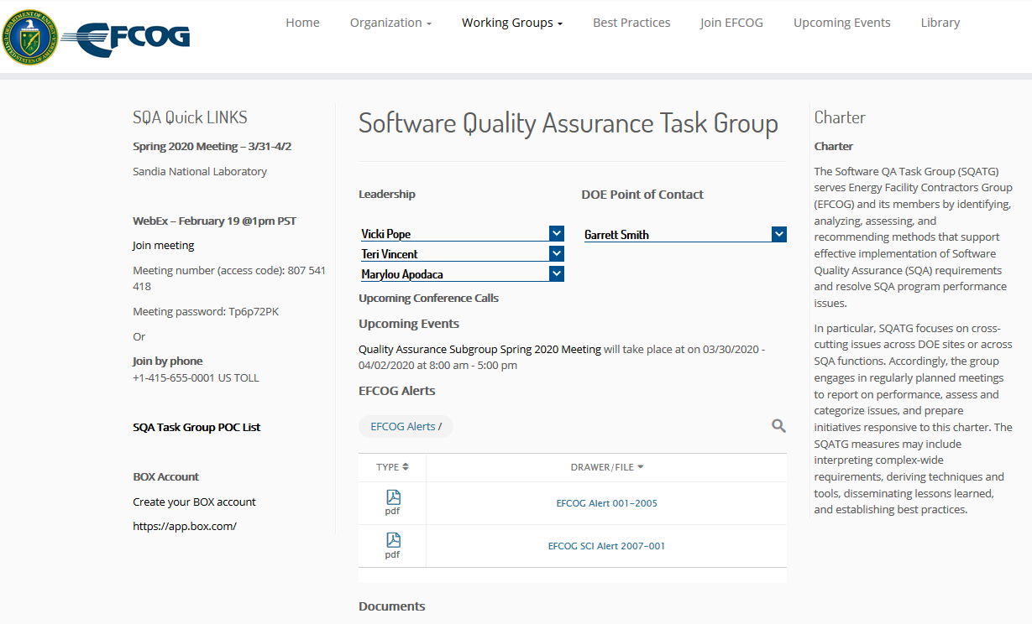
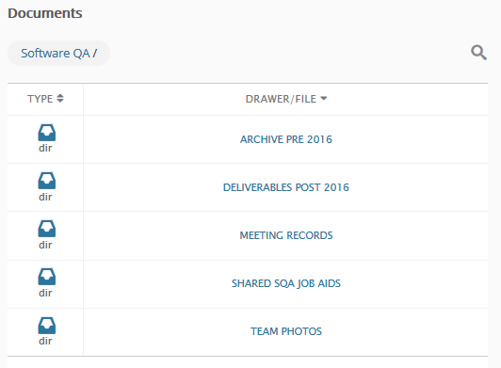
EFCOG SQA Web Site Changes
https://efcog.org/safety/quality-assurance-subgroup/software-quality-assurance-task-group/
Left Side-bar includes:
Upcoming Events
Box Information/Links
POC list
Pictures moved to folder under “Documents”
SQA Zip file contents under Archive Pre 2016
Folder for Shared Information
Reorganized Meeting Records to include host sites

Slide 5
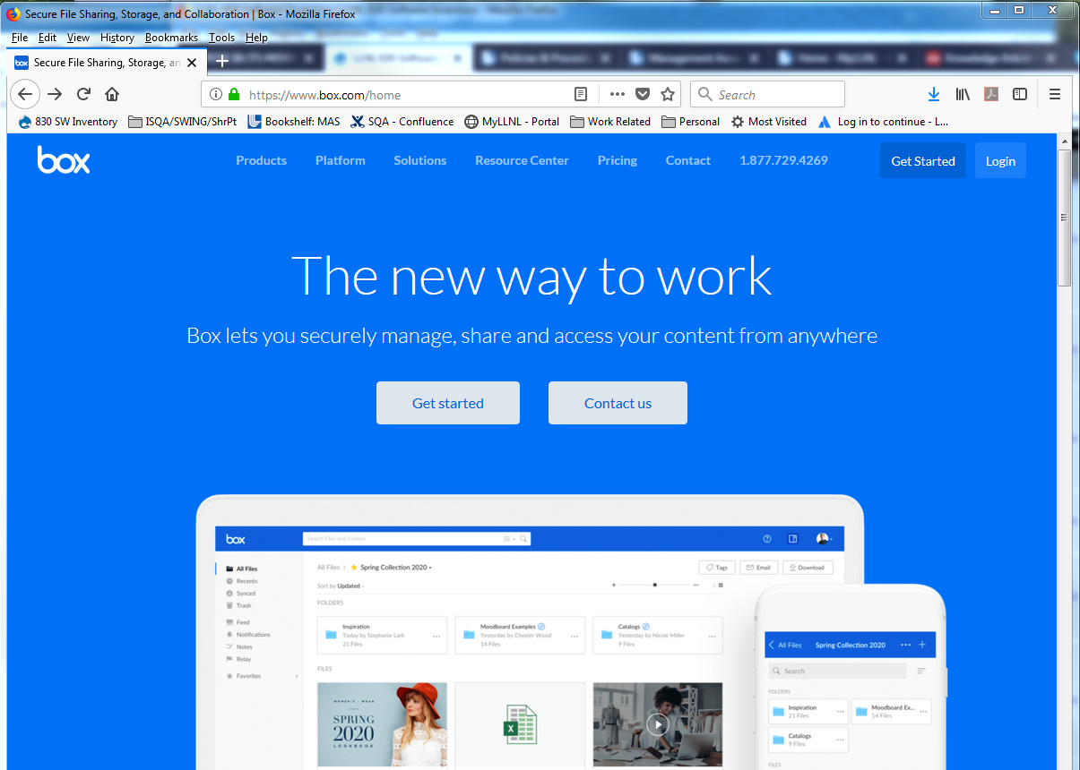
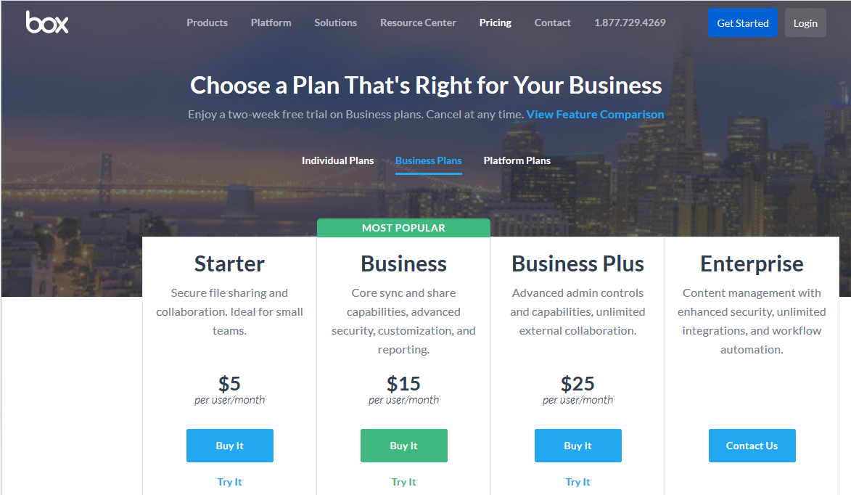
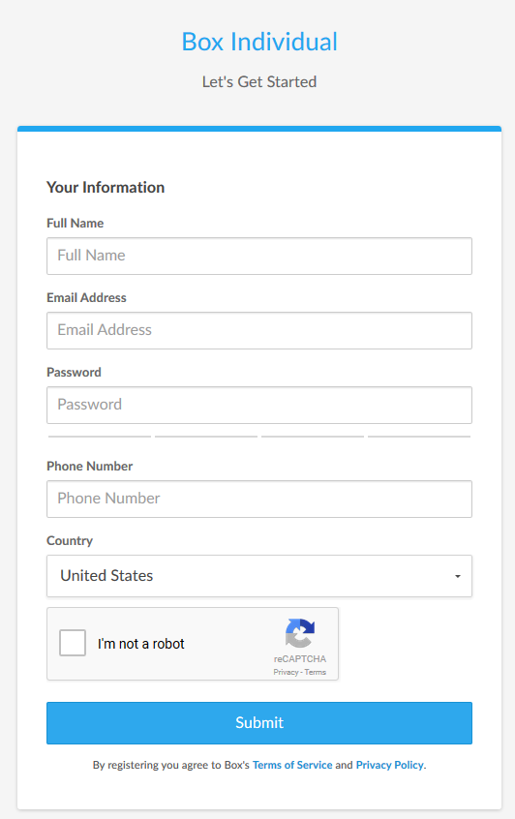
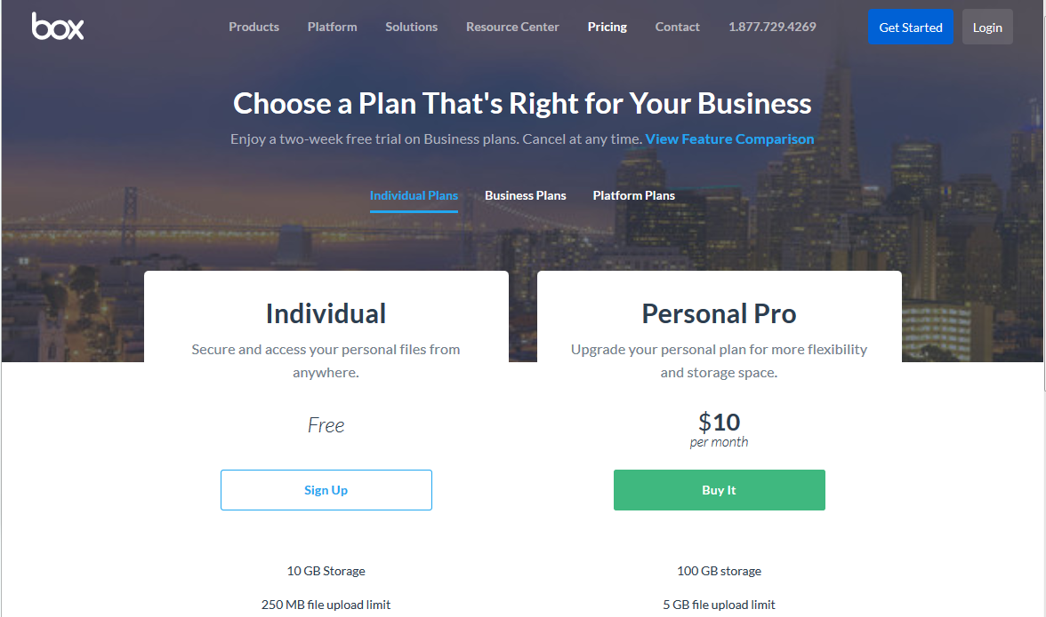
Create your BOX account in 6 Steps
5
1
Go to URL: https://www.box.com/home
Click on the “Get Started” button
Select “Individual Plans”
2
3
5
Complete the form
Send your user ID/email to:
cschultz@anl.gov *
4
6
* You may need to ask your IT group to grant you special access through
your site’s firewall to Box

Slide 6
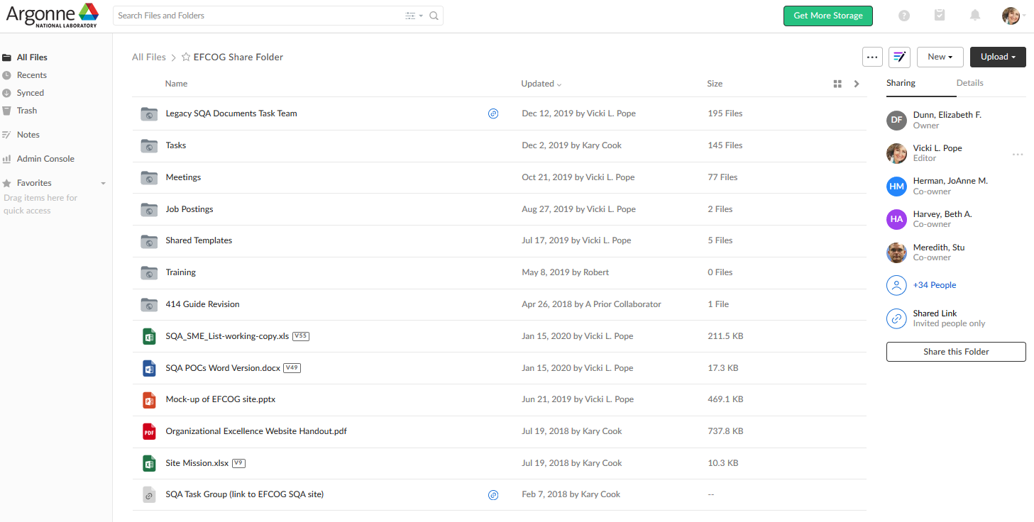
Click on the EFCOG Share Folder once you’ve logged in (box.com)
New Content
SQA POC Listing
Links
Job Postings (PNNL)
Spring 2020 Agenda
Word Version
Updates Needed
Add phone numbers
sqa Box Account Main page
6

Slide 7
Spring 2020 Face-to-Face Agenda Topics:
Software Gone Wrong (need volunteers to present examples)
RadCalc Assessment Debrief
Disagreeable Audit Findings (come prepared to discuss yours)
Task Group status updates (leaders, check in with your groups)
Exemptions for DOE O 470.6, Technical Security
Sandia Presentation (need volunteer from SNL and topic)
Current Pain Points and Set Agenda for WebExs and Fall Meeting

Slide 8
Spring 2020 Face-to-Face Agenda Topics:
Breakout groups to discuss/define/report on:
“Graded Approach”
Removing “nuclear” and including non-safety software
Scope of Safety Software Inventories
Alternate Standards to NQA-1
Vote on Definition of Software
Breakout groups to work on current sub-tasks (see slides 10 and 11)

Slide 9
Central Registry Toolbox Qualification: RESRAD
Assessment team: 4-5 Feds/Consultants + 2 SQA SMEs from Labs (requested from LANL, LLNL, PNNL, SNL for this particular code)
Code: RESRAD, Produced by Argonne National Lab
Time Commitment:
Assessment Activities Over 3-4 Months
July through Early October
Document Review and On-Site Interviews TBD
SQA SMEs responsible for
Configuration Management
Requirements
Design
Testing/Verification and Validation (“Fed” team members to V&V model used)
Lead in assessing and writing results for their assigned section(s)
Expenses/Costs – paid by team members’ sites

Slide 10
Task Updates
Toolbox Qualification Recommendations (Vicki Pope)
SW Checklists for Audits (Kary Cook)
Definition of Software (Marylou Apodaca)
EFCOG Zip File Review (Ashley Toth)
SQA Group Strategic Planning (Nathaniel Hein)
SCRUM to Work Activities Mapping (Stella McKirdy)
Cloud-based Hosting Whitepaper (Russell Swannack)
How to Manage Configurable Devices (Veronica Camarillo-Morris)
Matrix of SW-Effecting Orders and Policies (Gary Heidel)

Slide 11
Draft Definition of Software
Software which supports or affects the achievement or verification of regulatory, programmatic or statutory requirements. Such software includes:
Software which collects or analyzes data (i.e. data quality objectives) to be used for nuclear site section, characterization, or performance assessment
Software used for environmental protection, security, emergency management, occupational safety, nuclear criticality, waste management, design of waste packages, waste disposal and nuclear facilities, including radiological facilities
Software that resides on the same system (processor) as safety-critical software.
Software whose output impacts physical, functional, or operational requirements and whose use or failure to perform as intended cause or contribute to a hazard.
Additionally, software that is used to:
Perform safety basis calculations or to model nuclear operations
Provide control or mitigation for hazards.
Control safety-critical functions.
Process safety-critical commands or data.
Detect and report, or take corrective action, if the system reaches a specific hazardous state.
Mitigate damage if a hazard occurs.
Process data or analyze trends that lead directly to safety decisions (e.g., determining when to turn power off to a wind tunnel to prevent system destruction).
Provide full or partial verification or validation of safety-critical systems, including hardware or software subsystems.

Slide 12
Draft Definition of Software (cont.)
Programmatic Software:
Software that is used by an organization, i.e., the offices and people at all Field Installations and Headquarters, who support customers with policy, process, and standards development; oversight and insight; and technology development and transfer, in the disciplines of safety, reliability, maintainability, and quality.
Exempt Software: Software that meets the following criteria is exempt from the formal control requirements of this procedure:
Vendor-supplied software that is purchased with and integral to the operation of Measuring and Test Equipment (M&TE) is exempt from this procedure, provided the M&TE is tested and/or calibrated in accordance with applicable procedures and the software is not altered by the user organization, and where the functionality of the system is demonstrated through calibration over the operational range.
System software (e.g., operating systems, administrative and management systems, system utilities, compilers, assemblers, translators, interpreters, query languages, word processing programs, database managers, and graphing programs) or other software that does not generate data that are used in the formulation of conclusions.
Spreadsheets or other system software applications (e.g., Mathcad) which do produce quality data are exempted from this procedure if the results are wholly incorporated into technical reports, calculation notes or other documentation where the calculations, mathematical formulas, and input data can be exactly verified during the technical review of the report. Such calculations are treated as and considered to be manual calculations because the assumptions, formulas, inputs and outputs are verified as part of the calculation package technical review.
Configurable Software applications that are not quality-related, such as PLC software configured to start and control pumps, blowers, or other commercial products, where software failure will not affect project objectives or mission performance.
Software that has no impact on safety, security or business risk. If the software fails is not available or if the software produces invalid information these conditions will not impact safety, security or business. Example: Office Coffee Fund, tracking and trending, may be used as input decisions-administrative spreadsheets.

Slide 13
Task Team Members
SQA Strategic Planning
Nathaniel Hein, LANL (lead)
Marylou Apodaca, SNL
James Hylko, Paducah
Greg Smith, LANL
Teri Vincent, Y-12 / Pantex
SQA Checklists
Kary Cook, PNNL (lead)
Pat Auer, LLNL
Jeni Turgeon, SNL
Cloud-based Hosting Software
Russell Swannack, PNNL (lead)
Vicki Pope, LLNL
Ashley Toth, Hanford
Definition of Software
Marylou Apodaca, SNL (lead)
Sid Ailes, Atkins
Faith Girolamo, SRS
Cristy Renner, Ports
Pat Nakagawa, CNS/Y-12
Jeni Turgeon, SNL
EFCOG Zip File Review
Ashley Toth, Hanford (lead)
Kary Cook, PNNL
Dave Thoman, Amentum
Toolbox Qualification
Vicki Pope, LLNL (lead)
Cliff Glantz, PNNL
Roger Lanning (Hanford)
Keith Morrell, NNSS
Carol Olijar, ANL
Russell Swannack, PNNL
Dave Thoman, Amentum
Ashley Toth, Hanford
Configurable Devices
Veronica Camarillo-Morris, LANL (lead)
Lance Abbott, SRS
Christy Renner, PORTS
SW-Effecting Orders
Gary Heidel, ETTP (lead)
Clyde Armstrong, Tru Project
Vicki Pope, LLNL
SCRUM to WA Mapping
Stella McKirdy, INL (lead)
Sid Ailes, Atkins
Kary Cook, PNNL
Carol Olijar, ANL
Jeni Turgeon, SNL

Slide 14
Next Steps
Volunteer to present your site’s tool/process
10 minutes or less (contact Vicki, Teri or Marylou)
Task Groups to meet prior to Spring Face-to-Face
No WebEx in March, but one in April
Volunteer for Sub-Task Groups
Load sharable document templates, job aids, and SQA-related job postings to Box site
Register for Spring 2020 Face-to-Face

Slide 15
We do quality software,
and we can prove it.
Chair: Vicki Pope (pope13@llnl.gov)
Vice Chair: Teri Vincent (teri.vincent@cns.doe.gov)
Secretary: Marylou Apodaca (marapod@sandia.gov)

