Slide 1
EFCOG SQA Group Meeting
April 15, 2020
Chair: Vicki Pope (pope13@llnl.gov)
Vice Chair: Teri Vincent (teri.vincent@cns.doe.gov)
Secretary: Marylou Apodaca (marapod@sandia.gov)

Slide 2
Agenda
Announcements and Updates
Task Group Updates & Discussion
Prioritization of Subtasks and Other Issues
Exemptions from DOE O 470.6, Technical Information Security
Next Steps

Slide 3
Work-From-Home Good Practices
Fall 2020 Meeting:
November 30-December 3, 2020
NNSS; Las Vegas, NV
3
Announcements
and
Updates
REVCOM of DOE Guide 414.1-4 Revision Still Delayed
Toolbox Qualification of RESRAD Code Delayed Until Summer?
PNNL Job Posting at Marine Sciences Lab, Sequim, WA – ICP/MS Analyst
Email Marylou Apodaca for Meeting Attendance
(Meeting credit for recertifications)
Any site Announcement or concerns?

Slide 4
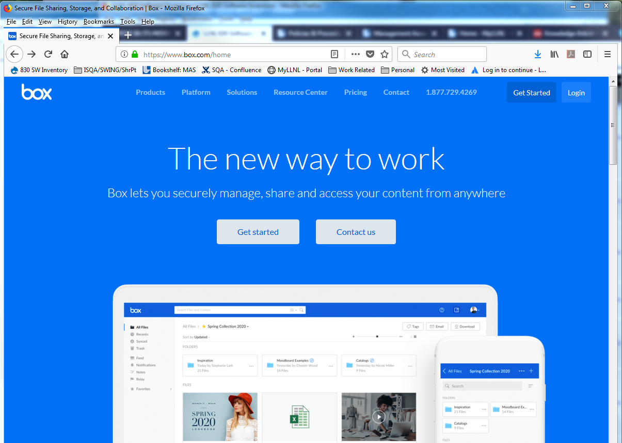
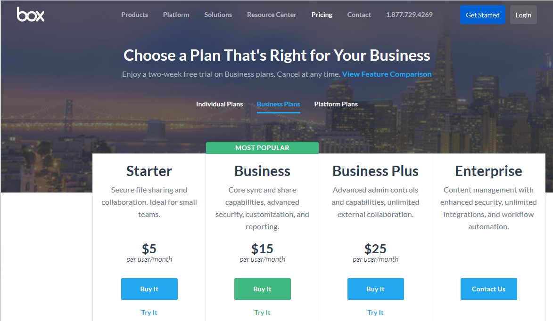
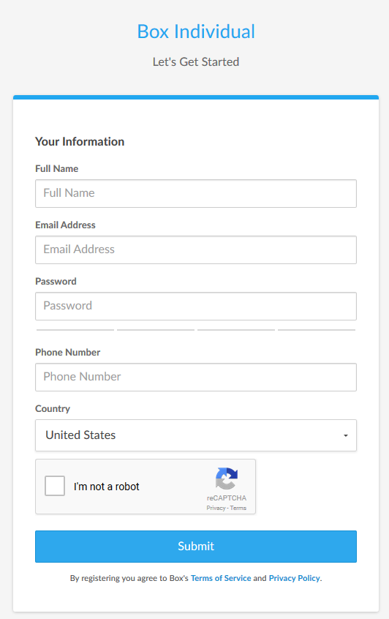
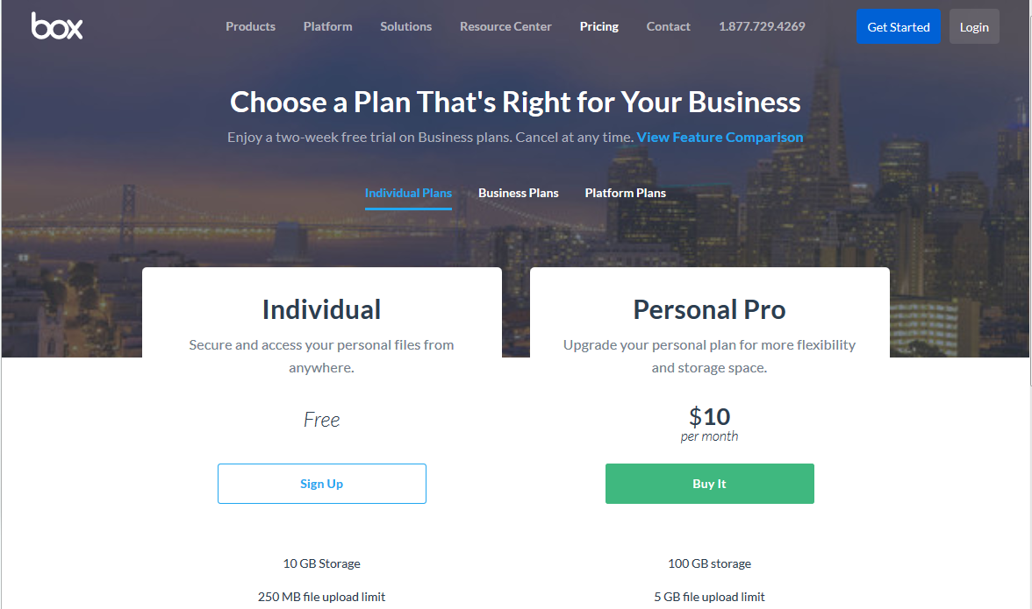
Create your BOX account in 6 Steps
4
1
Go to URL: https://www.box.com/home
Click on the “Get Started” button
Select “Individual Plans”
2
3
5
Complete the form
Send your user ID/email to:
cschultz@anl.gov *
4
6
* You may need to ask your IT group to grant you special access through
your site’s firewall to Box

Slide 5
Task Updates
SQA Checklists for Audits (Kary Cook)
Definition of Software (Marylou Apodaca)
SQA Group Strategic Planning (Nathaniel Hein)
SCRUM to Work Activities Mapping (Stella McKirdy)
Cloud-based Hosting Whitepaper (Russell Swannack)
How to Manage Configurable Devices (Veronica Camarillo-Morris)
Matrix of SW-Effecting Orders and Policies (Gary Heidel)
Toolbox Qualification Recommendations (Vicki Pope)

Slide 6
Task Team Members
SQA Strategic Planning
Nathaniel Hein, LANL (lead)
Marylou Apodaca, SNL
James Hylko, Paducah
Greg Smith, LANL
Teri Vincent, Y-12 / Pantex
SQA Audit Checklists
Kary Cook, PNNL (lead)
Pat Auer, LLNL
Jeni Turgeon, SNL
Cloud-based Hosting Software
Russell Swannack, PNNL (lead)
Vicki Pope, LLNL
Ashley Toth, Hanford
Definition of Software
Marylou Apodaca, SNL (lead)
Sid Ailes, Atkins
Faith Girolamo, SRS
Cristy Renner, Ports
Pat Nakagawa, CNS/Y-12
Jeni Turgeon, SNL
Toolbox Qualification
Vicki Pope, LLNL (lead)
Cliff Glantz, PNNL
Roger Lanning (Hanford)
Keith Morrell, NNSS
Carol Olijar, ANL
Russell Swannack, PNNL
Dave Thoman, Amentum
Ashley Toth, Hanford
Configurable Devices
Veronica Camarillo-Morris, LANL (lead)
Lance Abbott, SRS
Christy Renner, PORTS
SW-Effecting Orders
Gary Heidel, ETTP (lead)
Clyde Armstrong, Tru Project
Vicki Pope, LLNL
SCRUM to WA Mapping
Stella McKirdy, INL (lead)
Sid Ailes, Atkins
Kary Cook, PNNL
Carol Olijar, ANL
Jeni Turgeon, SNL

Slide 7
EFCOG SQA Subtasks and Issues
Toolbox Qualification Streamlining Recommendations
SQA Checklist for Vendor Audits
Work Activities to SCRUM Mapping
Strategic Planning
Cloud-Hosted Software White Paper
Management of Configurable Devices
414: Matrix of Orders and Policies Effecting SQA
414: Definition of Software
414: Definition of Graded Approach
414: De-emphasizing “nuclear” to better expand 414 to “all” software for application of QA criteria
414: Alternate Standard(s) to NQA-1
414: How to enforce 414 for Non-Safety Software
414: List of what works and what doesn’t in current version of 414 (in relation to software)
414: Integration of 414 to other DOE orders for software (200.1A, 205.1C, etc.)
414: Current requirements are geared more toward hardware; how to modify to they better fit sw
414: Scope of Safety Software Inventories
414: Exemptions and how to record/control them? What do they still need to do?
414: How to legitimize tool use for records/evidence of conformance
Other: Bad audit findings – why bad; how to make them better
Other: Audits too compliance based, not enough performance based? How to “fix”?
7

Slide 8
DOE O 414 Issues Refined by AU-32
Matrix of Orders and Policies Effecting SQA – initial matrix drafted [feeds bullet 8]
Definition of Software: 414 defines it differently than DOE O 200.1A; Nuclear safety software, quality-affecting software, non-safety software are all examples of software, which according to DOE Order 414.1D has to meet the criteria in Attachment 2. So, what is software? need a common, “simple” definition
Definition of Graded Approach, what about additional requirements for graded approach too? Like you can’t grade requirements, no grading to zero, etc.
Re-emphasizing quality assurance De-emphasizing “nuclear” to better clarify 414 to all software for application of 10 QA criteria
Alternate Standard(s) for software quality assurance to NQA-1
How to clarify applicability of 414 for all Software
List of what works and what doesn’t in current version of 414 (in relation to software)
Integration of 414 to other DOE orders for software (200.1A, 205.1C, etc.)
Current requirements are geared more toward traditional hardware (i.e., valves, bolts, etc.). How do we clarify them so they better apply to software?
Scope of Safety Software Inventories [not sure I remember what this was about, but ok with having the discussion]
Exemptions and how to record/control them? What do they still need to do?
How to legitimize tool use for records/evidence of conformance

Slide 9
DOE O 470.6 Technical Information Security
EFCOG presentation April 2020

Slide 10
Purpose
This Order implements the DOE Technical Security Program (TSP).
This program represents the convergence of two distinct disciplines: Counterintelligence (CI) and Security Countermeasures.
Compliments DOE 250.1B Cyber Security

Slide 11
How to handle claims for exemption
Customers trying to claim exemption based on 470.6
Discussion with author of DOE O 470.6 (Sam Soley)
Never intended as wholesale exemption from SQA
Could see how one would not want much information (e.g., description of what/how the software functions) available to many

Slide 12
CNS Solution
Limited information in software inventory:
Enter into SQA inventory with cryptic information (e.g., obscure name, etc.)
Configuration Management Plan that describes:
How change is managed
Location of documentation (design, testing, etc.) in a designated document management system
Contact information

Slide 13
Next Steps
Volunteer to present your site’s tool/process
10 minutes or less (contact Vicki, Teri or Marylou)
New Task Groups to meet prior to May WebEx
Volunteer for Sub-Task Groups
Load sharable document templates, job aids, and SQA-related job postings to Box site

Slide 14
We do quality software,
and we can prove it.
Chair: Vicki Pope (pope13@llnl.gov)
Vice Chair: Teri Vincent (teri.vincent@cns.doe.gov)
Secretary: Marylou Apodaca (marapod@sandia.gov)

