Slide 1
EFCOG SQA Group Meeting
May 20, 2020
Chair: Vicki Pope (pope13@llnl.gov)
Vice Chair: Teri Vincent (teri.vincent@cns.doe.gov)
Secretary: Marylou Apodaca (marapod@sandia.gov)

Slide 2
Agenda
Announcements and Updates
Task Group Updates & Discussion
DOE O 414.1E Task Groups
PNNL Project Safety Software Audit Review
Next Steps

Slide 3
Work-From-Home Good Practices
3
Fall 2020 Meeting:
November 30-December 3, 2020
NNSS; Las Vegas, NV
Announcements
and
Updates
REVCOM of DOE Guide 414.1-4 Revision – Duli Argarwal
Toolbox Qualification of RESRAD Code Delayed Until Summer?
Email Marylou Apodaca for Meeting Attendance
(Meeting credit for recertifications)
Any site Announcement or concerns?

Slide 4
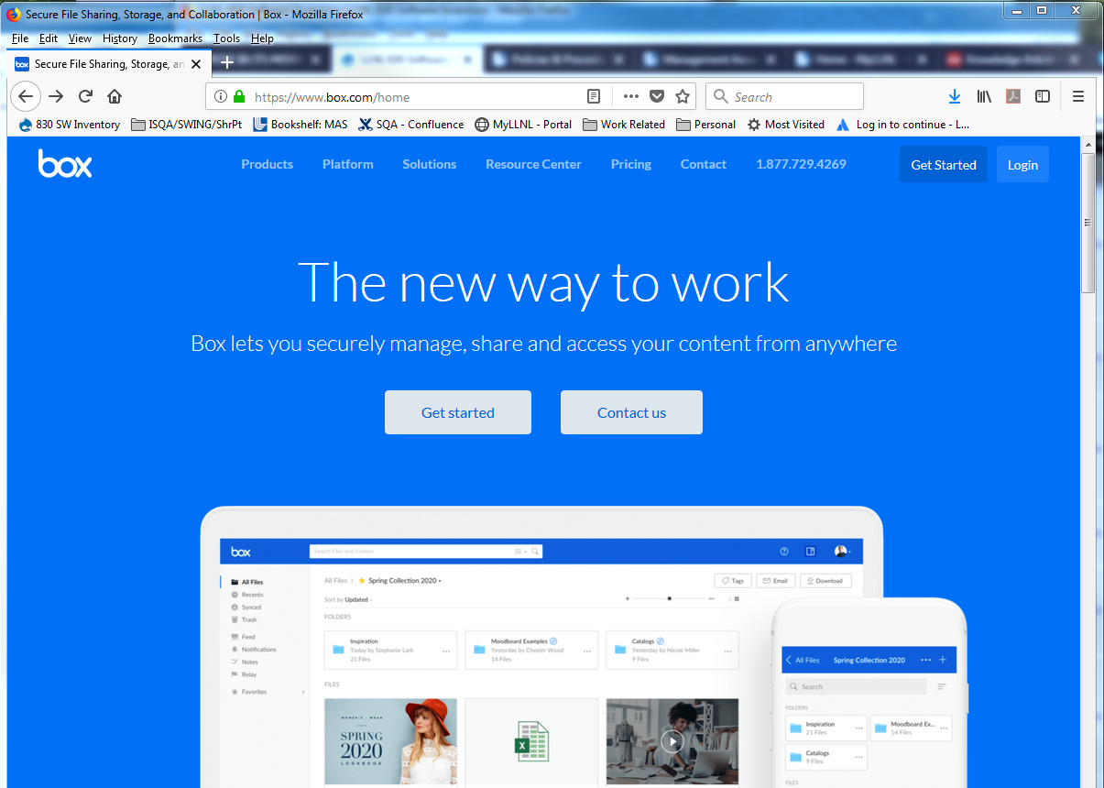
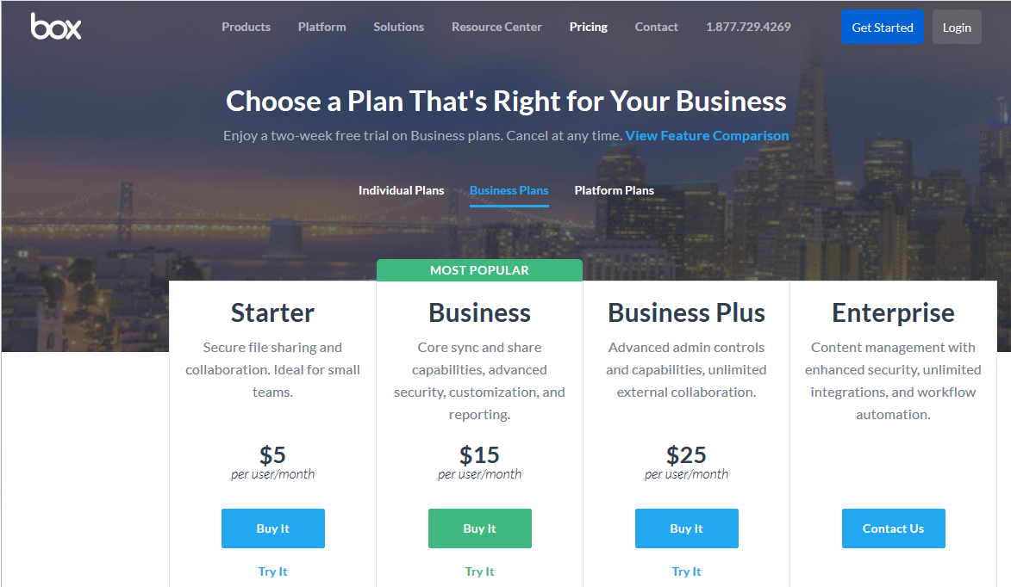
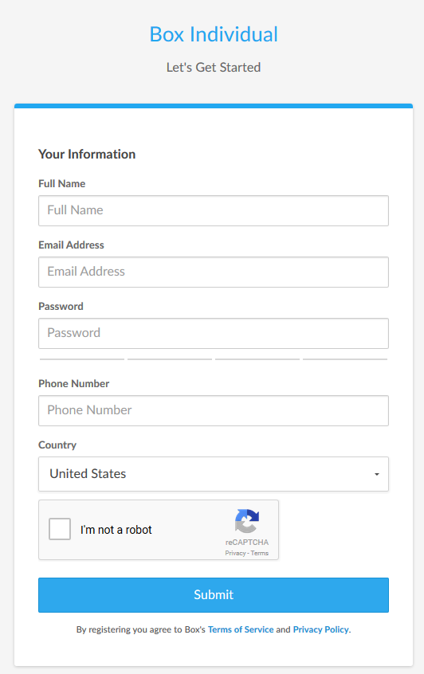
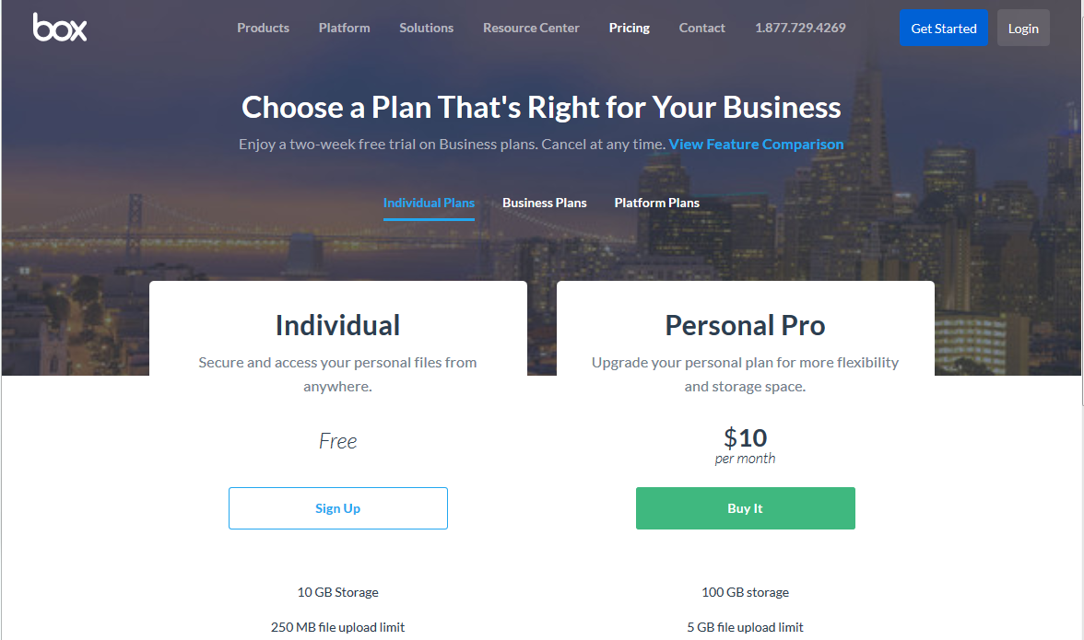
Create your BOX account in 6 Steps
4
1
Go to URL: https://www.box.com/home
Click on the “Get Started” button
Select “Individual Plans”
2
3
5
Complete the form
Send your user ID/email to:
cschultz@anl.gov *
4
6
* You may need to ask your IT group to grant you special access through
your site’s firewall to Box

Slide 5
Task Updates
SQA Checklists for Audits (Pat Auer)
Definition of Software (Marylou Apodaca)
SQA Group Strategic Planning (Nathaniel Hein)
Cloud-based Hosting Whitepaper (Russell Swannack)
How to Manage Configurable Devices (Veronica Camarillo-Morris)
Toolbox Qualification Recommendations (Vicki Pope)

Slide 6
Definition of Software
Software is a set of instructions, data and/or programs used to operate computers and/or hardware to perform quality affecting activities.
Examples include:
Controls production process or equipment
Controls testing or inspection process or equipment
Controls the calibration of standards and measurement devices
Provides data files to support manufacturing, inspection, test, and/or acceptance parameters/records
Supports the analysis of materials
Supports embedded applications include vendor-supplied firmware and/or firmware developed at DOE sites which can be changed or programmed and that could potentially affect processes
Provides analysis capability to determine acceptability of products or parts
Supports programmatic analysis or design
Simple and easily understood software-includes utility calculations that do not fall directly under the Commercial off the Shelf (COTS) GOTS (Government off the Shelf) or developed software and if the software is a calculation, results can be verified by hand calculation.
Software whose output results in mistakes or use of data that cause incorrect results that affect (impact) the physical, functional, or operational requirements of configuration
Software used to meet a regulatory requirement

Slide 7
Task Team Members
SQA Strategic Planning
Nathaniel Hein, LANL (lead) – nhein@lanl.gov
Marylou Apodaca, SNL
James Hylko, Paducah
Greg Smith, LANL
Teri Vincent, Y-12 / Pantex
SQA Audit Checklists
Pat Auer, LLNL (lead) – auer2@llnl.gov
Jeni Turgeon, SNL
Cloud-based Hosting Software
Russell Swannack, PNNL (lead) - Russell.Swannack@pnnl.gov
Vicki Pope, LLNL
Ashley Toth, Hanford
Definition of Software
Marylou Apodaca, SNL (lead) – marapod@sandia.gov
Sid Ailes, Atkins
Faith Girolamo, SRS
Cristy Renner, Fluor BWXT
Pat Nakagawa, CNS/Y-12
Jeni Turgeon, SNL
Toolbox Qualification
Vicki Pope, LLNL (lead) – pope13@llnl.gov
Cliff Glantz, PNNL
Roger Lanning (Hanford)
Keith Morrell, NNSS
Carol Olijar, ANL
Russell Swannack, PNNL
Dave Thoman, Amentum
Ashley Toth, Hanford
Configurable Devices
Veronica Camarillo-Morris, LANL (lead) – vcamari@lanl.gov
Lance Abbott, SRS
Christy Renner, Fluor BWXT

Slide 8
DOE O 414.1E Tasks
Better Application To “All” Software
Re-emphasize quality assurance to better clarify DOE O 414 to “all” software for application of QA criteria
How to clarify applicability of DOE O 414 to all software
Current requirements are geared more toward traditional hardware. How to clarify so they better apply to sw?
Current DOE O 414 Pain Points
Create a list of what works, what doesn’t, and what is confusing in current version in relation to software.
Software-Relevant DOE Orders
Matrix of Orders, Policies, and Guides with software requirements.
How to better integrate 414 with other DOE orders (e.g., 200.1A, 205.1C, etc.) and clarify areas that seem to contradict.
Better Definition of Software
Definition of Graded Approach
Standard(s) for Software
7

Slide 9
414 Task Team Members
Better Application to “ALL”
LEAD???
Pat Auer, LLNL
Veronica Camarillo-Morris, LANL
Stella McKirdy, INL
Current 414 Pain Points
LEAD????
Members????
Cloud-based Hosting Software
Russell Swannack, PNNL (lead) – Russell.Swannack@pnnl.gov
Orlando Ferrer, RL
Vicki Pope, LLNL
Ashley Toth, Hanford
Definition of Software
Marylou Apodaca, SNL (lead) – marypod@sandia.gov
Sid Ailes, Atkins
Faith Girolamo, SRS
Cristy Renner, Ports
Pat Nakagawa, CNS/Y-12
Jeni Turgeon, SNL
Software-Relevant Orders
LEAD????
Clyde Armstrong, Tru Project
Vicki Pope, LLNL
Graded Approach for Software
LEAD????
Marylou Apodaca, SNL
Jeni Turgeon, SNL (?)
7
Standard for Software
LEAD????
Cristy Renner, Fluor BWXT (?)

Slide 10
Next Steps
Volunteer to present your site’s tool/process
10 minutes or less (contact Vicki, Teri or Marylou)
Task Groups to meet prior to June WebEx
Volunteer for Sub-Task Groups
Load sharable document templates, job aids, and SQA-related job postings to Box site

Slide 11
We do quality software,
and we can prove it.
Chair: Vicki Pope (pope13@llnl.gov)
Vice Chair: Teri Vincent (teri.vincent@cns.doe.gov)
Secretary: Marylou Apodaca (marapod@sandia.gov)

