Slide 1
EFCOG SQA Group Meeting
June 17, 2020
Chair: Vicki Pope (pope13@llnl.gov)
Vice Chair: Teri Vincent (teri.vincent@cns.doe.gov)
Secretary: Marylou Apodaca (marapod@sandia.gov)

Slide 2
Agenda
Announcements and Updates
DOE Organizational Excellence Forums
Task Group Updates & Discussion
DOE O 414.1E Task Groups
Discuss Pain Points of DOE O 414.1D
Next Steps

Slide 3
Fall 2020 Meeting:
November 30-December 3, 2020
NNSS; Las Vegas, NV
3
Announcements
and
Updates
Justification for Revision to DOE O 414 – Duli Agarwal
REVCOM of DOE Guide 414.1-4 Revision – Duli Agarwal
Email Marylou Apodaca for Meeting Attendance
(Meeting credit for recertifications)
Other site announcements?

Slide 4
EFCOG Award of Excellence
Congratulations, Sid Ailes!
Sid was selected to receive an Award of Excellence for his contributions to EFCOG.
The award was announced during the EFCOG 2020 Annual Meeting via teleconference on June 3, 2020

Slide 5
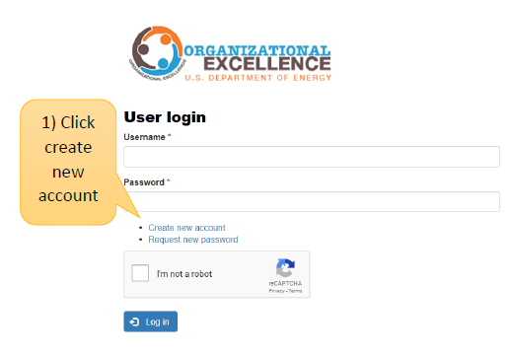
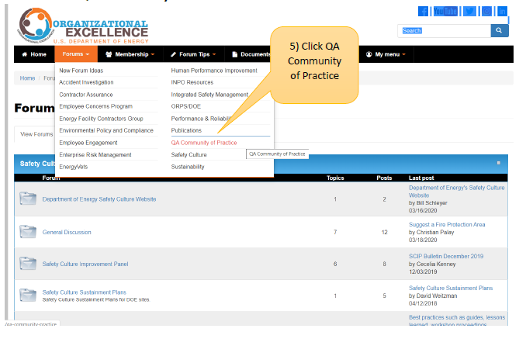
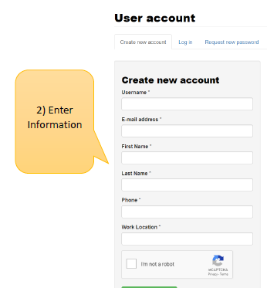
DOE Organizational Excellence Forums
https://orgex.energy.gov/
3
Identify Christian Palay as sponsor if needed

Slide 6
2019 Sub-Tasks Update
SQA Checklists for Audits (Pat Auer – WHITEPAPER IN REVIEW until 6/19/2020)
Toolbox Qualification Recommendations (Vicki Pope – WHITEPAPER IN REVIEW until 6/25/2020)
SQA Group Strategic Planning (Nathaniel Hein – TASK TEMPLATE CREATED)
Cloud-based Hosting Whitepaper (Russell Swannack – WHITEPAPER IN DRAFT)
How to Manage Configurable Devices (Veronica Camarillo-Morris – SUB-TASK ON HOLD)

Slide 7
DOE O 414.1E Tasks
Better Application To “All” Software
Re-emphasize quality assurance to better clarify DOE O 414 to “all” software for application of QA criteria
How to clarify applicability of DOE O 414 to all software
Current requirements are geared more toward traditional hardware. How to clarify so they better apply to sw?
Current DOE O 414 Pain Points
Create a list of what works, what doesn’t, and what is confusing in current version in relation to software.
Software-Relevant DOE Orders
Matrix of Orders, Policies, and Guides with software requirements.
How to better integrate 414 with other DOE orders (e.g., 200.1A, 205.1C, etc.) and clarify areas that seem to contradict.
Better Definition of Software – DRAFT READY FOR REVIEW
Definition of Graded Approach
Standard(s) for Software
7

Slide 8
Definition of Software
Software is a set of instruction, data and/or programs used to operate computers and/or hardware.
Vs.
Software is a set of instruction, data and/or programs used to operate computers and/or hardware to perform quality affecting activities.

Slide 9
Examples of Software
Controls production process or equipment
Controls testing or inspection process or equipment
Controls the calibration of standards and measurement devices
Provides data files to support manufacturing, inspection, test, and/or acceptance parameters/records
Supports the analysis of materials
Supports embedded applications include vendor-supplied firmware and/or firmware developed at DOE sites which can be changed or programmed and that could potentially affect processes
Provides analysis capability to determine acceptability of products or parts
Supports programmatic analysis or design
Simple and easily understood software-includes utility calculations that do not fall directly under the Commercial off the Shelf (COTS) GOTS (Government off the Shelf) or developed software and if the software is a calculation, results can be verified by hand calculation.
Software whose output results in mistakes or use of data that cause incorrect results that affect (impact) the physical, functional, or operational requirements of configuration
Software used to meet a regulatory requirement

Slide 10
414 Task Team Members
Better Application to “ALL”
Pat Auer, LLNL (lead) – auer2@llnl.gov
Marylou Apodaca, SNL
Veronica Camarillo-Morris, LANL
Stella McKirdy, INL
Current 414 Pain Points
LEAD????
Members????
Cloud-based Hosting Software
Russell Swannack, PNNL (lead) – Russell.Swannack@pnnl.gov
Lisa Cooper, Paducah
Orlando Ferrer, RL
Vicki Pope, LLNL
Definition of Software
Marylou Apodaca, SNL (lead) – marapod@sandia.gov
Sid Ailes, Atkins
Faith Girolamo, SRS
Cristy Renner, Fluor BWXT
Pat Nakagawa, CNS/Y-12
Jeni Turgeon, SNL
Software-Relevant Orders
LEAD????
Annette Coonfield, WRPS
Clyde Armstrong, Tru Project
Vicki Pope, LLNL
Graded Approach for Software
Lance Abbott, SRS (co-lead)
Jeni Turgeon, SNL (co-lead)
Marylou Apodaca, SNL
7
Standard for Software
LEAD????
Cristy Renner, Fluor BWXT
Dave Thoman, Amentum

Slide 11
Group Discussions
Importance of Participation in Sub-tasks and Meeting Discussions/eMails
Pain Points of DOE Order 414.1D

Slide 12
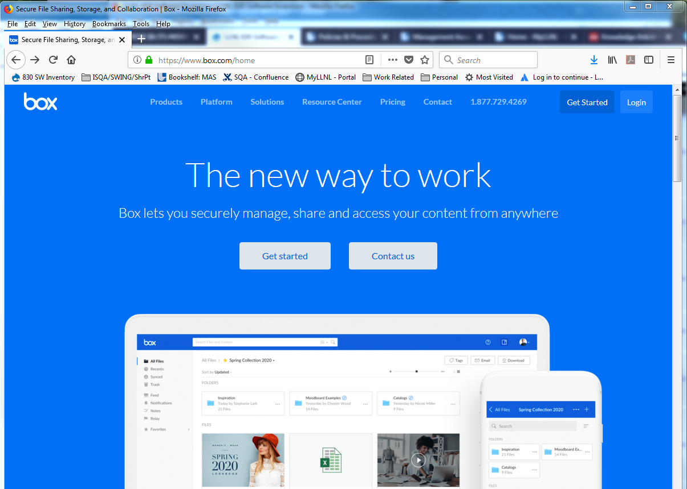
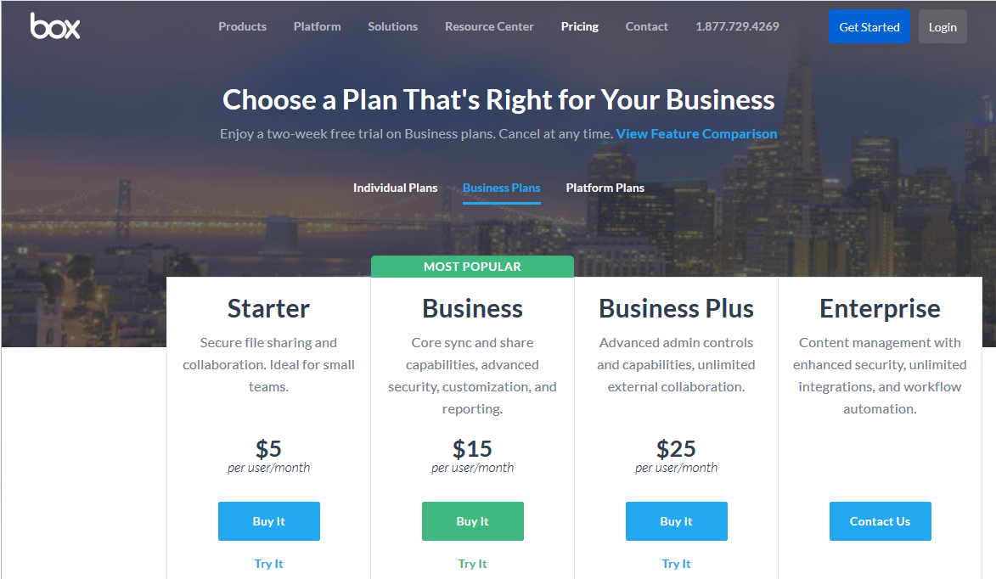
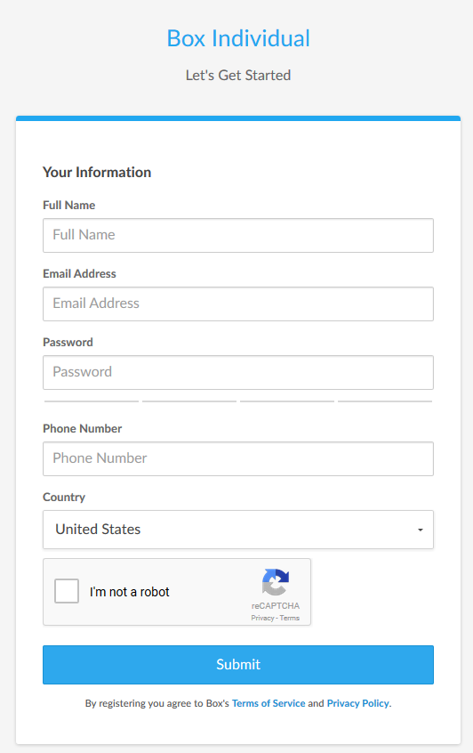
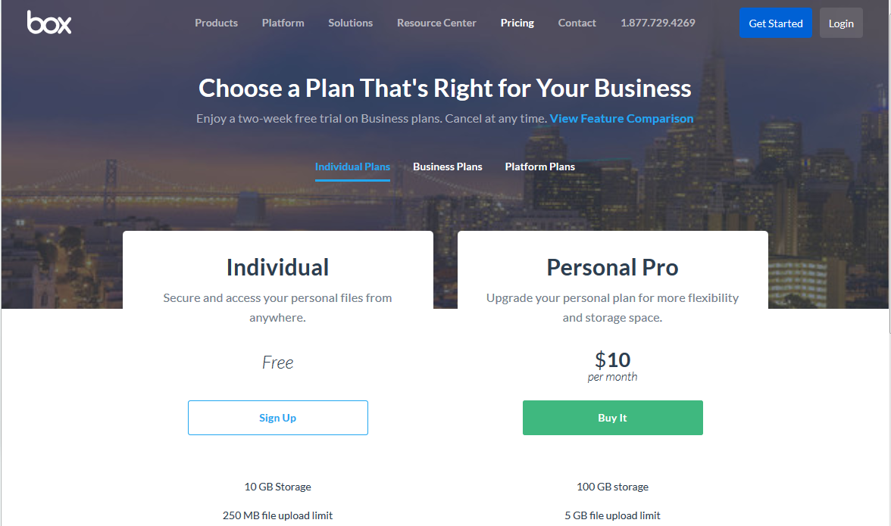
Create your BOX account in 6 Steps
12
1
Go to URL: https://www.box.com/home
Click on the “Get Started” button
Select “Individual Plans”
2
3
5
Complete the form
Send your user ID/email to:
cschultz@anl.gov *
4
6
* You may need to ask your IT group to grant you special access through
your site’s firewall to Box

Slide 13
Next Steps
Volunteer to present your site’s tool/process
10 minutes or less (contact Vicki, Teri or Marylou)
Task Groups to meet prior to July WebEx
Volunteer for Sub-Task Groups
Load sharable document templates, job aids, and SQA-related job postings to Box site

Slide 14
We do quality software,
and we can prove it.
Chair: Vicki Pope (pope13@llnl.gov)
Vice Chair: Teri Vincent (teri.vincent@cns.doe.gov)
Secretary: Marylou Apodaca (marapod@sandia.gov)

