Slide 1
EFCOG SQA Group Meeting
July 15, 2020
Chair: Vicki Pope (pope13@llnl.gov)
Vice Chair: Teri Vincent (teri.vincent@cns.doe.gov)
Secretary: Marylou Apodaca (marapod@sandia.gov)

Slide 2
Agenda
Announcements and Updates
DOE Organizational Excellence Forums
Task Group Updates & Discussion
Discuss Pain Points of DOE O 414.1D
Next Steps

Slide 3
Fall 2020 Meeting:
November 30-December 3, 2020
NNSS; Las Vegas, NV
3
Continued Work-From-Home – Follow your site/state guidance
Announcements
and
Updates
REVCOM of DOE Guide 414.1-4 Revision & Justification for Order 414 Update – Duli Agarwal
AU-30 SQA Position Openings –
Gen Engineer: https://www.usajobs.gov/GetJob/ViewDetails/546803700 Physical Scientist: https://www.usajobs.gov/GetJob/ViewDetails/546797100
Email Marylou Apodaca for Meeting Attendance
(Meeting credit for recertifications)
RESRAD Toolbox Code Assessment – Anticipate conducting remotely ~ Fall 2020

Slide 4
2019 Sub-Tasks Update
SQA Checklists for Audits (Completed)
Toolbox Qualification Recommendations (Completed)
SQA Group Strategic Planning (Completed)
Cloud-based Hosting Whitepaper (WHITE PAPER IN DRAFT)
How to Manage Configurable Devices (On HOLD)

Slide 5
DOE O 414.1E Sub-Tasks Update
Better Application To “All” Software (Pat Auer, LLNL, Leader)
Current DOE O 414 Pain Points (Kamie Hopper, SNL, Leader)
Software-Relevant DOE Orders (Annette Coonfield, WRPS, Leader)
Better Definition of Software (Marylou Apodaca, SNL, Leader - WHITE PAPER IN DRAFT)
Definition of Graded Approach (Lance Abbott, SRS/Jeni Turgeon, SNL, Co-leaders)
Standard(s) for Software (Cristy Renner, Fluor BWXT, Leader)
5

Slide 6
414 Task Team Members
6
Definition of Software
Marylou Apodaca, SNL (Lead) – marapod@sandia.gov
Sid Ailes, Atkins
Faith Girolamo, SRS
Cristy Renner, Fluor BWXT
Pat Nakagawa, CNS/Y-12
Jeni Turgeon, SNL
Better Application to “ALL”
Pat Auer, LLNL (Lead) – auer2@llnl.gov
Marylou Apodaca, SNL
Veronica Camarillo-Morris, LANL
Stella McKirdy, INL
Graded Approach for Software
Lance Abbott, SRS (co-lead) – lance.abbott@srs.gov
Jeni Turgeon, SNL (co-lead) – jturgeo@sandia.gov
Marylou Apodaca, SNL
Current 414 Pain Points
Kamie Hopper, SNL (Lead) – kmhoppe@sandia.gov
EFCOG SQA Group Members
Software-Relevant Orders
Annette Coonfield, WRPS (Lead) – Annette_e_coonfield@rl.gov
Clyde Armstrong, Tru Project
Faith Girolamo, SRS
Vicki Pope, LLNL
Standard for Software
Cristy Renner, Fluor BWXT (Lead) - cristy.renner@ports.pppo.gov
Faith Girolamo, SRS
Kamie Hopper, SNL
Dave Thoman, Amentum
Cloud-based Hosting Software
Russell Swannack, PNNL (lead) – Russell.Swannack@pnnl.gov
Lisa Cooper, Paducah
Orlando Ferrer, RL
Vicki Pope, LLNL

Slide 7
Pain Points of DOE Order 414.1D (Group Discussion)
Issue #1:
General Discussion
Possible Solution/Change
Pros and Cons of solution
Interdependencies and Assumptions

Slide 8
414 Pain Points: Definitions
Assessment
Configuration Management
Item
Verification
Validation

Slide 9
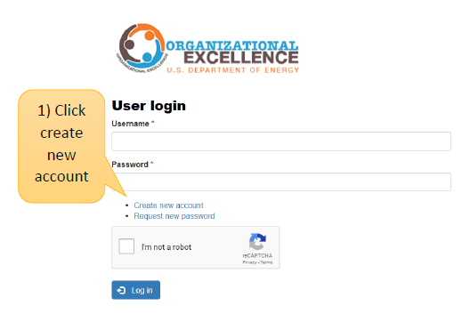
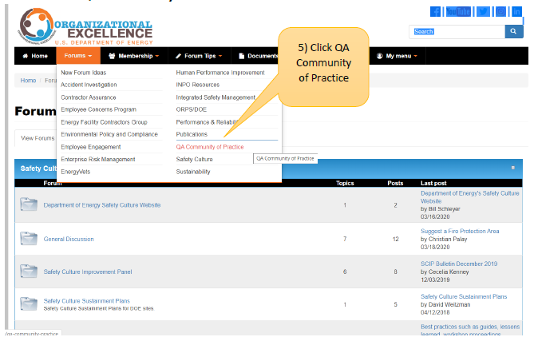
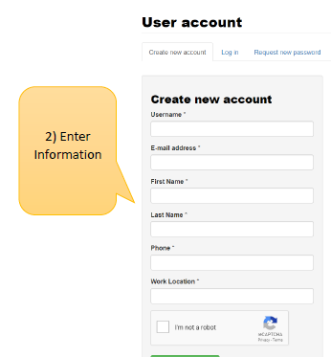
DOE Organizational Excellence Forums
https://orgex.energy.gov/
3
Identify Christian Palay as sponsor if needed

Slide 10
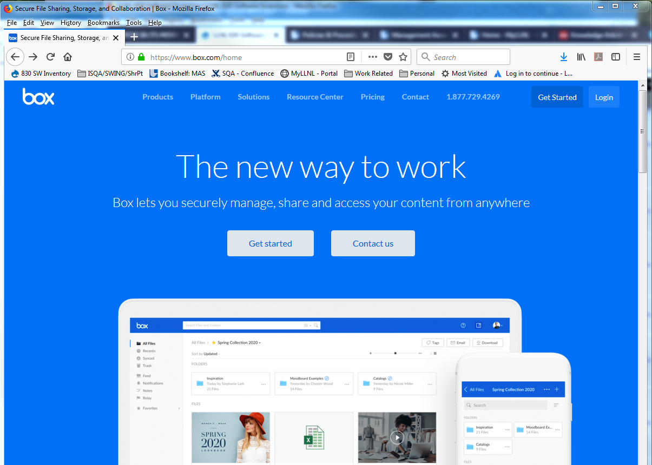
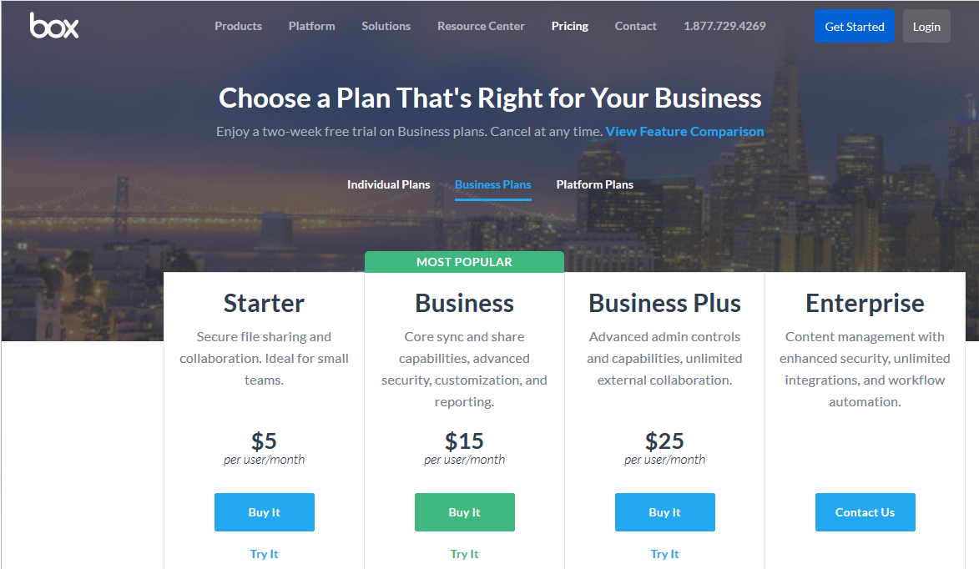
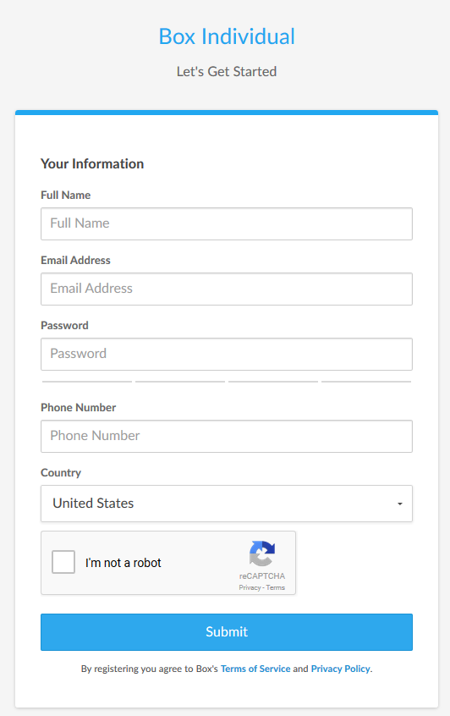
Create your BOX account in 6 Steps
10
1
Go to URL: https://www.box.com/home
Click on the “Get Started” button
Select “Individual Plans”
2
3
5
Complete the form
Send your user ID/email to:
cschultz@anl.gov *
4
6
* You may need to ask your IT group to grant you special access through
your site’s firewall to Box

Slide 11
Next Steps
Volunteer to present your site’s tool/process
10 minutes or less (contact Vicki, Teri or Marylou)
Task Groups to meet prior to August WebEx
Volunteer for Sub-Task Groups
Load sharable document templates, job aids, and SQA-related job postings to Box site

Slide 12
We do quality software,
and we can prove it.
Chair: Vicki Pope (pope13@llnl.gov)
Vice Chair: Teri Vincent (teri.vincent@cns.doe.gov)
Secretary: Marylou Apodaca (marapod@sandia.gov)

