Slide 1
EFCOG SQA Group Meeting
August 19, 2020
Chair: Vicki Pope (pope13@llnl.gov)
Vice Chair: Teri Vincent (teri.vincent@cns.doe.gov)
Secretary: Marylou Apodaca (marapod@sandia.gov)

Slide 2
Agenda
Announcements and Updates
Task Group Updates & Discussion
Discuss Pain Points of DOE O 414.1D
Member Bios for White Papers
Next Steps

Slide 3
Fall 2020 Meeting:
November 30-December 3, 2020
NNSS; Las Vegas, NV
3
Continued Work-From-Home – Follow your site/state guidance
Announcements
and
Updates
REVCOMM of DOE Guide 414.1-4 Revision & Justification for Order 414 Update – Duli Agarwal
AU-30 SQA Position Openings in USA Jobs –
801, Gen Engineer: https://www.usajobs.gov/GetJob/ViewDetails/546803700 1301, Physical Scientist: https://www.usajobs.gov/GetJob/ViewDetails/546797100
Email Marylou Apodaca for Meeting Attendance
(Meeting credit for recertifications)
RESRAD Toolbox Code Assessment – Anticipate conducting remotely ~ Fall 2020

Slide 4
Sub-Tasks Update
Better Application To “All” Software (Pat Auer, LLNL, Leader)
Current DOE O 414 Pain Points (Kamie Hopper, SNL, Leader)
Software-Relevant DOE Orders (Annette Coonfield, WRPS, Leader)
Better Definition of Software (Marylou Apodaca, SNL, Leader - WHITE PAPER IN DRAFT)
Definition of Graded Approach (Lance Abbott, SRS/Jeni Turgeon, SNL, Co-leaders)
Standard(s) for Software (Cristy Renner, Fluor BWXT, Leader)
Please send in your good/bad/how to improve “stories” of using NQA-1 and/or suggested alternate standards to cristy.renner@ports.pppo.gov.
Cloud-based Hosting Whitepaper (WHITE PAPER IN DRAFT)
4

Slide 5
414 Task Team Members
5
Definition of Software
Marylou Apodaca, SNL (Lead) – marapod@sandia.gov
Sid Ailes, Atkins
Faith Girolamo, SRS
Cristy Renner, Fluor BWXT
Pat Nakagawa, CNS/Y-12
Jeni Turgeon, SNL
Better Application to “ALL”
Pat Auer, LLNL (Lead) – auer2@llnl.gov
Marylou Apodaca, SNL
Veronica Camarillo-Morris, LANL
Stella McKirdy, INL
Graded Approach for Software
Lance Abbott, SRS (co-lead) – lance.abbott@srs.gov
Jeni Turgeon, SNL (co-lead) – jturgeo@sandia.gov
Marylou Apodaca, SNL
Carol Olijar, ANL
Current 414 Pain Points
Kamie Hopper, SNL (Lead) – kmhoppe@sandia.gov
EFCOG SQA Group Members
Standard for Software
Cristy Renner, Fluor BWXT (Lead) - cristy.renner@ports.pppo.gov
Faith Girolamo, SRS
Kamie Hopper, SNL
Dave Thoman, Amentum
Software-Relevant Orders
Annette Coonfield, WRPS (Lead) – Annette_e_coonfield@rl.gov
Clyde Armstrong, Tru Project
Orlando Ferrer, RL
Faith Girolamo, SRS
Alvin McClerkin, DOE-OREM
Vicki Pope, LLNL
Abhijit Sengupta, HQ
Cloud-based Hosting Software
Russell Swannack, PNNL (lead) – Russell.Swannack@pnnl.gov
Lisa Cooper, Paducah
Orlando Ferrer, RL
Vicki Pope, LLNL

Slide 6
Pain Points of DOE Order 414.1D Definitions (Group Discussion)
Assessment: A review, evaluation, inspection, test, check, surveillance, or audit to determine and document whether items, processes, systems, or services meet specified requirements and perform effectively.
Configuration Management: The process that controls the activities, and interfaces, among design, construction, procurement, training, licensing, operations, and maintenance to ensure that configuration of the facility is established, approved, and maintained. (ASME NQA-1 2008 with NQAA-1a2009 addenda)

Slide 7
414 Pain Points: Definitions
Item: An all-inclusive term used in place of appurtenance, assembly, component, equipment, material, module, part, structure, product, software, subassembly, subsystem, system, unit, or support systems. (10 CF.R. § 830.3)
Legal definition of appurtenance: property (as an outbuilding or fixture) or a property right (as a right-of-way) that is incidental to a principal property and that passes with the principal property upon sale or transfer
Webster definition: accessory or object. An incidental right (such as a right of way). A subordinate part or adjunct.

Slide 8
414 Pain Points: Definitions
Verification: The process of: (a) evaluating a system or component to determine whether the products of a given development phase satisfy the conditions imposed at the start of that phase; or, (b) providing objective evidence that the software and its associated products conforms to requirements (e.g., for correctness, completeness, consistency, accuracy) for all life-cycle activities during each life-cycle process (acquisition, supply, development, operation, and maintenance); satisfies standards, practices, and conventions during life-cycle processes; and, successfully completes each life-cycle activity and satisfies all the criteria for initiating succeeding life-cycle activities (e.g., building the software correctly). (IEEE Standard 1012-2004)

Slide 9
414 Pain Points: Definitions
Validation: The process of: (a) evaluating a system or component during, or at the end of the development process to determine whether it satisfies specified requirements; or, (b) providing evidence that the software, and its associated products, satisfies system requirements allocated to software at the end of each life-cycle activity, solves the right problem (e.g., correctly models physical laws, implements business rules, uses the proper system assumptions), and satisfies the intended use and user needs. (IEEE Standard 1012-2004)

Slide 10
EFCOG SQA Member Bios
Short Bio to be used in White Papers
Example:
Vicki L. Pope
Vicki Pope is an American Society of Quality Certified Software Quality Engineer and the SQA Manager for Lawrence Livermore National Laboratory (LLNL). In this position, she analyses legal and contractual SQA requirements and translates those into meaningful and usable information for software development and user teams at her site. She also is a certified lead assessor in both NQA-1-2008 and ISO 9001:2015, leading assessments and audits at LLNL and other DOE Complex sites to evaluate level, completeness, and implementation of SQA requirements and practices as specified through DOE O 414.1D. In addition, Ms. Pope is the Chairperson for the EFCOG SQA Task Group. In these two capacities, she frequently interacts with senior LLNL and project management, local and national external oversight, and other DOE site SQA offices.

Slide 11
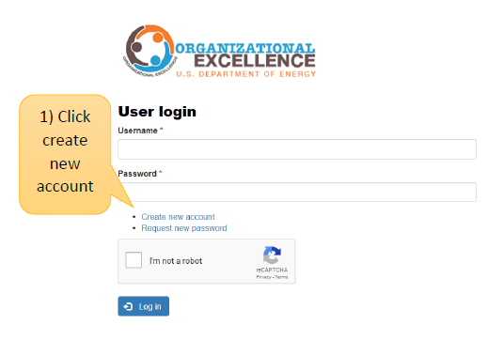
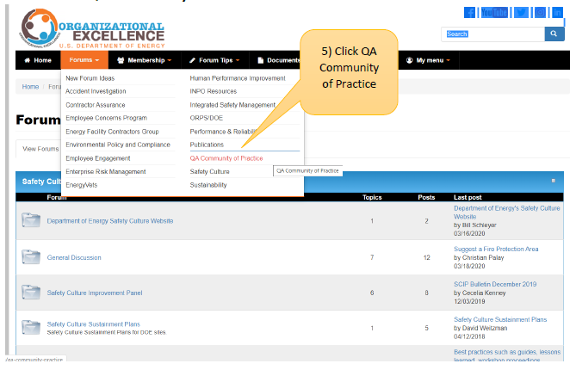
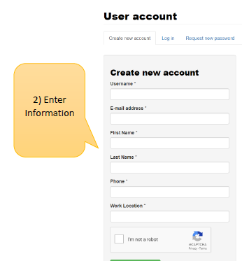
DOE Organizational Excellence Forums
https://orgex.energy.gov/
3
Identify Christian Palay as sponsor if needed

Slide 12
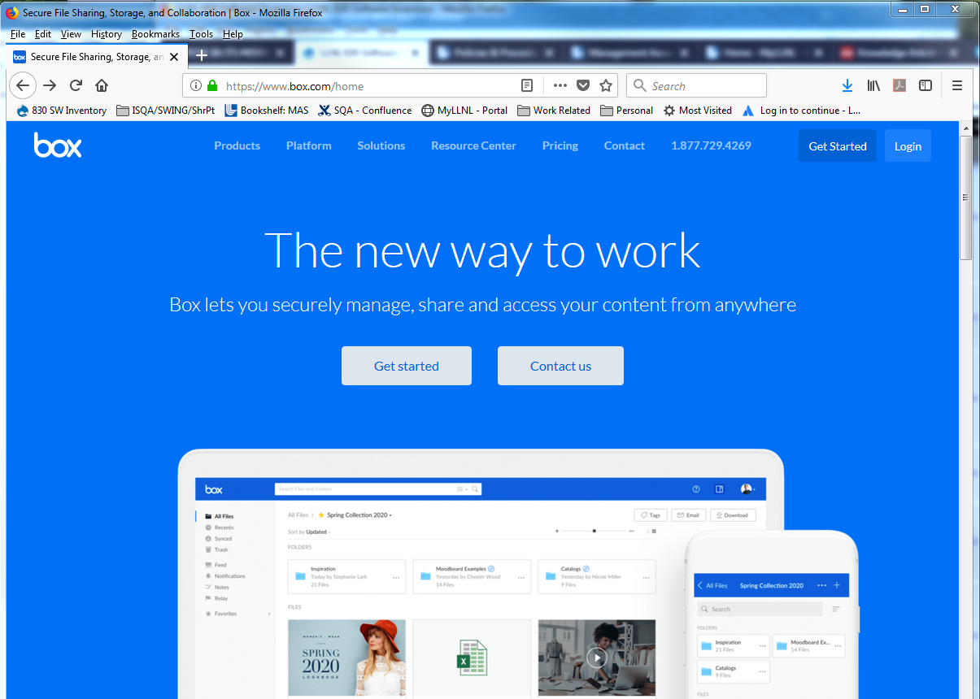
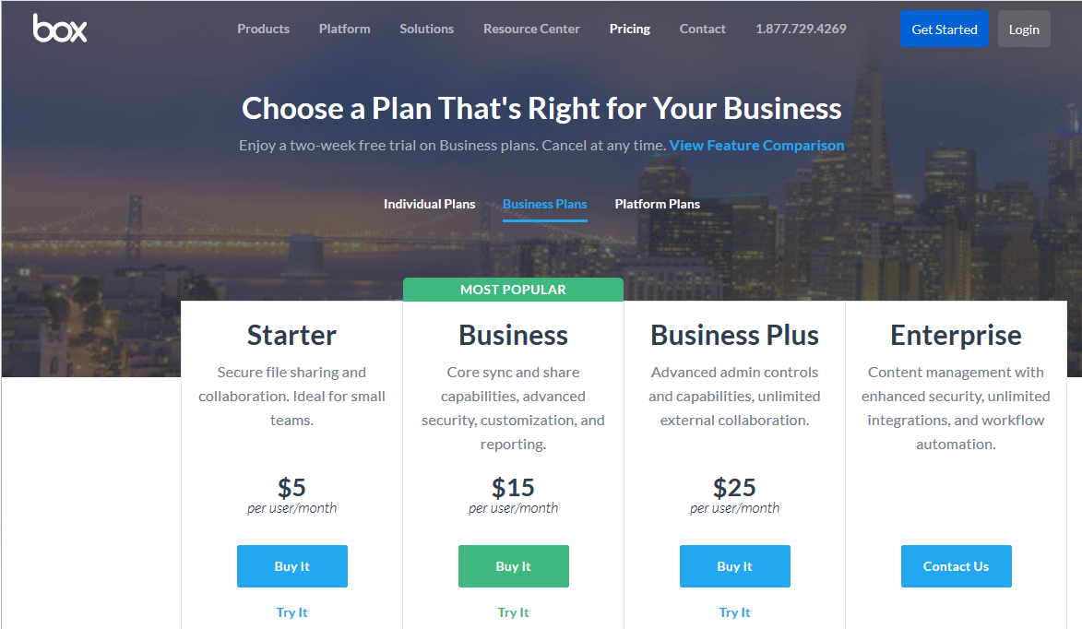
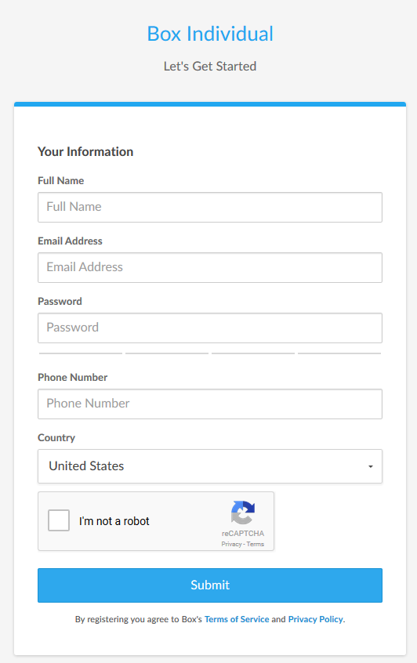
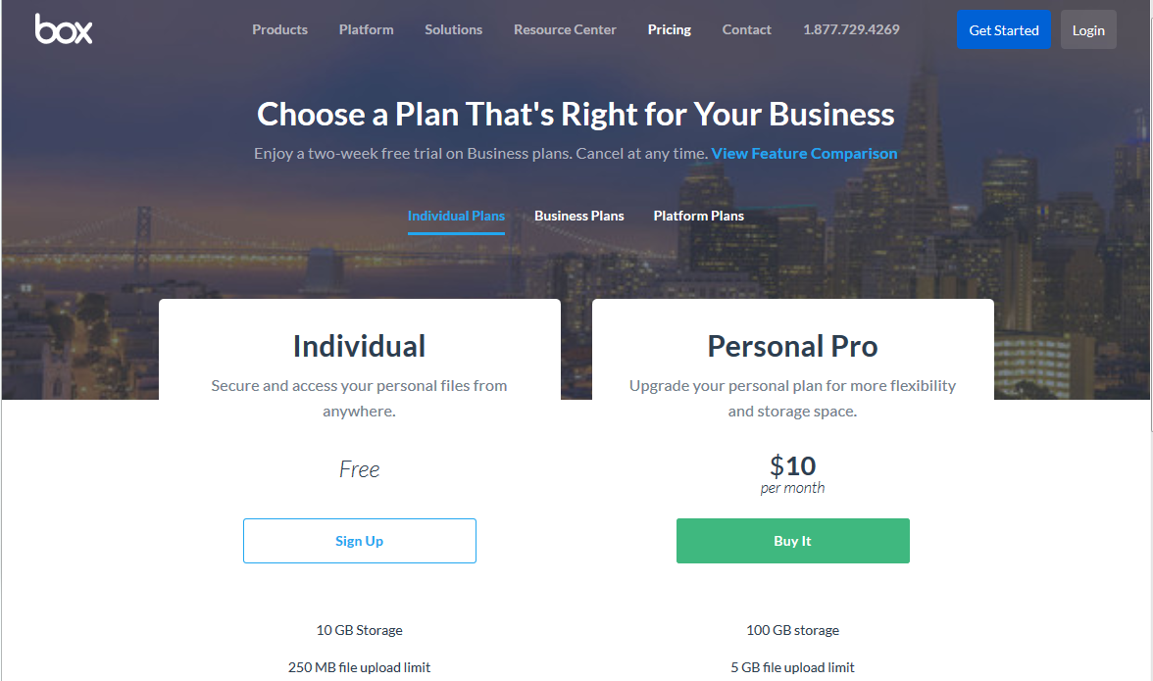
Create your BOX account in 6 Steps
12
1
Go to URL: https://www.box.com/home
Click on the “Get Started” button
Select “Individual Plans”
2
3
5
Complete the form
Send your user ID/email to:
cschultz@anl.gov *
4
6
* You may need to ask your IT group to grant you special access through
your site’s firewall to Box

Slide 13
Next Steps
Volunteer to present your site’s tool/process
10 minutes or less (contact Vicki, Teri or Marylou)
Task Groups to meet prior to September WebEx
Volunteer for Sub-Task Groups
Send Bios to pope13@llnl.gov
Load sharable document templates, job aids, and SQA-related job postings to Box site

Slide 14
We do quality software,
and we can prove it.
Chair: Vicki Pope (pope13@llnl.gov)
Vice Chair: Teri Vincent (teri.vincent@cns.doe.gov)
Secretary: Marylou Apodaca (marapod@sandia.gov)

