Slide 1
Cloud Computing Quality Assurance
Energy Facility Contractors Group
Russell D Swannack
Senior Software Quality Engineer
Notes:
Stock image of cloud formations

Slide 2
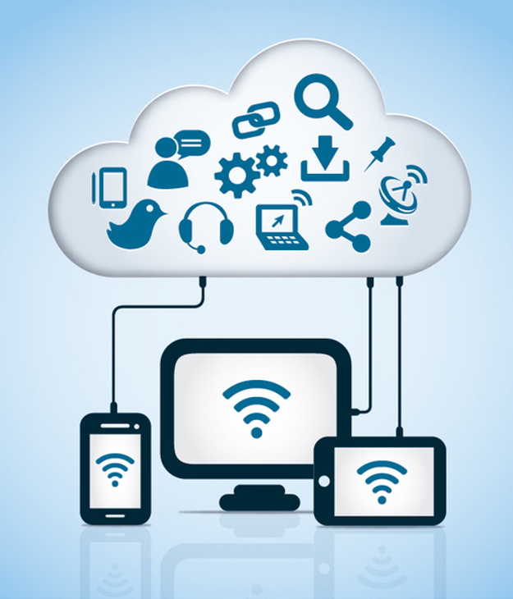
Cloud Computing
The delivery of computing services over the Internet (“the cloud”).
Provides faster innovation, flexible resources, and economies of scale.
Includes: servers, storage, databases, networking, software, analytics, and intelligence.
Typically, “Pay as you go” model.
Only pay for cloud services used.
Lower operating costs.
Increase infrastructure efficiency.
Scale as computing needs change.
Assumption: Audience is already somewhat familiar with software quality assurance concepts.
Notes:
Cost
Cloud computing eliminates the capital expense of buying hardware and software and setting up and running on-site datacenters—the racks of servers, the round-the-clock electricity for power and cooling, and the IT experts for managing the infrastructure. It adds up fast.
Speed
Most cloud computing services are provided self service and on demand, so even vast amounts of computing resources can be provisioned in minutes, typically with just a few mouse clicks, giving businesses a lot of flexibility and taking the pressure off capacity planning.
Global scale
The benefits of cloud computing services include the ability to scale elastically. In cloud speak, that means delivering the right amount of IT resources—for example, more or less computing power, storage, bandwidth—right when they’re needed, and from the right geographic location.
Productivity
On-site datacenters typically require a lot of “racking and stacking”—hardware setup, software patching, and other time-consuming IT management chores. Cloud computing removes the need for many of these tasks, so IT teams can spend time on achieving more important business goals.
Performance
The biggest cloud computing services run on a worldwide network of secure datacenters, which are regularly upgraded to the latest generation of fast and efficient computing hardware. This offers several benefits over a single corporate datacenter, including reduced network latency for applications and greater economies of scale.
Reliability
Cloud computing makes data backup, disaster recovery, and business continuity easier and less expensive because data can be mirrored at multiple redundant sites on the cloud provider’s network.
Security
Many cloud providers offer a broad set of policies, technologies, and controls that strengthen your security posture overall, helping protect your data, apps, and infrastructure from potential threats.

Slide 3
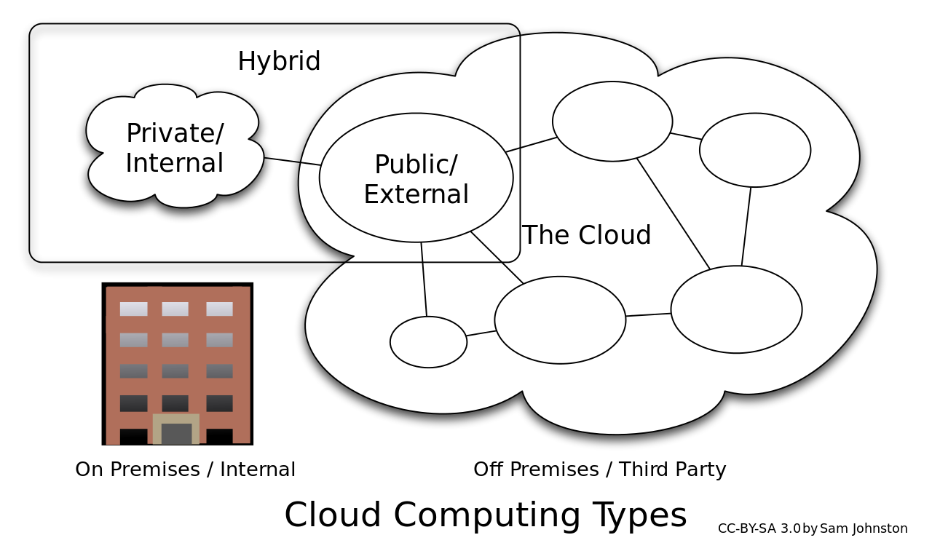
Cloud - Types
Public Cloud
Owned and operated by a third-party cloud service provider.
Delivering computer resources over the internet (e.g., servers & storage).
Cloud service provider owns all hardware, software, and support infrastructure.
Private Cloud
Computer resources used exclusively a single business/organization.
Can be physically located on the company’s data systems.
May pay third-party service provider to host their private cloud.
Hybrid Cloud
Combines a company on-campus “private cloud” with “public cloud” resources.
Shared applications and data streams.
Highly sensitive data can be stored in the private cloud while less sensitive data may be stored in the public cloud.
Typically accessed via web browser interface.
Notes:
The public cloud is defined as computing services offered by third-party providers over the public Internet, making them available to anyone who wants to use or purchase them. They may be free or sold on-demand, allowing customers to pay only per usage for the CPU cycles, storage, or bandwidth they consume.
Unlike private clouds, public clouds can save companies from the expensive costs of having to purchase, manage, and maintain on-premises hardware and application infrastructure - the cloud service provider is held responsible for all management and maintenance of the system. Public clouds can also be deployed faster than on-premises infrastructures and with an almost infinitely scalable platform. Every employee of a company can use the same application from any office or branch using their device of choice as long as they can access the Internet. While security concerns have been raised over public cloud environments, when implemented correctly, the public cloud can be as secure as the most effectively managed private cloud implementation if the provider uses proper security methods, such as intrusion detection and prevention systems (IDPS).
---------------------------------------------------------------------------------
The private cloud is defined as computing services offered either over the Internet or a private internal network and only to select users instead of the general public. Also called an internal or corporate cloud, private cloud computing gives businesses many of the benefits of a public cloud - including self-service, scalability, and elasticity - with the additional control and customization available from dedicated resources over a computing infrastructure hosted on-premises. In addition, private clouds deliver a higher level of security and privacy through both company firewalls and internal hosting to ensure operations and sensitive data are not accessible to third-party providers. One drawback is that the company’s IT department is held responsible for the cost and accountability of managing the private cloud. So private clouds require the same staffing, management, and maintenance expenses as traditional datacenter ownership.
-------------------------------------------------------------------------------------
A hybrid cloud is a computing environment that combines an on-premises datacenter (also called a private cloud) with a public cloud, allowing data and applications to be shared between them. Some people define hybrid cloud to include “multicloud” configurations where an organization uses more than one public cloud in addition to their on-premises datacenter.

Slide 4
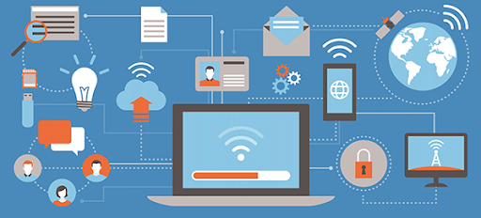
Cloud - Services
IaaS: Infrastructure as a Service
Instantly provides computing infrastructure (rent/lease).
Servers, virtual machines, storage, networks, operating systems
Ability to scale up/down with demand.
Install, configure & manage your own software and operating system(s).
PaaS: Platform as a Service
Provides and manages underlying infrastructure for you.
Servers, storage, network, database, operating systems
Designed for development, testing, delivering and managing your own software.
SaaS: Software as a Service
Method for delivering software applications over the Internet.
Cloud providers host and manage the software application, underlying infrastructure and handle any maintenance (e.g., software upgrades & security patches).
Notes:
Infrastructure as a service (IaaS) is an instant computing infrastructure, provisioned and managed over the internet. It’s one of the four types of cloud services, along with software as a service (SaaS), platform as a service (PaaS), and serverless.
IaaS quickly scales up and down with demand, letting you pay only for what you use. It helps you avoid the expense and complexity of buying and managing your own physical servers and other datacenter infrastructure. Each resource is offered as a separate service component, and you only need to rent a particular one for as long as you need it. A cloud computing service provider, such as Azure, manages the infrastructure, while you purchase, install, configure, and manage your own software—operating systems, middleware, and applications.
--------------------------------------------------
Platform as a service (PaaS) is a complete development and deployment environment in the cloud, with resources that enable you to deliver everything from simple cloud-based apps to sophisticated, cloud-enabled enterprise applications. You purchase the resources you need from a cloud service provider on a pay-as-you-go basis and access them over a secure Internet connection.
Like IaaS, PaaS includes infrastructure—servers, storage, and networking—but also middleware, development tools, business intelligence (BI) services, database management systems, and more. PaaS is designed to support the complete web application lifecycle: building, testing, deploying, managing, and updating.
PaaS allows you to avoid the expense and complexity of buying and managing software licenses, the underlying application infrastructure and middleware, container orchestrators such as Kubernetes, or the development tools and other resources. You manage the applications and services you develop, and the cloud service provider typically manages everything else.
-------------------------------------------------
Software as a service (SaaS) allows users to connect to and use cloud-based apps over the Internet. Common examples are email, calendaring, and office tools (such as Microsoft Office 365).
SaaS provides a complete software solution that you purchase on a pay-as-you-go basis from a cloud service provider. You rent the use of an app for your organization, and your users connect to it over the Internet, usually with a web browser. All of the underlying infrastructure, middleware, app software, and app data are located in the service provider’s data center. The service provider manages the hardware and software, and with the appropriate service agreement, will ensure the availability and the security of the app and your data as well. SaaS allows your organization to get quickly up and running with an app at minimal upfront cost.
------------------------------------------------------------------
Serverless computing enables developers to build applications faster by eliminating the need for them to manage infrastructure. With serverless applications, the cloud service provider automatically provisions, scales, and manages the infrastructure required to run the code.
In understanding the definition of serverless computing, it’s important to note that servers are still running the code. The serverless name comes from the fact that the tasks associated with infrastructure provisioning and management are invisible to the developer. This approach enables developers to increase their focus on the business logic and deliver more value to the core of the business. Serverless computing helps teams increase their productivity and bring products to market faster, and it allows organizations to better optimize resources and stay focused on innovation.

Slide 5
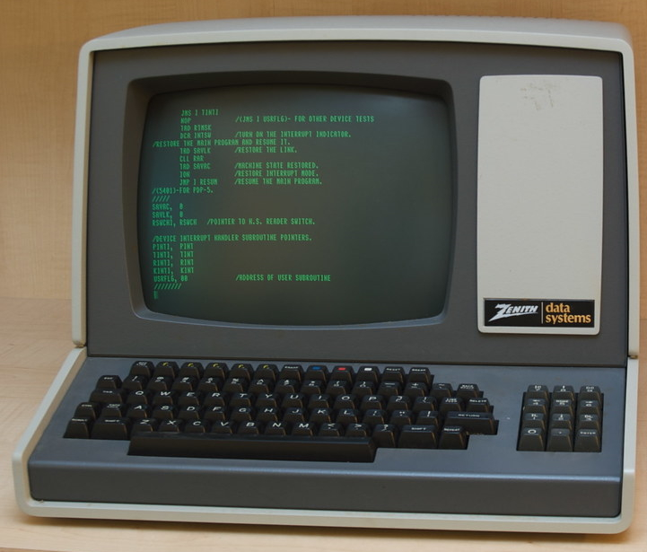
NQA-1-2012 Quality Assurance Requirements for Nuclear Facility Applications
Part I, Requirement 3 Design Control
§800 Software Design Control
Part I, Requirement 11 Test Control
§200 Test Requirements
§400 Computer Program Test Procedures
§602 Computer Program Test Records
Part II, Subpart 2.7 Quality Assurance Requirements for Computer Software for Nuclear Facility Applications
§301 Procured Software and Software Services
Part I, Requirement 4 Procurement Document Control
Part I, Requirement 7 Control of Purchased Items and Services
Shall be applied to the procurement of software and software services.
Notes:
No explicit requirements for “Cloud Computing” - All requirements are applicable, just as before.
301 Procured Software and Software Services
Part I, Requirements 4 and 7 for items and services shall be applied to the procurement of software and software services. The Purchaser shall be responsible for the appropriate requirements of this Subpart upon acceptance of the software or related item (e.g., programmable device). Procurement documents shall identify requirements for Supplier’s reporting of software errors to the Purchaser and, as appropriate, the Purchaser’s reporting of software errors to the Supplier.

Slide 6
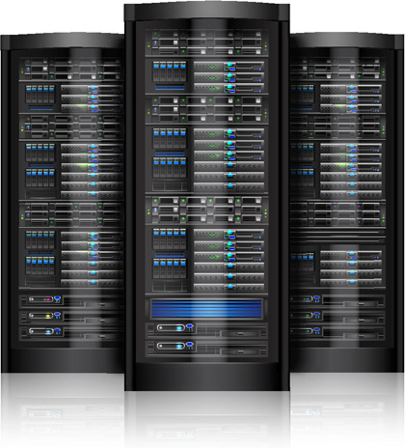
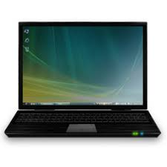
Quality Assurance Interpretation/Documentation
NETWORK
Information
Results
User Computer
Remote Computer
Flow down requirements to Cloud provider - where applicable and possible.
CSA provisions: Service availability (QoS), data ownership & integrity, hardware & software, security (controls, monitoring, response, notification), roles & responsibilities, disaster/failure recovery & backup, privacy/confidentiality, authentication & authorization, deployment, business policies, governance, exit process
Configuration Management is a key work activity throughout life cycle.
Identify which parts are owned (i.e., controlled) by your organization.
Which parts of the overall system are not owned and the extent they are “controlled”.
Risk Identification and Management is a priority during planning.
Understand and implement mitigation strategies.
E.g., Real-time data acquisition & control systems are not recommended.
QoS = Quality of Service
CSA = Cloud Service Agreement
Notes:
Quality of service (QoS) is the description or measurement of the overall performance of a service, such as a telephony or computer network or a cloud computing service, particularly the performance seen by the users of the network.
A service-level agreement (SLA) is a commitment between a service provider and a client. Particular aspects of the service – quality, availability, responsibilities – are agreed between the service provider and the service user. The most common component of an SLA is that the services should be provided to the customer as agreed upon in the contract.
Cloud Type = Public, Private, Hybrid
Cloud Service = Infrastructure, Platform, Software … as a Service

Slide 7
Quality Assurance Interpretation/Documentation
NETWORK
Information
Results
User Computer
Remote Computer
Where in the overall system do your software work activities occur?
Project Management and Planning
Risk Management
Configuration Management
Procurement and Supplier Management
Requirements Identification and Management
Design and Implementation
Software Safety
Verification and Validation
Problem Reporting and Corrective Action
Training Personnel about Safety Software
Identify otherwise acquired software, support software (i.e., tools & systems).
Do they need to be placed under configuration control (contractually)?
Is there a need to perform a Commercial Grade Dedication (CGD) on any items?
Considerations and priorities may differ, per the use case.
You are using cloud hosted software.
You are providing cloud hosted software - used by others.
You are developing software within a cloud hosted system.
Notes:
Cloud Type = Public, Private, Hybrid
Cloud Service = Infrastructure, Platform, Software … as a Service

Slide 8
Conclusion
NQA-1 applicable requirements stay the same
Implementation documentation may differ
Additional risk categories are considerable
Configuration management is still a primary focus
Guidance is needed.
EFCOG
White
Paper

Slide 9
Questions?

