Slide 1
Solar Winds Incident and IoT for Federal Networks (Draft)
EFCOG 1/2021
Gregory Pope, CSQE

Slide 2
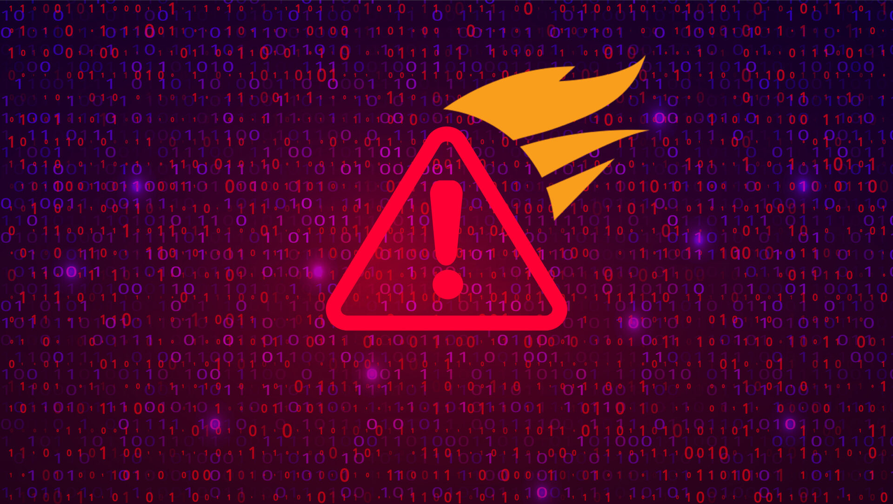
Factoids:
Breached MFA (Multi Factor Authentication) login access to source code
Added source code to Orion project library
Orion product used by 30,000 customers for Network Management
Added source code included in product updates
Change log could have shown these changes

Slide 3
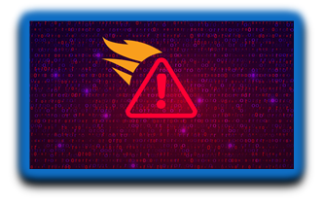
More Factoids
One of the customers was Fire Eye, a cyber security company, their cyber security tools were stolen.
Federal government also uses Orion product
Intrusion happened in April 2020
Discovered on December 14, 2020. Checker available same day.

Slide 4
Factoids and Some Lessons Learned
Infected code was compiled into .NET CIL (Component Intermediate Language)
For COTS software source is usually not available.
Need to check .NET files and Java Byte Code as well as source and binaries.
Need to detect intrusions earlier in CIL or binary files.

Slide 5
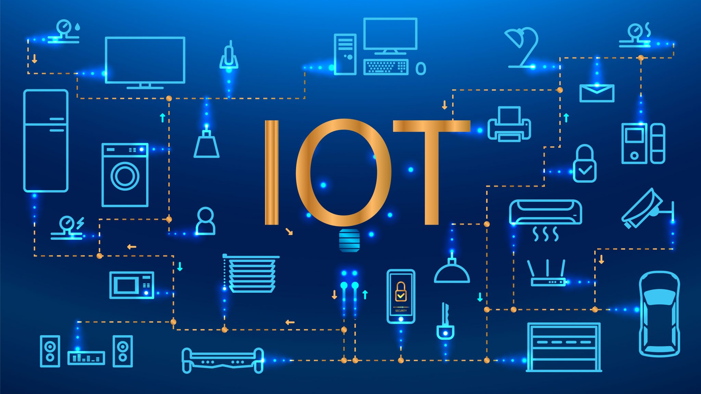
IoT (Internet of Things) Devices
IoT devices are: Pieces of hardware, such as sensors, actuators, gadgets, appliances, or machines, that are programmed for certain applications and can transmit data over the internet or other networks. They can be embedded into other mobile devices, industrial equipment, environmental sensors, medical devices, and more.
Characteristics:
Low-Cost
Security adds more code
More code reduces battery life
Examples:
Smart Home Security
Connected Appliances
Wearable Health Monitors

Slide 6
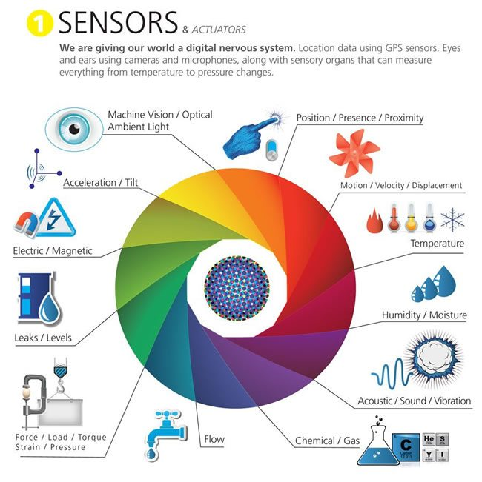
DOE/NNSA Use

Slide 7
IoT for Federal Government IT
NIST IoT for Fed Requirements
NIST SP 800-213 (Draft) - IoT Device Cybersecurity Guidance for the Federal Government: Establishing IoT Device Cybersecurity Requirements
NISTIR 8259B (Draft) - IoT Non-Technical Supporting Capability Core Baseline
NISTIR 8259C (Draft) - Creating a Profile Using the IoT Core Baseline and Non-Technical Baseline
NISTIR 8259D (Draft) - Profile Using the IoT Core Baseline and Non-Technical Baseline for the Federal Government
iotsecurity@nist.gov until Feb 12, 2021 for comments
NIST IR 8228 – Considerations for Managing IoT Cybersecurity and Privacy Risks

Slide 8
Sample Requirements for IoT (NIST IR 8228)
Unique identifiers (Code, O/S, Libraries)
Firmware update for vulnerabilities
Data at rest is encrypted
No default passwords
Passwords not stored plain text
Device status reported
Multi privileged access
Physical Access to Device
Automated Checkers
Visual Inspection

Slide 9
How to Enforce IoT Compliance ?
Ask IoT manufactures to promise they are compliant
Review IoT device specifications
Audit IoT manufacture’s development
Ronald Regan approach - Create tools that verify firmware compliance
Funding, probably must wait for an embarrassing incident
Start an EFCOG group to be proactive
Wisdom, MT. Zip Code 59761
Population 98

