Slide 1
EFCOG SQA Group Meeting
March 17, 2021
Chair: Vicki Pope (pope13@llnl.gov)
Vice Chair: Teri Vincent (teri.vincent@cns.doe.gov)

Slide 2
Safety Moment
Announcements and Updates
Spring Virtual Meeting Agenda Discussion
Discuss Draft DOE Guide 414.1-4A
Briefing on SQA-Related Standards and Orders Matrix
Task Group Updates & Members
Upcoming Events of Interest
Next Steps

Slide 3
REVCOM: DOE Guide 414.1-4 – Comments Due 4/26
RevCom website: https://www.directives.doe.gov/revcom
Site Coordinators: https://www.directives.doe.gov/dpc-resources/ac_list
3
Sign up for QA Community of Practice on Organizational Excellence Website: https://orgex.energy.gov/
Announcements
and
Updates
Spring 2021 Virtual Face-to-Face Meeting
DATE: April 19-22
Secretary/Scribe Needed for EFCOG SQA Task Group
Email Vicki Pope for Meeting Attendance
(Meeting credit for recertifications)
Any site Announcement or concerns?

Slide 4
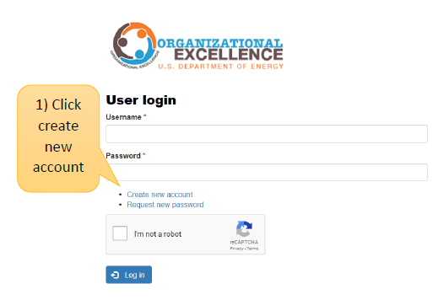
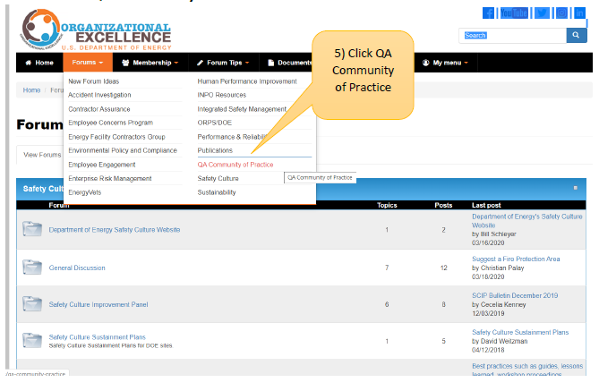
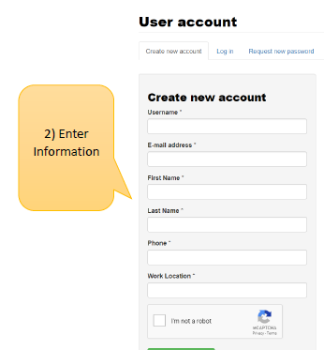
DOE Organizational Excellence Forums
https://orgex.energy.gov/
3

Slide 5
Ideas for Spring Virtual Meeting
Similar format and agenda to Fall Virtual Meeting
Monday: Joint Task Group Presentations
Tuesday-Thursday: Task Group working sessions
Discussion of Revised DOE 414 Guide – pros & concerns
Briefing on SQA-Related Standards and Orders Matrix (if not today)
Sub-task working sessions and Updates
Presentations/Briefings
Creating a safety/security library for your code – Greg Pope, LLNL
Process to stand up Master Supplier List - Supply Chain member
Joint Sessions with other EFCOG Task Groups?
Safety, Security, and Quality Moments – Volunteers needed for ~5-minute presentations each day

Slide 6
Revised DOE 414 Guide
Participation in comment process
Sign up to review: https://www.directives.doe.gov/revcom
RevCom Due Date: April 26, 2021
Internal Due Dates will be earlier
General Impressions
Concerns/major comments

Slide 8
Sub-Tasks Update
Definition of Graded Approach (Lance Abbott, SRS/Jeni Turgeon, SNL, Co-leaders)
Cloud-based Hosting White Paper (WHITE PAPER IN DRAFT)
Software Standards and Orders (Cristy Renner, Fluor BWXT, Leader)
NEW: Internet of Things White Paper (Orlando Ferrer, WRPS, Leader)
NEW: Testing Spreadsheets White Paper (Greg Pope, LLNL, Leader)
NEW: Toolbox Alternatives (NEEDS A LEADER)

Slide 9
Task Team Members
Graded Approach for Software
Lance Abbott, SRS (co-lead) – lance.abbott@srs.gov
Jeni Turgeon, SNL (co-lead) – jturgeo@sandia.gov
Marylou Apodaca, SNL
Carol Olijar, ANL
NEW: Internet of Things
Orlando Ferrer, WRPS (Lead) – Orlando_a_ferrer@rl.gov
Greg Pope, LLNL
Gladys Udenta, NNSA
Software Standards and Orders
Cristy Renner, Fluor BWXT (Lead) - cristy.renner@ports.pppo.gov
Annette Coonfield, WRPS (Deputy)
Clyde Armstrong, Tru Project
Orlando Ferrer, RL
Faith Girolamo, SRS
Kamie Hopper, SNL
Alvin McClerkin, DOE-OREM
Abhijit Sengupta, HQ
Dave Thoman, Amentum
NEW: Testing Spreadsheets
Greg Pope, LLNL (Lead) – pope12@llnl.gov
Dave Thoman, Amentum
NEW: Toolbox Alternatives
NEEDS A LEADER
Pat Auer, LLNL
Carl Mazzola, Project Enhancement Corp
Vicki Pope, LLNL
Dave Thoman, Amentum
Cloud-based Hosting Software
Russell Swannack, PNNL (lead) – Russell.Swannack@pnnl.gov
Lisa Cooper, Paducah
Orlando Ferrer, RL
Vicki Pope, LLNL

Slide 10
Dates to Remember
Upcoming SW-Related Conferences and Training
Date | Conference/Training Title | Teaching Org | Website
April 12-15 | NQA-1 Software Sub-committee Spring 2021 Virtual Meeting | Virtual | TBD
April 19-22 | EFCOG ISM/QA Spring 2021 Meeting | Virtual | TBD
April 19-23 | NQA-1 Lead Auditor Training | Kinetix Quality Services (virtual class) | https://kinetixquality.com/services/nqa-1-lead-auditor-training
April 20-22 | NQA-1 Lead Auditor Training | Nuclear Training Institute (virtual class) | https://nucleartraininginstitute.com/product/nqa-1-lead-auditor-training-april-20-22-2021/
June 8-10 | Lead Auditor Training | J-E-T-S Quality Consultants Inc. (virtual class) | https://jetsquality.com/leads-auditor-training/
June 14-17 | ASME NQA-1 Lead Auditor Training | Theseus Professional Services (virtual class) | https://www.theseuspro.com/academy/current-courses/

Slide 11
Next Steps
Volunteer to present your site’s tool or process
10 minutes or less (contact Vicki, Teri or Marylou)
Task Groups to meet prior to March WebEx
Don’t forget to post your Task products to Box
Volunteer for Sub-Task Groups
Load sharable document templates, job aids, and SQA-related job postings to Box site

Slide 12
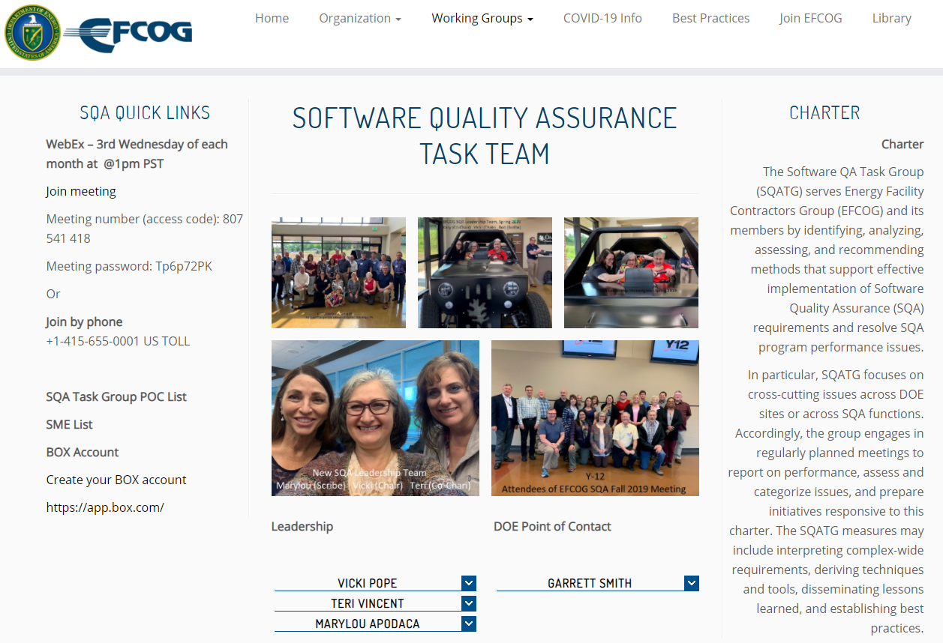
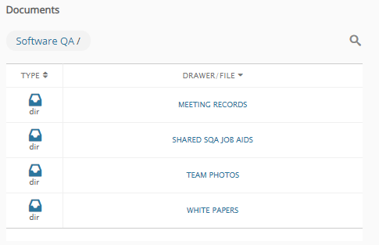
EFCOG SQA Web Site Changes
https://efcog.org/safety/quality-assurance-subgroup/software-quality-assurance-task-group/
New content has been posted to:
DELIVERABLES AFTER2016 folder – now labeled WHITE PAPERS
Meeting Minutes and Presentation from January WebEx Meeting now in MEETING RECORDS folder
Meeting files from the last three years have been restored to the MEETING RECORDS folder
Scroll down to page bottom

Slide 13
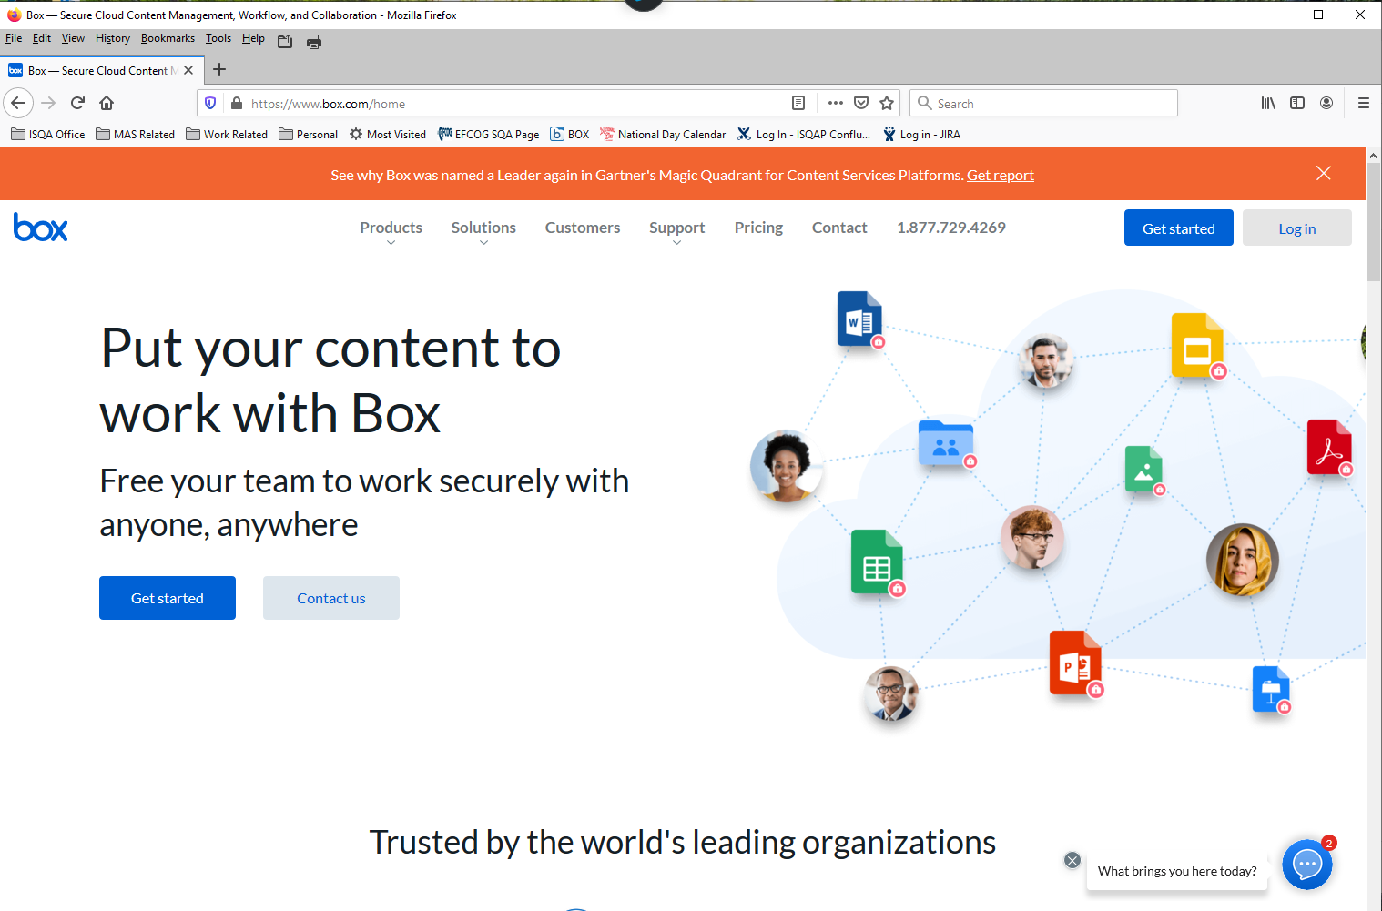
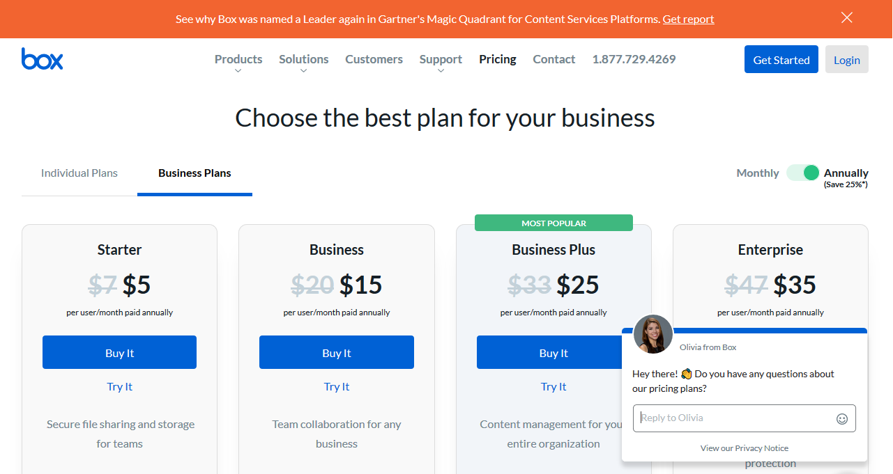
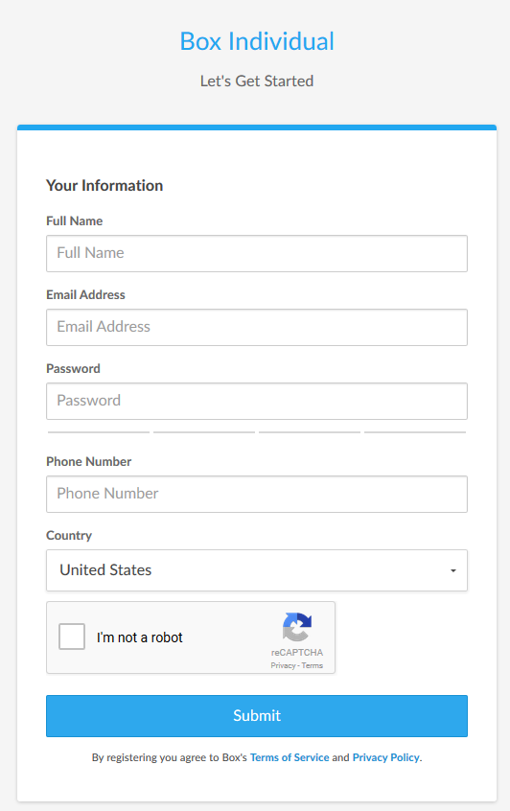
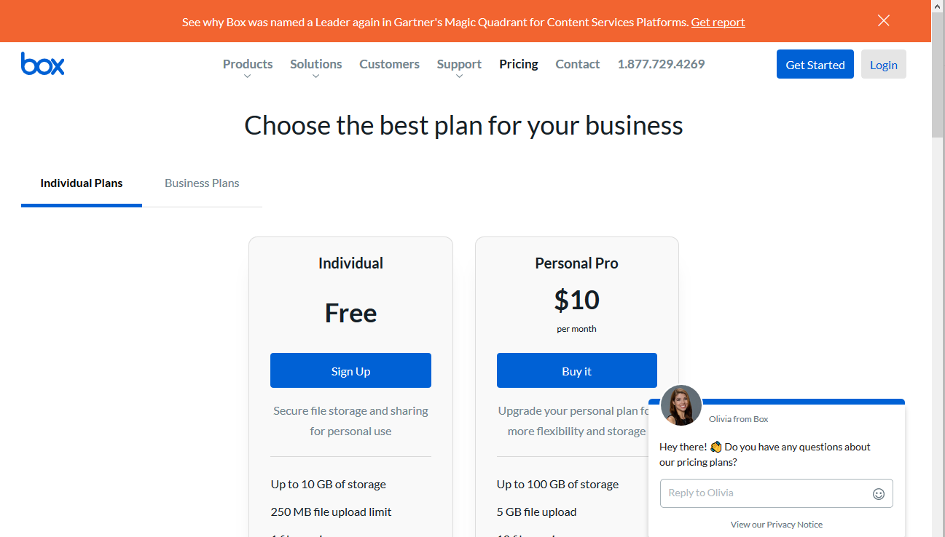
Create your BOX account in 6 Steps
13
1
1
Go to URL: https://www.box.com/home
Click on the “Get Started” button
Select “Individual Plans”
2
2
3
5
Complete the form
Send your user ID/email to:
cschultz@anl.gov *
4
6
4
* You may need to ask your IT group to grant you special access through
your site’s firewall to Box. Justified as member of EFCOG SQA Working Group.

Slide 14
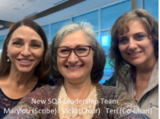
We do quality software,
and we can prove it.
Chair: Vicki Pope (pope13@llnl.gov)
Vice Chair: Teri Vincent (teri.vincent@cns.doe.gov)

