Slide 1
EFCOG Supply Chain Quality Task Team Conference Call Nov 18, 2020
Vince Grosso
Quality Assurance Technical Team Chair
William R Wingfield
Supply Chain Quality Task Team Chair
Joseph Fulghum
Supply Chain Quality Task Team Vice Chair
Julie Snelling
Supply Chain Quality Secretary
Unclassified
Notes:
If troubles connecting to WebEx, call their help line 866-863-3903 or 866-229-3239

Slide 2
Overview
MSL Supplier Database access
Upcoming Conferences / Workshops
Industry / Supplier Issues
Interface Representative Updates
EFCOG Safety Working Group
Supply Chain Project Updates
Audit Opportunities Update
Old / New Business
Discussion & Close Out

Slide 3
PLEASE MUTE YOUR PHONES
I suggest you call in on your phones vs using the computer mics.
Please mute your phones
Please mute the microphones on your computer

Slide 4
Supplier Database Access
Effective Sun 3/22/20 the MASL went dark (i.e. It is no longer active.)
Wed 3/25/20, the MSL is now active.
The new link to the MSL is: https://www.msl.kcnsc.doe.gov
MSL Registration:
- You must possess one of three types of credential [PIV, Entrust, or ONE ID (for those sites such as LANL that have that option)]. PIV is the preferred method. Your local Help Desk will be able to assist you in identifying what options are available and obtain the appropriate credential.
- After attaining a credential you are ready to register it with the Portal site. The ID and password PIN (PIV), ONE ID, or Entrust will be the only accepted ways to access the Portal, and if applicable, Spend Analysis/MASL. Registration for SCMC Portal (NNSA, EM and Ariba) (https://fmt.kcp.com/nice/display/itfaq/Registration+for+the+Portal+%28e.g.,+NNSA%2C+EM+and+MASL%29):
System compatibility check
Logging into the portal
Self-registration (IMPORTANT: Temporary Admin rights for your PC is necessary to successfully complete this step)
To begin the process: a. open a browser and go to SKY Portal (https://thesource.energy.gov) It may be necessary to open in IE vs Firefox. b. click on “Sign-in” or “Login", located at the top, right-hand corner of the page.
c. You will be prompted through a few screens to register your credential. You will need to select “Edit” capability to put suppliers into the MSL or update information for your suppliers in the MSL.
If you have any questions, please call the KCNSC Help Desk at 816.488.3671 - press "1".
Self-enrollment:
Portal Self Enrollment (https://fmt.kcp.com/nice/display/itfaq/Portal+Self+Enrollment) Now that your credential is registered you will need to enroll into the appropriate site on the Portal.
- Return to the SKY Portal, Sign-In, and locate the following portlet:
Please make sure that these sites are trusted by the client site.
https://spaces.kcp.com https://webconf.kcp.com https://access.kcp.com https://thesource.energy.gov

Slide 5
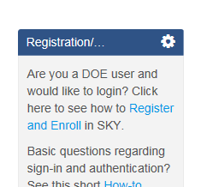
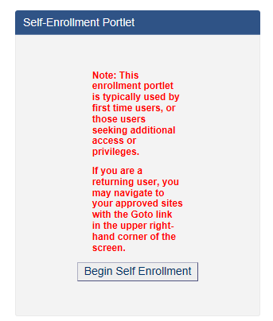
Supplier Database Access (Cont.)
- On the resulting screen, locate the following portlet (left-hand side of screen):
Click the button: “Begin Self Enrollment” (if need to, click on the link “How-to Guide”.
When prompted for "which portal you are requesting access to...," select the desired portal site from the currently available: (EM, NNSA or MSL). You will want to select MSL.
You will need to select the appropriate EM Contractor, NSE Contractor, Office Of Science Contractor, Other. NSE Contractors are the NNSA Contractors.
You will want to select Edit Content if you are going to be putting suppliers into the MSL or want to view what suppliers are in the MSL.
- Approval by selected site ICR (Information Content Representative, Bill Wingfield, or Vince Grosso for the MSL) will take place and you will be notified by email.

Slide 6
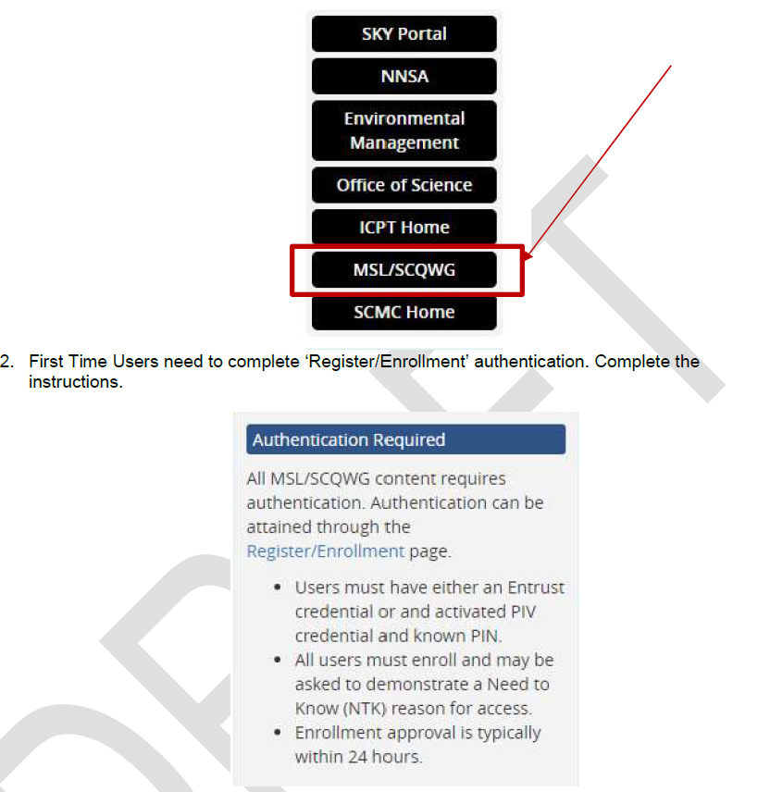
Supplier Database Access (Cont.)
After you have approval to access the MSL: -
Your screen should look like this:

Slide 7
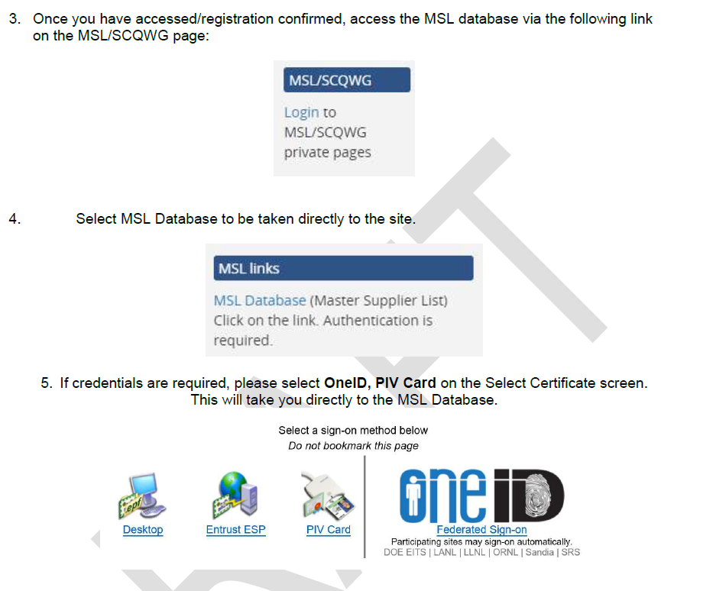
Supplier Database Access (Cont.)

Slide 8
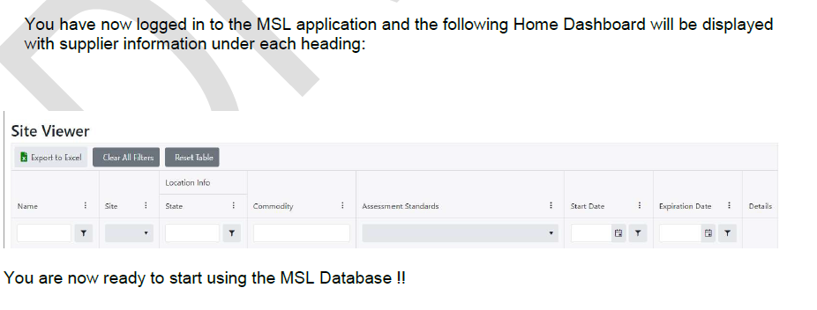
Supplier Database Access (Cont.)

Slide 9
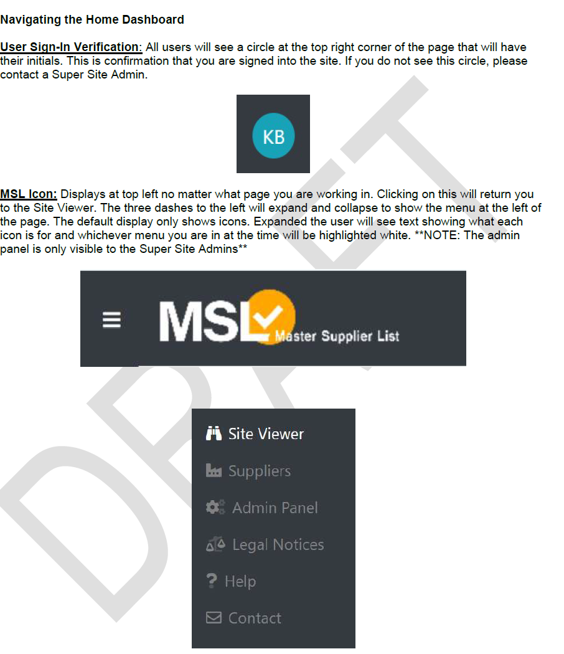
Supplier Database Access (Cont.)

Slide 10
Supplier Database Access (Cont.)
Please use MSL cost avoidance forms to help us identify savings from sharing 3rd party audits.
If you have saved $ by performing a 3rd party review or only sending 1 or 2 person(s) on an audit team vs. a 3 person team, you need to enter into MASL an eForm.
Any issues with access or use? Email Kristin Bell @ kbell@sandia.gov or Bill @ wwingfield@lanl.gov
The eight (8) NNSA sites have committed to using the MSL
7 of the 17 Environmental Management Sites are using the MSL (CHPRC, MSA, WRPS, SRNS, SRR, FRNP & UCOR)
6 of the 17 EM Sites are interested in using the MSL (WIPP, DUF6, ICP, FBP, SST, & CH2WV)
3 of the 17 EM Sites are unsure (N3B, PMA, & Parsons/SWPF)
1 not interested (BNI)
Of the 10 Office of Science (OOS) sites, 2 are using the MSL (PNNL & BNL)
2 are interested in using the MSL (ORNL, & PPPL)
The one (1) Nuclear Energy (NE) site INL is interested in using the MSL.

Slide 11
Upcoming Conferences / Workshops
Nov 2020 – Mar 2021
Date | Conference Title | Location | Website
11/4-6/20 | NIAC Mandatory Meeting (NOT CANCELLED – This will be virtual) | Miramar Beach FL
11/16/20 | NQA-1 / 10CFR PART 50 APPENDIX B REMOTE AUDITING SEMINAR (1-day --- 0.8 CEU’s) | Your office | www.nqa-1auditor.com
11/17/20 | NQA-1 / 10CFR PART 50 APPENDIX B REMOTE AUDITING SEMINAR (1-day --- 0.8 CEU’s) | Your office | www.nqa-1auditor.com
11/10 – 11/12/20 | Fall 2020 EFCOG ISM & QA Working Group Meeting will be held at NNSS, – scheduled for 11/10 – 11/12/20. | Your office | EFCOG.org
12/1-3/20 | J-E-T-S - Lead Auditor with Commercial Grade Dedication Workshop | Your office | https://jetsquality.com/leads-auditor-training/
12/7 -11/20 | NQA-1/10CFR 50 APP B Nuclear QA Lead Auditor Certification Training (Day 1 includes NQA-1:2012/2015 Executive Overview and Interpretation Course. | LMJ International GoToMeeting Online Classroom | http://www.lmarvinjohnson.com/nuclear_quality_assurance_lead_auditor_certification_training.htm
12/9-11/20 | Nuclear Internal / External Auditor Training | Your Office | training@gqainc.com
12/14-15/20 | Commercial Dedication Workshop | LMJ GoToMeeting Online Classroom | http://www.lmarvinjohnson.com/commercial_grade_dedication_program_development.htm
3/15 -19/21 | NQA-1/10CFR 50 APP B Nuclear QA Lead Auditor Certification Training (Day 1 includes NQA-1:2012/2015 Executive Overview and Interpretation Course. | LMJ International GoToMeeting Online Classroom | http://www.lmarvinjohnson.com/nuclear_quality_assurance_lead_auditor_certification_training.htm

Slide 12
Industry Supplier Issues / Feedback
9/15/2020 S/CI Working Group Notification
Fraudulent Vendor Payment Request(Source: User Submitted - ID: 2020-BNL-I-1506)
Statement: Assess the validity of payment requests or account changes to mitigate potential fraud/scam. Brookhaven received a request to change the bank account established for vendor payments, this was determined to be a fraudulent email and bank account. "Due diligence" by staff avoided making a fraudulent payment, the vendor and authorities were notified, and a large dollar loss was avoided.
Discussion: An email from an outside source claiming to be a Brookhaven National Lab vendor was sent to Accounts Payable asking to have a new bank account number established for payments. When the request was forwarded to Procurement to update the vendor’s account information in the computer system, a contracts specialist suspected something was not right and reached out to the vendor for confirmation. It was determined the email was not from the vendor but was a social engineering ’phishing attack’ attempting to fraudulently reroute the payment to another account.
Analysis: To establish trust the scammer first contacted Accounts Payable and requested last payment amount and due date. This was then followed by an email asking to check account numbers, followed by a third email requesting to have the bank account number changed to a new account. When the request was forwarded to procurement in order to update the computer record, a contracts specialist contacted the vendor vice president to ask if the change was legitimate. The vendor vice president confirmed this was not a legitimate request. It was determined this was a scam and the change and payment were not made. It was noted that the email from the scammer had an xxx.org URL when the actual vendor email is xxx.com.

Slide 13
Industry Supplier Issues / Feedback
9/21 – 9/25/20 GIDEP Notifications
Subject: GIDEP Suspect Counterfeit Doc's between 21-SEP-2020 and 25-SEP-2020 * * * * * DOC=AZE-A-20-01 CEDATE=23-SEP-2020 DD=AL Title:
SUSPECT COUNTERFEIT, NETWORK CONTROLLER & PROCESSOR, IC Abstract: Palomar ordered new and unused components from the identified supplier in block 16. It was found that the component referenced above in block 5, were resurfaced. The counterfeit components were found during a quality inspection process. Excess resurfacing material was noticed on one of the pin molds brought suspicion to the components. This then brought an awareness to the inspector, and to proceed to the next steps per the IDEA- STD-1010. The scrape test and acetone tests followed. The two tests failed, exposing visual indications of sanding and prior markings of the components. At this stage this resulted in the components to be considered ?suspect counterfeit.? The components were then sent to a test-house, to have testing completed per the AS6081 (steps A1 through A6) and were found to be Counterfeit. The test results found the components to be blacktopped, remarked, inconsistent lead frames, and a sample from d/c 0746 showed missing wire bonds. The Counterfeit Components were originally procured by Palomar’s Contract Manufacturer, Delta Group Electronics. The Delta Group Electronics did follow PPI’s process by contacting Palomar prior to procuring the parts from a distributor/broker. Palomar approved the purchase of the components, with the requirement that testing shall be completed for counterfeit mitigation. Once all testing was completed, Delta sent Palomar a completed test report prior to shipment. All the completed tests showed that the components passed incoming inspection, X-Ray, XRF, and Decapsulation. Delta retained a specified amount, and the excess amount were shipped to Palomar. The excess components were then received by Palomar in Delta Group packaging, and inspected prior to being placed into stock. September 28, 2020

Slide 14
Industry Supplier Issues / Feedback
8/31 – 9/4/20 GIDEP Notifications
Subject: GIDEP Suspect Counterfeit Doc's between 31-AUG-2020 and 04-SEP-2020 * * * * * DOC=CJ5-A-20-02 CEDATE=31-AUG-2020 DD=AL
Title: SUSPECT COUNTERFEIT, MULTILAYER CERAMIC CHIP CAPACITOR Abstract: We were supplied Suspect Counterfeit product which reached our Tier 1 Customer. This was detected during an ADI audit of a supplier notified of a previous supply of suspect Counterfeit. When a MFR C of C was requested and no response was received, after several attempts we contacted the MFR TDK who has this vendor listed as a Franchised supplier. The MFR TDK Corporation of America via e-mail along with photos of the label and LDC traceability, the MFR has identified these parts as Counterfeit trail trail between ADI and TDK Corporation of America with the response to the supplied information). ADI has removed all personal information from the e-mails submitted. September 8, 2020

Slide 15
Industry Supplier Issues / Feedback
8/24 - 8/28/20 GIDEP Notifications
DOC=CJ5-A-20-01A CEDATE=27-AUG-2020 DD=AL
Title: SUSPECT COUNTERFEIT, MULTILAYER CERAMIC CAPACITOR
Abstract: Amendment A has been issued by the document submitter to include an updated supplier response and correct block 18 of the original document CJ5-A-20-01, dated 11 Aug 2020. Pages 2 through 7 contain the original document. Page 8 contains Amendment A. We were supplied Suspect Counterfeit product which reached our Tier 1 Customer. This was detected during an ADI audit of a supplier not typically used.
When a MFR Certificate of Conformance (C of C) was requested and no response was received, we contacted the manufacture, who has this vendor listed as a Franchised supplier. The MFR Kemet via email photos of the label and LDC traceability has identified these parts as suspect (See attached E-mail trail both Kemet India and Kemet USA responses to the supplied information). August 31, 2020

Slide 16
Industry Supplier Issues / Feedback
SME’S ON SUPPLIER AUDITS – Helps with Cost Avoidances & Good Business Practice
DOT Packaging suppliers - If you are doing an audit of a DOT packaging supplier. You need to have a DOT SME along for the audit, or at least an a DOT checklist provided to a QA auditor who has been trained in DOT. It’s a good idea to interview the SME to make sure of his qualifications.
Welding programs – If you are doing an audit of a supplier who is doing welding or providing welding materials you need to have a CWI or similar type welding SME.
There may be cases where you need to bring both a DOT and Welding SME. If no specialized welding is required you may not need a Welding SME.

Slide 17
Industry Supplier Issues / Feedback
12/5/19 S/CI UPDATE News Articles
Publisher: Lucas White, MSA Inspector Training Program Administrator, Suspect/Counterfeit Items SME & POC 509-376-9407
www.fakespot.com
From: White, Lucas D
Sent: Monday, December 2, 2019 12:14 PM Subject: S/CI Awareness
All,
With the holidays fast approaching and today being Cyber Monday, many of us are using online shopping websites like Amazon, who utilize third-party sellers. There is a website you can use to help distinguish if the item you’re purchasing is legitimate or not.
The website is www.fakespot.com and is very simple to use.
Once you find an item you are thinking of purchasing, just copy the URL and paste it into search bar on www.fakespot.com.

Slide 18
Interface Representative(s) Update
Safety Working Group - Engineering Practices Subgroup EPSG (previously EPWOG) – Brad Walker of CNS-Y12; or Tobin Oruch, LANL, Secr – Working on best practices for welding for DOE Facilities (whether welders have to be re-qualified when contract ownership changes.
Supply Chain Management Center – Paul Biagioli, Compliance Mgr SCMC
Packaging Management Council – John (Woody) Woodbury / Jennifer Burch
EFCOG Software QA Task Team – Vicki Pope / Teri Vincent / Marylou Apodaca
EFCOG Policy & Procedures Task Team – Ben Arrigoni / Bryon Mowlds / John Verderber
EFCOG Procurement Engineering Quality – Spencer Daw / John Hendricks / Richard Pratt
NNSA – Jim Winter, Nate Morley
EM – Larry Perkins, Acting Director
Office of Science – Some one from forum?
AU – Sonya Barnette (Christian Palay Director of AU-32)
PSL – Roger Burton
Others – ???

Slide 19
EFCOG Safety Working Group
EFCOG Safety Working Group Organizational Structure
Jan Preston (Fluor) – Working Group Chair
Trish Allen (SRS) – Working Group Vice-Chair
Jonathan Fortkamp [(Veolia Nuclear Solutions-Federal Services (VNSFS)] – Working Group Secretary
Pat Worthington DOE Liaison
Michael K. Lempke, EFCOG Chair, Huntington Ingalls Industries (HII)
Sandra Fairchild, EFCOG Vice Chair, Savannah River Remediation LLC & WRPS Director Project Services and Support Mgr
Morgan Smith, EFCOG Vice Chair Elect, Consolidated Nuclear Security (CNS), LLC President & CEO

Slide 20
EFCOG Safety Working Group
Technical Subgroup Chairs
Nuclear and Facility Safety Subgroup
Mike Greutman, Chair - mrgreutm@bechtel.com
Regulatory and Enforcement Subgroup
Debbie Jenkins, Co-Chair - jenkinsdl@ornl.gov
Kathy Brack, Co-Chair - kathy.brack@cns.doe.gov
Integrated Safety Management (Contractor Assurance Sys, Safety Culture/HRO, & HPI)
Darlene Murdoch Darlene.Murdoch@srs.gov;
Quality Assurance (P&P, SQA, SCQWG & Procurement Engrg)
Vince Grosso, Chair - grossovj@nv.doe.gov; Matt Alt, Vice-Chair – Matthew.alt@cns.doe.gov; Michelle Montoya, Sec. mic_mon@lanl.gov
Contractor Assurance System (CAS)
Norm Barker– norm.barker@atkinsglobalns.com (replaced Darlene Murcoch); Jita Ellis Co-Chair
Sustainability and Environment
Monica Witt, Chair – mwitt@lanl.gov
Engineering Practices
Brad Walker CNS-Y12 Chair; Tobin Oruch, LANL Secretary
EFCOG Working Group leadership Directory (Hyperlink)
http://efcog.org/working-group-directory/

Slide 21
Project Update (Supply Chain Contacts)
Task: SC-12-01 – Supply Chain POC List
Project Manager: Veronica Ballew
Action: Comprehensive Supply Chain Quality Site, Site contact, and list of Subject Matter Experts/Points of Contact (POCs) from across the complex.
This is a living document
Email updates to: veronica.ballew@wipp.ws
Status: We went thru and discussed and made changes at the EFCOG QA – Supply Chain WG Fall 2015 Meeting.
It was agreed that this should be called a POC list vs a SME, and that this list is for the Supply Chain use. Other groups should maintain their own list.
2/8/2016 the latest and greatest was transmitted
This Task is COMPLETE – (But will be kept up by Veronica)
The latest and greatest POC List dated 2/26/2020 is posted @:
https://efcog.org/safety/quality-assurance-subgroup/supply-chain-quality-task-group/?drawer=Supply%20Chain%20Quality*Documents

Slide 22
Project Update (MASL Cost Avoidance Increases)
Task: SC-17-02 – MSL Cost Avoidance - How do we get additional eForms added
Project Manager: Bill Wingfield
Action: Only LLNL, LANL, & Y12 provided cost avoidances in the MASL in 2016. How do we get back to FY 2012 & 2013 figures?
In the past we had the following cost avoidances:
See previous slide
This new task was discussed at the EFCOG Fall 2016, Spring & Fall 2017, Spring & Fall 2018, and Spring 2019 meetings. One thing that would make it easier is if sites could enter a cost avoidance without being entered on the Project as a team member. Another thought is to modify 3rd party eval forms to remind sites to enter the eForm. Others?
3/6/18 per Bob Bailey Y-12, Bonnie Phillips completed uploading $324,338 of cost avoidances for the past 18 months.
4/25/18 need white paper for funding request FY19 to make MASL changes.
9/18/18 Bill Wingfield has a list of needed changes to the MASL. These are being worked with the Spend Analysis Replacement (SAR) project being worked by KCP-Honeywell.
EFCOG Fall 2019 meeting discussed standard templates and figures to get consistent & make it easier to add an eForm.
As of 8/15/19 SNL performed approximately 20 3rd Party Reviews, or approximately $280K in Cost Avoidances that have not been added to the MASL. These are not included in the FY 2019 Cost Avoidance $ identified for 2019.
As of 3/13/20 there are $827,593 Cost Avoidances (eForms) in the MASL for FY2019 and $152,384 for FY2020.

Slide 23
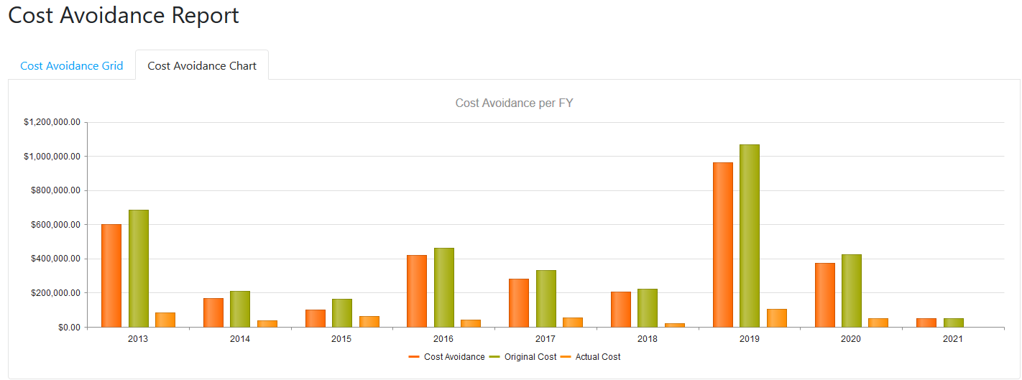
Project Update (MSL Cost Avoidance Increases)
As of11/3/2020

Slide 24
Project Update (MSL Cost Avoidance Increases)
Task: SC-17-03 – DOE EM Single Approved Supplier List
Project Manager: John McDonald
This new task was discussed at the EFCOG Spring 2017 and Fall 2017 meeting.
6/7/17 task start date
Objective: Provide recommendations to develop and maintain a single list of approved NQA-1 and Commercial Grade suppliers for use at DOE EM facilities. As a minimum, the list should support EM facilities, but may include all of DOE.
Deliverable: The task Team will provide recommendations to DOE and EFCOG on how to proceed with use of a complex wide EM approved supplier list. The recommendation should address the actions needed to allow contractors to use and maintain the list, contractual considerations, DOE endorsement, procedures, lead auditor certification, and conduct of supplier audits.
9/25/17 Final Report Issued.
2/13/18 MASL POC list is being populated to show which sites are participating. There are 16 EM sites, 8 NNSA, 10 OOS, and 1 NE site. See the MASL POC list for specifics. Only NTS, SRS, LANL, LLNL, & MSA are actively entering info into the MASL. Only NTS has it in their procedure to update the MASL as this is their ASL.
10/4/19 Summary for the 17 DOE EM sites: 6 are using the MASL [SRNS (includes SRR) & MSA, (includes CHPRC & WRPS) & FRNP] ; 7 are interested in putting suppliers into the MASL [WIPP-NWP; DUF6-MCS; ICP; SST (1 supplier in MASL); FBP; URS/CH2M; and CH2WV]; 3 unsure [N3B; PMA; Savannah River-Parsons/SWPF]
8/2018, EFCOG Safety Working Group Chair along with the SCQWG Chair have created a draft MOU. This MOU was discussed at the Fall 2018 Working Group meeting and Spring 2019 Working Group meeting.
7/31/19 the 8 NNSA sites signed a MOU document to agree to use the MASL.
9/16/20 Update:
7 of the 17 EM sites are using the MSL (CHPRC, MSA, WRPS, SRNS, SRR, FRNP, & UCOR);
6 of the 17 EM sites are interested in using the MSL (WIPP, DUF6, ICP, FBP, SST, CHBWV)
4 of the 10 OOS sites should be using the MSL. 2 of the 4 are using it: PNNL & BNL; ORNL, & PPPL are interested.
1 NE (INL) site should be using the MSL

Slide 25
Project Update (S/CI Improvement)
Task: SC-18-01 – S/CI Improvement
Project Manager: Bill Wingfield
This new task was discussed at the EFCOG Fall 2017 meeting 6/7/17 task start date
Task Start Date 11/7/17 12/31/18 Estimated Completion Date
Objective: S/CI Improvements
Deliverable: There will be three (3) deliverables:
1) DOE O 232.2A revised to address the fact that for legacy items the manufacture/supplier/vendor name is not available even though DOE O 232.2A, Attach 3, Occurrence Report Preparation, states “4. Reports on suspect/counterfeit and defective items or material, must provide..” The DOE Order currently requires the person who reports legacy S/CI to give the name of the supplier and other stuff that is impossible to provide.
2/5/18 sent suggestion to Ashley Ruocco that an Administrative Change be issued to DOE O 232.2A to add words such as: “if available”.
5/16/19 Per Ashley Ruocco, they have this note in the file for next time this DOE Order is up for review. It is not up for review this year. Ashley Ruocco ORPS and OPEX Program Manager, AU-23.
2) DOE EFCOG members need a S/CI Clearing House to share information. There maybe 2 avenues:
12/4/17 SCI information can be entered into the OPEXShare system that has over 10,000 registered users across the DOE Complex. Users can subscribed to be notified when new content is entered. SCI information is included in the Quality Assurance Topic that can be selected when setting up the account. New S/CI content can be sent to the site Operating Experience Coordinator for entry into OPEXShare. The system is cloud-based and content containing OUO or sensitive information is not allowed. If you have questions you can contact David Kelly david_s_Kelly@rl.gov or Luke White lucas_d_white@rl.gov as both Gerry Whitney and Mike Wingfield both retired.
https://opexshare.doe.gov/
Need to get the word out to site Receiving Inspectors.
https://www.energy.gov/ehss/policy-guidance-reports/databases/suspectcounterfeit-and-defective-items
As of 1/2/17, this site does not work for personnel not having PIV card/reader, so this is not a viable option.
Larry Adkinson Larry.adkinson@hq.doe.gov ; SCI Reporting, Program Manager; EHSS, AU-23, C-161; Office of EH&S Analysis and Reporting; Germantown, MD 20874; Office: 301-903-9311, stated that Frenda Lundmark took over for Deborah Garnett-Harris who just retired at end of January, 2018. Frenda.landmark@hq.doe.gov 301-903-8008. Larry retired from DOE-HQ 12/31/19. Colette Broussard was his boss.
3) DOE O 414.1D Attachment 3, page 2, 2.i, needs to be revised to correct the link: The DOE Order Att 3, page 3, 2.i states: “The organization’s QAP must:
Collect, maintain, disseminate, and use the most accurate, up-to-date information on S/CIs and suppliers. Sources are identified on the DOE S/CI website (http://www.hss.energy.gov/csa/csp/sci/)” This link does not work. Per DOE O 414.1D, Admin Change 1, 5/8/13 change the link to: http://www.hss.energy.gov /sesa/corporatesafety/sci/. However this is not a valid link either. Googling this gives lots of information, but this is not a valid link.
2/12/19, per Larry Adkinson, DOE O 414.1D is under revision this is the correct link:
https://energy.gov/ehss/policy-guidance-reports/databases/suspectcounterfeit-and-defective-items

Slide 26
Project Update (Foreign Nationals)
New Task: SC-19-01 – Foreign Nationals / Sensitive Information Supplemental Checklist
Project Manager: Bill Wingfield / Donna Schutzius / Dennis Owens
This new task was discussed at the EFCOG Fall 2018 meeting 10/16/18.
Task Start Date: 10/16/18 Estimated Completion Date: 9/30/19
Objective: Develop a supplemental checklist.
Deliverable: Post the new supplemental checklist along with guidance on the EFCOG web-site.
The current EFCOG Joint Supplier Evaluation Program Supplier Evaluation Governing Document, Rev 2, 2/1/2016, Appendix J, Export Control Checklist provides a good start on the types of questions that should be asked.
This JSEP governing document is being revised to Rev 3, to specifically add 3rd Party Evaluation Checklists for NQA-1 and NAP-24A.
The Appendix J Export Control Checklist was revised to Export Control / Interruptions From National Events Checklist.
COMPLETE 7/16/2020 – 20200709_EFCOG JSEP Governing Document E-SG-QA-SCQ-2020-01 Rev 0 was issued. This document was distributed to the SCQWG by Bill Wingfield.

Slide 27
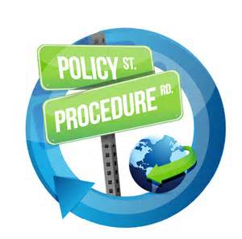
Project Update (JSEP/MSL Program Guide)
Task: SC-20-01 – JSEP/MSL Program Guide
Project Manager: Bill Wingfield
Team: Bill Wingfield,
Action: Revise the existing JSEP/MASL Program Guide
The JSEP/MASL Program Guide is available at: http://efcog.org/wp-content/uploads/Wgs/Safety Working Group/_Quality Assurance Subgroup/Supply Chain Quality/Documents/JSEP Supplier Evaluation Governing Document - Jan 2016.
This Task replaces the previous Task SC-14-01 – Note: This document is intended to be a guidance document to maintain consistency. Sites can use their own documents as long as they meet the intent of this document.
Status: Joe Fulghum revised the doc to Rev 3.
6/12/20 Bill Wingfield incorporated comments from reviewers, changed MASL to MSL, approved the document and forwarded it to Joe and Vince for approval..
COMPLETE 7/16/2020 – 20200709_EFCOG JSEP Governing Document E-SG-QA-SCQ-2020-01 Rev 0 was issued. This document supersedes Rev 2 of the JSEP Governing Document. It was distributed to the SCQWG by Bill Wingfield. David Hebert uploaded a link in the MSL.
Christine Frei is uploading a copy in the EFCOG Web site.

Slide 28
Project Update (MSL User Guide Update)
Task: SC-20-02 - MSL User Guide Issued and Published
Project Manager: Kristin Bell
Action: Issue and publish the MSL User Guide.
The NSE QSWG MASL Project User Guide for Site Administrators was last published 7/2017.
Based on previous task SC-16-01, the MASL user guide was added to MASL @: https://thesource.energy.gov/ptl/group/MASL/MASL-homepage and added to the EFCOG QA Supply Chain Quality Docs @: https://efcog.org/safety/quality-assurance-subgroup/supply-chain-quality-task-group/. This task SC-16-01 was closed 2/5/2018, and MASL User Guide was updated in 4/2019.
3/13/2020, Kristin Bell, SNL is writing the MSL User Guide.
3/25/20, The MASL was replaced by the MSL. Kristin is working on a MSL User Guide which needs to be issued and published.

Slide 29
Project Update (HEPA FTF Rejection)
Task: SC-20-03 – HEPA Filter Test Facility Rejection
Project Manager: Joe Fulghum
Action: Work with Sonya Barnett and the FTF to identify actions to help reduce FTF Rejections
The EFCOG QA SCQWG will help identify ways that we can reduce the rejections of filters at the FTF and during receipt inspections at the sites.
An analysis of FTF and the manufacturer test reports will help in pin pointing problem areas.
Upon completion of the activity, a briefing to the Office of Nuclear Safety, AU-30, covering the recommended actions will benefit the DOE-HQ program management of the facility.
Here is the FTF page:
https://orgex.energy.gov/forums/hepa-filter-poc
Christian Palay, DOE-HQ supports this task

Slide 30
Project Update (Remote Audits)
Task: SC-20-04 – Video Assessments / eAudits
Project Manager: Amber Romero
Action: Identify sites using eAssessments
Video Assessment/Audits – A2LA and PSL are performing Virtual assessments. Can we EFCOG implement this?
INPO issued guidance on performing Source Verifications remotely. (CGD Method 2)
DOECAP is performing Remote Audits.
6/17/20, Amber is attempting to do remote video/virtual assessments and will relay the results.
7/24/20 per NIAC Memo:
REMOTE AUDITING
We (NIAC) continue to receive inquiries regarding “remote audits” from members, as well as suppliers. Since no regulatory basis currently exists, NIAC does not approve of remote audits. The initial meeting of the EPRI task group for remote auditing was held last week. A larger than normal team with representation from EPRI, NRC, NEI, NUPIC, ASME, NIAC, and some nuclear suppliers. Discussion was good, but it will take some time to generate useful guidance.
The NIAC memo goes on to say: As previously noted, a remote review of programmatic elements and records prior to the site visit could be used to minimize time needed on site, but does not replace the site visit. Also, NQA-1, Requirement 7, Section 507 Acceptance of Services Only, provides some alternatives for accepting services only, in the event that an audit cannot be performed.
LANL’s Elizabeth Grossman developed a Remote audit procedure
SNL’s Dennis Owens drafted a Remote Assessment procedure.
SRNS’ Joe Fulghum sent request to NQA-1 committee for clarification.
EPRI has a Remote Guidance document

Slide 31
Project Update (Remote Audits)
Task: SC-20-04 – Video Assessments / eAudits (Continued)
Project Manager: Amber Romero
Action: Identify sites using eAssessments
9/16/20 Per Amber, here is the guidance from ISO on remote audits:
https://committee.iso.org/files/live/sites/tc176/files/documents/ISO%209001%20Auditing%20Practices%20Group%20docs/Auditing%20General/APG-Remote_Audits.pdf
Note that ISO says that the Audit Program Manager selects the methods for effectively conducting the audit.
Consider the purpose and scope of each audit to decide whether remote techniques will be effective for an individual assessment. Audit planning will (and should) take longer for remotely conducted assessments. Of course, both parties must agree that remote aspects will achieve the audit objectives.
Critical to know and trust, and test beforehand, the technology that will be used. Don’t allow remote techniques to compromise data protection or confidentiality. Ensure the interviewee is able to share their screen to demonstrate evidence documents. Build flexibility into audit schedule to accommodate potential downtime due to connectivity issues.
Ensure agreement in place with the vendor regarding any recording or images, including images of individuals (discouraged). Ensure authorization is in writing if this is needed.
Closing meeting: may want to push closing meeting out farther to allow auditors not working physically together to adequately collaborate and discuss findings/results.
9/16/20 per Dan Dilly SNL’s Site Office, they do NOT believe that Remote Audits could take the place of an on-site.
11/11/20 Amber Romero discussed these options at the Remote Fall 2020 SCQWG web-ex.

Slide 32
Project Update (Remote Audits)
Task: SC-20-04 – Video Assessments / eAudits (Continued)
Project Manager: Amber Romero
Action: Identify sites using eAssessments
9/16/20 Per Amber, here is the guidance from ISO on remote audits:
https://committee.iso.org/files/live/sites/tc176/files/documents/ISO%209001%20Auditing%20Practices%20Group%20docs/Auditing%20General/APG-Remote_Audits.pdf
Note that ISO says that the Audit Program Manager selects the methods for effectively conducting the audit.
11/11/20 Joe suggested developing list of Lessons Learned:
- Know what previous issues were identified.

Slide 33
Project Update (Common Suppliers)
Task: SC-21-01 – Expand Nuclear Security Enterprise (NSE Supply) Base
Project Manager: Dennis Owens, Lydia Ellis
Action: ????
Goal: increase the number of NSE shared suppliers from 11% to 30% by FY 25.
POC: Dennis Owens, Lydia Torres
At the last EFCOG – SCQWG Meeting at Y-12, Oct 2019 Dennis Owens suggested a task to identify those NNSA Suppliers that are common suppliers.

Slide 34
Audit Opportunities Update
(As of Nov 2020)
Notes:
Send Bill updates as your schedule changes.

Slide 35
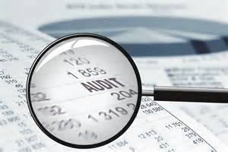
Audit Scheduling – Nov 2020
Supplier | Audit Basis | Lead
Airgas, Plumsteadville, PA (Exp 11/16/20) | NON – NQA-1 | LANL – Bill Wingfield (see section 310 of Standard, they are ISO/IEC 17025 accredited)
Air Techniques, Owings Mills, MDLANL audited 2019 to ISO 17025 (Nov) | Z540 | SRS – Craig Lewis
Appendix R Solutions, Glenn Allen, TX (11/10-12/20) | NQA-1-2008 / 1a-2009 | SRS – Mark
Bentley Systems, Inc., Anaheim, CA (11/27-28/20) | NQA-1-2008 / 1a-2009 & 2.7 | MSA-Bud Twigg
Intermech, Inc., Richland, WA (Exp 11/16/20) | NQA-1-2008 / 1a-2009 | PNNL - ????
MDC Vacuum, Hayward, CA (Ext from 4/20) | NQA-1-2008/1a-2009 & Non-NQA-1 | LANL – Bill Wingfield & LLNL Kristi & Pat
SwRI, San Antonio, TX (11/~17-19/2020) | NON – NQA-1 | PTX – Sylvia & Keith
Vacuum Process Engrg, Sacramento, CA (11/3-5/20) | NON – NQA-1 | KCNSC & SNL – Verne Howard & Amber Romero
Viking Packaging, Specialists, Catoosa, OK (11/9-13/20) | NON – NQA-1 | PTX – Dan & Steve S

Slide 36
Audit Scheduling – Dec 2020
Supplier | Audit Basis | Lead
Cyient Defense Services, New Britain, CT (12/07-11/2020) | NON – NQA-1 | PTX - Dan & Keith (welding)
Honeywell Fire Systems, Northford, CT (12/1-3/20 | NQA-1-2015 | NNSS – Andrew Birmingham
Phibro-Tech, Santa Fe Springs, CA (Exp 05/2020, Ext 11/2020) Remote???? | NON – NQA-1 | LANL - Bill Wingfield
SGS IBR Lab, Grass Lake, MI | ISO-17025 Testing | MSA - Shawn Slover
Team Tech, Albuquerque, NM (Exp 12/20) | NON – NQA-1 | LANL - Alonzo Simon, Bill Wingfield SNL - Amber Romero & KC??? (8/26/20)

Slide 37
Audit Scheduling – Jan 2021
Supplier | Audit Basis | Lead
Kiewit Power Constructors, Inc., Lenexa, KS (01/18-22/2021) WIPP did audit Sept 2020 (onsite NQA-1) | NQA-1-2008 / 1a-2009 | PTX - Sylvia Martinez
Leak Testing Specialist Inc., Orlando, FL (01/10-13/2021) | NQA-1-2008 / 1a-2009 | MSA - Shawn Slover
River Bend Transfer Sys, South Bend, IN (01/14-15/2021) | NQA-1-2008 / 1a-2009 & 2.14 | MSA - Shawn Slover
Packaging Specialties Inc. (PSI), Medina, OH (Exp 08/2020, Ext 01/11-13/2021) | NON – NQA-1 | LANL - David Destromp W PTX-Steve Solis, FRNP interested in copy; ORNL may support (Mike)
Swagelok Southwest Albuquerque, NM & Phoenix, AZ (Ext from 07/2020) (Supplemental Surveillance) | NQA-1-2008/1a-2009 & Non-NQA-1 | LANL - Bill Wingfield

Slide 38
Audit Scheduling – Feb 2021
Supplier | Audit Basis | Lead
Accurate Machine & Tool Feb 2021 | Non-NQA-1 | PTX – Supplier removed from QASL need full re-audit.

Slide 39
Audit Scheduling – Mar 2021
Supplier | Audit Basis | Lead
Manufacturing Sciences, Oak Ridge, TN (3/?) | Non-NQA-1 | LANL – Dave Destromp
Matheson Tri-Gas, Albuquerque, NM (3/8) | Non-NQA-1 | LANL – Alonzo Simon

Slide 40
Audit Scheduling – Apr 2021
Supplier | Audit Basis | Lead
Hand Precision, Los Alamos, NM (4/4) | Non-NQA-1 | LANL – Alonzo Simon
Springs Fab, CO (04/??/2021) Michelle Montoya audited PTX audited Non-NQA-1 WIPP audited 01/2020 | NQA-1-2008 / 1a-2009 | ORNL - Tommy Rowe
Thompson Machine, Albuquerque, NM (4/12) | Non-NQA-1 | LANL – Dave Destromp

Slide 41
Audit Scheduling – May 2021
Supplier | Audit Basis | Lead
Airgas, Plumsteadville, PA (Ext 05/2021) | NON – NQA-1 (see section 310 of Standard, they are ISO/IEC 17025 accredited) | LANL - Bill Wingfield
Jaguar Precision, Albuquerque, NM (5/24) | Non-NQA-1 | LANL – Bill Wingfield

Slide 42
Audit Scheduling – Jun 2021
Supplier | Audit Basis | Lead
Government Scientific Source (GSS), Reston, VA & Albuquerque, NM (6/26) | NQA-1-2008/1a-2009 & Non-NQA-1 | LANL – Bill Wingfield
NLI? (Formerly AZZ) Michelle Montoya possibly audited ~01/2020 | NQA-1-2008/1a-2009 & Non-NQA-1 (Possibly NQA-1-2015) | ORNL - Tommy Rowe

Slide 43
Supply Chain Quality Webex Calls
2020 Supply Chain Quality Webex / Conference Call Schedule
Date | EST | CST | MST | PST
Dec 16, 2020 | 11 AM | 10 AM | 9 AM | 8 AM
Jan 20, 2021 | 11 AM | 10 AM | 9 AM | 8 AM
Feb 17, 2021 | 11 AM | 10 AM | 9 AM | 8 AM
Mar 17, 2021 | 11 AM | 10 AM | 9 AM | 8 AM
Apr 21, 2021 | 11 AM | 10 AM | 9 AM | 8 AM
May x, 2021 | 11 AM | 10 AM | 9 AM | 8 AM
Jun y, 2021 | 11 AM | 10 AM | 9 AM | 8 AM
Jul z, 2021 | 11 AM | 10 AM | 9 AM | 8 AM
Aug z, 2021 | 11 AM | 10 AM | 9 AM | 8 AM
Notes:
If you have a topic that you would like discussed at a call, please send an email to Bill wwingfield@lanl.gov

Slide 44
Old Business
Any Other Old or New Business to Discuss?

Slide 45
Project Update (Common Suppliers)
Organizational Excellence Web-site:
https://orgex.energy.gov/
You register, you should be able to access the QA Community of Practice page at:
https://orgex.energy.gov/forums/qa-community-practice
Here is the FTF page: https://orgex.energy.gov/forums/hepa-filter-poc

Slide 46
New Business
The new High Efficiency Particulate Air (HEPA) Filters web-site is available at:
https://powerpedia.energy.gov/wiki/High_Efficiency_Particulate_Air_(HEPA)_Filters
This site provides all you need to know about HEPA filters including DOE’s role and Monthly Reports.
Contact Sonya Barnette (AU Filter Test Facility Program Manager, AU-32) sonya.Barnette@hq.doe.gov if any questions or suggestions for improvement.
FTF needs an advance copy of the Purchase Order or they are no longer receiving Filters. Send a copy to Chris Hart FTF testing manager. chart@atitest.com Note: This is a proposed policy that Christian Palay wants to institute next year. The FTF currently is receiving filters without POs, but they are not being tested until a site PO is received. Effective 10/1/19 the FTF will not be receiving Filters w/o a PO.
Effective 10/1/19, the FTF will no longer receive Filters w/o a PO previously being provided. The DOE draft policy regarding not accepting filters w/o POs at the FTF is still under discussion at DOE-HQ.
3/12/20 per Sonya in Feb 2020 2 filters were rejected for penetration and 43 filters were rejected for labeling problems (32 rejected from 1 order). 80 filters on hold for either missing or incomplete POs.
New 2020 Supply Chain Quality Task – How do we help reduce rejections – Joe Fulghum Chairman
Here is the FTF page:
https://orgex.energy.gov/forums/hepa-filter-poc
The EFCOG Web site is located at: http://efcog.org/
Contact Changes and Document Postings should be sent to:
Christine Frei
Longenecker & Associates, Inc.
804-263-4591
cfrei@la-inc.com

Slide 47
New Business
Proposed additions to NAP-24B (401.1A)
Attachment 5 M&TE requirements (will be R028)
Attachment 6 Supplier Quality Requirements (will be added to R013 Control Supply Chain)
7/9/2020, Per Andi Rainer,
NAP-24A was changed to NAP-401.1 on 10/1/19. Content was the same, only the number was changed.
The Weapon Quality Division, NA-121.3 is in the process of revising NAP-401.1. The revised version NAP-401.1A (previously called NAP-24B) released this CY 2020. It will be released at the same time as R013 and R028 are released.

Slide 48
New Business
Does your site include Suspect/Counterfeit Item (S/CI) Prevention Lines of Inquiry (LOIs) in your checklists?
If not you should add S/CI LOIs to your checklists.
The main thing we should be asking our suppliers, is if they find a suspect/counterfeit item do they hold it for investigation (by the IG) or return it to the supplier?
DOE O 414.1D “Quality Assurance” is trying make sure S/CI items do NOT get back into the supply chain and offenders are prosecuted.
See DOE Handbook Suspect/Counterfeit Items Resource Handbook DOE-HDBK-1221-2016 August 2016, Change 1, effective Jan 2017).
Gabby Holcomb of Sandia has shared with us an on-line S/CI training:
https://prod-ng.sandia.gov/wbt/SCA050/course_holder.html
2/7/20 the latest DOE S/CI site is:
https://www.energy.gov/ehss/policy-guidance-reports/databases/suspectcounterfeit-and-defective-items

Slide 49
Supplier ISO Certification Validation/Verifications
Supplier ISO Certification Validation/Verification Links
A2LA: https://portal.a2la.org/search/
ABS Quality Evaluations: https://www.eagle.org/qenetcert/ECert.Abs_ccd1
ACM: https://www.acmcert.com/certificate-checker/
Afnor: https://certificats-attestations.afnor.org/
ANAB: https://www.anab.org/ or https://search.anab.org/
Or https://anabdirectory.remoteauditor.com/ (this is a good tool to get the name, phone, and email of persons to contact from the Certification Company).
ASME: https://caconnect.asme.org/directory/
Aston-Global: http://www.aston-global.com/ (CAUTION: This does not appear to be an accredited organization. This company has issued ISO-9001 Cert to Mbraun, Stratham, NH)
BSI America: https://www.bsigroup.com/en-US/our-services/Management-system-certification/Certificate-and-Client-Directory-Search/
China National Accreditation Service for Conformity Assessment (CNAS): http://wwwcnas.org.cn/English/findanaccreditedbody/index.shtml
DNV-GL: https://certificatechecker.dnvgl.com/
DQS: https://www.mydqs.com/en/customers/customer-database.html
(Continued)

Slide 50
Supplier ISO Certification Validation/Verifications (Cont.)
IAQG: https://www.iaqg.org/oasis/login
Online Aerospace Supplier Information System (IAQG-OASIS).
This online resource contains a list of suppliers who are certified / registered under the IAQG rules to be in compliance with the aerospace quality management system requirements (9100 series).
IAS: https://www.iasonline.org/search-accredited-organizations-2/
ILAC: https://ilac.org/signatory-search/ (For Calibration, testing, etc)
Intertek: http://www.intertek.com/business-assurance/certificate-validation/
JQA: https://www.jqa.jp/cgi-bin/06manage/14_touroku/search_e.html
NIST: https://www-s.nist.gov/niws/index.cfm?event=directory.search#no-back
NSF: https://nsf-isr.org, or http://info.nsf.org/Certified/isr/index.asp
NSAI - For National Standards Authority of Ireland (NSAI), https://www.nsai.ie/certification/search-for-a-certified-company/ or for Certs contact Jodi Espinal, Certification & Quality Cord. @ 603.689.9102 or cell 603.930.7076 email @: Jodi.Espinal@NSAIinc.com or Lisa Greenleaf Operations Manager, US Lisa.Greenleaf@NSAIinc.com, 603.689.9145
NQA Global: https://www.nqa.com/en-us/contact-us 800-649-5289
NVLAP: https://www-s.nist.gov/niws/index.cfm?event=directory.search#no-back
(Continued)

Slide 51
Supplier ISO Certification Validation/Verifications (Cont.)
Perry Johnson: http://www.pjlabs.com/search-accredited-labs
QAS International: https://www.qas-international.com/contact/
SAI Global: http://qmi-saiglobal.com/qmi_companies/ or https://register.saiglobal.com/Default.aspx?stype=simple
SAI Global QMI: https://www.saiglobal.com/en-us/assurance/auditing_and_certification/certification_registry/
SGS: https://www.sgs.com/en/certified-clients-and-products/certified-client-directory
Smithers Quality Assessments: https://smithersregistrar.com/resources/certifiedcompanies
SQS Switzerland: https://www.sqs.ch/en/certified-organisations
SRI: https://www.sriregistrar.com/resources/sri-certificate-validation/
TUV Nord: https://www.tuev-nord.de/en/company/certification/certificate-database/
TUV Rhineland: https://www.certipedia.com/
TUV Sud – America: https://www.tuvsud.com/en-us/resource-centre/certificate-finder
TUV Sud Group: https://www.tuev-sued.de/management-systems/our-company/reference-list
Others???
Newly added:
Institute of Printed Circuits: www.ipc.org/cert-search.aspx If you go to ipc.org/files-history/HistoryBook you can download a pdf From Vacuum Tubes to Nanotubes, 50 years,1957-2007.

Slide 52
Supplier ISO Certification Validation/Verifications (Cont.)
Who is Eligible to Grant ISO 9001 Certification?
So who is eligible to grant ISO 9001 certification? Many people assume that ISO grants certification, but in fact, this is not true, instead, a registrar or certification body (CB) will be the one to grant certification (Read: Who is ISO?). When choosing a registrar a supplier should make sure that they are accredited. They should be a member of the International Accreditation Forum (IAF), and additionally need to be ISO/IEC 17021:2015 certified.
One of these standards is ISO/IEC 17021:2015 Conformity assessment “Requirements for bodies providing audit and certification of management systems“, which in effect stipulates the requirements for Registrars who certify organizations to ISO management standards like ISO 9001, ISO 14001, etc.
People often say “ISO Certified” but ISO does not issue certificates or certify individual companies to any standard. So who can Grant ISO 9001 Certification? They are issued by certification/registration bodies (also called Registrars or CB’s), which are independent of ISO. CB’s need to be accredited by an IAF member to be internationally recognized.
ISO/IEC 17021 ensures international acceptance of the CB’s certifications (i.e. your ISO 9001:2008 certificate) by requiring that all Accreditation bodies (ANAB, etc.) belong to an internationally accredited organization, like the IAF. Likewise, the IAF ensures that CB’s comply with ISO/IEC 17021.
Some Quality System Registrars are not accredited by IAF, and thus are not meeting ISO 17021 — and will not be internationally recognized. Make sure that you choose a Registrar who is accredited by an IAF member (ANAB or the equivalent of ANAB in your country or region).
When you receive your registration certificate, it should display the ANAB and the IAF logos and unfortunately, without them, you are not officially ISO 9001 certified.

Slide 53
Recent Complex Organizational Moves
Recent Complex Organizational Moves!!
Effective 8/3/2020 Nevada Field Office Mgr Steve Lawrence has taken a new position in the Office of Admin as Sr. Tech Advisor for Field Operations.
Dr. David Bowman is acting Nevada Field Office Mgr & Laura Tomlinson is serving as the acting Nevada Field Office Deputy Mgr.
Larry Adkinson retired from DOE-HQ 12/31/2019. His replacement is TBD. Colette Broussard, Director Office of ES&H Reporting and Analysis (AU-23) is looking for his replacement (if that is possible to replace Larry ☺).
Colette is hosting a Monthly DOE Contractor S/CI Working Group web-ex meeting.

Slide 54
Recent Complex Organizational Moves
Recent Complex Organizational Moves!!
Cincinnati – 5/14/20, U.S. DOE awarded the Hanford Tank Closure Contract (TCC) that will provide a variety of services at the Hanford Site in Richland, Washington, to Hanford Works Restoration, LLC, located in Lynchburg, Virginia. The Hanford Works Restoration members are BWXT Technical Services Group, Inc. (Lynchburg, Virginia), Fluor Federal Services, Inc. (Greenville, South Carolina), INTERA, Inc. (Austin, Texas), and DBD, Inc. (Richland, Washington). This is an Indefinite Delivery Indefinite Quantity (IDIQ) contract under which firm-fixed-price and/or cost reimbursement task orders may be issued. The total estimated value of the contract is up to approximately $13 billion over a 10-year ordering period.
The contractor will perform these services under task orders issued off the master IDIQ contract. Firm-fixed-price and/or cost reimbursement task orders may be issued under the contract. The solicitation for this contract used the new End State Contracting Model that the DOE Office of Environmental Management expects will significantly reduce risk and environmental liability to provide the best overall solution for the accelerated completion and closure of the Hanford Site.
MSA will be replaced by HMIS HMIS stands for Hanford Mission Integration Solution and should be effective sometime in December 2020.
Additional information is available via the procurement website at https://www.emcbc.doe.gov/SEB/TCC/.

Slide 55
Recent Complex Organizational Moves
Recent Complex Organizational Moves!!
Mike Lempke, Huntington Ingalls Industries (HII), replaces Billy Morrison, Veolia Nuclear Solutions as the EFCOG Chair. Sandra Fairchild Savannah River Remediation is the EFCOG Vice Chair, and Morgan Smith, Consolidated Nuclear Security, is the Vice Chair-elect.
N3B LANL – Stoller Newport News Nuclear & BWXT (N3B) - Los Alamos w/ Subcontrators Longenecker & Associates, Inc. (L&A) and Tech2 Solutions (T2S) Wins $1.4B LANL Award - EM program to monitor contaminated water systems, D&D contaminated buildings, clean up soiled lands, and ship mixed, low level & transuranic radioactive waste at LANL in Mar 2018. Scott Hobbs, is the new N3B Quality Assurance Program Director starting 10/2019. http://n3b-la.com/
Mission Support and Test Services, LLC (MSTS) - a joint venture with Honeywell International, and equity partners Jacobs Engineering, and Stoller Newport News Nuclear Inc. (SN3), a part of Huntington Ingalls Industries Technical Solutions division.
Beginning Dec. 1, 2017, MSTS is the new M&O contractor for the Nevada National Security Site (NNSS).
Triad National Security, LLC – 6/6/18, NNSA announced award of contract valued at $2.5B/yr of Battelle Memorial Institute, the Regents of the University of CA, and the Regents of Texas A&M University the M&O contract for LANL. Fluor Federal Services, Huntington Ingalls Industries/Stoller Newport News, Longenecker & Assoc, TechSource, Strategic Management Solutions and Merrick & Co. will support Triad National Security, LLC. LANS contract expires 9/30/18 will be extended to allow for a full 4 month transition period. 7/9/18 NNSA issued notice to proceed with Transition. 11/1/18 Triad took over LANL.

Slide 56
Future EFCOG ISM & QA Working Group Meetings
Spring 2019 EFCOG ISM & QA Working Group Meeting was at ORNL, 5/6-10/2019
Fall 2019 EFCOG ISM & QA Working Group Meeting – was at Y12, 10/28 – 31/2019
Spring EFCOG QA 2020 meeting at SNL, 3/30-4/2/2020 – CANCELLED (COVID-19)
Spring EFCOG ISM 2020 meeting at PTX, 4/20-23/2020 – CANCELLED (COVID-19)
EFCOG ISM & QA Fall 2020 meeting was held remotely, 11/9 – 11/12/2020
EFCOG ISM & QA Spring 2021 meeting at SNL???, dates TBD??? (NQA-1 Meets xx/xx/21 and Weapons QA meets xx/xx/21 can’t conflict.)

Slide 57
Fall 2020 EFCOG Meeting @ Your Desk Agenda
Fall 2020 EFCOG QA Meeting – Scheduled 11/9-11/12/20 at Your Desk
Registration is available @: https://efcog.org
Monday Nov 9, 2020 415-655-0001 Meeting ID# 133 478 0001
EFCOG Joint QA/ISM Session Noon – 4:30 pm EST @ your desk
Tuesday Nov 10, 2020 10:30 – 4:30 EST @ your desk break out sessions
Working Group Reports – Overview of initiatives, issues, roadblocks, and opportunities:
QA P&P,
Software QA,
Supply Chain Quality Phone # 415-655-0002 Meeting ID 133 776 8152
Procurement Engineering
Wed Nov 11, 10:30 – 4:30 EST breakout sessions @ your desk Phone SCQWG # 415-655-0002 Meeting ID 133 776 8152 #
Thurs Nov 12, 10:30 – 1:30 EST breakout sessions @ your desk Phone SCQWG # 415-655-0002 Meeting ID 133 776 8152 #

Slide 58
Open Discussion

Slide 59
People wanting to participate on audits:
These individuals are interesting in obtaining their Lead Auditor Certifications and willing to participate on audits free of charge (i.e. they will pay their own way):
Amber Romero SNL; allewis@sandia.gov
Sherri Auckland, LANL-Carlsbad Operations; sauckland@lanl.gov
Surendra Tiwari, PPPL; stiwari@pppl.gov

Slide 60
Next Webinar/Call & Close Out
Next Webinar/Call: (Usually the Third Wednesday of each month)
12/16/20
11:00 AM EST
10:00 AM CST
09:00 AM MDT
08:00 AM PST

