Slide 1
EFCOG Supply Chain Quality Task Team Conference Call Sep 21, 2022
Vince Grosso
Quality Assurance Technical Team Chair
William R Wingfield
Supply Chain Quality Task Team Chair
Joseph Fulghum
Supply Chain Quality Task Team Vice Chair
Kristin Bell
Supply Chain Quality Secretary
Unclassified
Notes:
If troubles connecting to WebEx, call their help line 866-863-3903 or 866-229-3239

Slide 2
Overview
MSL Supplier Database access
Upcoming Conferences / Workshops
Industry / Supplier Issues
Interface Representative Updates
EFCOG Safety Working Group
Supply Chain Project Updates
Audit Opportunities Update
Old / New Business
Discussion & Close Out

Slide 3
PLEASE MUTE YOUR PHONES
I suggest you call in on your phones vs using the computer mics.
Please mute your phones
Please mute the microphones on your computer
You may have to unmute your computer.
Press *6 to unmute your phones.

Slide 4
Supplier Database Access
History
Effective Sun 3/22/20 the MASL went dark (i.e. It is no longer active.)
Wed 3/25/20, the MSL is now active.
Registration (Step 1 - Must be completed first):
Required Credentials: You must possess one of two types of credential (PIV or OneID). PIV is the preferred
method, OneID is available for those sites that have adopted. Your local Help Desk will be able to assist you in
identifying what options are available and obtain the appropriate credential only They do not support MSL.
- After attaining a credential, you are ready to register it with the Portal site. PIV (with activated credential and
PIN for virtual authentication) and OneID will be the only accepted ways to access the Portal
Registration Process:
a. Open a browser and go to SKY Portal (https://thesource.energy.gov)
b. Click on "Sign In", located at the top, right-hand corner of the page.
c. You will be prompted through a few screens to register your credential
For question or user guides, email : mslsupport@sandia.gov

Slide 5
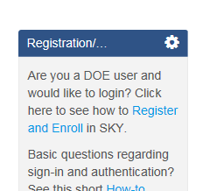
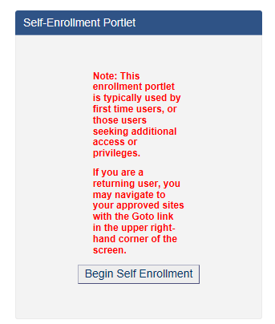
Supplier Database Access (Cont.)
Self-enrollment: (Step 2 –Step 1 MUST be completed first):
Now that your credential is registered you will need to enroll into the appropriate site on the Portal.
- Return to the SKY Portal (URL above), Sign-In, and locate the following portlet new the top right corner of the screen - Figure 1:
- On the resulting screen, locate the following portlet (left-hand side of screen) – Figure 2:
Click the button: “Begin Self Enrollment” (if need to, click on the link “How-to Guide”).
When prompted for "which portal you are requesting access to...," select the desired portal site from the currently available: (EM, NNSA or MSL). You will want to select MSL.
You will need to select the appropriate EM Contractor, NSE Contractor, Office Of Science Contractor, Other. NSE Contractors are the NNSA Contractors.
You will want to select Edit Content if you are going to be putting suppliers into the MSL or want to view what suppliers are in the MSL.
- Approval by selected site ICR (Information Content Representative - Bill Wingfield, or Vince Grosso for the MSL) will take place and you will be notified by email.
Figure 1
Figure 2

Slide 6
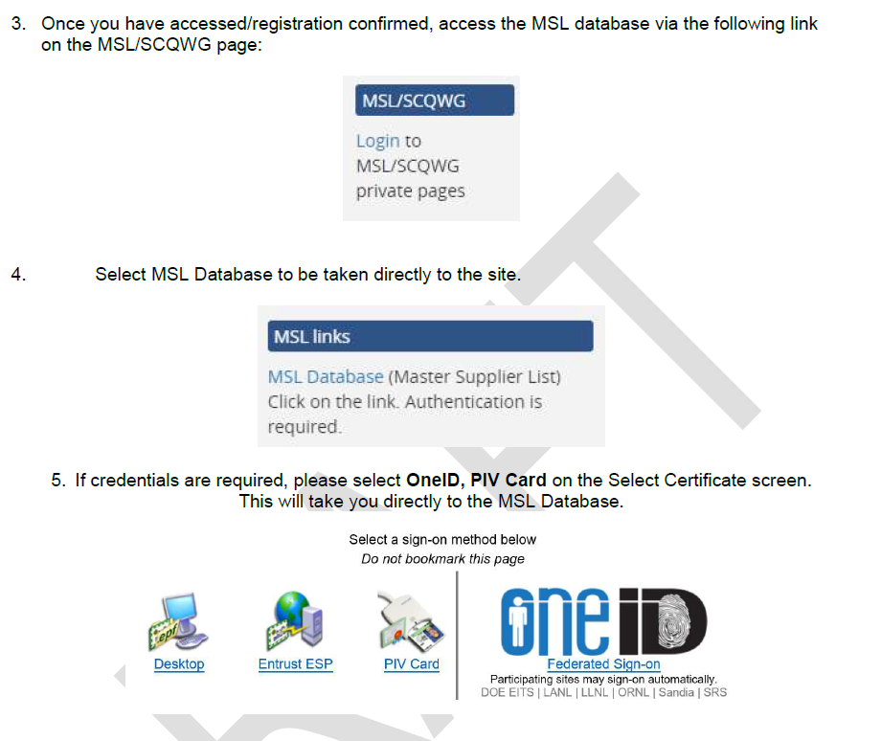
Supplier Database Access (Cont.)
Use the site https://msl.kcnsc.doe.gov after registered or access through SKY Portal

Slide 7
Supplier Database Access (Cont.)
You have now logged into the MSL application and the following Home dashboard will come up. You are ready to start using the MSL database!

Slide 8
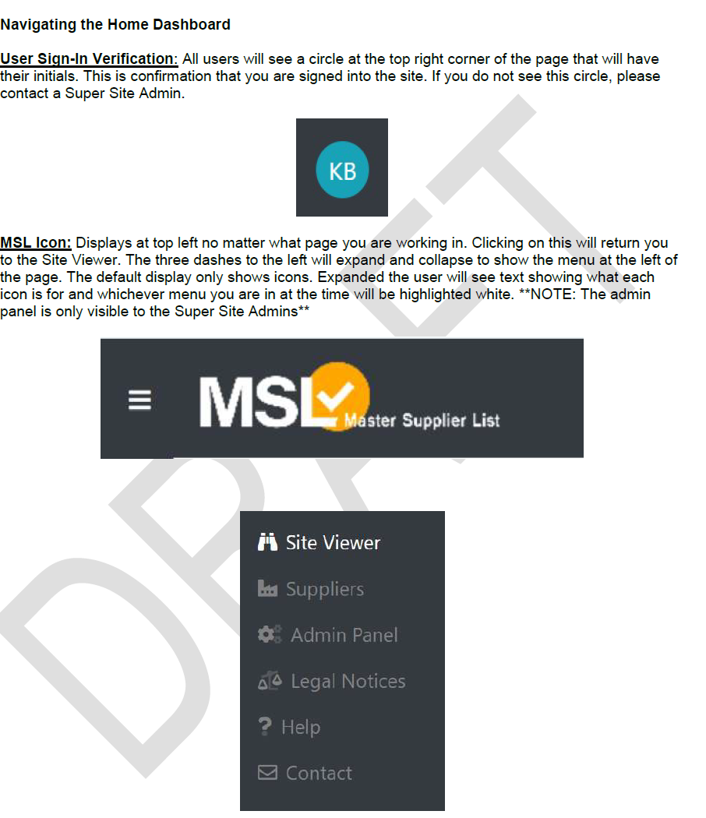
Supplier Database Access (Cont.)

Slide 9
Supplier Database Access (Cont.)
12/6/2021 Update to MSL deployed
Changes:
Added Auto Generated Avoidance Title feature.
Added notice that the title is generated when creating an Avoidance.
Added tooltip to Title on Edit Avoidance explaining generated title option.
Added Assessment Start Date to Assessments listed on a Supplier Details Pages.
Removed Status from Supplier pages.
Fixed Delete Avoidance to be available for Admin Users.
Various other small adjustments to User interface.

Slide 10
Supplier Database Access (Cont.)
Please use MSL cost avoidance feature to help us identify savings from sharing 3rd party audits.
If you have saved $ by performing a 3rd party review or only sending 1 or 2 person(s) on an audit team vs. a 3 person team, you need to enter a cost avoidance in MSL.
Any issues with access or use?
Email Kristin Bell @ mslsupport@sandia.gov or Bill @ wwingfield@lanl.gov
The eight (8) NNSA sites have committed to using the MSL (CNS-PTX, CNS-Y12, KCNSC, LLNL, LANL, NNSS, SNL, SRS)
7 of the 17 Environmental Management Sites are using the MSL (CHPRC (now CPCco), MSA (now HMIS), WRPS, SRNS, SRR, FRNP & UCOR)
6 of the 17 EM Sites are interested in using the MSL (WIPP, DUF6, ICP, FBP, SST, & CH2WV)
3 of the 17 EM Sites are unsure (N3B, PMA, & Parsons/SWPF)
1 not interested (BNI)
Of the 10 Office of Science (OOS) sites, 2 are using the MSL (PNNL & BNL)
2 are interested in using the MSL (ORNL, & PPPL)
The one (1) Nuclear Energy (NE) site INL is using the MSL.

Slide 11
Upcoming Conferences / Workshops
Sep 2022 – Dec 2022
Date | Conference Title | Location | Website
9/12-15/22 | DOECAP Analytical Services Program (ASP) 2022 Annual Training Workshop for TSDF (Previously CANCELLED, but back on | Las Vegas, NV | https://doecapasp.projectenhancement.com/
9/19-22/22 | ASME NQA-1 Lead Auditor Training | Virtual Classroom | Theseus Professional Services, LLC Nmoreau@theseuspro.ccsend.com
9/21-23/22 | 8th Annual National Cleanup Workshop (NCW 2022) | Crystal Gateway Marriott – Arlington, VA | https://www.cleanupworkshop.com/rates---registration.html
10/3-7/22 | GQA Global QA Nuclear Training Intro to Nuclear/Lead Auditor/SCWE Safety Conscious Work Environment | Orlando, FL | Training@GQAINC.COM 888.322.3330
10/12-14/22 | 2022 ASQ Quality 4.0 Summit | Grand Hyatt, San Antonio River Walk | ASQ Communications <bounceback@asq.org>
10/17-21/22 | Nuclear QA Lead Auditor Cert Training | GoToMeeting Online Classroom | http://www.lmarvinjohnson.com/nuclear_quality_assurance_lead_auditor_certification_training.htm
11/14-17/22 | EFCOG ISM & QA Working Group Fall 2022 Meeting | Virtyal | TBD
11/14-15/22 | ASME NQA-1 Req for Computer Software used in Nuclear Facilities | Virtual Classroom | Theseus Professional Services, LLC Nmoreau@theseuspro.ccsend.com
11/14-15/22 | Commercial Grade Dedication Workshop | GoToMeeting Online Classroom | http://www.lmarvinjohnson.com/commercial_grade_dedication_program_development.htm
12/5-8/22 | ASME NQA-1 Lead Auditor Training | GOTOMEETING Online Classroom | Theseus Professional Services, LLC Nmoreau@theseuspro.ccsend.com
12/6-8/22 | DOECAP Analytical Services Program (ASP) 2022 Annual Training Workshop for Laboratory | Las Vegas, NV | https://doecapasp.projectenhancement.com/
12/7/22 | 2022 ASQ Women I Quality Symposium | Virtual | ASQ Communications <bounceback@asq.org>
12/12-16/22 | Nuclear QA Lead Auditor Cert Training | GoToMeeting Online Classroom | http://www.lmarvinjohnson.com/nuclear_quality_assurance_lead_auditor_certification_training.htm

Slide 12
Upcoming Conferences / Workshops
Jan 2023 – Jun 2023
Date | Conference Title | Location | Website
2/6-7/23 | ASME NQA-1 Req for Computer Software used in Nuclear Facilities | Virtual Classroom | Theseus Professional Services, LLC Nmoreau@theseuspro.ccsend.com
2/13-15/23 | Annual Nuclear Deterrence Summit | Arlington, VA Hyatt Regency Crystal City | https://na.eventscloud.com/ereg/index.php?eventid=697070&
3/6-9/23 | ASME NQA-1 Lead Auditor Training | Virtual Classroom | Theseus Professional Services, LLC Nmoreau@theseuspro.ccsend.com
5/8-9/23 | ASME NQA-1 Req for Computer Software used in Nuclear Facilities | Virtual Classroom | Theseus Professional Services, LLC Nmoreau@theseuspro.ccsend.com
6/5-8/23 | ASME NQA-1 Lead Auditor Training | Virtual Classroom | Theseus Professional Services, LLC Nmoreau@theseuspro.ccsend.com
6/26-29/23 | ASME NQA-1 Lead Auditor Training | Virtual Classroom | Theseus Professional Services, LLC Nmoreau@theseuspro.ccsend.com

Slide 13
Industry Supplier Issues / Feedback
SME’S ON SUPPLIER AUDITS – Helps with Cost Avoidances & Good Business Practice
DOT Packaging suppliers - If you are doing an audit of a DOT packaging supplier. You need to have a DOT SME along for the audit, or at least an a DOT checklist provided to a QA auditor who has been trained in DOT. It’s a good idea to interview the SME to make sure of his qualifications.
Welding programs – If you are doing an audit of a supplier who is doing welding or providing welding materials you need to have a CWI or similar type welding SME.
There may be cases where you need to bring both a DOT and Welding SME. If no specialized welding is required you may not need a Welding SME.

Slide 14
Industry Supplier Issues / Feedback
Air Force Fatal Fighter Jet Crash in 2020 may be due to counterfeit parts:
An Air Force investigation of a fatal fighter jet crash in 2020 quietly discovered that key components of the pilot’s ejection seat may have been counterfeit, Air Force Times has learned.
First Lt. David Schmitz, an F-16 Fighting Falcon pilot at South Carolina’s Shaw Air Force Base, died June 30, 2020, when his ejection seat malfunctioned as he tried to escape from a failed nighttime landing. He was 32.
The Air Force’s official inquiry in the months following the accident found that electronics inside the seat were scratched, unevenly sanded and showed otherwise shoddy craftsmanship.
That raised red flags at the Air Force Research Laboratory, which called for a closer look to confirm whether the pieces were fraudulent, according to previously unreported slides provided to Air Force Times. It’s unclear whether that question was ever answered.
While the Air Force suspected parts of the seat were counterfeit, it buried the information in a nonpublic section of its accident investigation report.
Those details have come to light in a federal civil lawsuit filed by Schmitz’s widow, Valerie, who is suing three defense companies for negligence and misleading the Air Force about the safety of their products.
https://www.defensenews.com/news/your-air-force/2022/09/13/an-f-16-pilot-died-when-his-ejection-seat-failed-was-it-counterfeit/?utm_source=linkedin&utm_medium=social&utm_campaign=dfn-rss-zap

Slide 15
Industry Supplier Issues / Feedback
DOE OPEXShare
Idaho National Laboratory, Advanced Test Reactor NE-ID--BEA-ATR-2022-0012 - Suspect/Counterfeit (S/CI) Fasteners Discovered on Plant Protective System B and C Battery Racks - (Reporting Level L) On August 9, 2022, during an inspection of the four Plant Protective System (PPS) batteries and battery racks, suspect/counterfeit (S/CI) fasteners were discovered on PPS-B and C battery racks. PPS-B had one suspect fastener and PPS-C had two suspect fasteners. The PPS battery racks are required to withstand a design basis seismic event. The PPS batteries were not required to be operable at the time of discovery. The items were deemed suspect/counterfeit or defective because Part Number 80449 did not have a model number, no headmarking was shown per list or how the item/material is being used to ensure the structural integrity of the battery rack during a seismic event is maintained, and no identification of any resulting consequences was indicated. Appropriate levels of Battelle Energy Alliance Management and the Department of Energy Facility Representative were notified of this discovery.
Link to Article: Daily ORPS Summary for August 25, 2022

Slide 16
Industry Supplier Issues / Feedback
GIDEP S/CI Issues: between 29-AUG-2022 and 02-SEP-2022
Subject: GIDEP Suspect Counterfeit Doc's between 29-AUG-2022 and 02-SEP-2022 * * * * * DOC=AAN-U-22-252A CEDATE=31-AUG-2022 DD=AN
Note this was previously identified by GIDEP in July
Title: SUSPECT COUNTERFEIT & COUNTERFEIT CISCO ROUTERS Abstract: This amendment is to add Cisco (Cage Code 0GX96), whose products have been or may have been counterfeited, to GIDEP parts database. CONTRACTOR NAME: Pro Network LLC CAGE CODE: 7KCD7
The Grand Jury of the United States District Court ? District of New Jersey has released an Indictment against various persons and companies who conspired from approximately 2013 through 2022 with suppliers in China & Hong Kong and others to import low-quality, modified computer networking devices with counterfeit labels, stickers, boxes, documentation, and packaging to make the items falsely appear to be new, genuine, and high-quality devices manufactured and authorized by Cisco Systems, Inc. ( ?Cisco?, CAGE Code 0GX96). These conspirators then resold tens of thousands of those devices in the United States and around the world, falsely representing those devices to buyers as new, genuine, and high-quality Cisco products. (See attached Indictment). Known affiliated company names. None of these have CAGE Codes. 1. Netech Solutions LLC 2. Target Network Solutions LLC 3. Easy Network LLC 4. ACE NETUS LLC (a/k/a Ace Network) 5. Mv Network Dealer LLC 6. 1701 Doral LLC 7. Maytech Trading LLC 8. NFD Trading LLC 9. Kenet Solutions LLC 10. Team Tech Global LLC 11. Tenek Trading LLC 12. The Network Gears LLC 13. All Networking Solutions LLC (a/k/a All Network) 14. JMS TEK LLC 15. SAN Network LLC 16. Renewed Equipment LLC 17. Pro Ship US LLC
* * * * DOC=DJS-A-22-04 CEDATE=30-AUG-2022 DD=AL
Title: SUSPECT COUNTERFEIT, ZENER DIODE SINGLE 120V 5% 380 OHM 3000MW 2-PIN SMB T/R Abstract: 10 devices were visually inspected under 40x microscope. Marking is suspected. Devices construction and leads formation do not match the manufacturer spec drawing. Total parts: 30,000 Global ETS test report photos attached. September 5, 2022

Slide 17
Industry Supplier Issues / Feedback
GIDEP S/CI Issues: between 22-AUG-2022 and 26-AUG-2022
Subject: GIDEP Suspect Counterfeit Doc's between 22-AUG-2022 and 26-AUG-2022 * * * * *
DOC=DJS-A-22-03 CEDATE=24-AUG-2022 DD=AL Title: SUSPECT COUNTERFEIT, FPGA SPARTAN-6 LX FAMILY 74637 CELLS 45NM TECHNOLOGY 1.2V 484-PIN CSBGA
Abstract: 10 devices were visually inspected under 40x microscope. Secondary coating was observed. Marking is suspect. Devices are not in new or original condition (see figure 7). BGA are suspect re-balled (see figure 9). Heated Solvent Testing was performed on 1 device using Dynosolve 750 solution. Secondary coating was removed during this process. The device failed Heated Solvent testing (see figure 14). Total parts: 40 Global ETS test report photos attached. August 29, 2022

Slide 18
Industry Supplier Issues / Feedback
GIDEP S/CI Issues: between 27-JUN-2022 and 01-JUL-2022
Subject: GIDEP Suspect Counterfeit Doc's between 08-AUG-2022 and 12-AUG-2022 * * * * * DOC=AAN-U-22-252 CEDATE=11-AUG-2022 DD=AN
Title: SUSPECT COUNTERFEIT & COUNTERFEIT CISCO ROUTERS Abstract: CONTRACTOR NAME: Pro Network LLC CAGE CODE: 7KCD7 The Grand Jury of the United States District Court, District of New Jersey has released an Indictment against various persons and companies who conspired from approximately 2013 through 2022 with suppliers in China & Hong Kong and others to import low-quality, modified computer networking devices with counterfeit labels, stickers, boxes, documentation, and packaging to make the items falsely appear to be new, genuine, and high-quality devices manufactured and authorized by Cisco Systems, Inc. ( Cisco, CAGE Code 0GX96).
These conspirators then resold tens of thousands of those devices in the United States and around the world, falsely representing those devices to buyers as new, genuine, and high-quality Cisco products. (See attached Indictment). Known affiliated company names. None of these have CAGE Codes. 1. Netech Solutions LLC 2. Target Network Solutions LLC 3. Easy Network LLC 4. ACE NETUS LLC (a/k/a Ace Network) 5. Mv Network Dealer LLC 6. 1701 Doral LLC 7. Maytech Trading LLC 8. NFD Trading LLC 9. Kenet Solutions LLC 10. Team Tech Global LLC 11. Tenek Trading LLC 12. The Network Gears LLC 13. All Networking Solutions LLC (a/k/a All Network) 14. JMS TEK LLC 15. SAN Network LLC 16. Renewed Equipment LLC 17. Pro Ship US LLC
August 15, 2022
Subject: GIDEP Suspect Counterfeit Doc's between 27-JUN-2022 and 01-JUL-2022 * * * * * DOC=BMG-A-22-01 CEDATE=30-JUN-2022 DD=AL
Title: SUSPECT COUNTERFEIT, ACEX 1K PROGRAMMABLE LOGIC DEVICE FAMILY
Abstract: Upon performing visual inspection of parts, it was observed that the I has been remarked from C and the 2 has been remarked from a 3. This was seen on ALL 122 parts Inspected. July 4, 2022

Slide 19
Interface Representative(s) Update
Safety Working Group - Engineering Practices Subgroup EPSG (previously EPWOG) – Grant Ryan Hanford Mission Integration Solutions (HMIS); or Julie Minton-Hughes, Vice Chair, Fluor-BWXT Portsmouth; Tobin Oruch, LANL, Secr – Working on best practices for welding for DOE Facilities (whether welders have to be re-qualified when contract ownership changes.
Supply Chain Management Center – Marilyn Ferguson, Compliance Mgr SCMC
Packaging Management Council – John (Woody) Woodbury / Stephen McGaughey
EFCOG Software QA Task Team – Christy Renner, Teri Vincent / Carol Olijar
EFCOG Policy & Procedures Task Team – Robin Dillman / Jessica Yockers, / John Verderber
EFCOG Procurement Engineering Quality – Spencer Daw / John Hendricks / Sandra Schindler
NNSA – Jim Winter, Nate Morley, Jeffrey Winter (Defense Programs)
EM-3.113 EM QA – Joanne Lorence, Director replaced Larry Perkins
Office of Science – Some one from forum?
EHS – Garrett Smith - Director EHS & EFCOG DOE Liaison/Rep
PSL – Roger Burton
S/CI – Gabby Holcomb
Others – ???

Slide 20
EFCOG Safety Working Group
EFCOG Safety Working Group Organizational Structure
Jan Preston (Fluor) – Working Group Chair
Bill Mairson, (LANL) – Working Group Vice-Chair
Frances Alston, (BWXT) – Working Group Secretary
Garrett Smith EFCOG - DOE Liaison
Michael K. Lempke, EFCOG Chair, Huntington Ingalls Industries (HII)
Sandra Fairchild, EFCOG Vice Chair, Savannah River Remediation LLC & WRPS Director Project Services and Support Mgr
Kelly Beierschmitt, EFCOG Vice Chair Elect, LANL Deputy Dir of Operations

Slide 21
EFCOG Safety Working Group (SWG)
SWG Technical Subgroup Chairs
Nuclear and Facility Safety Subgroup
Jeff Buczek, Chair, Tihn Tran, Alyssa Kersting
Regulatory and Enforcement Technical Subgroup
Kathy Brack, Co-Chair - kathy.brack@cns.doe.gov; Barry Thom, Co-Chair; Anthony Pierpoint, DOE Office of Enforcement, Sponsor.
Integrated Safety Management [Contractor Assurance Sys (CAS), Safety Culture, Work Planning & Control, & Human Performance Improvement (HPI)]
6/2022, Tim McEvoy replaced Darlene Murdoch who stepped down as Chair of the ISM Subgroup. Tim McEvoy (CNS) - Chair and Jim Coy (LANL) - Vice Chair of the ISM Subgroup; Sponsor - Kevin Dressman, the Director of the DO Office of Health & Safety (EHSS-10)
Human Performance Improvement (HPI) Mike Petrowski - LANL
Safety Culture – Davyda Hammond, ORAU; Adriene King - RL
Work Planning & Control – Bruce Stuart - Amentum
Contractor Assurance System (CAS) New Chair Mike Peloquin; Vice-Chair Norm Barker – norm.barker@atkinsglobalns.com; Kristen Rubino BNL Vice-Chair & Tyson Olson INL Vice-Chair; TBD Secretary; Mike Beckenbile (RL, DOE POC)
Quality Assurance (P&P, SQA, SCQWG & Procurement Engrg)
Vince Grosso, Chair - grossovj@nv.doe.gov; Matt Alt, Vice-Chair – Matthew.alt@cns.doe.gov; Michael Russell Secretary
P&P Robin Dillman, Chair – SRS, Jessica Yockers, SNL Vice Chair, John Verderber
SQA – Teri Vincent, Co-Chair, – ANL; Cristy Renner, Co-Chair; Carol Olijar Secretary
Procurement Engrg – Spencer Daw, Chair - INL
Sustainability and Environment
Catherine Hurley, Chair; Suzanne Belmont
Engineering Practices
Grant Ryan Hanford Mission Integration Solutions (HMIS); Julie Minton-Hughes, Vice Chair, Fluor-BWXT Portsmouth; Tobin Oruch, LANL Secretary
Worker Safety & Health (Rad Protection, Electrical Safety, Laser Safety, Industrial Hygiene & Safety, & Occupational Medicine)
Mary Flora, Chair ; Dina Siegel, Mark Brynildson

Slide 22
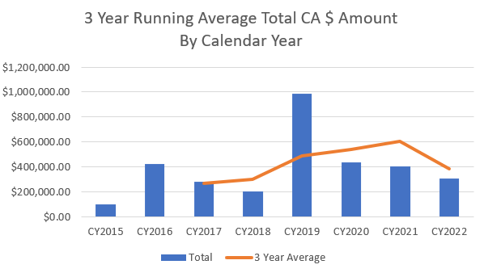
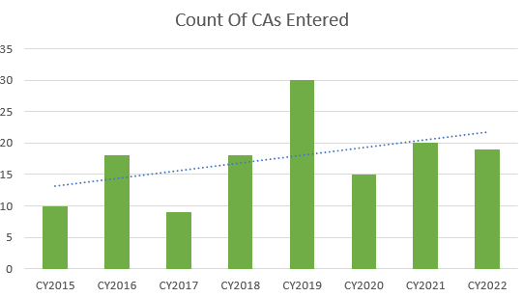
Project Update (MSL Cost Avoidance Increases)
As of 8/1/2022
As of 8/1/2022
2021 Total Number of CA Entered – 20
2022 Number of CA Entered To Date – 19
Total Number of CAs All Years - 139
CY2020 | $434,461.50
CY2021 | $403,931.00
CY2022 | $306,100.00

Slide 23
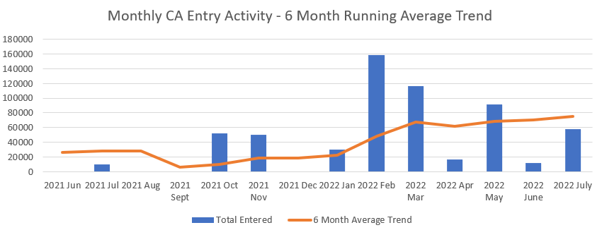
Project Update (MSL Cost Avoidance Increases)
As of 8/1/2022

Slide 24
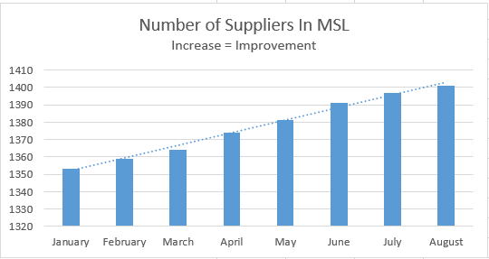
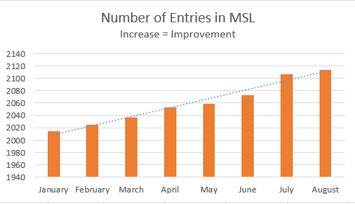
Project Update (MSL Data)
As of 8/1/2022
Total Number of Suppliers – 1401
Total Number of Entries – 2114

Slide 25
Project Update (MSL Cost Avoidance Increases)
Task: SC-17-03 – DOE EM Single Approved Supplier List
Project Manager: John McDonald
This new task was discussed at the EFCOG Spring 2017 and Fall 2017 meeting.
6/7/17 task start date
Objective: Provide recommendations to develop and maintain a single list of approved NQA-1 and Commercial Grade suppliers for use at DOE EM facilities. As a minimum, the list should support EM facilities, but may include all of DOE.
Deliverable: The task Team will provide recommendations to DOE and EFCOG on how to proceed with use of a complex wide EM approved supplier list. The recommendation should address the actions needed to allow contractors to use and maintain the list, contractual considerations, DOE endorsement, procedures, lead auditor certification, and conduct of supplier audits.
9/25/17 Final Report Issued.
2/13/18 MASL POC list is being populated to show which sites are participating. There are 16 EM sites, 8 NNSA, 10 OOS, and 1 NE site. See the MASL POC list for specifics. Only NTS, SRS, LANL, LLNL, & MSA are actively entering info into the MASL. Only NTS has it in their procedure to update the MASL as this is their ASL.
10/4/19 Summary for the 17 DOE EM sites: 6 are using the MASL [SRNS (includes SRR) & MSA (now HMIS), (includes CHPRC & WRPS) & FRNP] ; 7 are interested in putting suppliers into the MASL [WIPP-NWP; DUF6-MCS; ICP; SST (1 supplier in MASL); FBP; URS/CH2M; and CH2WV]; 3 unsure [N3B; PMA; Savannah River-Parsons/SWPF]
8/2018, EFCOG Safety Working Group Chair along with the SCQWG Chair have created a draft MOU. This MOU was discussed at the Fall 2018 Working Group meeting and Spring 2019 Working Group meeting.
7/31/19 the 8 NNSA sites signed a MOU document to agree to use the MASL.
3/30/22 Update:
7 of the 17 EM sites are using the MSL (CHPRC now CPCco), MSA, WRPS, SRNS, SRR, FRNP, & UCOR);
6 of the 17 EM sites are interested in using the MSL (WIPP, DUF6, ICP, FBP, SST, CHBWV)
2 of the 10 OOS sites are using the MSL (BNL & PNNL)
2 other of the 10 OOS sites should be using the MSL. (ORNL, & PPPL are interested.)
1 NE (INL) site is now using the MSL

Slide 26
Project Update (Common Suppliers)
Task: SC-21-01 – Expand NNSA, DOE EM, & DOE Office Of Science (OOS) Shared Supply Base
Project Manager: Bill Wingfield
Action: ????
Goal: Increase the number of shared suppliers.
POC: TBD
10/20/21 EFCOG SCQWG October Web-ex it was decided to change this Task from the Expand the NSE Supply Base to Expand the NNSA, DOE-EM, & DOE OOS supply base.
Listed below are groups working (other than us in SCQWG) on improving the Supply Chain:
6/9/21 - The NSE Share Supplier Assessment Working group started by Greg Hilgenkamp, KCNSC & Stefan Komarek, KCNSC; meeting every other Wed(s) 2:00pm EST.
Dennis Emmert, Office of Strategic Planning and Analysis (NA-183), Defense Programs, NNSA, Industrial Based Efforts to improve the Supply Chain met with the NSE Shared Supplier group on 8/25/21.
Amy Lientz, INL, & Jason Eaton, CNS-Y12 & Pantex started a Supply Chain Task with an EFCOG SCRM Subgroup to address Presidential Executive Orders (#13817, 12/27 and #14017, 2/21). This is part of a new EFCOG Supply Chain Working Group lead by John Robinson.
EFCOG Glove Box Acquisition Improvement – John Longenecker, Mark Edelson, Bill Stephens, & Dave Olson’s request, LANL & SRS are meeting to share information on glovebox suppliers. Last meeting was 10/05. Roland Chreiten (SRNS Capital Projects QA Manager) and Dana De Santos (LANL-Institutional Quality (Acting) Group Leader) are steering the QA changes.

Slide 27
Project Update (NIAC Checklist Rev)
Task: Potential Task SC-21-04 – NIAC Checklist Rev
Project Manager: Brent Shealy, Jim White, & Mark Ryan
DOE Liaison: Garrett Smith
Goal: Draft Rev 4 of NIAC Standard Checklist and send it to Katrina Anderson NIAC Procedures / Checklist Chair katrina.Anderson@aecom.com
Action: the revision will have to be approved by the NIAC membership and we will not be repeating requirements or just restating the NQA-1 requirement.
3/2021, per Mike Dunkelberger NIAC Chairman, many of the requirements listed in the EFCOG Supplemental checklist are already addressed in the NIAC Standard Checklist. For example, when I look at the Section for NQA-1 Requirement 15, I see more words, but the requirements are already addressed in NIAC Checklist Section 1.B.1 and 1.B.2. Almost everything stated for NQA-1 Requirement 12 is already addressed in NIAC Checklist Section 8. The requirements listed for NQA-1 Requirement 4 are already addressed in NIAC Checklist Section 3.2. We don’t want the checklist to be repetitive, and I don’t think a majority of NIAC members are willing to accept a checklist that simply copies and pastes the requirements from NQA-1.
Also, the requirements for configuration management of an operating facility, only apply to an operating facility. We could include those requirements in the NIAC Checklist. However, I think they would be N/A for almost any Supplier audit performed by a NIAC member.
7/22/2021 Bill provided a word version of Rev 4 of the NIAC STD Checklist to Jim White, along with the gap analysis performed by Turk.
10/19/2021 Aaron Kramer provided comments to Jim White’s proposed revision.
12/13/21 Comments were due to Jim White
1/15/2022 NIAC Checklist (proposed Rev 5) with NQA-1 requirements submitted to NIAC committee for consideration.

Slide 28
Project Update (NIAC Checklist Rev)
Task: Potential Task SC-21-04 – NIAC Checklist Rev
Project Manager: Brent Shealy, Jim White, & Mark Ryan
DOE Liaison: Garrett Smith
Goal: Draft Proposed Rev 5 of NIAC Standard Checklist and send it to Katrina Anderson NIAC Procedures / Checklist Chair katrina.Anderson@aecom.com
The DOE sites that are NIAC members are:
NWP Veronica Ballew & Jason Mayse
UCOR Kevin Collins & Carl Wilkey
CNS-PTX Scott Weaver & Steve Solis
CNS-Y-12 Stephen Sands Jr & Jack Payton
LANL Kim Duran & Tione Erdrich
NNSS Vince Grosso & Aaron Kramer
SRS Jim White & Mark Ryan
ORNL Dave Shuter & Michael Houston
INL – Brian Chesnovar & Christian Grebstad

Slide 29
New Project SCQWG webpage with FAQ
Task: New Task SC-22-01 – SCQWG & FAQ Web-page managed
Project Manager(s): Jason Mayse & Kristi Haataja (Co-managers)
DOE Liaison: Garrett Smith
Goal:
1) Update the SCQWG web page at: https://efcog.org/safety/quality-assurance-subgroup/supply-chain-quality-task-group/
2) Add Frequently Asked Questions. (See the EFCOG QA Procurement Engineering and SQA web-pages for examples)
5/18/2022 Brainstorming Meeting – Discussed possible ways to open communication between all sites. A couple actions items will be discussed next EFCOG meeting after follow-ups complete.

Slide 30
New Project MSL SQA Plan
Task: New Task SC-22-03 – Supplier Performance Metrics
Project Manager(s): Steve Behrends (ANL)
DOE Liaison: TBD (possibly Christopher Beaman)
Members: TBD
Goal: Identify sites with supplier performance metrics that could be turned into a white paper.
Discussion: Per Steve I am suspicious that we are not capturing many of the nonconformances I believe are occurring as our numbers are just too low and year to year, fewer reported. Hopefully there will be a few locations that have metrics on this topic.

Slide 31
Audit Opportunities Update
(As of Sep 2022)
Purpose:
Reduce burden on audited facilities (if you plan to audit or have audited the facility, speak up!)
Reduce burden on DOE sites (if interested in a supplier and can provide audit support, speak up!)
Communicate focus areas (if applicable) (if you had an experience with the supplier or other supplier with a similar commodity that warrants focused attention during an audit, speak up!)
Notes:
Send Bill updates as your schedule changes.

Slide 32
Audit Scheduling – Sep – Oct 2022
Supplier | Audit Basis | Lead
Diversified Scientific Services, Inc., TN (9/20-21/2022 & wk of 9/26/22 on-site) | DOECAP-Remote & Onsite | DOECAP-Pete Yerace
Labware, Wilmington, DE (9/27-29/2022) | NQA-1-2008 / 1a-2009 & Non-NQA-1 | LANL – Alonzo Simon
Mersen USA, St. Marys, PA (10/2022) | Non-NQA-1 | LANL – Alonzo Simon; Pawel Grzeszykowski LA In-Training
NAC International, Norcross, GA (10-24-27/22) | NQA-1-2008 / 1a-2009 & Subpart 2.2, 2.7, 2.14, & 2.15 | HMIS-Bud Twigg for CPCCo
PCB Piezotronics, Inc., Depew, NY (10/18-20/22) | NQA-1-2015 | NNSS-Andrew Burningham

Slide 33
Audit Scheduling – Nov – Dec 2022
Supplier | Audit Basis | Lead
Channel Comp, LLC, St Petersburg, FL (11/8-10/2022) | Non-NQA-1 | LANL – Bill Wingfield
Frontier Tech Corp, Xenia, OH (Dec 2022) | Non-NQA-1 | LANL – Alonzo Simon
Hot Cell Services, Richland, WA (11/15-18/2022) | NQA-1:2008 / 1a-2009 | PNNL – Quincy Stowe
Jona Machining, Los Alamos, NM (12/2022) | NQA-1-2008 / 1a-2009 & Non-NQA-1 | LANL – Bill Wingfield

Slide 34
Audit Scheduling – Jan – Jun 2023
Supplier | Audit Basis | Lead
Accurate Machine, Los Lunas, NM (4/2023) | Non-NQA-1 | LANL – Bill Wingfield
APCT, Inc. Santa Clara, CA (3/2023) | Non-NQA-1 | LANL – Alonzo Simon
Benchmark Elect, Tempe, AZ (5/2023) | Non-NQA-1 | LANL – Alonzo Simon
Columbia Energy and Environmental Services (CEES), Richland, WA (1/31-2/2/2023) | NQA-1:2008 / 1a-2009 | PNNL – Quincy Stowe
Excelitas, Miamisburg, OH (2/2023) | Non-NQA-1 | LANL – Bill Wingfield
Benchmark Elect, Tempe, AZ (6/2023) | Non-NQA-1 | LANL – Pawel Grzeszykowski
Military Fastners, Melbourne, FL (1/20230 | NON-nqa-1 | LANL – Dave Destromp

Slide 35
Supply Chain Quality Webex Calls
2022/2023 Supply Chain Quality Webex / Conference Call Schedule
Date | EST | CST | MST | PST
Oct 19, 2022 | 11 AM | 10 AM | 9 AM | 8 AM
Nov 16, 2022 | 11 AM | 10 AM | 9 AM | 8 AM
Dec 21, 2022 | 11 AM | 10 AM | 9 AM | 8 AM
Jan 18, 2023 | 11 AM | 10 AM | 9 AM | 8 AM
Feb 15, 2023 | 11 AM | 10 AM | 9 AM | 8 AM
Mar 15, 2023 | 11 AM | 10 AM | 9 AM | 8 AM
Apr 19, 2023 | 11 AM | 10 AM | 9 AM | 8 AM
Notes:
If you have a topic that you would like discussed at a call, please send an email to Bill wwingfield@lanl.gov

Slide 36
Old Business
Any Other Old or New Business to Discuss?

Slide 37
Project Update (Common Suppliers)
Organizational Excellence Web-site:
https://orgex.energy.gov/
You register, you should be able to access the QA Community of Practice page at:
https://orgex.energy.gov/forums/qa-community-practice
Here is the FTF page: https://orgex.energy.gov/forums/hepa-filter-poc
Powerpedia Web-site:
To find DOE documents and items such as ORGEX and S/CI:
https://powerpedia.energy.gov

Slide 38
Reference Information
EFCOG Site
The EFCOG Web site is located at: http://efcog.org/
Contact Changes and Document Postings should be sent to:
Christine Frei, Longenecker & Associates, Inc., 804-263-4591, cfrei@la-inc.com
The EFCOG Supply Chain Quality Working Group or Task Team is located at:
https://efcog.org/safety/quality-assurance-subgroup/supply-chain-quality-task-group/
Jason Mayse WIPP and Kristi Haataja LLNL to chair updates to site layout
Supply Chain POC List (7/2022 looking at adding ISM personnel)
Contact Changes and Document Postings should be sent to:
Veronica Ballew, veronica.ballew@wipp.ws
The latest and greatest POC List is posted on the EFCOG Supply Chain Quality Task Team Website – or – URL:
https://efcog.org/safety/quality-assurance-subgroup/supply-chain-quality-taskgroup/?drawer=Supply%20Chain%20Quality*Documents
7/2022 looking at adding ISM personnel (CAS, SC, HPI, WP&C)

Slide 39
New Business
Proposed additions to NAP-24B (401.1A)
Attachment 5 M&TE requirements (will be R028 NNSA Metrology Program)
Attachment 6 Supplier Quality Requirements (will be added to R013 Control Supply Chain)
NAP-24A was changed to NAP-401.1 on 10/1/19. Content was the same, only the number was changed.
The Weapon Quality Division, NA-121.3 revised NAP-401.1; NAP-401.1A was published on 6/23/2021. 7/20/21 an Administrative Change was issued.
R-013 Face to Face Kick off meeting was held 6/30/2022 at KCNSC
SNL (Phil New & Melissa Flurry) & KCNSC (Verne Howard & Ben Harper) are drafting PQRs for R-013.
R-028 NNSA Metrology Program is in RevCom

Slide 40
New Business
Does your site include Suspect/Counterfeit Item (S/CI) Prevention Lines of Inquiry (LOIs) in your checklists?
If not you should add S/CI LOIs to your checklists.
The main thing we should be asking our suppliers, is if they find a suspect/counterfeit item do they hold it for investigation (by the IG) or return it to the supplier?
DOE O 414.1D “Quality Assurance” is trying make sure S/CI items do NOT get back into the supply chain and offenders are prosecuted.
See DOE Handbook Suspect/Counterfeit Items Resource Handbook DOE-HDBK-1221-2016 August 2016, Change 1, effective Jan 2017).
Gabby’s email address has changed. Please note: gabrielle.holcomb@hq.doe.gov
Gabby Holcomb of Sandia has shared with us an on-line S/CI training:
https://prod-ng.sandia.gov/wbt/SCA050/course_holder.html
2/7/20 the latest DOE S/CI site is:
https://www.energy.gov/ehss/policy-guidance-reports/databases/suspectcounterfeit-and-defective-items

Slide 41
Supplier ISO Certification Validation/Verifications
Supplier ISO Certification Validation/Verification Links
A2LA: https://portal.a2la.org/search/
ABS Quality Evaluations: https://www.eagle.org/qenetcert/ECert.Abs_ccd1
ACM: https://www.acmcert.com/certificate-checker/
Afnor: https://certificats-attestations.afnor.org/
ANAB: https://www.anab.org/ or https://search.anab.org/
Or https://anabdirectory.remoteauditor.com/ (this is a good tool to get the name, phone, and email of persons to contact from the Certification Company).
ASME: https://caconnect.asme.org/directory/
Aston-Global: http://www.aston-global.com/ (CAUTION: Aston-Global may not to be an accredited organization.)
BSI America: https://www.bsigroup.com/en-US/our-services/Management-system-certification/Certificate-and-Client-Directory-Search/
China National Accreditation Service for Conformity Assessment (CNAS): http://wwwcnas.org.cn/English/findanaccreditedbody/index.shtml
DNV-GL: https://certificatechecker.dnvgl.com/
DQS: https://www.mydqs.com/en/customers/customer-database.html
(Continued)

Slide 42
Supplier ISO Certification Validation/Verifications (Cont.)
(Continued)
IAQG: https://www.iaqg.org/oasis/login
Online Aerospace Supplier Information System (IAQG-OASIS).
This online resource contains a list of suppliers who are certified / registered under the IAQG rules to be in compliance with the aerospace quality management system requirements (9100 series).
IAS: https://www.iasonline.org/search-accredited-organizations-2/
ILAC: https://ilac.org/signatory-search/ (For Calibration, testing, etc)
Intertek: http://www.intertek.com/business-assurance/certificate-validation/
JQA: https://www.jqa.jp/cgi-bin/06manage/14_touroku/search_e.html
NADCAP – A list of National Aerospace and Defense Contractors Accreditation Program (NADCAP) approved Suppliers can be viewed by means of the Aerospace QML application in Performance Review Institute’s (PRI) eAuditNet.
The Aerospace QML can be accessed via logging into the system, then go to Resources (located in the top left corner of the screen after login), then select Aerospace QML. From here you can select the area, commodity, and any other search criteria to find the specific information you need. You also have the ability to conduct a more detailed search via using the “Refine Search Based on Scope (click to expand/collapse)” feature. Once you select the Search button, you can select a Supplier’s company name to get more information about the accreditation or select on the Print Details button on the results page for a print friendly version of the information showing company name, address, commodities and scopes accredited to and their expiration date.
(Continued)

Slide 43
Supplier ISO Certification Validation/Verifications (Cont.)
(Continued)
OASIS – Online Aerospace Supplier Info System – to idenfiy AS-9100 qualified suppliers
Perry Johnson: http://www.pjlabs.com/search-accredited-labs (to search go to PJR.com click on About PJR, then click on PJR Clients and put in the supplier’s name)
QAS International: https://www.qas-international.com/contact/
SAI Global: http://qmi-saiglobal.com/qmi_companies/ or https://register.saiglobal.com/Default.aspx?stype=simple
SAI Global QMI: https://www.saiglobal.com/en-us/assurance/auditing_and_certification/certification_registry/
SAI Global: https://www.saiglobal.com/en-us/assurance/auditing_and_certification/certification_registry/
NIST: https://www-s.nist.gov/niws/index.cfm?event=directory.search#no-back
NSF: https://nsf-isr.org, or http://info.nsf.org/Certified/isr/index.asp
NSAI - For National Standards Authority of Ireland (NSAI), https://www.nsai.ie/certification/search-for-a-certified-company/ or for Certs contact Jodi Espinal, Certification & Quality Cord. @ 603.689.9102 or cell 603.930.7076 email @: Jodi.Espinal@NSAIinc.com or Lisa Greenleaf Operations Manager, US Lisa.Greenleaf@NSAIinc.com, 603.689.9145
NQA Global: https://www.nqa.com/en-us/contact-us 800-649-5289 or Arlen Chapman 978-635-9256 (this is not NQA-1)
NVLAP: https://www-s.nist.gov/niws/index.cfm?event=directory.search#no-back
(Continued)

Slide 44
Supplier ISO Certification Validation/Verifications (Cont.)
(Continued)
PRI Performance Review Institute email: PRIAmericas@p-r-i.org
SGS: https://www.sgs.com/en/certified-clients-and-products/certified-client-directory
Smithers Quality Assessments: https://smithersregistrar.com/resources/certifiedcompanies
SQS Switzerland: https://www.sqs.ch/en/certified-organisations
SRI: https://www.sriregistrar.com/resources/sri-certificate-validation/
TUV Nord: https://www.tuev-nord.de/en/company/certification/certificate-database/
TUV Rhineland: https://www.certipedia.com/
TUV Sud – America: https://www.tuvsud.com/en-us/resource-centre/certificate-finder
TUV Sud Group: https://www.tuev-sued.de/management-systems/our-company/reference-list
Others???
Newly added:
Institute of Printed Circuits: www.ipc.org/cert-search.aspx If you go to ipc.org/files-history/HistoryBook you can download a pdf From Vacuum Tubes to Nanotubes, 50 years,1957-2007.

Slide 45
Supplier ISO Certification Validation/Verifications (Cont.)
Who is Eligible to Grant ISO 9001 Certification?
So who is eligible to grant ISO 9001 certification? Many people assume that ISO grants certification, but in fact, this is not true, instead, a registrar or certification body (CB) will be the one to grant certification (Read: Who is ISO?). When choosing a registrar a supplier should make sure that they are accredited. They should be a member of the International Accreditation Forum (IAF), and additionally need to be ISO/IEC 17021:2015 certified.
One of these standards is ISO/IEC 17021:2015 Conformity assessment “Requirements for bodies providing audit and certification of management systems“, which in effect stipulates the requirements for Registrars who certify organizations to ISO management standards like ISO 9001, ISO 14001, etc.
People often say “ISO Certified” but ISO does not issue certificates or certify individual companies to any standard. So who can Grant ISO 9001 Certification? They are issued by certification/registration bodies (also called Registrars or CB’s), which are independent of ISO. CB’s need to be accredited by an IAF member to be internationally recognized.
ISO/IEC 17021 ensures international acceptance of the CB’s certifications (i.e. your ISO 9001:2008 certificate) by requiring that all Accreditation bodies (ANAB, etc.) belong to an internationally accredited organization, like the IAF. Likewise, the IAF ensures that CB’s comply with ISO/IEC 17021.
Some Quality System Registrars are not accredited by IAF, and thus are not meeting ISO 17021 — and will not be internationally recognized. Make sure that you choose a Registrar who is accredited by an IAF member (ANAB or the equivalent of ANAB in your country or region).
When you receive your registration certificate, it should display the ANAB and the IAF logos and unfortunately, without them, you are not officially ISO 9001 certified.

Slide 46
Recent Complex Organizational Moves
Recent Complex Organizational Moves!!
UCOR
The Department of Energy’s Office of Environmental Management (EM) has awarded a 10-year, $8.3 billion contract to United Cleanup Oak Ridge (UCOR), of Germantown, Md., for the cleanup of the Oak Ridge Reservation in Tennessee, including the Y-12 National Security Complex, Oak Ridge National Laboratory (ORNL), and the East Tennessee Technology Park (ETTP).
UCOR is a newly formed limited liability company made up of AECOM Energy and Construction, Jacobs Technology, and Honeywell International. UCOR’s teaming subcontractors include RSI EnTech, Strata-G, Longenecker and Associates, and Environmental Alternatives.
The timeline: The Oak Ridge Reservation Cleanup Contract will replace the ETTP cleanup contract held by URS/CH2M Oak Ridge that expires on January 31, 2022. The current contract, however, includes one additional six-month option period that, if exercised, could extend it through July 31, 2022.
The tasks: As the cleanup contractor, UCOR is to lead cleanup and remedial actions at ETTP; cleanup of excess facilities at ORNL and Y-12; design, construction, and operation of the new on-site disposal facility, the Environmental Management Disposal Facility; operational activities and surveillance and maintenance for multiple EM operational and nonoperational facilities; and core functions for central and project services.
According to EM, the goal of this end-state contract award is to achieve measurable results toward the completion of the DOE-EM mission at the Oak Ridge Reservation by accomplishing the maximum amount of environmental cleanup within the 10-year ordering period at the best value to taxpayers.
.

Slide 47
Future EFCOG ISM & QA Working Group Meetings
EFCOG ISM & QA Spring 2021 meeting hosted virtually by PNNL, dates 4/19-22/21
EFCOG ISM & QA Fall 2021 meeting was held remotely 11/1-4/21
EFCOG ISM & QA Spring 2022 meeting was held remotely 4/25-28/2022.
EFCOG ISM & QA Fall 2022 meeting is scheduled for week of 11/14/2022

Slide 48
Fall 2022 EFCOG Meeting @ Your Desk Agenda
Fall 2022 EFCOG QA Meeting – Scheduled the week of 11/14/22 at Your Desk
Registration is available @: TBD
Monday 11/14/22, 415-655-0002, Meeting ID 2464 256 4331#
EFCOG Joint QA/ISM Session 10:30 am – 5:00 pm EST @ your desk
Tuesday 11/15/22, 415-655-0002, Meeting ID 2454 968 6208#
EFCOG QA groups meeting together (P&P, SCQWG, SQA, & Procurement Engrg)
These were presented at the Spring 2022 Meeting:
NQA-1 updates by Taunia Sandquist & Jim McIntyre
DOECAP assessments by Steve Clark DOE-HQ
S/CI by Gabby Holcomb – DOE-HQ
GIDEP – Pete Panaguiton – GIDEP Ops Cntr Dir
DOE QA topics – Chris Beaman DOE HQ
Weapons Program – Andrea Rainer DOE/NNSA NA-121.3
CGD – Embedded digital devices – John Hendricks, Curtis-Wright
Dedication of Software How to qualify otherwise acquired software – Pat Aurer, LLNL
Wed 11/16/22, 10:30 – 4:30 EST breakout sessions @ your desk Phone SCQWG # 415-655-0002 Meeting ID 2461 820 3537#
Thurs 11/17/22, 10:30 – 1:30 EST breakout sessions @ your desk Phone SCQWG # 415-655-0002 Meeting ID 2461 820 3537#

Slide 49
Joint Supplier Audit Pre-planning
Possible new Task for Joint Audits?
Does any site have a good method of sharing supplier documents (i.e. procedures) with team members?
LANL can use Teams and we have shared folders for our suppliers.
A LANL supplier uses IMSXpress or ISOXpress to post their Quality Manual and Procedures
Any others?
Thanks !
Bill

Slide 50
EFCOG Meeting Improvements
We are looking to make this meeting as useful and meaningful to the audience as possible and would like to hear from the ‘customer’ on how we can make it more valuable
If you have any suggestions for this meeting (anything specific or general you want to add to meeting, anything you don’t want to see, etc.), please send to mslsupport@sandia.gov
Your suggestion will be kept anonymous. Only looking for feedback to make this meeting as useful and meaningful to the audience as possible.
Thanks !
Kristin Bell

Slide 51
MSL Requests/Information
We are working on some new upgrades. Details will be discussed in the EFCOG Fall Meeting during the MSL session.
One feature is the merged multi-site audit schedule. In order to build the prototype all site need to submit their schedules to Kristin Bell as soon as possible to mslsupport@sandia.gov NLT September 30th. Once in place, the schedule in these slides will go away.

Slide 52
MSL Police ☺
We will be checking the MSL for ‘violations’ and contacting people individually!
Kinds of errors found:
No auditor name (There should be an Owner name and at least the Lead Auditor name)
No start date (if you did an assessment, there is a start date or a scheduled start date)
Incorrect site identified (the site should always be the site who did the assessment even if you do it for another site)
No assessment method (if you did an assessment, there was a way you did it)
Not checking to see if supplier already exists and adding same one in a different naming format
Prefer and strongly recommend (but not required) a comment indicating pending CARs
Prefer and strongly recommend (but not required) updating record once CARs are closed and uploading
Kristin will be releasing new user guides to cover some of these things.
There will be emails going out to the people who entered these, to try to fix future entries.
Our goal is to have the best quality of information in MSL!

Slide 53
Next Webinar/Call & Close Out
Next Webinar/Call: (Usually the Third Wednesday of each month)
10/19/22
11:00 AM EDT
10:00 AM CDT
09:00 AM MDT
08:00 AM PDT

Slide 54
Open Discussion

