Slide 1
Partial Finger Amputation- Oak Ridge TN

Slide 2
Presentation Summary
Company Overview
Contract Overview
Situation Review
Enforcement Process
Enforcement Letter Findings
Closure
g

Slide 3
Company Overview
501(c)(3) Corporation with over 1000 employees in 9 states
Skookum provides services primarily through the Ability One program
Customers include Army, Navy, Air Force, and Department of Energy.
Mission: To Create Opportunities for People with Disabilities
As of June 1, 2014:
661 employees have a significant disability
332 are Veterans
243 are Veterans with Disabilities
226 are Veterans with Service Related Disability
7 are Veterans with a Purple Heart
53 are veterans whose Disability resulted from Combat Operations in Iraq or Afghanistan
al Housekeeping

Slide 4
Contract Overview (Oak Ridge, TN)
Contract Number DE-NA0001745 (3 Task Orders)
Program and Administrative Support (Task 1)
Includes the Program Management and Administrative Services necessary to oversee the Facilities (Task 2) and the VMF/MEMF (Task 3) maintenance projects.
Facility, Logistical, and Ancillary/Repair Support Services (Task 2)
Skookum will provide support to the NNSA OST facilities in Oak Ridge, Tennessee, for facilities maintenance and related services such as cost estimation, and market research, and ancillary/repair for projects to the facilities and infrastructure under OST cognizance. Skookum shall provide administrative support in areas of logistics (requisition support, shipping and receiving, property), mailroom operations, property management, project planning, and acquisitions
VMF/MEMF (Task 3)
Skookum operates a vehicle maintenance facility and mobile electronics maintenance facility to perform all scheduled and non-scheduled Preventive Maintenance (PM) and repair of OST Mission and Non-Mission vehicles as well as all vehicle and trailer communication alarm systems. Skookum is also responsible for repair of any government provided equipment associated with this Task Order.

Slide 5
Situation Review
On December 4, 2014 at approximately 4:45 PM (EST) a Skookum employee sustained a partial amputation of his left hand, ring finger above the distal knuckle and below the cuticle.
Employee was assisting with the removal of two unused building transformers located behind Building 9714 maintenance shop.
Employees were tasked with fluid draining and removal of unit hold down bolts.
Employees took the initiative to remove units from concrete pad and place in parking lot for easy pick-up by salvage company.
Upon placing second transformer onto forklift tine, employee’s finger became trapped between unit and forklift tine causing the partial amputation.

Slide 6
Situation Review (Cont.)
Location of transformer on concrete pad

Slide 7
Situation Review (Cont.)
Right Side View
= Position of injured worker

Slide 8
Situation Review (Cont.)
Left Side View
= Position of other workers

Slide 9
Situation Review (Cont.)
Injured employee was positioned with his back against the radiator with his hands gripping the radiator in the locations shown by the red arrows.

Slide 10
Situation Review (Cont.)
When the employee started to lift and push the transformer back, the end of the tines were flush up against the radiator at about the location of the yellow arrow. The employee was gripping the radiator at about the location of the red arrows. As he lifted the transformer he pushed it back onto the tines where the end was covering the fingers on his left hand. When he went to set the transformer down his finger became caught between the tine and the transformer and his bodily reaction was to jerk his hand away causing the tip of his finger to become amputated.

Slide 11
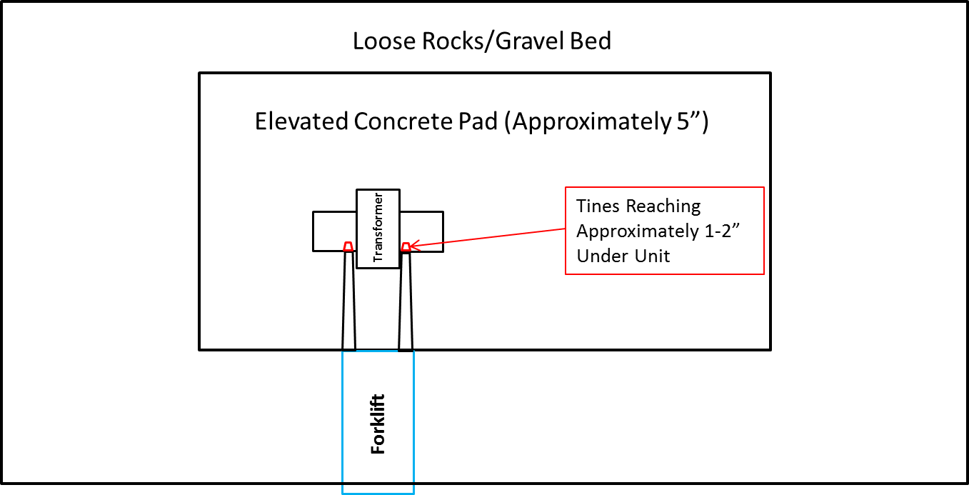
Situation Review (Cont.)
Aerial View of Work Site

Slide 12
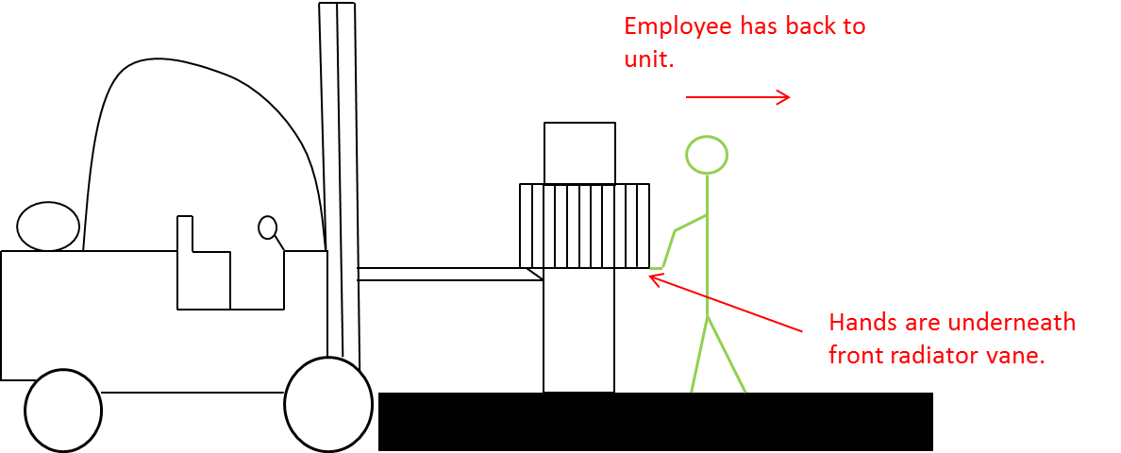
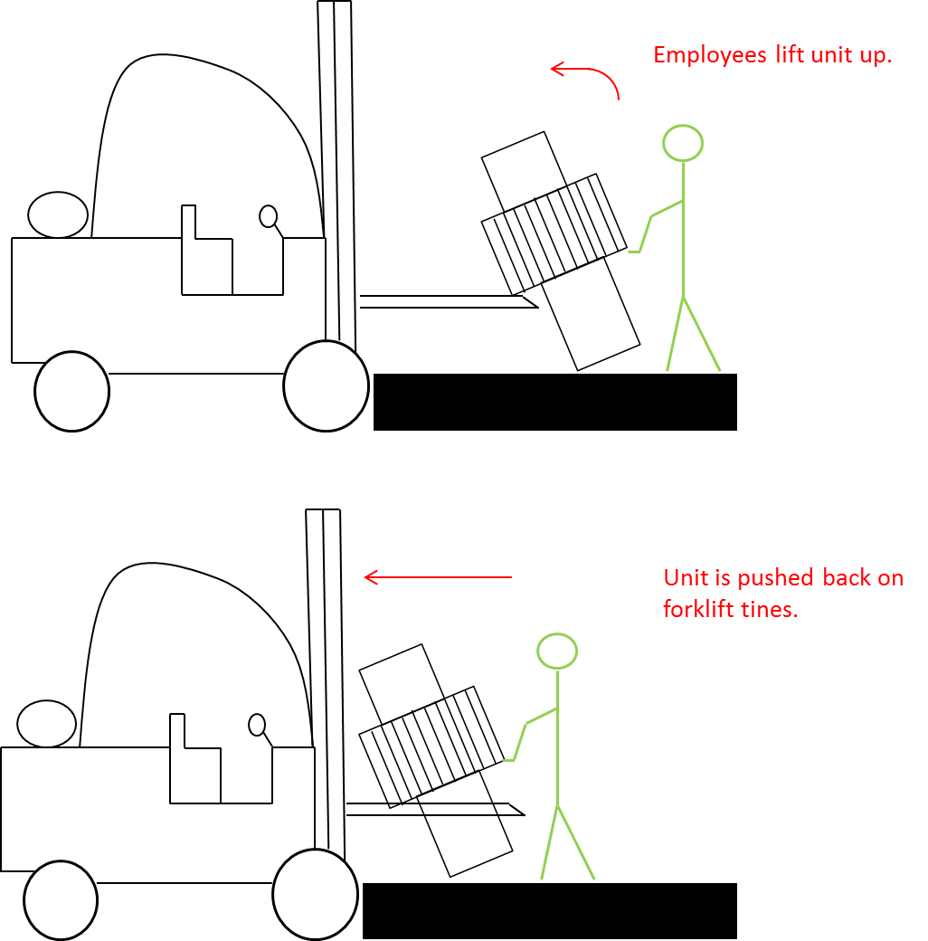
Situation Review (Cont.)

Slide 13
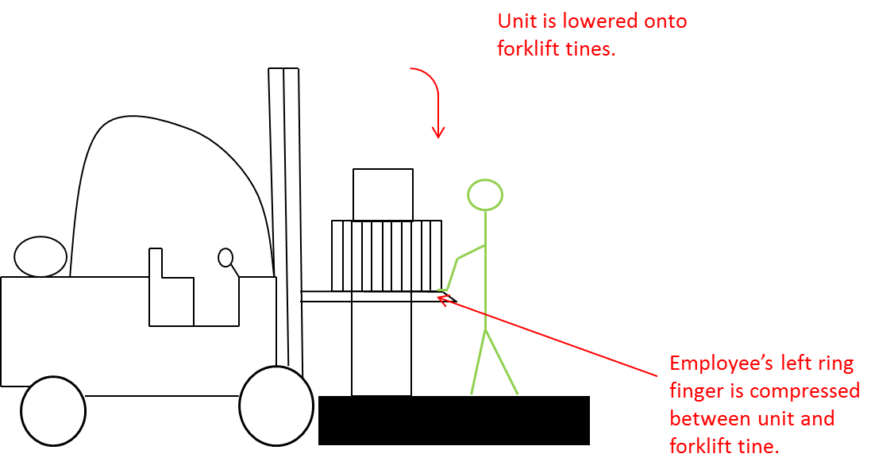
Incident Layout (Cont.)

Slide 14
Enforcement Process
Skookum received notification on January 30, 2015 of the Office of Enterprise Assessment Intent to Investigate.
Submitted first document request within the 7 business day turn-around requirement.
Completed three additional document requests throughout the process.
Site audit was conducted by the Office of Enforcement on March 25-26, 2015 (3 person team led by Mr. Dressman).
Skookum management team determined that they would not be involved in the employee interviews unless an employee made the request of their free will.
al Housekeeping

Slide 15
Enforcement Letter Findings
Skookum did not prepare a job hazards analysis that critically examined the occupational hazards for each step of the demolition.
Explanation: Due to employee “initiative” the work progressed beyond what was expected by site management. As such, the expansion of the work scope did not allow Skookum’s Scope of Work Process to proceed as detailed in the Site Procedures.
The hot work permit utilized during the maintenance activity did not provide a complete and accurate record of work crew participation. Additionally, portions of the welding/burning/hot work process were performed by a craftsperson other than the employee authorized by the Permit Authorizing Individual (PAI).
Explanation: During the performance of work, employees cycled in and out of the work area to serve as fire-watch. Additionally, the authorized craftsperson used the activity as an on-the-job training experience and supervised another employee who utilized the torch for bolt removal. This was not communicated to the PAI so the Hot Work Permit was never reviewed and updated.
al Housekeeping

Slide 16
Enforcement Letter Findings (Cont.)
Skookum did not report the work-related injury consistent with DOE Manual 231.1A. Additionally, the injury was incorrectly categorized as an “avulsion” instead of “amputation”.
Explanation: Skookum was unaware of the CAIRS database entry requirements. Upon notification, the injury was input immediately. It is unclear why the classification of injury was listed as a finding since the official classification was updated to reflect amputation due to the progression of care.
Skookum did not review the effectiveness of the medical portion of its site emergency plan in accordance with Part 851 and was unaware that the medical emergency response capabilities through the community hospital would not meet the immediate needs of the injured worker.
Explanation: The hospital selected for immediate employee care is a trauma center with an orthopedic surgeon on staff capable/competent to perform the required medical treatment. The specialist's assessment of the injury was such that it was a non-urgent injury that it did not jeopardize the life/health/safety of the individual. Their assessment model placed him into a 7-10 day treatment window. Skookum voluntarily took the employee to a second hospital who concurred with the assessment, but was able to accommodate the employee into their schedule for treatment due to the emotional toll placed on the employee waiting for wound closure.

Slide 17
Enforcement Letter Findings (Cont.)
Skookum did not control the accident scene to allow an accurate investigation of the event.
Explanation: Upon reporting to work the day following the injury, an employee completed the transformer movement, and sprayed down the work area with a pressure washer.
Office of Enforcement Determination:
Since Skookum does not have the Nuclear Hazard Indemnity Clause in our contract, the Office of Enforcement exercised their discretion and did not pursue further enforcement regarding the event.

Slide 18
Questions & Discussion
al Housekeeping

