Slide 1
Maintenance Worker Fall from Ladder
Kathy Brack
Kathy.Brack@cns.doe.gov
Senior Manager
Scott Hope
10/3/2017 eDC/RO ID:34151

Slide 2
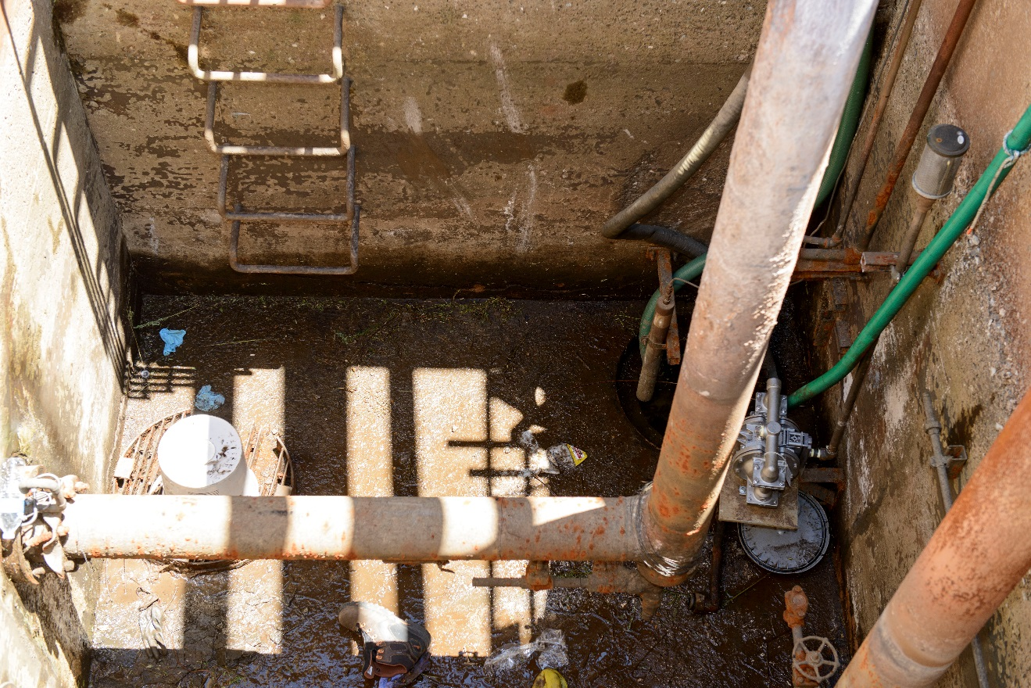
The Mission
Replace the sump pump in the utility pit located in the Old Salvage Yard
Confined Space
LO / TO
80⁰ F
38% Relative Humidity
Contamination Area
Sump pump replaced

Slide 3
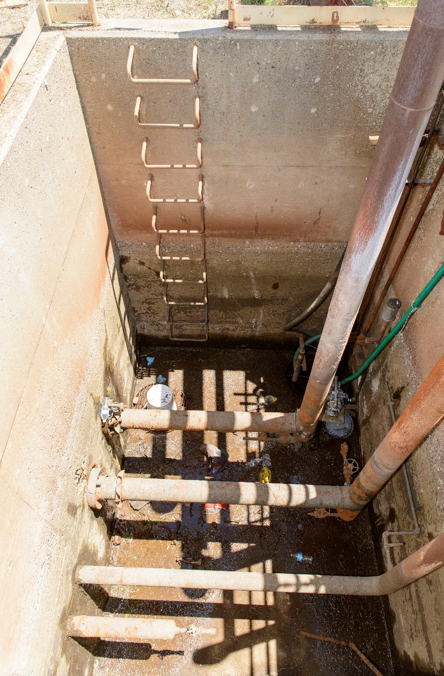
What happened
Pre job brief
Changed conditions – water still in pit – air driven de-watering pump failed
2 pumps later – pit was emptied, gasoline powered pump
Pipefitter #2 removes bolts – last one won’t come loose
Pipefitter #1 enters pit, successfully loosens last bolt
Sump pump installed, beginning to hook up
Pipefitter #3 had to leave; crew decided to finish task during the next workday
Pipefitter #3 retrieves tools via bucket and rope as planned
Pipefitter #2 exits the pit via fixed vertical ladder
Pipefitter #1 climbs same ladder, reaches for vertical guardrail post and falls

Slide 4
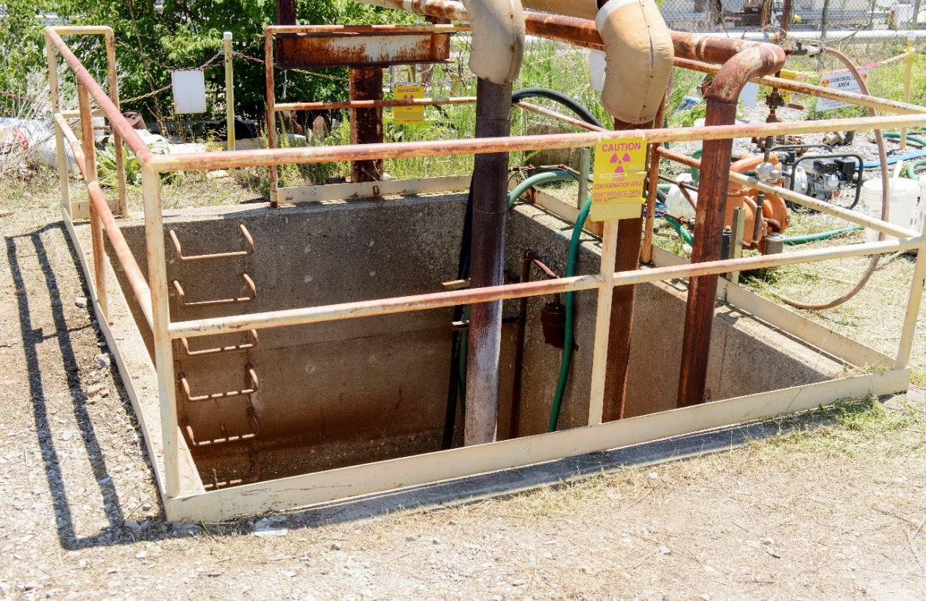
Mechanism of Fall
Pipefitter #1 reaches to the right and grasps vertical portion of barrier
His left foot slipped “very unexpectedly”
His left hand then slipped and his body swung to the right
As he tried to swing back and re-engage the ladder, his right foot slipped, placing an abrupt downward force on his right hand overwhelming his ability to maintain grip with the right hand
Right hand on vertical post
Left hand on top rung
Both feet on fifth rung
Notes:
This removes downward force from his left side and foot.
He had 4 points of contact at the moment of the fall.
Very few humans could maintain the grip with even a fraction of the force placed on the right hand.

Slide 5
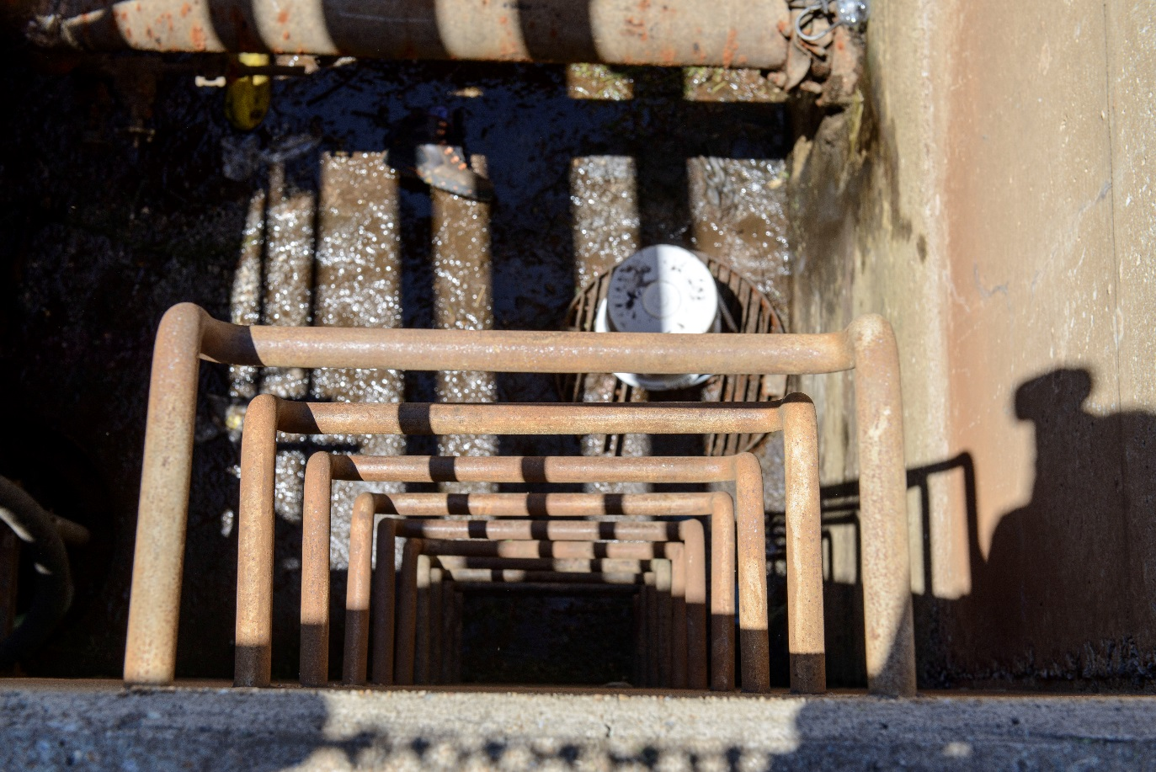
Cause(s)
Most probable cause of fall due to a combination of factors
Wet muck on ladder rungs and bottom of shoe covers substantially reduced the static friction between the rubber and steel. This affected the foot and gloved hands.
Reaching for vertical portion of barrier reduced the downward force and increased the outward force on the left foot.
Notes:
Coefficient of Rubber/ steel 0.7
Brake material and iron 0.4
Water and oil
Where’s the water in the pictures? The combination of 80⁰F temp, 37% RH, and forced air would dry the rungs quickly.

Slide 6
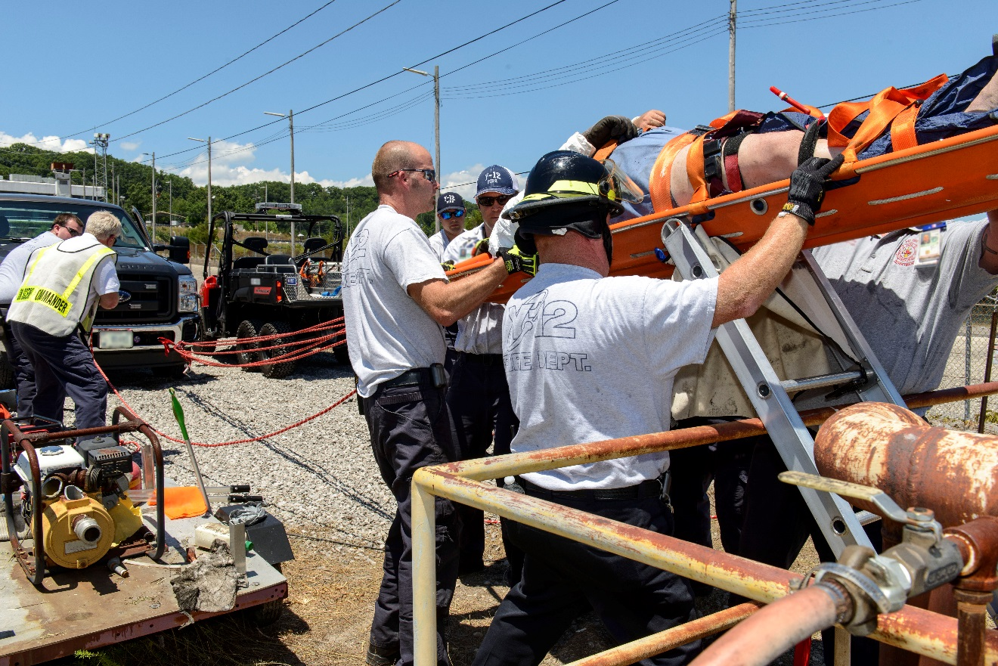
Emergency Response
Started with Pipefitter #2 who immediately returned to the aid of his colleague
Attendant summoned help, and along with Pipefitter #3 began clearing the area for rescue crews
Rescue crews arrived in 4 minutes, first equipment on scene in 5 minutes
Completed a complex, technical rescue, focus on patient outcome and comfort
ALL ARE POSITIVE NOTEWORTHY ACTIONS

Slide 7
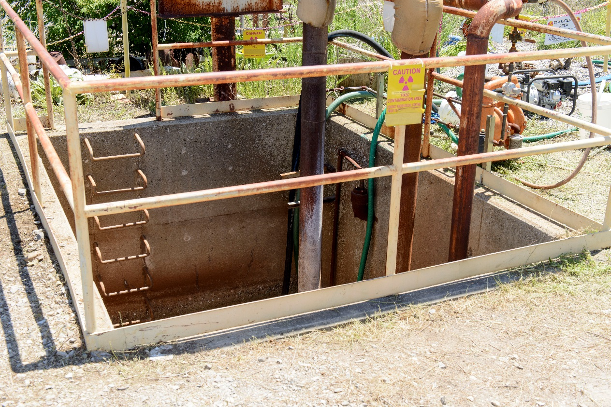
Confined Space
Eleven specific concerns with the planning and execution of confined space entry were identified
Contemporary evaluation of space hazards is required but was not performed
Initial atmospheric monitoring is required and cannot be waived – not performed
PPE reconciliation process not used
Protection for potential hazard negated equipment for actual identified hazard

Slide 8
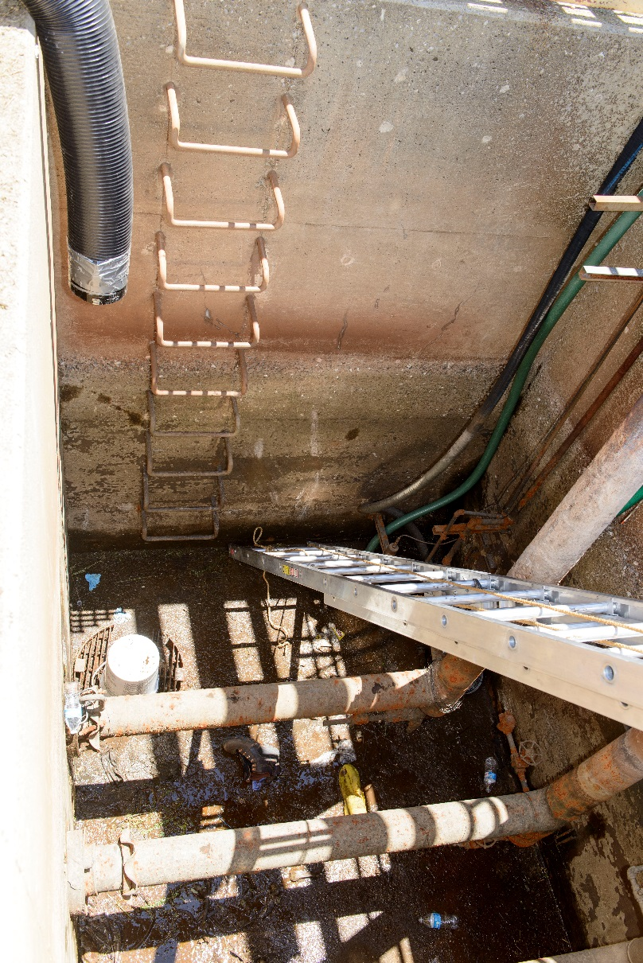
Work Processes
Significant number of disparities many of a significant safety nature
Underscores the importance of following procedures vs. filling out forms
Fragmented walk down and planning
Notes:
List examples:
Goal of investigation is to prevent next accident – not limited to falls, but other accidents as well
LOTO – Three different perceptions of what was locked out not all who entered locked out
Training and quals for confined space not up to date for one individual

Slide 9
Investigation
Timeline
Injury June 30, 2016
Occurrence Report July 6, 2016
Investigation Board chartered July 6, 2016
Phone call to OE
No noncompliance direct to slip and fall, but context includes confined space entry to a radiation contamination area. We believe the Investigation may reveal one or more noncompliance requiring a report in NTS.
Investigation Report completed August 24, 2016
Reporting Determination August 24, 2016
3 Judgements of Need
Report identifies facts that represent noncompliance
Phone call to OE to discuss the need for time to evaluate the report
Identify noncompliance citations September 7, 2016
Phone call to OE confirming intention to report
Submit NTS Report September 21, 2016
Phone call to OE
Shared investigation report with OE
Shared an analysis of non-compliance with OE via Email the following day

Slide 10
Timeline
Timeline
Notice of Intent to Investigate October 13, 2016
Received phone call before the notice
Subsequent discussion and phone call to determine willingness to consider a consent order
Request Consent Order November 18, 2016
Included the investigation and analysis of non-compliances
Email OE: plan to fill in the Utility Pit November 29, 2016
Entered action plan to NTS December 12, 2016
Phone call from OE December 20, 2016
Extent of Condition Review December 21, 2016
Response to 12/20 phone call January 5, 2017
Included identification of additional actions
Transmitted Extent of Condition Results
Teleconference: Emergency Response January 25, 2017
Email follow-up to teleconference January 26, 2017

Slide 11
Timeline
Timeline
Email with results of evaluation February 15, 2017
Utilities Work Planning and Control evaluation – 1 new issue not related to the accident
Consent Order signed May 5, 2017
Transmitted to OE May 10, 2017
Last Action Completed August 31, 2017
Effectiveness Review September 28, 2017
2 findings and will add actions in November
Phone call to OE September 28, 2017
Email to OE September 28, 2017
Share the effectiveness review.
Update NTS report with Effectiveness review results and add actions to address 2 findings October 2, 2017

Slide 12
Consent Order Provisions
Develop and finalize site-wide corrective action plan and extent of condition review.
Enhance hazard identification and assessment requirements related to confined space entry and lockout-tagout (LOTO), as revealed by the event.
Update CNS WSH program content, and the related processes for implementation of forms/permits to address the procedural deficiencies from the event.
Provide initial and periodic training as necessary, in revised WSH program content to ensure that personnel are adequately informed about required procedures and potential worksite hazards.
Enhance hazard prevention and abatement provisions related to confined space entry and LOTO as revealed by the event. To the extent feasible, reconfigure utility pit equipment to locations outside of pits so as to preclude personnel entry into a confined space.
Communicate lessons Learned.
Conduct Effectiveness Review.

Slide 13
Consent Order Provisions
Quarterly Reports of corrective action status.
Written notification of extensions 30 days in advance of original due date.
Notify when all actions are complete.
Provide results of final effectiveness review.
$45,000 monetary remedy.

