Slide 1
U.S. Department of Energy Office of Enterprise Assessments Office of Enforcement (EA-10)
Anthony C. Pierpoint, Director
November 8, 2022

Slide 2
Office of Enterprise Assessments’ Office of Enforcement (EA-10) Organization
EA-10
Director
Dr. Anthony C. Pierpoint
EA-10
Deputy Director
Robin M. Keeler
Jennifer Fulfer*
EA-11
Office of Worker Safety & Health Enforcement
Shannon Holman, Acting Director
EA-12
Office of Nuclear Safety Enforcement
Jacob M. Miller, Director
EA-13
Office of Security Enforcement
Carrianne J. Zimmerman, Director
Annette Bright
Jason Capriotti
Stanley Dutko
Lori Gray
Shannon Holman
Robert Smith
Scott Wenholz
Andrea Reid
Lisa German*
Joe DeMers
Margaret Kotzalas
Jonathan Marcano Lozada
Christian Palay
Erin Newton*
Jill Gesell*
Charles Isreal
Lin Livingston**
Karen Sims
* Denotes Contractor Support ** Denotes Remote Contractor Support – Part-Time Red Denotes Administrative Support

Slide 3
Enforcement Process Timelines
Previous Process Timelines | New Process Timelines
Decision to Investigate (JFI-NOI): 60 days | Decision to Investigate (JFI-NOI): 60 days
Investigation: 150 days | Investigation: 100 days
Enforcement Outcome: 150 days | Enforcement Outcome: 100 days
Total: 360 Days | Total: 260 Days

Slide 4
EA-10 Overall Case Duration Since 2018

Slide 5
Enforcement Policy
Worker Safety and Health
Part 851. —General Statement of Enforcement Policy Enforcement
“(c) The PNOV will normally be issued promptly, before the opportunity for an enforcement conference, following the inspection/investigation. In some cases an enforcement conference may be conducted onsite at the conclusion of an inspection/ investigation.“
Nuclear Safety
Part 820 - General Statement of Enforcement Policy
(a) “…DOE will normally hold an enforcement conference with the DOE contractor involved prior to taking enforcement action.”
Security Enforcement
Part 824 - General Statement of Enforcement Policy
(a) “…DOE will normally hold an enforcement conference with the DOE contractor involved prior to taking enforcement action.”

Slide 6
Enforcement Policy
Worker Safety and Health - 851.42 Preliminary notice of violation.
If a contractor fails to submit a written reply within 30 calendar days of receipt of a PNOV: (1) The contractor relinquishes any right to appeal any matter in the preliminary notice; and (2) The preliminary notice, including any proposed remedies therein, constitutes a final order.
Nuclear Safety - 820.24 Preliminary notice of violation.
Within 30 days after the filing of a Preliminary Notice of Violation, the respondent shall file a reply.
Security Enforcement - 824.6 Preliminary notice of violation.
If a person fails to submit a written reply within 30 calendar days of receipt of a preliminary notice of violation: (1) The person relinquishes any right to appeal any matter in the preliminary notice; and (2) The preliminary notice, including any remedies therein, constitutes a final order.

Slide 7
IR Process Flow Chart
Process in Review

Slide 8
Streamlining Effort
Streamline Investigation Report to more closely match PNOV.
Issue investigation summary with preliminary findings, shortly after the on-site investigation.
Preliminary findings match violations expected in PNOV.
Treat investigation summary and preliminary findings as an extension of the investigation.
Preliminary document for discussion with the contractor at the Enforcement Conference.
Sequester investigation team to prepare summary and preliminary findings.
Complete summary and preliminary findings within 2 weeks of on-site visit.
Issue for review by EA-1, PO/FO and submit to Contractor for review.
Schedule EC for 30-days following issuance of summary.

Slide 9
Other Options
Increase Federal staff
Increase contractor support
Investigate fewer events
Make decisions on investigations sooner
Has been discussed many times.

Slide 10
EA-10 Office of Enforcement 1995-Current

Slide 11
EA-11 Worker Safety and Health 2008-Current

Slide 12
EA-12 Nuclear Safety Enforcement 1995-Current

Slide 13
EA-13 Security Enforcement 2007-Current

Slide 14
Other Activities
EFCOG Engagement
Lessons Learned
Trends
Key Issues
Data Analysis
Regulatory Program Assistance Reviews

Slide 15
Regulatory Program Assistance Review (RPAR) Purpose and Value
Establish and strengthen communication flow between contractor enforcement program personnel and the Office of Enforcement
Increase senior management awareness of regulatory program process strengths and challenges
Offer contractors the opportunity to validate its resource investment in the regulatory program
Build confidence in the contractor’s ability to effectively identify and correct noncompliance
Familiarize Office of Enforcement personnel with site operations
Provide constructive feedback to enhance the regulatory program processes
Increase engagement with Federal enforcement partners

Slide 16
Regulatory Program Assistance Review (RPAR) When to Have A Review
Never hosted a review
New contractor/ new personnel
Contractor mission change

Slide 17
Annual Workshop Update

Slide 18
Questions?

Slide 19
Worker Safety and Health Enforcement FY22 - Notable Trends
Stan Dutko, Jr., Enforcement Officer
Office of Worker Safety and Health Enforcement Office of Enterprise Assessments

Slide 20
Overview
Current EA-11 Staffing
Worker Safety & Health Enforcement Notable Trends
Subcontractor Oversight/Subcontract Flow-Down
Fall Protection
Emergency Response
Injury & Illness Reporting and Recordkeeping
Request for Investigation (RFI)

Slide 21
EA-11 Staffing
EA-11
Office of Worker Safety & Health Enforcement
Shannon Holman, Acting Director
Enforcement Officers
Jason Capriotti Stan Dutko
Lori Gray Shannon Holman
Andrea Reid Robert Smith
Scott Wenholz
Program Analyst
Annette Bright

Slide 22
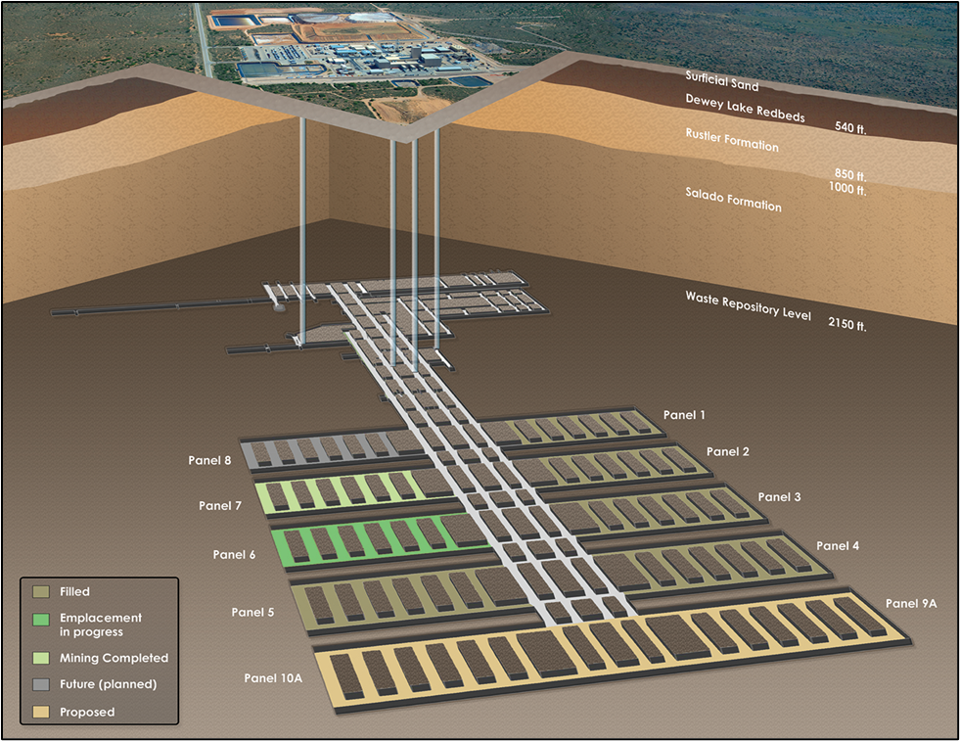
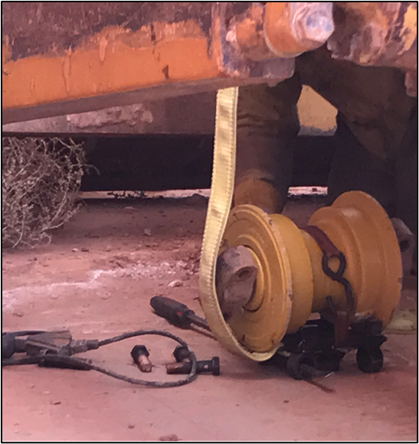
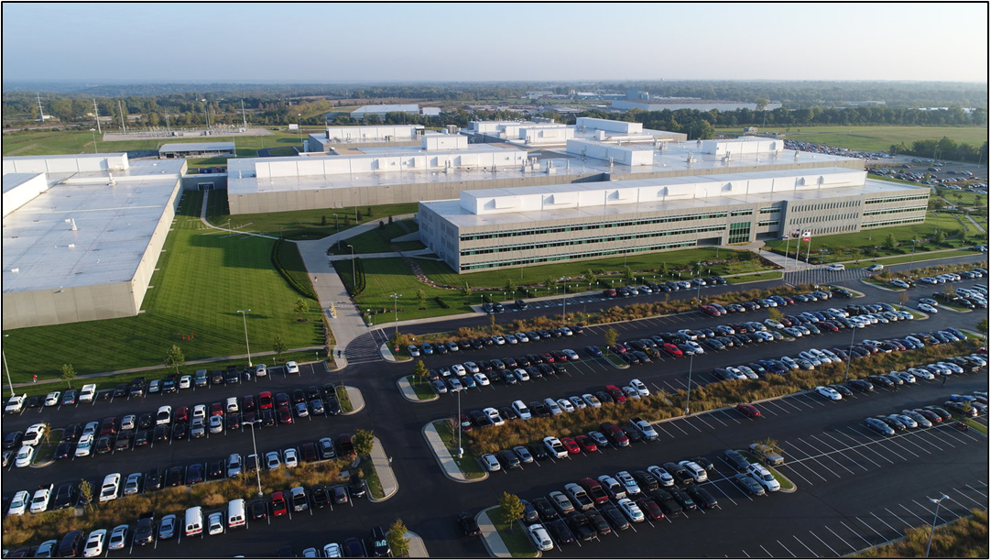
Worker Safety & Health Enforcement Notable Trends

Slide 23
Subcontractor Oversight/Subcontract Flow-Down

Slide 24
Subcontractor Oversight/Subcontract Flow-Down
Did not adequately oversee subcontractor range operation processes or work controls associated with live fire operations
Range operation processes and work controls were inadequate in a few areas such as:
Preventing workers from going downrange during live firing activities
Clearing live fire range surface danger zones of personnel or other hazards prior to re-starting
Identifying operational status (active or inactive)
Lack of Communication

Slide 25
Subcontractor Oversight/Subcontract Flow-Down
Did not provide adequate oversight for tank surface preparation project
Failed to ensure that fall protection systems were provided and installed inside tank
Fall protection anchorage points capable of supporting at least 5,000 pounds per worker were not present
A manway on the top of the tank was designated as the entry point to access the scaffold platform where abrasive blasting work would be performed
Workers accessed the tank from a ground-level manway and used the scaffold (which was not engineered or rated by the manufacturer as an anchorage point) for the attachment of fall protection systems.
Notes:
-Did not develop an appropriate rescue plan that included retrieval of an injured or incapacitated worker from a 25-foot scaffold within a permit-required confined space
-Did not confirm that the County Fire Department had the capability to perform an emergency rescue on the 25-foot scaffold that was erected in Tank prior to abrasive blasting

Slide 26
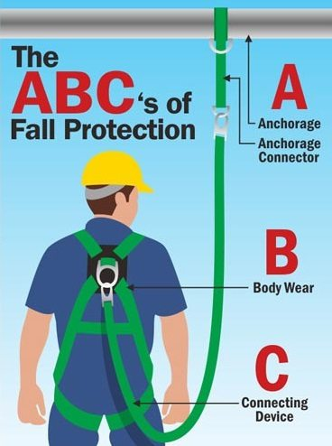
Fall Protection

Slide 27
Fall Protection (Recent Examples)
A subcontractor did not ensure that abrasive blasting operators were protected from a fall
The subcontractor allowed abrasive blasting operators to perform abrasive blasting at a height of approximately 25 feet without certified personal fall arrest anchor points
The subcontractor permitted the abrasive blasting operators to anchor their personal fall arrest system to the guard rails of an unsecured (i.e., mobile) scaffold that was not permitted by the manufacturer or certified as a designed anchorage point

Slide 28
Fall Protection
Construction ironworker installing insulation and metal roof panels on a roof when they fell off the leading edge
The fall protection system that the ironworker was wearing arrested the worker's fall
The worker sustained abrasions to their left bicep and left latissimus dorsi (back muscle behind arm) as a result
Manufacturer's instructions for the SRL includes a warning to "Avoid sudden or quick movement during normal work operation…This may cause the device to lock-up."
Notes:
- There were 2 instances where workers fall into holes on a roof, 1 into the system and the other caught himself.
-1 ladder fall, 1 incident involving both improper ladder use and improper fall arrest use with no fall.
-When a construction sub-contractors need to work at heights, diligence in oversight of the WPC process, then verifying that they are following the plan in the field is imperative.

Slide 29
Emergency Response

Slide 30
Emergency Response (Recent Examples)
Two workers sustained 2nd degree chemical burns from anhydrous acetic acid discharge
Didn’t use chemical safety shower in lab
Didn’t report injuries to emergency response or ESH personnel until reporting to site clinic for medical treatment
Inappropriate response to LEL alarm
Used “skill-of-the-craft” for lab workers

Slide 31
Emergency Response (Recent Examples)
Worker receiving a crush injury to the right hand during post-maintenance component testing
Failed to provide underground occupants with real-time primary/secondary egress hoist status information
Workers attempted to use a hoist they felt was a faster egress route, only to find it out of service and non-recoverable
Workers were redirected to another egress hoist, causing a combined delay of 10 minutes in the treatment and evacuation of the injured worker

Slide 32
Emergency Response (Recent Examples)
Worker injured on 25’ scaffold inside a tank
Abrasive blast hose malfunctioned
Forearm severely lacerated
Climbed down scaffold & exited tank
Supervisor called project manager, not FD
Contractor didn’t confirm local FD capabilities before starting work

Slide 33
Emergency Response (Recent Examples)
Worker was seriously injured when a 142-pound track roller fell on their hand, crushing two fingers
Did not follow the required emergency response protocol of calling 911 to request EMS to provide medical care, stabilize, and transport the injured worker
Injured worker’s hand was wrapped in sterile gauze and the worker was transported by a supervisor to an offsite medical facility

Slide 34
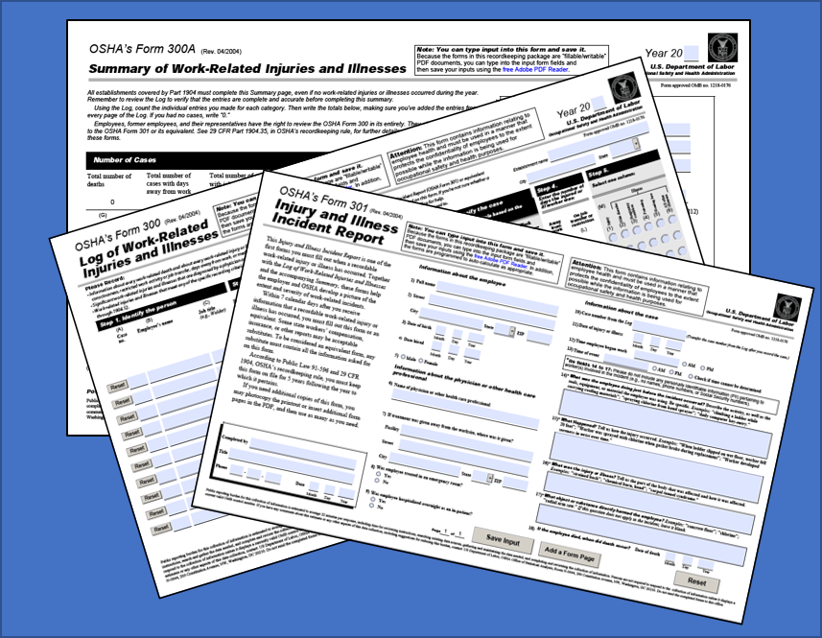
Injury & Illness Reporting and Recordkeeping

Slide 35
Injury & Illness Reporting and Recordkeeping (Recent Examples)
Recorded that the injured worker was away from work for 13 days and on restricted duty for 23 days.
Attending physician released the employee to return to work with restrictions, reflecting a total of 12 days away from work.
Attending physician later released the employee to return to work without restrictions, reflecting a total of 77 days of restricted duty.

Slide 36
Injury & Illness Reporting and Recordkeeping (Recent Examples)
Initial DOE CAIRS report did not accurately record the injured worker’s number of days away from work and total number of restricted days
CAIRS report recorded that the injured worker was away from work for 5 days and on restricted duty for 0 days
Did not submit a quarterly update to the number of DART by the 10th of the month following the calendar quarter as required
Injured worker was still on restricted duty (134 days) when EA-11 Investigated

Slide 37
Request for Investigation (RFI)

Slide 38
Questions ?

Slide 39
Nuclear Safety Enforcement Program Update
Joseph DeMers, CHP, CSP
Enforcement Officer
Office of Nuclear Safety Enforcement
Office of Enterprise Assessments

Slide 40
Overview
Nuclear Safety Enforcement Office Update
Ongoing Cases
NTS Data Analysis
Common Areas of Weakness
Other Activities

Slide 41
Nuclear Safety Enforcement Office Update
Staffing:
Jacob M. Miller, Director
Joseph DeMers, Enforcement Officer
Margaret Kotzalas, Enforcement Officer
Jonathan Marcano Lozada, Enforcement Officer
Christian Palay, Enforcement Officer
Lisa German, Contractor Administrative Support

Slide 42
Ongoing Cases
Contractor | Issue | Notice of Intent
Triad National Security, LLC (Triad) | Water Tank Overflow and Other Recent Nuclear Safety Events | September 2021
Triad National Security, LLC (Triad) | Radioactive material release from a glovebox in the Plutonium Facility Building 4 (PF-4) | July 19, 2022

Slide 43
Water Tank Overflow & Recent Nuclear Safety Events
Between February and June 2021, a series of unintentional nuclear safety-related events occurred in the same facility. These events included:
Exceedance of nuclear criticality safety mass-control requirements,
Exothermic reaction of materials in a waste barrel destined WIPP,
Glove breach releasing radioactive contamination, resulting in skin contamination of three radiation workers,
Overfilling a water bath, resulting in flooding a vault containing fissionable materials.

Slide 44
Radioactive Plutonium Material Release from a Glovebox
Event:
January 7, 2022, glovebox breach occurred
4 of 6 individuals contaminated
Continuous Air Monitors (CAMs) alarmed
Field indicators potentially significant internal uptake

Slide 45
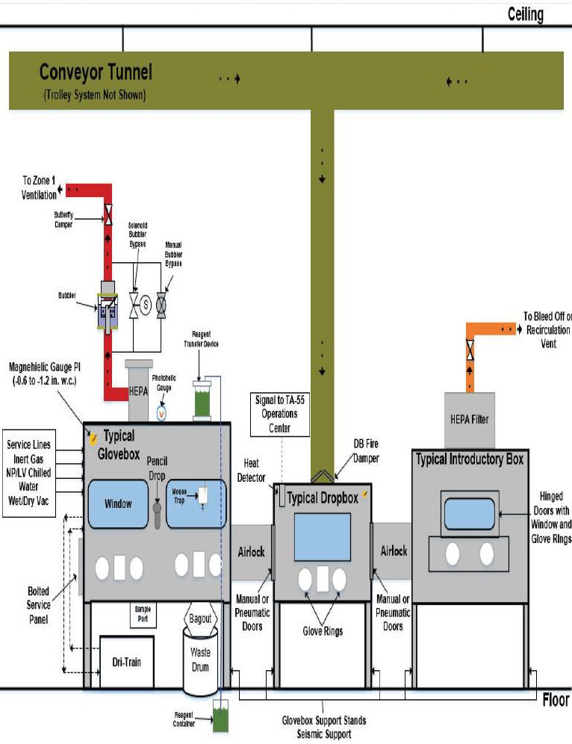
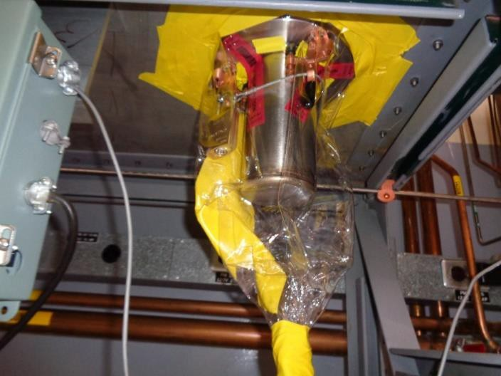
Radioactive Material Release from a Glovebox

Slide 46
Safety Significance of Nuclear Safety NTS Reports
Noncompliances from 2019-2022

Slide 47
NTS Safety Significance – Observed Differences
Noncompliances from 2019-2022

Slide 48
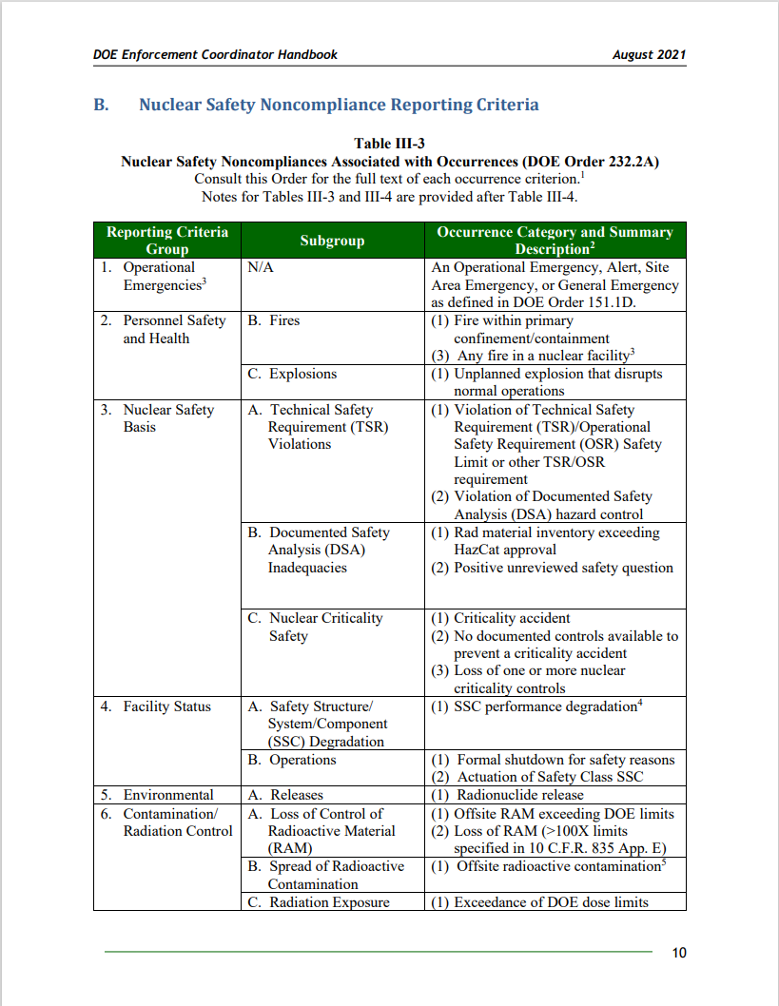
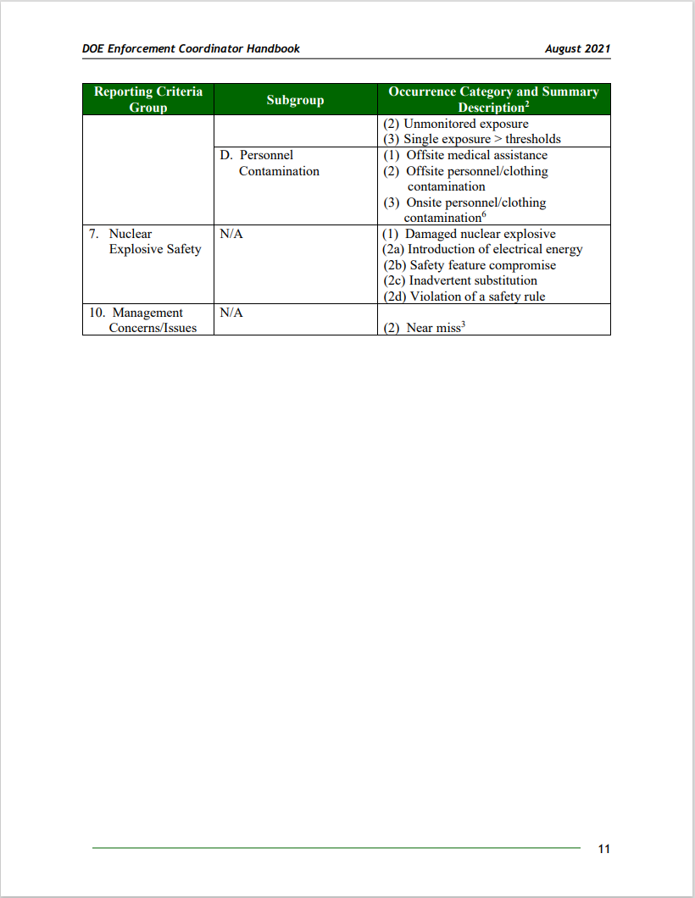
Nuclear Safety Noncompliance Reporting Criteria
DOE Enforcement Coordinator Handbook
Page 10 and 11

Slide 49
Common Areas of Weakness
Procedural Compliance
Software Quality Assurance
Hazard Identification and Control
Quality Improvement
Identifying issues
Missing/Incomplete causal factors
Inadequate corrective actions
Hierarchy of controls

Slide 50
Other Activities
Involvement in the DOE and Nuclear Communities
American Nuclear Society
Chair of ANS 57.11 Integrated Safety Assessments for Nonreactor Nuclear Facilities working group
ANS 3.14 Process for Infrastructure Aging Management and Life Extension of Nonreactor Nuclear Facilities working group
Standard was approved in August 2021
ASME Nuclear Quality Assurance
Software Quality Assurance subcommittee
Department of Energy
QA Community of Practice
Technical Standards Program

Slide 51
Other Activities
Involvement in the DOE and Nuclear Communities (continued)
Energy Facility Contractors Group (EFCOG)
Radiation Protection working group
Presentation on Nuclear Safety Enforcement Process
Nuclear safety working group
Health Physics Society
Governmental Relations Committee

Slide 52
Questions ?

Slide 53
Security Enforcement Program Update
Karen Sims
Enforcement Officer
Office of Security Enforcement
Office of Enterprise Assessments

Slide 54
Overview
Security Enforcement Office Update
Classified Information Security Incident Data
Security Enforcement Activities Update

Slide 55
Security Enforcement Office Update
Staffing:
Carrianne Zimmerman, Director
Charles Isreal, Enforcement Officer
Karen Sims, Enforcement Officer
Erin Newton, Contractor Administrative Support
Jill Gesell, Contractor Enforcement Analyst and Safeguards and Security Information Management System (SSIMS) Support
Linwood Livingston, Contractor Security Specialist Support

Slide 56
IOSCs Reported vs. Action Taken by the Office of Security Enforcement (FY 2020-2022)
Total number of IOSCs screened by EA-13 and considered related to 10 CFR Part 824 from FY 2020 to FY 2022: 795
Number of IOSCs on which the Office of Security Enforcement acted: 4
2 Fact-Findings
2 Investigations

Slide 57
Classified Information Security IOSCs Topical Trends
NOTE: Multiple topical areas can apply to a single IOSC

Slide 58
Classified Information Security IOSCs Comparative Data – Classification Issues
FY 2020
Total # of IOSCs: 306
FY 2021
Total # of IOSCs: 309
FY 2022
Total # of IOSCs: 183

Slide 59
Classified Information Security IOSCs Comparative Data – Classification Issues (Cont’d)
NOTE: Multiple classification issues can apply to a single IOSC

Slide 60
Classified Information Security IOSCs Comparative Data – Likelihood of Compromise
FY 2020 Closed IOSCs: 289
FY 2021
Closed IOSCs: 286
FY 2022
Closed IOSCs: 127

Slide 61
Security Enforcement Activities Update
Investigation – National Technology and Engineering Solutions of Sandia, LLC at Sandia National Laboratories, New Mexico:
Introduction of Unauthorized Electronic Equipment (Panasonic Pan-Tilt-Zoom Cameras) into Security Areas and the Potential Unauthorized Disclosure of Classified Information
Issues:
Proper identification, review, and marking of classified information
Information protection and control
Classified cyber security
IOSC inquiries
Causal analysis and corrective actions

Slide 62
Security Enforcement Activities Update (cont’d)
Investigation – National Technology and Engineering Solutions of Sandia, LLC at Sandia National Laboratories, New Mexico (cont’d):
Outcome: Pending
Longstanding nature of noncompliance
Causal analysis
Extent of condition
Corrective actions

Slide 63
Security Enforcement Activities Update (cont’d)
Fact-Finding – National Technology and Engineering Solutions of Sandia, LLC at Sandia National Laboratories, New Mexico:
Three similar security incidents involving the improper protection of visually classified items
Issues:
Similar IOSCs within the same Center
Processes and procedures for protecting visually classified items
Self-assessments

Slide 64
Security Enforcement Activities Update (cont’d)
Fact-Finding – National Technology and Engineering Solutions of Sandia, LLC at Sandia National Laboratories, New Mexico (cont’d):
Outcome: Enforcement Letter issued, June 6, 2022
Causal analysis
Corrective actions

Slide 65
Security Enforcement Activities Update (cont'd)
IOSC Evaluation – Battelle Energy Alliance, LLC at Idaho National Laboratory
Issues:
Storage and protection of classified matter
Ineffective work planning and control processes
Outcome – Enforcement Letter issued, November 4, 2022
Corrective Actions

Slide 66
Security Enforcement Reference Tools
Office of Security Enforcement Website: http://energy.gov/ea/services/enforcement
Enforcement Process Overview and Enforcement Coordinators Handbook: http://energy.gov/ea/services/enforcement/enforcement-program-and-process-guidance-and-information

Slide 67
Contact Information Office of Security Enforcement, EA-13
Carrianne Zimmerman, Director
carrianne.zimmerman@hq.doe.gov
301-903-8996
Karen Sims karen.sims@hq.doe.gov
301-903-0244

Slide 68
Questions?

