Slide 1
The Dangers of Look-Alike Equipment
EFCOG-ESTG
Electrical Safety Month
May 2016

Slide 2
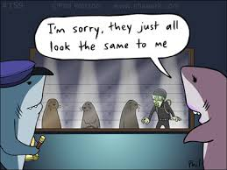
Have you ever called out to someone across a public place only to realize it wasn’t the person you thought it was?
Notes:
Tip: Add your own speaker notes here.

Slide 3
Have you ever grabbed the keys to your car only to find out they were actually for one of your other vehicles?

Slide 4
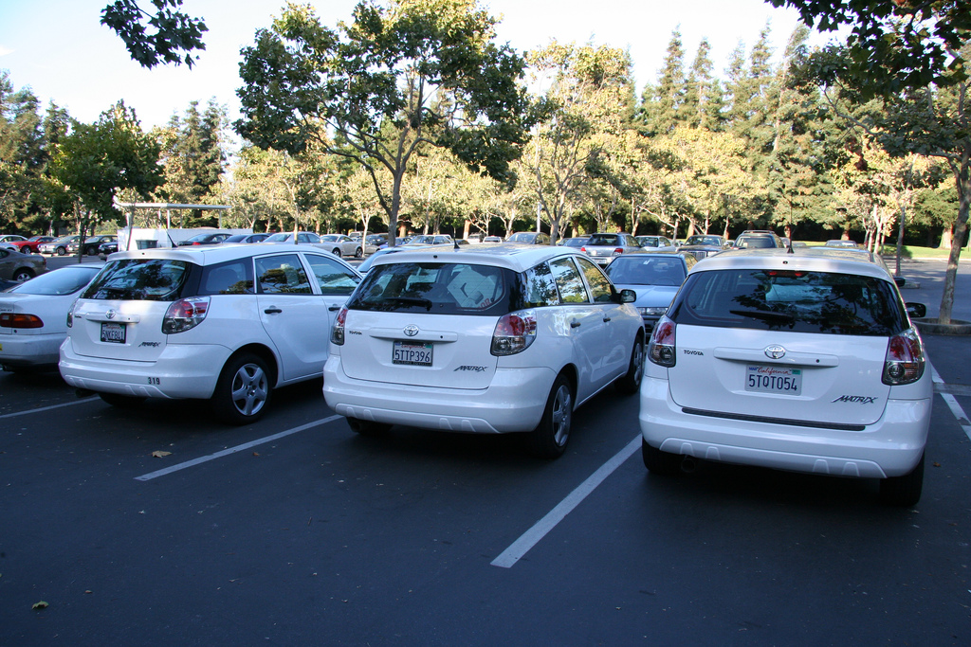
Have you ever tried to unlock your car in a crowded parking lot and after trying for some time realize it’s not your car?
Notes:
Tip: Add your own speaker notes here.

Slide 5
Similar or look-alike objects can cause confusion which can lead to mistakes.

Slide 6
Mistakes involving look-alike or similar things can create funny or embarrassing situations.

Slide 7
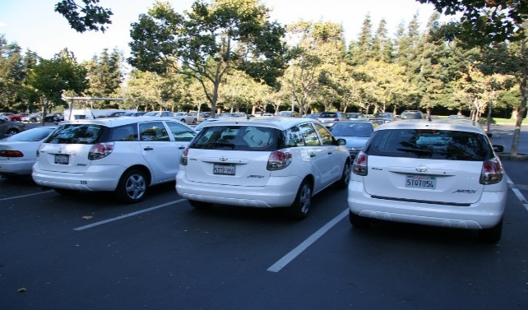
The consequences of these types of mistakes are relatively minor compared to incidents involving electrical equipment.
Notes:
Tip: Add your own speaker notes here.

Slide 8
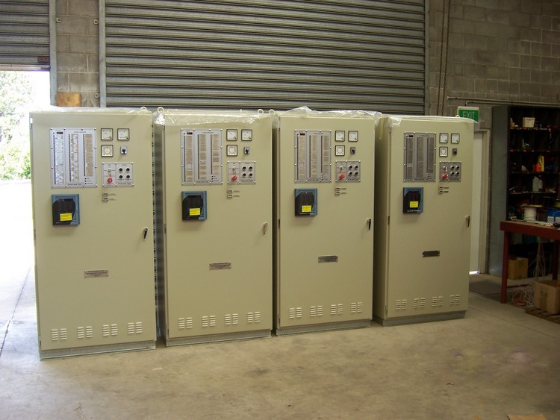
Mistakes involving look-alike electrical equipment have led to incidences where employees have been severely injured or killed.

Slide 9
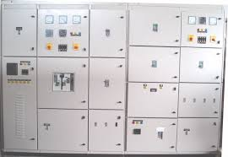
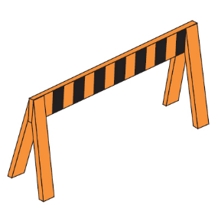
Since 2009, NFPA 70E has required that if electrical equipment placed in an electrically safe work condition exists in a work area with other energized look-alike equipment, then one of the altering methods described in “Alerting Techniques” (Safety Signs, Barriers, Attendants) must be used to prevent employees from entering look-alike equipment.
Energized
Electrically Safe

Slide 10
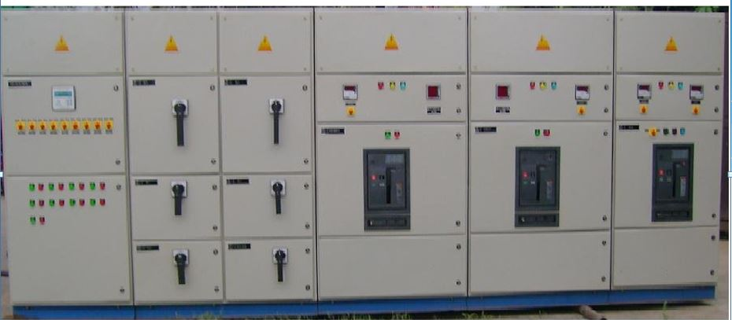
Without clear indication of what is energized and what is not it can be difficult to determine where the boundaries are when working with look-alike equipment.
Notes:
Tip: Add your own speaker notes here.

Slide 11
When clearly identified look-alike equipment mistakes can be greatly reduced or eliminated.
DO NOT ENTER

Slide 12
NFPA 70E
NFPA 70E requires equipment in an electrically safe work condition to be differentiated from other look-alike equipment in the area that is energized. NFPA 70E provides direction on the methods that can be used to warn and restrict access but stops short of dictating the details on how to accomplish the methods.

Slide 13
Alerting Technique
Since NFPA 70E leaves out the details on how to accomplish it’s “Alerting Technique” it is up to each employer to determine how best to accomplish the task of alerting their employees when the dangers of look-alike equipment exist in the work area.

Slide 14
EFCOG ESTG-HEC Working Group
The methods to differentiate look-alike equipment has been a topic of great concern and much discussion around the DOE complex. The Hazardous Energy Control (HEC) group, a subgroup of the EFCOG-ESTG will be tasked with developing a best practice standardizing how differentiation of equipment can be best accomplished.

Slide 15
The Dangers of Look-Alike Equipment
Mistaken identity in the workplace due to look-alike equipment can expose workers to hazards for which they are unaware. Opening, or removing the wrong guards or covers and working in the wrong equipment can lead to serious injury or death. Make every effort to ensure that employees are aware of the dangers and take action(s) to prevent access to energized look-alike equipment.
Energized
Electrically Safe

