Slide 1
EFCOG Hazardous Energy Control Working Group
Electrical Safety
Chair: Stephanie Collins, LBL
Date: July 8, 2016

Slide 2
HEC Working Group Purpose
Work towards consistent and effective hazardous energy control (LOTO) programs at DOE sites which are in compliance with standards such as NFPA 70E Article 120 and 29 CFR 1910.147.
Determines Electrical Safety Month topic and develops supporting materials.
Provides input to standards-making bodies where justified.

Slide 3
Membership
From EFCOG 2015:
Orlando Abeyta John Armstrong Joanne Bailey
Jennifer Bilskis Richard Caummisar Greg Christensen
Stephanie Collins Bill DeHope Joan Edwards Peter Foster
Samuel Garcia Michael Hicks Vernon Phinney Rick Ramirez
Alex Romero Lucille Roybal Jonathan Swanks Richard Waters

Slide 4
Goals for HEC Working Group for 2015 EFCOG
Complete Draft for Generic LOTO Procedure that meets the minimum requirements
Finalize Work Control Area and submit for Review as Best Practice
Address Lockout Before Work and Test Before Touch
Continue work to provide clarification and proper use of air gap and relationship to LOTO
Improve upon hazardous energy thresholds proposed previously and submit as an appendix for review by other SME's.

Slide 5
Deliverable Progress During 2015 EFCOG ESW
Each group presented their proposal and the group provided feedback. Proposals were edited and reviewed and approved by the HEC group.
Products completed:
1. Controlled Work Area Best Practice Proposal
2. Zero Voltage Verification Best Practice Proposal
3. Physical Separation Best Practice Proposal

Slide 6
2015 Follow-On Goals and Deliverables
Determined we would split into groups to:
  Clarify how to conduct Zero Voltage Verification. Write and submit best practice for Zero Voltage Verification.
  Addressed “air gap” and determined term has eroded. Write and submit best practice for Physical Separation exemption to LOTO
  Best Practice – Hazardous Energy Control Procedure

Slide 7
Continuing Work
LOTO Procedure for the Complex
Pro-Active Approach
Need to understand the problems to be able to provide a solution
Request made from DOE to update/revise DOE-STD-1030-96 Guide to Good Practices for Lockouts and Tagouts
Determined we would start on a matrix to consolidate standards & requirements from various regulations to look and resolve inconsistencies between them
Address LOTO requirements in an R&D environment
Generate a Survey to ESG to identify & prioritize future work
  Group members to provide ongoing support to resolve issues prior to next EFCOG
  ID issues to be worked on next workshop

Slide 8

Electrical Safety Month - Every May
Proposed Theme – Look Alike Equipment
Deliverables:
  Presentation and Posters
  Possible Best Practice Proposal
  (Switchgear & HP interface)

Slide 9
HEC – 2015 Deliverable Timelines
  3 Best Practice Proposals to be submitted to the ES Executive Committee NLT 31 July 2015
    Controlled Work Area
    Zero Voltage Verification
    Physical Separation exemption from LOTO
  2. Table of LOTO Requirements – 1st draft 30 September 2015
  1. cross-walk of LOTO requirements

Slide 10

Zero Voltage Verification Best Practice Proposal
This best practice should be used when operating under LOTO, outages or other processes that require zero voltage verification to work on circuits/equipment powered by a hazardous electrical source as determined by hazard assessment.
Zero voltage means absence of voltage, or voltages that are expected but not hazardous.
** As a Group decided the “how to conduct zero voltage verification” was directly related to skill of the craft and qualification – opted to not submit a BPP

Slide 11


HEC – Progress from Previous Deliverables
  3 Best Practice Proposals submitted to the ES Executive Committee
    Controlled Work Area – BPP #184 Controlled Work Area
    http://efcog.org/wp-content/uploads/2015/12/Work-Control-Area-Final4.pdf
    Zero Voltage Verification – no further action
    Physical Separation vs. LOTO – BPP # 180 Lockout Tagout Applicability to Physical Separation
    http://efcog.org/wp-content/uploads/2015/10/Physical-Separation-Best-Practice-Submittal_rev.11-2.pdf
  2. Table of LOTO Requirements –
  1. cross-walk of LOTO requirements

Slide 12
HEC Balancing Act
Previous Commitments
Current Issues within Complex
Table of LOTO Requirements (Cross-walk)
Formulate a Generic LOTO program based on cross-walk
Shocks received by improperly plugging in/un-plugging equipment
Shocks received on degraded equipment
Improper hazardous energy control
Not implementing LOTO as required
Not following prescribed HEC Process

Slide 13
Issues Across the Complex – Electrical Shocks & Injuries
  Reported July 17, 2015 up through June 17, 2016
  # Electrical Shocks and Injuries (19)
      C & P while plugging/unplugging devices – 6
      Improper HEC - 5
      Improper installations & degraded equipment - 4
      - Plugging in thermocouples - 2
      Capacitive shock – 1
      Capacitor short-circuit burn - 1

Slide 14
Issues Across the Complex – Lockout/Tagout (LOTO)
LOTO
  (19) Procedural Violations resulting in potential electrical hazard exposure
  (4) Personnel performing maintenance/servicing/repairs that were not on the LOTO
  (20+) Administrative and procedural violations that didn’t result in potential electrical hazard exposure
  (7) Unexpected hazardous energy found during ZVV or Test Before Touch
  (5) LOTO/HEC Recurring Occurrence Reports
  (1) Failure to recognize requirement for LOTO to control Hazardous Energy
  (12) Unplanned contact with energized conductors or damaging electrical equipment/cables due to drilling, excavating: walls, ceilings, underground and overhead contact – no electrical injury

Slide 15
HEC Sub-Group Decision Factors
Site Management Responsibilities
HEC
Procedural Compliance
Ensuring people are trained and qualified for job tasks
Authorizing Work
Providing Safety Training, PPE, etc.
# of previous occurrences
Likelihood of future incidents
Severity & risk if incident occurred
  Injury to people
  Operational risk
    Impacts on DOE labs
R & D issues inadequately or not addressed in current standards

Slide 16
2016 ESW HEC Goals and Priorities – Break into 4 Groups
Finalize format of the LOTO Cross-walk and begin work on generic LOTO program (with draft program completed NLT end of 2016)
Determine 2017 ES Month topic and assign folks to work on it (with draft completed end of January 2017)
Look Alike Equipment Best Practice Proposal
ARMS/ERMS (Arc Reduction Maintenance Switch)/(Energy Reduction Maintenance Switch) control

Slide 17
HEC WG Schedule
Tuesday Afternoon
Wednesday
Break into 4 groups and get to work
LOTO
2017 Electrical Safety Month
Look Alike Equipment
ARMS/ERMS Control
Generate products for HEC Working Group review
Finalized LOTO crosswalk format; Generic program template
ES Month Topic
Look Alike Equipment draft BPP
ARMS/ERMS Control draft BPP

Slide 18
HEC WG Schedule (continued)
Thursday Morning
Thursday Afternoon
Finish up working on products for this Workshop
Identify continuing work and assign members & get commitment for completion
Present HEC Working Group Progress

Slide 19
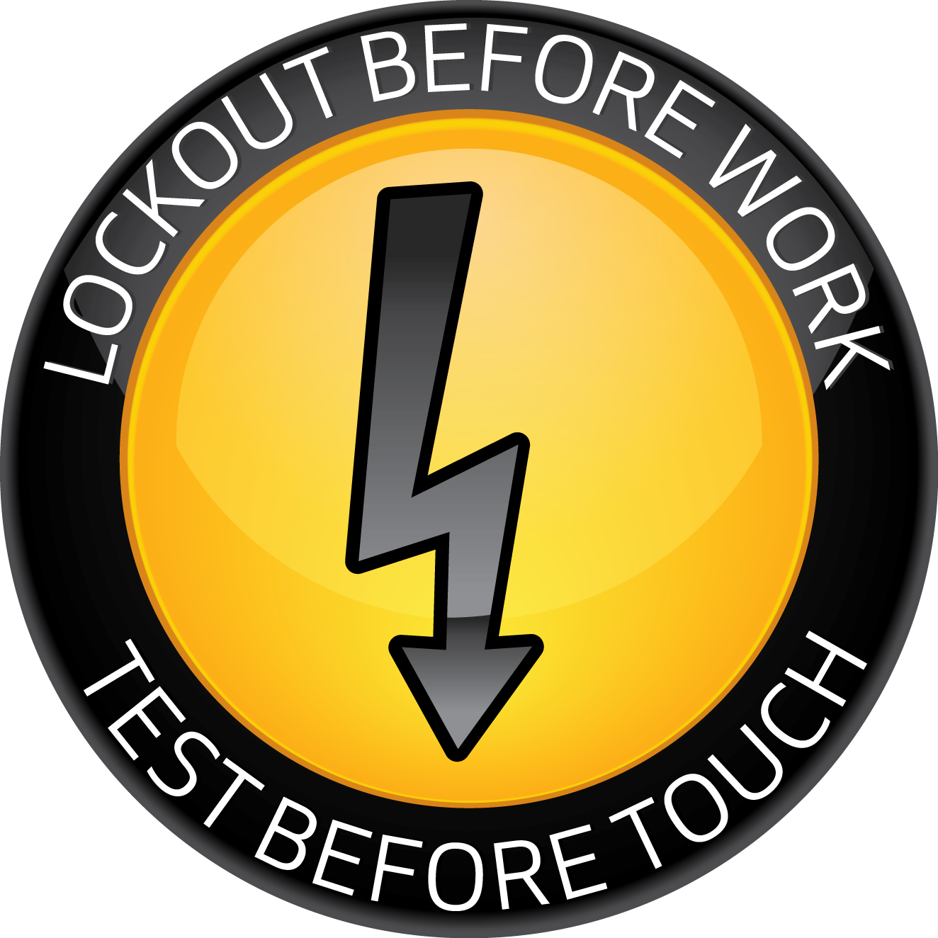
Two Habits That Work

