Slide 1
EFCOG Hazardous Energy Control Working Group
Electrical Safety
Chair: Stephanie Collins, LBL
Date: July 21, 2016

Slide 2
Members
EFCOG 2016:
Orlando Abeyta Rodney Baker Richard Biscardi
Brian Brass Rod Briscoe Stephanie Collins
Russ Harwood Dave Lipinski Troy Rogers
Mike Rosenow Lucille Roybal Gary Sanchez
Edward Sierra Eric Stromberg Richard Waters

Slide 3
Goals for HEC Working Group for This EFCOG
Tuesday: Discussed progress from last year for new participants and split into groups to address focus areas for this work shop:
Finalize format of the LOTO Cross-walk and begin work on generic LOTO program (with draft program completed NLT end of 2016)
Determine 2017 ES Month topic and assign folks to work on it (with draft completed end of January 2017)
Look Alike Equipment Best Practice Proposal – start framework
ARMS/ERMS (Arc Reduction Maintenance Switch)/(Energy Reduction Maintenance Switch) control – not prepared to address this work shop due to lack of manpower (15 vs 30)

Slide 4
Deliverable Progress
Thursday morning, each group presented their material and the group provided feedback.
Products completed:
1. LOTO Cross-walk agreed format
2. Electrical Safety Month topic “Batteries: The Positives and Negatives of Changing Battery Technology”
3. Look Alike Equipment framework for a Best Practice

Slide 5
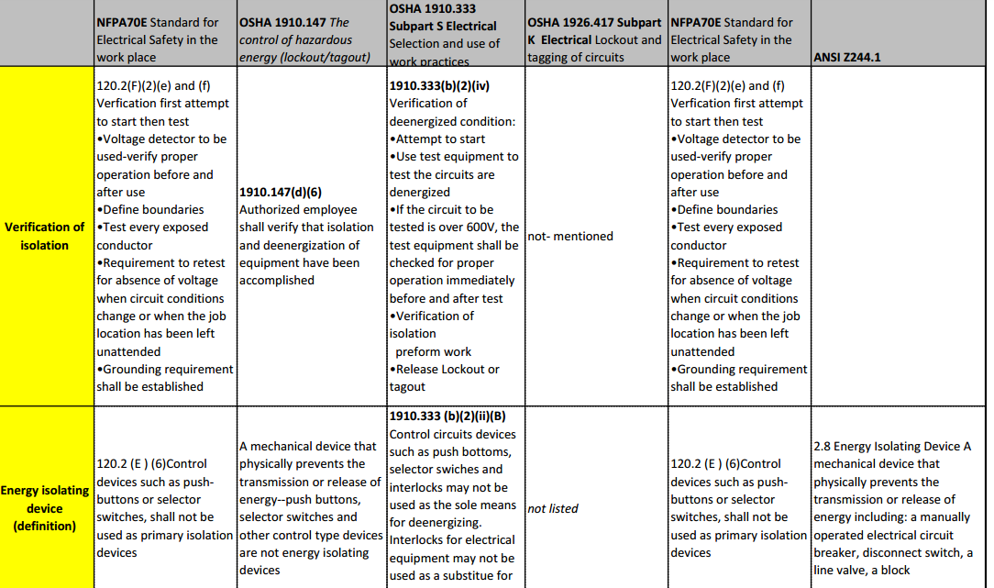
LOTO Cross-walk framework
2015 HEC group
Initial format started with 1910.147
Columns across the top to the right for each standard that also has implications for LOTO
Group decided to start with 70E and change format

Slide 6
New LOTO Cross-walk Format
Instead used 70E Articles and Bolded areas from 2015 as starting point
Began adding columns for other standards

Slide 7
Continuing Work – to develop LOTO Procedure template
Determine the need for LOTO
Determine the type of LOTO
Simple
Complex
Plan for the specific type of LOTO
Apply the LOTO
Remove LOTO
Return system to operations
Special conditions?

Slide 8
Electrical Safety Month 2017
Proposed Theme – Batteries: The Positives and Negatives of Changing Battery Technology
Types: Lead Acid, Alkaline / Mercury, Ni Cad / Ni Mh, Lithium Ion, Pu-238 (Medical devices)
Hazards, Care & Handling Considerations:
Alkaline
Potassium Hydroxide
Lead Acid
Sealed lead acid will swell
Hydrogen generation during charging
Ni-Cad / Ni-MH
Charging is the big issue here, due to memory issues

Slide 9
Electrical Safety Month 2017
Hazards, Care & Handling Considerations:
Lithium Ion
Charging. Critical that the proper charger is used. 80% of e-cig explosions have occurred during charging
Overheating
Substandard Manufacturing & Counterfeit issues
Pu-238
2 to 4 Curies of material
Medtronic produced 850 units
End of life considerations (including Cremation)
50 to 100 units still left
Instructions are to remove pacemakers and send them to Los Alamos

Slide 10
Electrical Safety Month 2017
Storage, Disposal & Recycling
More important than ever to recycle batteries properly.
Lithium – limited resource
Mercury - environmental
Lead - 98% to 99% of Car batteries can be recycled

Slide 11
Electrical Safety Month 2017
Deliverables:
Presentation – development in progress
Field Aids / Posters
Materials to be completed and sent to ES Executive Committee NLT January 2017

Slide 12
Look Alike Equipment
Initial comparison of programs at LBNL, Sandia and LANL
Text very similar between the three
If your Lab has learned from previous issues and wants to share – we welcome it
Programs are only part of the issue
People performing and planning the work need tools and reminders to ensure they stay safe during the performance of work…..to address equipment/energization status changes

Slide 13
Look Alike Equipment – Areas for Exploration
Temporary labeling to reflect current status of equipment; de-energized or energized & reminders to Test Before Touch
Labels outside equipment access doors (Equipment ID and highest voltage)
Labels inside the door
Barricades shall be used in conjunction with safety signs where it is necessary to prevent or limit employee access to work areas containing energized conductors or circuit parts. Conductive barricades shall not be used where it might increase the likelihood of exposure to an electrical hazard.

Slide 14
Look Alike Equipment
Signage will follow ANSI standards.
If signs and barricades do not provide sufficient warnings and protection from electrical hazards, an attendant shall be stationed to warn workers of potential hazards. Attendants focus shall be on the task at hand, no cell phone or personal electronic equipment shall be used by the attendant.
Examples of proper barricades/signage will be included.

Slide 15
HEC – Continuing & Future Work
Planned
Unplanned
LOTO Template
Electrical Safety Month Materials
Look Alike Material Best Practice
ARMS/ERMS (Arc Reduction Maintenance Switch)/(Energy Reduction Maintenance Switch) control – How do you control switch position?
Addressing arising needs across the Complex based upon hazard
severity and risk
Trends

Slide 16
How You Can Participate
If your Lab has learned from previous issues and wants to share – we welcome it
LOTO Template/Procedure – Send to lmroybal@sandia.gov
Batteries – Send to stromberg@lanl.gov
Look Alike Equipment – Send to slcollins@lbl.gov

Slide 17
Two Habits That Work

