Slide 1
Worker Safety and Health Enforcement
Program
Terry Meisinger
Office of Worker Safety and Health Enforcement
Office of Enterprise Assessments
http://energy.gov/ea/services/enforcement

Slide 2
Trends
Electrical Safety
Emergency Response
Hierarchy of Controls
Training and Information

Slide 3
National Security Technologies, LLC
Nevada National Security Site
Event
  5kV Electrical shock
Outcome
  PNOV
Issues
  Hazard Identification and Assessment
  Hazard Prevention and Abatement
  Safety & Health Standards
    Electrical Safety
  Training and Information
Notes:
The incident occurred during preventive maintenance work on electrical equipment at the U1a Complex, involving multiple crews, crafts, and locations. The electrical shock occurred while an employee was using a damp rag to clean the inside of an energized 5 kV splice box. After a determination that the exposed wiring in the splice box was energized (nominal voltage of 2,400 volts, phase to ground and 4,160 volts, phase to phase), the employee was taken to Fire Station #2 and then transported to a local hospital for evaluation. The hospital subsequently released the worker for full duty.
Work Planning Issues
Emergency Management
Nobody called 911 to coordinate response
Supervisor #2 drove shocked worker by himself to fire station (20 miles; 20 minutes) away.
No AED in truck.
Hospital about 40+ miles away
Cell coverage is sporadic
Test Equipment
Everyone’s favorite test equipment was out of calibration
Replacement equipment was from a new manufacturer
No instruction manual available to workers
No one trained on new equipment
Proper accessories (leads) were not with equipment to accomplish required tests. Before groundman was shocked, had to go 25 miles away to shop to get required accessories and supplies.
One line drawing was not accurate. Drawing had a “note” that documented rewiring.
The label describing where the electrical power came from was incorrect.
Sometime earlier in the day, a photographer wanted to take pictures inside the electrical equipment. Unknown if the electrical box was left open. Supervisor # 1 could have opened box based on incorrect label.
Supervisor # 1 told groundman before departing for supplies to clean the electrical boxes that were open upon arrival. “Skill of the Worker” was defined as having a defined level of technical proficiency for the worker to perform a particular job that is verifiable through some form of qualification or supervisor knowledge.
No communication if zero energy check was performed.
After the groundman said he was shocked, an electrician came over and accomplished zero energy checks without required PPE.
Scene was preserved overnight, but electrical box was left uncovered (and deenergized).
Management asked electrical worker if scene was “safe”. Electrical worker replied “yes”. What does “safe” mean?

Slide 4
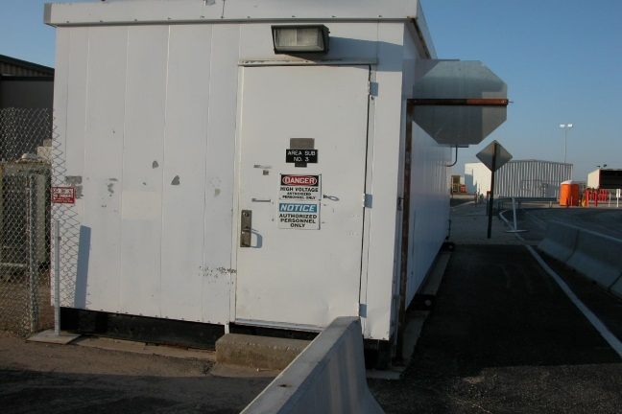
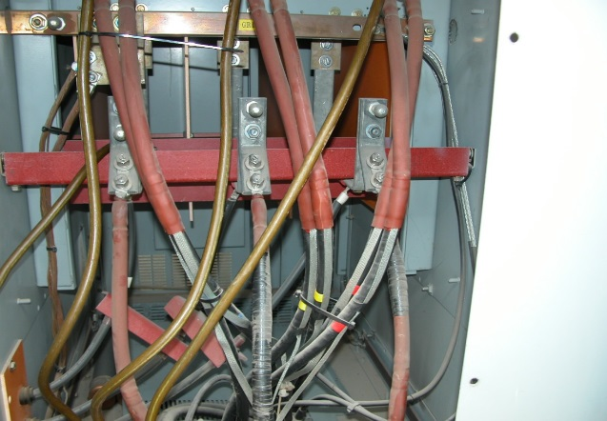
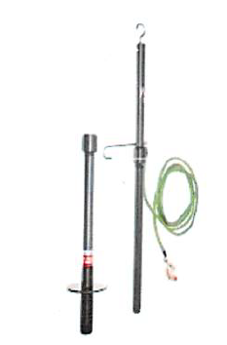
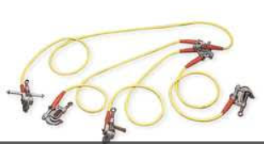
Nuclear Waste Partnership
WIPP
Event
  Electrical Shock Event at Transformer
Outcome
  Consent Order
Issues
  Hazard Identification and Assessment
  Hazard Prevention and Abatement
  Safety & Health Standards
  Training and Information
Notes:
On February 12, 2017, an electrician sustained a shock when attempting to attach a grounding cluster to the ground bus in a transformer. Initial investigation revealed that incoming power had been removed, feeds to the transformer had been properly locked and tagged out, and the absence of power checks had been performed. Discharge Sticks were then applied to each incoming power lead top discharge any residual/stored electrical energy within the circuitry and cabling. After these hazardous energy control processes were complete, the electrician removed his electrical PPE and donned leather gloves. When he attempted to attach the grounding cluster to the ground bus, he felt a shock in his thumb and dropped the cluster. The electrician walked to site medical for evaluation. No burns or injuries were observed and the employee refused further evaluation. Due to the nature of the energy form released, the specific voltages involved cannot be accurately quantified; however, NWP considers this as hazardous energy and immediately began event investigation.
Workers were not effectively trained on when an electrically safe working condition was established. (Worker removed PPE to install ground cluster.)
Discharge sticks were not maintained IAW manufacturer’s instructions. (Two out of four tested after event were identified as being unserviceable.)
Hot sticks were not inspected in accordance with manufacturer’s and OSHA requirements. (Tribal knowledge but nothing documented.)
Workers not effectively trained on testing and use of discharge stick.
Workers not effectively trained on installation of ground cluster.
Workers were not trained on task performed for the first time or at least annually.
Confusion as to applicability of NFPA 70E, OSHA’s Electrical Standards, and OSHA’s Electrical Power Generation, Transmission, and Distribution Standards.

Slide 5
UChicago Argonne, LLC
Argonne National Laboratory
Events
  Two Events
    May 10, 2017 – Hybrid Vehicle Battery
    July 18, 2017 – Capacitor Event
  Both Events Resulted in Electrical Burns
  Also a Third Event Outside of Part 851
    July 25, 2017 – Beamline Battery

Slide 6
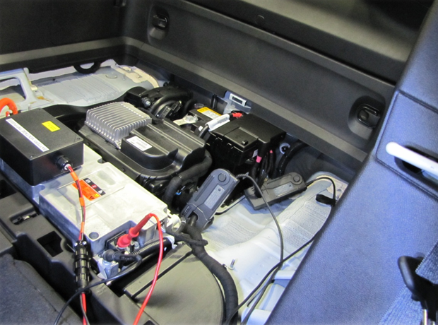
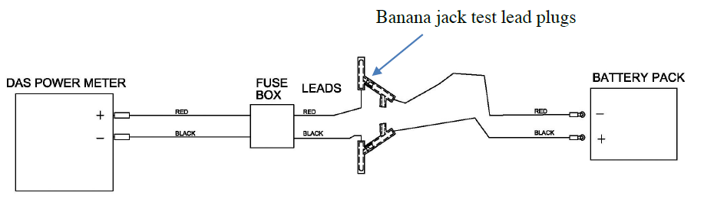
UChicago Argonne, LLC
Argonne National Laboratory
Hybrid Vehicle Event
  Troubleshooting instrumentation installed on a plug-in hybrid electric vehicle’s high voltage battery pack
Notes:
On May 10, 2017, a technician received thermal contact second degree burns on two fingers while troubleshooting instrumentation installed on a plug-in hybrid electric vehicle’s high voltage battery pack. During instrumentation installation, the service plug grip was removed and locked, leads from a lab-built fuse box were attached to the battery terminals, and the system re-energized. After connecting leads to the data acquisition system, the system was unexpectedly reading negative voltage. The technician attempted to switch the orientation of a pair of stacking banana jack test lead plugs located between the battery pack and the fuse box but inadvertently connected the positive and negative plugs from the battery terminals. The resulting short circuit caused the wire to melt and the technician’s injury.
Uniquely-configured fuse box designed for different vehicle (no longer being tested by lab). Unlike other boxes, this configuration had banana jacks on the unprotected side of the fuse, allowing full current when the short occurred.
Lab-built fuse box(es) not inspected under Designated Electrical Equipment Inspector program. Even if inspected, would likely not have prevented event due to undocumented “conditions of use”.
Work activities involving the unprotected side of the fuse required the source to be locked out and appropriate PPE for 0V check, none of which was done.
Work procedure past its review date.
Subsequent (post event) modifications to work package didn’t address increasing hazard due to increased allowable voltage. For example, mismatch between allowable voltage and fuse rating.

Slide 7
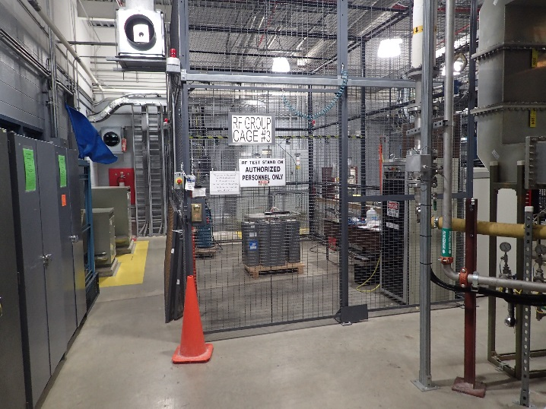
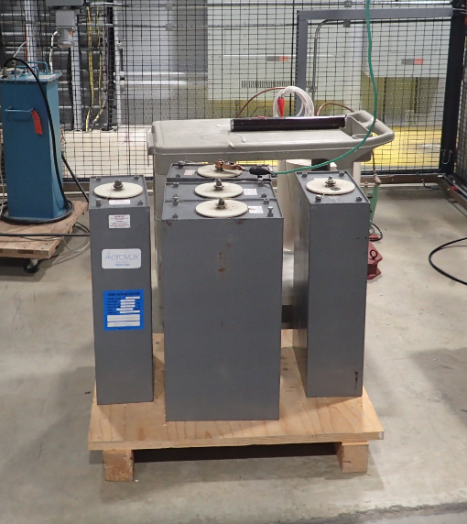
UChicago Argonne, LLC
Argonne National Laboratory
Capacitor Event
  Testing of 10 kilovolt, 15.5 kilojoule capacitors
Notes:
On July 18, 2017, an employee received second degree burns to his left hand from a capacitor arc flash. Two employees were sequentially testing a number of 10 kilovolt, 15.5 kilojoule capacitors inside a high voltage cage. After testing the first capacitor, a different power source was selected to reduce charging time. Because of the output polarity of the power source, the capacitor can was charged with the post serving as ground. After finishing testing of the second capacitor, one employee, wearing appropriate personal protective equipment, applied a discharging stick to the capacitor for approximately 10 seconds. The discharging stick did not adequately discharge the capacitor and a zero voltage check was not performed. When the second employee, dressed in normal attire and safety glasses, attempted to attach the safety ground across the capacitor, the arc flash occurred.
High hazard work performed without adequate hazard analysis, controls, or procedure.
Inadequate work authorization process permitted miscommunication/misunderstanding of whether activity was authorized.
Issued raised by worker prior to activity not addressed. Tie-in to understanding of stop work authority.
Manufacturer info lacking on discontinued capacitor (1980s vintage)
Lack of safety review when obtaining excess equipment (obtained from another DOE site) vs. process for procured items.
Charging method energized capacitor case, increasing potential for significant shock.
Lack of 0 V check after (attempted) discharge.
Lack of required PPE within approach boundary of source not verified as de-energized.

Slide 8
UChicago Argonne, LLC
Argonne National Laboratory
Outcome
  Consent Order (CO)
Issues
  Hazard Identification
  Hazard Prevention
  Safety and Health Standards

Slide 9
Sandia National Laboratory
National Technology and Engineering Solutions of Sandia, LLC
Notice of Intent
  High-Voltage Incident in Coyote Test Field Resulting in a Downed Live 46 kV Power Line and a Brush Fire (4/11)
  Electrical shock in a1 wind turbine nacelle for SWiFT Project in Lubbock, Texas (6/11)
  Electrical Shock at Thunder Range (6/12)

Slide 10
Questions?

