Slide 1
January ̶ September 2017 Electrical Safety Review
Heath Garrison, NREL
July 23, 2018

Slide 2
Introduction
Reporting criteria for electrical safety occurrences changed with the launch of ORPS 232.2A on October 1, 2017.
This report covers calendar year (CY) 2017 from January through September (CY 2017 Q1 – Q3)
Going forward, fiscal year reporting will align electrical safety measures with the new ORPS reporting criteria
An attempt will be made to align reporting categories and criteria from prior years with the new ORPS ORPS 232.2A to retain a historical perspective

Slide 3
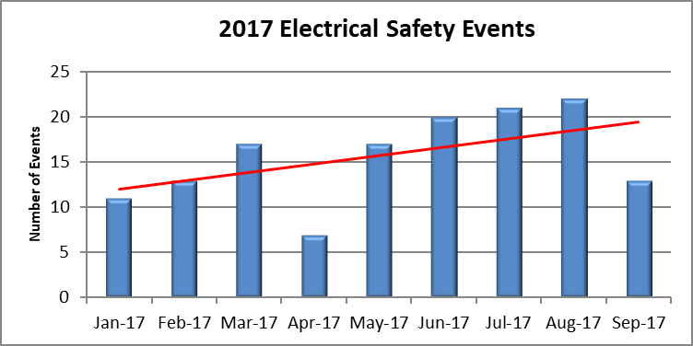
DOE Electrical Safety Events Jan ̶ Sept 2017
The data set is comprised of 713 ORPS occurrences reported in the first 9 months of 2017
141, or 20%, were coded for electrical safety issues

Slide 4
Why should we be concerned?
A DOE Office of ES&H Reporting and Analysis report titled Analysis of Electrical Safety ORPS Occurrences at DOE from FY2005 to FY2017 found:
Electrical safety occurrences have risen for the past three fiscal years
Primarily driven by the number of lockout/tagout events
Electrical wiring and electrical equipment failure also trended upward indicating that aging equipment, deferred maintenance, and configuration management issues may need to be addressed
The number of Significance Category 2 occurrences has trended sharply upward since FY 2009 indicating that electrical events are getting more severe, increasing the likelihood of serious injury or death

Slide 5
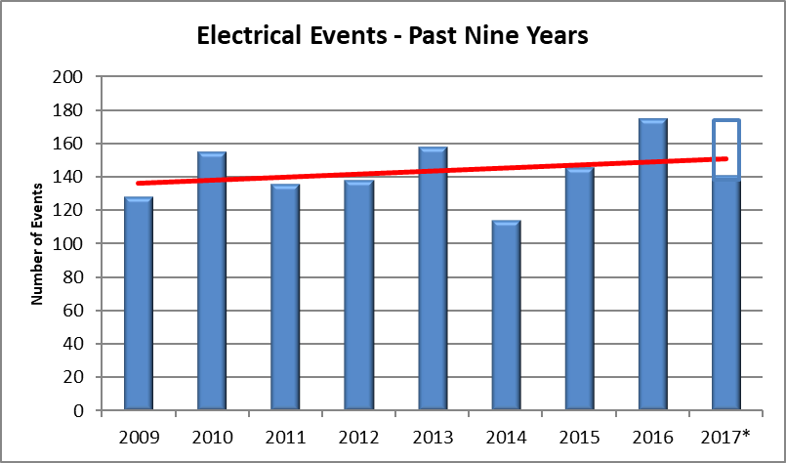
Nine Year Look Back
An upward trend in the number of reported electrical safety occurrences continued in 2017
2017 includes an estimate for the last three months of the calendar year if ORPS criteria had not changed

Slide 6
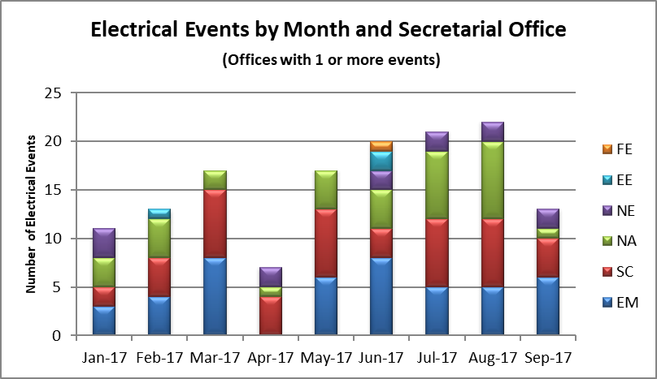
What Secretarial Offices were involved?
Notes:
FE = Fossil Energy
EE = Energy Efficiency
NE =
NA =
SC = Science
EM = Environmental Management

Slide 7
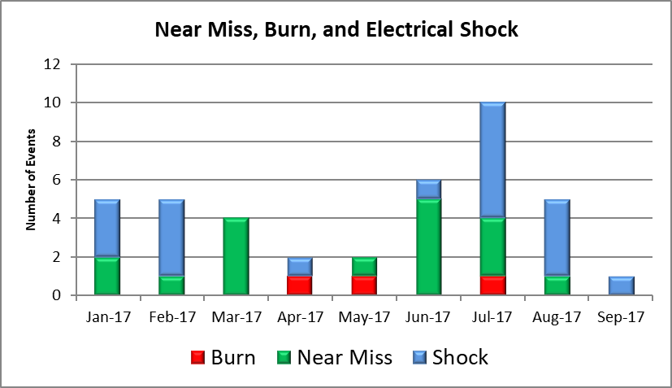
Event Outcomes

Slide 8
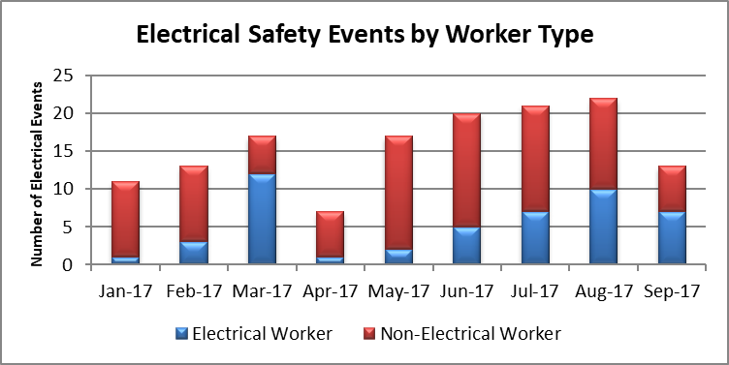
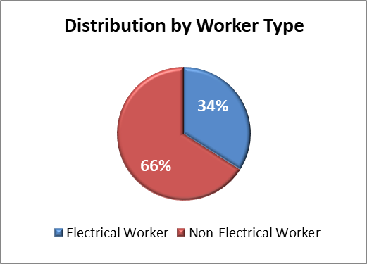
How do worker types compare?
Comparison of electrical workers and non-electrical workers

Slide 9
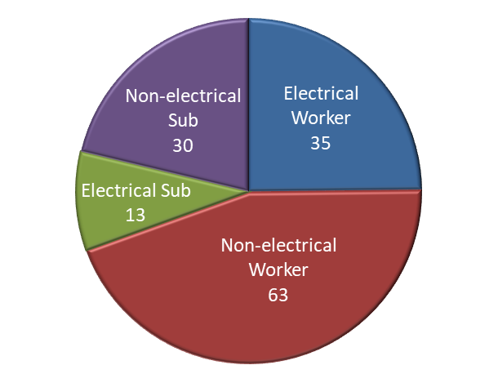
Who were the workers?
Electrical Workers: 25%
Non-electrical Workers: 45%
Electrical Subcontractors: 9%
Non-electrical Subcontractors: 21%

Slide 10
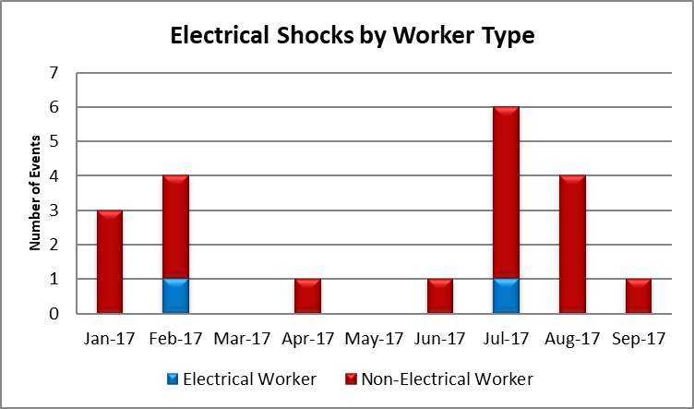
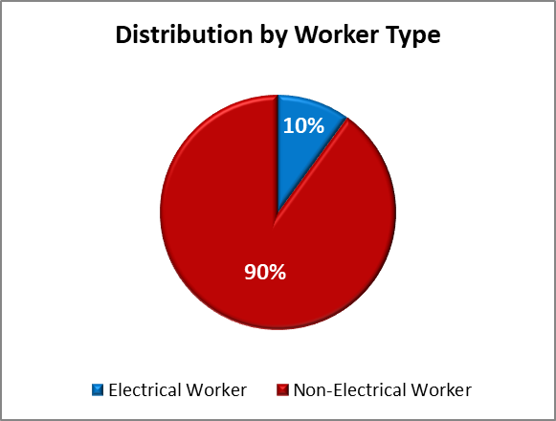
Electrical Shock Events
There were 20 shocks in the first 9 months of 2017 (2.22/mo.)
The average over the three previous calendar years is 29/year (2.42/mo.)

Slide 11
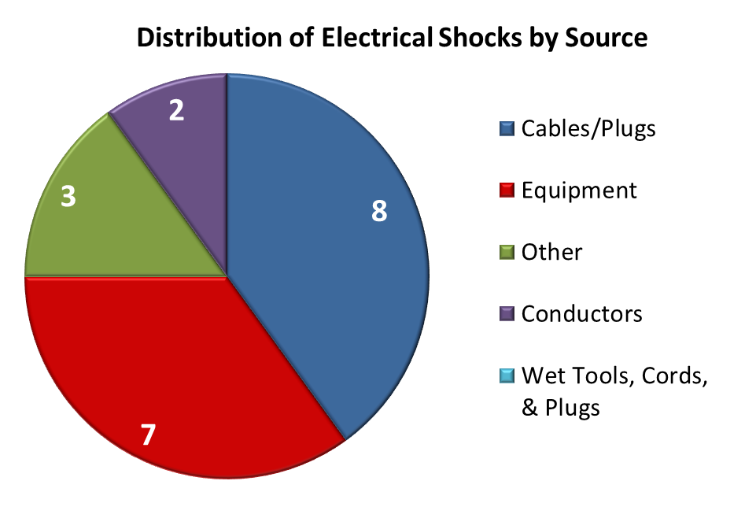
What are the sources of electrical shocks?
Cables/Plugs: 40%
Equipment: 35%
Other: 15%
Conductors: 10%

Slide 12
Electrical Intrusion Events
An unfavorable upward trend identified in 2016 continued in 2017 with 27 electrical intrusion occurrences in the first 9 months (3/mo. average)
CY 2016 saw 29 (2.5/mo. average) and all types were higher than 2015

Slide 13
Hazardous Energy Control, Lockout/Tagout and Job Planning
Next Few Slides
Hazardous Energy Control – 2(E)2, unexpected discovery of uncontrolled electrical hazardous energy source.
LOTO – 2(E)3, failure to follow prescribed electrical hazardous energy control process.
Job Planning – keyword 01M, Inadequate Job Planning

Slide 14
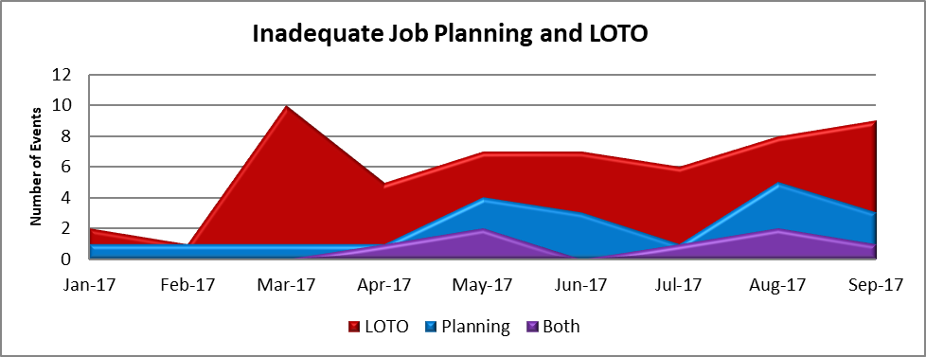
Lockout/Tagout and Job Planning
CY 2016 saw 72 lockout/tagout and 40 job planning events
Yearly averages for the five years prior to CY 2016 were 55 and 33 respectively
Estimates for the full CY 2017 are: 73 and 28 respectively (Q1-Q3 shown)

Slide 15
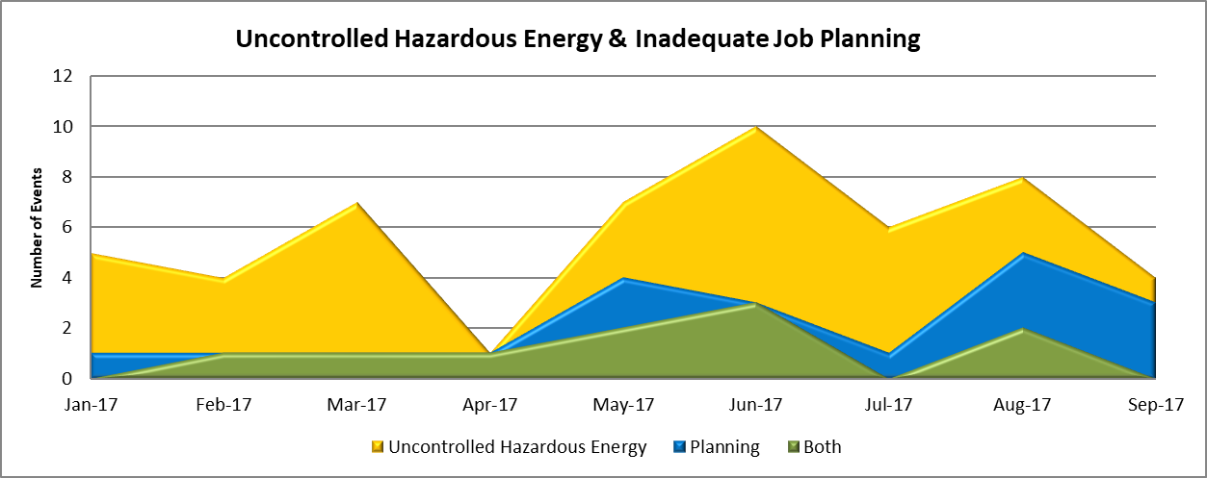
Hazardous Energy Control and Job Planning
CY 2016 saw 58 uncontrolled hazardous energy and 40 job planning events
Yearly averages for the five years prior to CY 2016 were 44 and 33 respectively
Estimates for the full CY 2017 are: 69 and 28, respectively (Q1-Q3 shown)

Slide 16
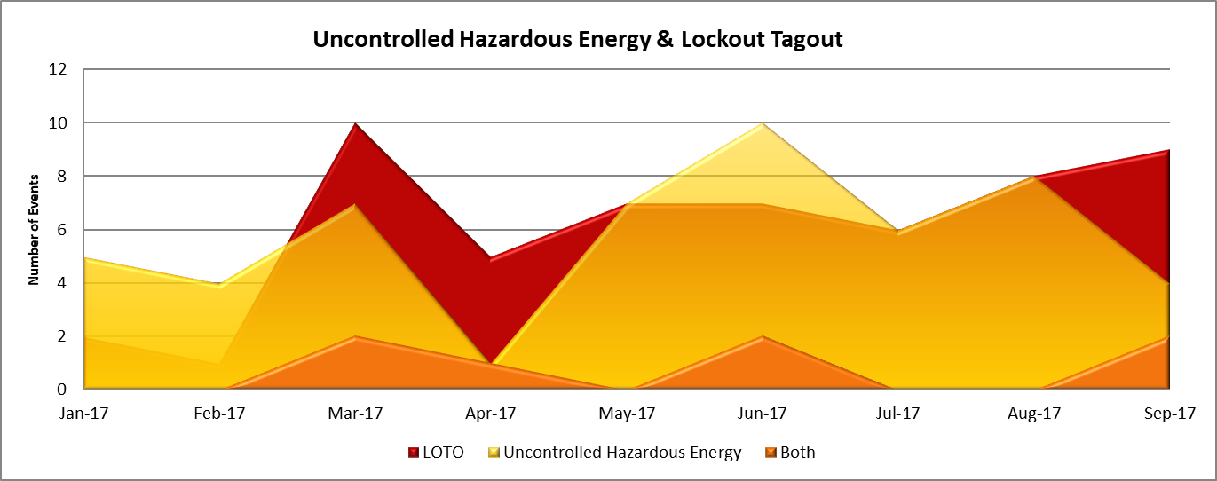
Hazardous Energy Control & LOTO
In CY 2016 there were 58 uncontrolled hazardous energy events and 72 lockout/tagout events
Yearly averages for the five years prior to CY 2016 were 44 and 55, respectively
Estimates for the full CY 2017 are 69 and 73, respectively (Q1-Q3 shown)

Slide 17
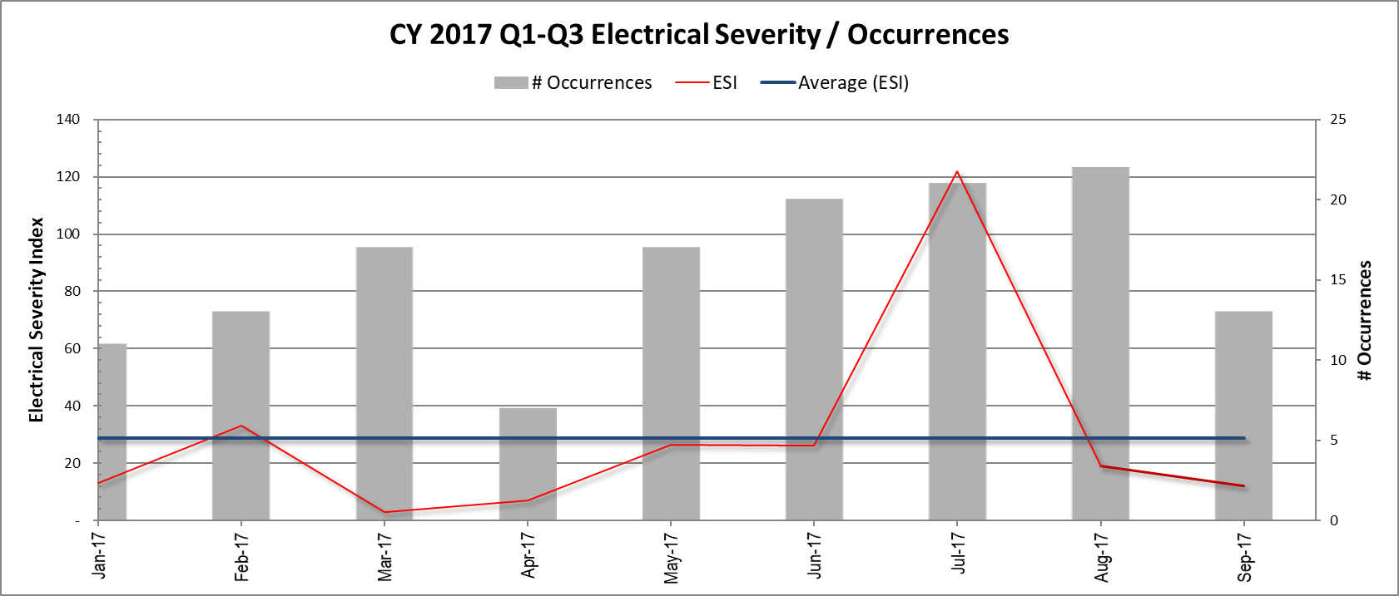
Electrical Severity
The ESI spike in July is due to a an 10,500 ESI occurrence involving contact with a hazardous energy source, while the Average ESI remains relatively constant

Slide 18
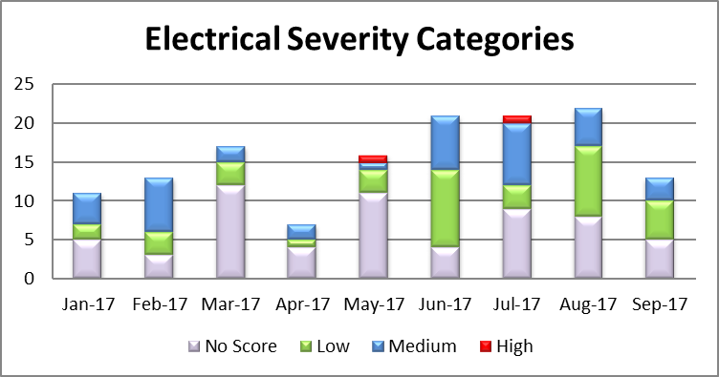
Electrical Severity Categories
No Score: 43%
Low: 28%
Medium: 28%
High: 1%

Slide 19
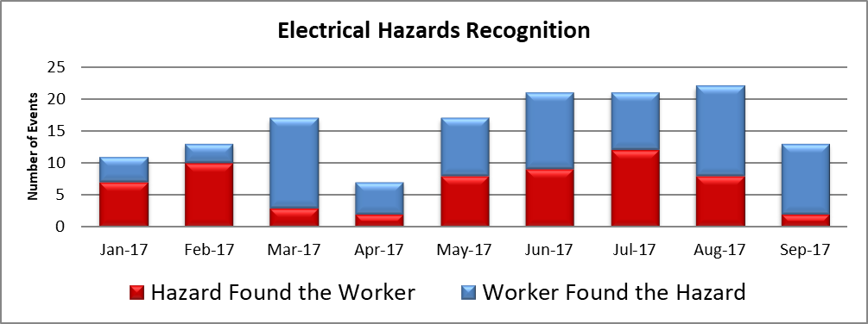
Electrical Hazards Recognition
During Q1-Q3 of 2017, workers recognized potential hazardous conditions 57% of the time ̶̶ compared to 63% in full CY 2016 and 74% in full CY 2015

Slide 20
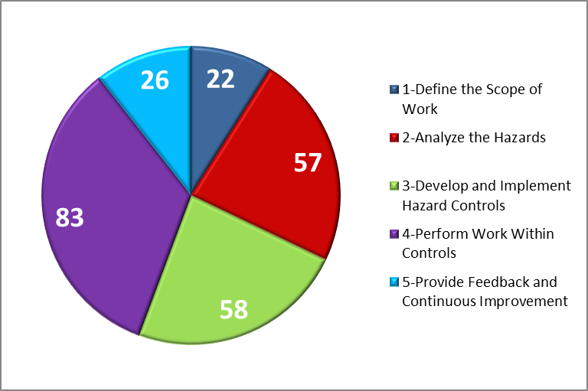
Integrated Safety Management
One or more ISM Core Function codes may be assigned to each electrical safety event
1-Define Scope of Work 9%
2-Analyze the Hazards 23%
3-Develop and Implement Hazard Controls 24%
4-Perform Work Within Controls 34%
5-Provide Feedback and Continuous Improvement 11%

Slide 21
Areas of Improvement
We have seen improvement in the following areas:

Slide 22
NREL Contacts
Heath Garrison
NREL – Electrical Safety Officer Field Manager / AHJ
303-384-7408
Heath.Garrison@nrel.gov
Katherine Johnson
NREL – ESH&Q Quality Specialist
303-275-3770
Katherine.Johnson@nrel.gov

Slide 23
Thank you

