Slide 1



WELCOMES
The
EFCOG-ESTG Summer Workshop
July 23rd - 27th, 2018
Continuous Improvement
Through
Collaboration

Slide 2

Agenda – Friday, July 27th
Meet out front in the lobby on the first floor
Tour participants will be required to wear long pants and close-toed shoes

Slide 3
Electrical Safety
Task Group
Closeout & Accomplishments

Slide 4
Agenda – Thursday, July 26th
0800-12:00 Final breakout sessions
Training X300 Alamosa
Utility Standards X326 Gunnison
HEC X344 San Juan A&B
AHJ X344 San Juan C
DC X424 North Platte
1:00 – 5:00 Final Group Session X344 San Juan

Slide 5

DOE Golden Field Office
Director – Derek Passarelli

Slide 6
Working Groups

Slide 7
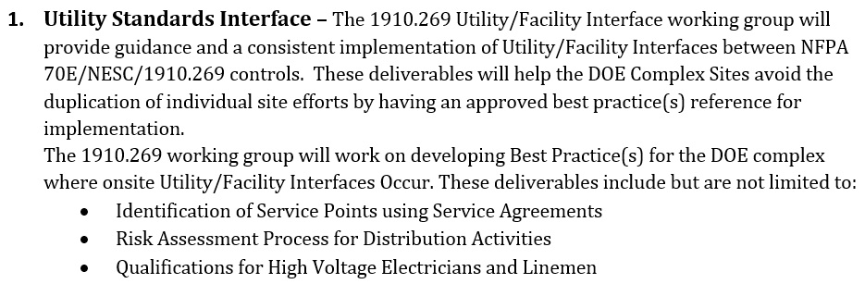
Working Group Descriptions
Leads: Don Lehman & Scot Winningham

Slide 8
Utility Standards Interface
2018 USI Working Group
July 26, 2018
National Renewable Energy Laboratory

Slide 9
Working Group Members
Don Lehman – INL; Chair
Scot Winningham – ORNL; Co-Chair
Barry Osborne – NREL
Kiley Taylor – NREL
Chris Foland – NREL
Tim Snow – NREL
Drew Thomas – Hanford/MSA
Mark Muir – SRS
Daniel Trujillo – LANL
Melkie Tega – DOE ISC
Terry Meisinger – DOE EA
Moriah Ferullo – DOE AU
James Parham – DNFSB

Slide 10
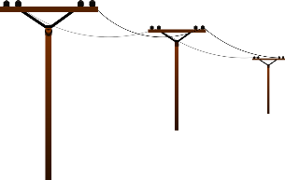
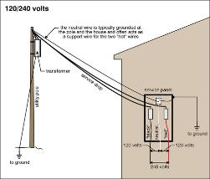
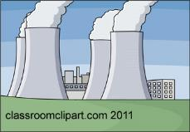

Site-owned Utility Interfaces
Public Utility
Site-owned Utility
29 CFR 1910.269 or Subpart S
29 CFR 1926 Subpart V
IEEE C2
NFPA 70E
Premises Wiring
NFPA 70
NFPA 70E
29 CFR 1910 Subpart S
29 CFR 1926 Subpart T

Slide 11
2018 Utility Interface Working Group Accomplishments
Drafted a Best Practice for:
  Establishing a Service Level Agreement.
    Defines service point
    Areas of responsibility
    Area control
    Coordination of clearances with LOTO
    Subcontractor Interface
  Program Requirements Matrix

Slide 12
Path Forward
Issue Best Practice
Prepare drafts for 2019 working group
  Possible topics include
    Risk assessment
    Job task qualifications
    Grounding
    Other?

Slide 13
Questions?

Slide 14
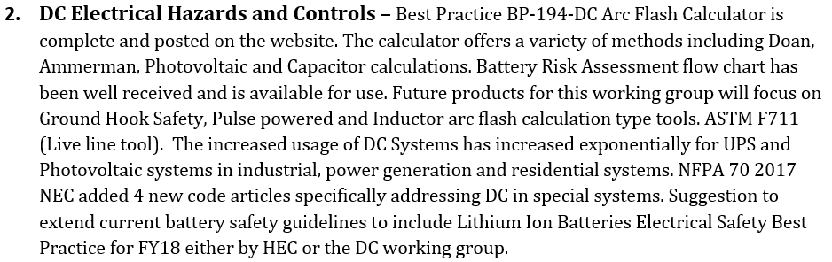
Working Group Descriptions
Leads: Gary Dreifuerst & Kyle Carr

Slide 15
DC Electrical Hazards and Controls Working Group
Gary Dreifuerst, AIS-LLNL
Kyle Carr, LANL
July 23-27, 2018

Slide 16
DC Arc Flash WG 2018 Members new members in 2018
Kyle Carr, Mike Day, Gary Dreifuerst, Lloyd Gordon, Ali Harding, Peter McNutt, Eugene Ormond, Greg Retter, Lynn Ribaud, David Robertson, Bill Sekulic
Facilities-ANL, KCP, LANL, LBNL, LLNL, NREL, SNL

Slide 17
DC WG - History
On the EFCOG ESTG website
  See DC Working Group 20140714e.PPTX for:
    DC Arc Flash WG Phase I – 10/2010
    DC Systems WG Phase II – 10/2012
    DC Systems WG Phase III – 7/2014
  See DC Working Group 20150713d1.PPTX for:
    DC Systems WG Phase IV – 7/2015
  See DC Working Group 20160718b3.PPTX for:
    DC Systems WG Phase V – 7/2016
  See DC Working Group 20170724 for:
    DC Systems WG Phase VI – 7/2017

Slide 18
Accomplishments 2018
Reviewed NFPA 70E2021 submissions for Chapter 360 and Annex R on Capacitors
Release for a BP - Battery Risk Assessment
Started work on a Lithium Ion BP
Extensive review of 29CFR1910.333, 29CFR1910.147, and NFPA 70E Article 120.5 concerning the sequence of actions for LOTO with respect to release of stored energy
Established a plan for future work on an inductor tab in BP194

Slide 19
Evolution of NFPA 70E
NFPA 70E was originally written to supplement the NEC and provide safe work practices for those workers who work on the installations as covered by NFPA 70, the NEC, i.e., electricians.
In 2000 the NFPA 70E committee entertained and moved to support the inclusion of other work places, specifically, non 60 Hz electrical hazards found in R&D labs and other locations
This was 21 years after 70E was first created
It took 9 more years to get new material in, 2009 NFPA 70E.

Slide 20
Contribution of EFCOG/DOE
2009 – Article 350
2012 – DC shock and arc flash hazard analysis
2015 – edits to 320 (batteries) and 340 (power electronics
2018 – edits to 330 (lasers) and 350 (ESA)
2021 – Capacitor Safety

Slide 21
Adaptation of 70E Ch. 1 to Ch. 3
Arc flash analysis for DC
Shock boundaries for DC
Achieving an Electrically Safe Work Condition
  Contact type meter TO Ground Stick
  Testing phase-to-phase and phase-to-ground TO testing terminal-to-terminal and terminal-to-ground
  Order of steps in LOTO

Slide 22
1910.147 – The Control of Hazardous Energy (LOTO)
147(d) – order of sequence
  Shutdown equipment
  Isolate energy sources (i.e., energy feeds)
  Apply locks and tags to energy isolating devices (e.g., breakers, disconnects)
  Remove stored energy
  Verify isolation and deenergization

Slide 23
1910.333(b)(2) – The control of hazardous electrical energy - order
have a procedure
Disconnect circuits and equipment from energy sources
Remove stored electrical energy from capacitors
Apply locks and tags
Verify de-energized condition

Slide 24
2018 NFPA 70E
120.5 Process for Establishing and Verifying an Electrically Safe Work Condition
  Establishing and verifying an electrically safe work condition shall include all of the following steps which shall be performed in the order presented, if feasible.

Slide 25
2018 NFPA 70E – 120.5
Determine all possible sources of electrical supply to the specific equipment…........
Interrupt load.........open each disconnecting device
Verify blades of disconnecting devices are fully open...
Release stored electrical energy
Release or block stored mechanical energy
Apply LOTO devices
Use test instrument...........
Put grounds in place.

Slide 26



Battery Risk Assessment Flowchart
70E 2015 for Worker
START
Electrical
Other Hazards to Consider
Thermal (>3kW)
Chemical (electrolyte)
Gas (explosion)
Pressure (case rupture)
Weight (lifting, rigging)
MIN PPE REQ:
Safety Glasses, No Metal/Jewelry, Insulated Tools
No exposed circuits
N
<100V
N
Can it be segmented <100V
N
Y
Y
Y
Y
<1.2 cal/cm²
N
N
No SHOCK or ARC FLASH Rated PPE REQ
SHOCK PPE REQ, no ARC FLASH Rated PPE REQ
SHOCK and ARC FLASH Rated PPE REQ

Slide 27
DC WG Li-Ion Battery Initiative
Best Practice for working with Li-Ion Batteries
Kyle Carr LANL
Mike Day NREL
Ari Harding LBNL
Peter McNutt NREL
Greg Retter KCP
David Robertson ANL
Bill Sekulic NREL
7/25/18

Slide 28
Lithium Ion BP –Purpose & Scope
New group to develop a best practice for safe transport, installation, operation, maintenance and storage of Lithium-ion energy storage systems.
Scope:
  Commercially-available batteries
  Research and emerging batteries
  Test and maintenance equipment
  Code & Standard Implications

Slide 29
Lithium Ion Best Practice next steps
Primary Focus:
  What are the gaps in safety
  What are similarities/differences with non-LI chemistries
  Develop a matrix of strengths & weaknesses for the most common LI chemistries
  Definitions and references
We are requesting input from SMEs and other parties with knowledge and experience in these battery systems

Slide 30
ESTG reviewed NFPA 70E2021 submissions
IEEE ESW paper by Mark Scott ESW2018-20 is the basis for these submissions
IEEE ESW 2018-20 NFPA 70E Article 360 Capacitor Proposal
  Refers to Annex R for more detailed information
NFPA 70E Annex R Capacitor Proposal
  Provides guidance to evaluate and mitigate the hazards associated with the use of capacitors
  Created a table method to present the voltage and energy considerations for testing and discharge of capacitors

Slide 31
Annex R.6.7 Test & Grounding Table

Slide 32
Annex R.6.7 Table annotations

Slide 33
IEEE 1584 – Guide to Arc Flash Calculations
2002: 100 data points for AC
2013 – 2016: 1000 data points for AC
2014: 50 data points for DC (150 and 250 V)
2018 – 2020: proposed tests for DC
Efforts:
  IEEE/NFPA collaboration – Univ. of Texas, Arl
  SNL
  NREL

Slide 34
IEEE 1584 – Guide to Arc Flash Calculations - concerns
Based on experience serving on the 1584 during the current revision, concerns are:
  Developing tests that are representative of real world geometries and sources
  Assuring models are source specific, including
    DC power supplies, battery banks, solar arrays
    capacitors
  Avoid jumping to conclusions based on “one-off” data points
  Integrate Science!

Slide 35
IEEE 1584 – Guide to Arc Flash Calculations and EFCOG ESTG
The EFCOG Electrical Safety Task Group must supply the experience, expertise, and science to advise, balance, and “watch dog” the IEEE/NFPA efforts

Slide 36
Future work for EFCOG ESTG
Support NFPA 70E submissions for Article 360 and Annex R on Capacitors
Support the DC evaluations for the IEEE 1584 committee
Support the development of a Best Practice for Lithium Ion battery Energy Storage Systems
Submit the battery flowchart Best Practice

Slide 37
QUESTIONS?

Slide 38
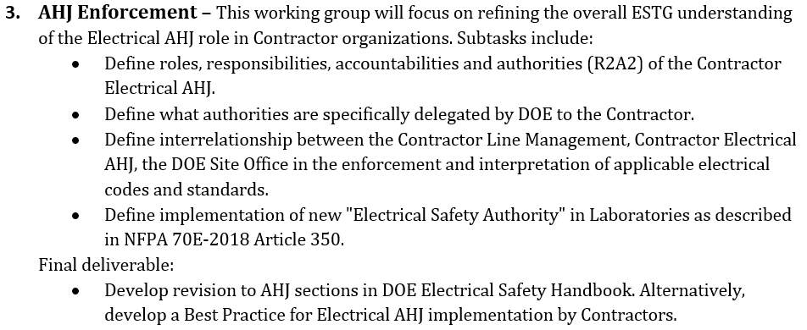
Working Group Descriptions
Leads: Jennifer Martin & Heath Garrison

Slide 39
Contractor
Authority Having Jurisdiction
Chair - Heath Garrison NREL
Co-Chair - Jennifer Martin Hanford/FE&C

Slide 40
DOE Complex Site Representation
DOE HQ Pantex
INL NREL
BNL PNNL
Hanford KCNSC
Schneider Electric DOE-NNSA/LANL
DNFSB DOE-PPPO
SRS LLNL
DOE-INL ORNL
DOE-RL/ORP

Slide 41
Best Practice
Facility: DOE Complex
Best Practice Title: Contractor Authority Having Jurisdiction
Point of Contact: (Name, Phone, e-mail)
Brief Description of Best Practice: Provides a template letter to facilitate the assignment of the contractor authority having jurisdiction (C-AHJ) and identifies the routine activities assigned to the C-AHJ from the DOE head of the field element.
Why the best practice was used: To eliminate inconsistency with the assignment of C-AHJ routine activities.
What are the benefits of the best practice: To promote consistency of the C-AHJ assignment and provide clarity of the routine activities.
What problems/issues were associated with the best practice: N/A (New best practice.)
How the success of the Best Practice was measured: N/A (New best practice.)
Description of process experience using the Best Practice: N/A (New best practice.)

Slide 42
Definitions
DOE Authority Having Jurisdiction (DOE-AHJ).
Contractor Authority Having Jurisdiction (C-AHJ).
In DOE, the head of field element is the AHJ and is ultimately responsible for enforcing requirements of a code or standard, or for approving equipment, materials, an installation, or a procedure, but responsibility can be designated to another federal official and routine activities can be assigned to a contractor.
A contractor organization, office, or individual assigned routine activities by the head of field element. Routine activities may include assuring compliance with technical requirements of a code or standard, or for approving equipment, materials, an installation, or a procedure.

Slide 43
Routine Activities
Routine C-AHJ activities include but are not limited to the following:
Render interpretations to provide clarification of NFPA 70 and NFPA 70E requirements (e.g. as permitted by NEC 90.4 and NFPA 70E 350.4).
Examine and approve electrical equipment and installations. (i.e. as defined in NEC 110.2 and 110.3)
Waive specific requirements in NFPA 70 and NFPA 70E or permit alternative methods where it is assured that equivalent objectives can be achieved by establishing and maintaining effective safety.
Keep a record of actions on applications for waiver or alternative methods of a specific electrical requirement.
Require plans and/or specifications to assure compliance with NFPA 70 and NFPA 70E.
Inspect, at reasonable times, a building or premises for dangerous or hazardous conditions or equipment as set forth in NFPA 70 and NFPA 70E. Permitted to direct person(s) to have removed or remedy such dangerous or hazardous conditions or equipment.
Be empowered to have the premises disconnected from its source of electric supply and/or evacuated when the use of electrical equipment or its installation is found to be dangerous to human life or property.
Assign to other qualified individuals such powers as necessary for the proper administration and compliance of NFPA 70 and NFPA 70E.
Keep a record of electrical inspections, including the date of such inspections and a summary of violations found to exist, the date of the services of notices, and a record of the final disposition of violations.
Require violations of NFPA 70 and NFPA 70E be corrected when deemed that conditions hazardous to life and property exist.
Investigate the cause, origin, and circumstances of any fire, explosion, or other hazardous condition related to NFPA 70 and NFPA 70E.

Slide 44
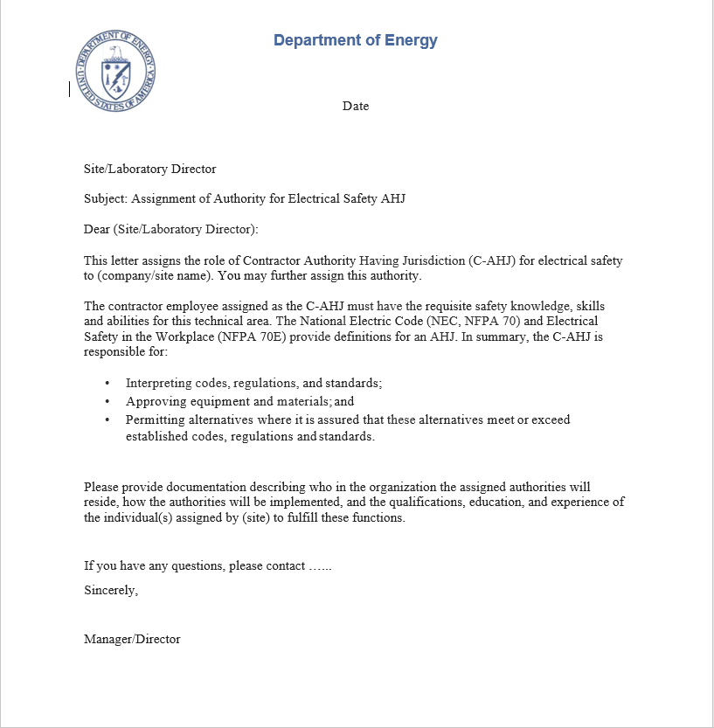
Assignment of Authority Template

Slide 45
Potential Future Endeavors:
Best Practice for Electrical Safety Authority (ESA).
NFPA 70E 2018
Article 350.4
Best Practice for AHJ Qualifications
Certificates
Experience
Recertification
Revocation or Suspension of Authority

Slide 46
Thank you to our participants
Heath Garrison Patrick Romero Jennifer Martin
Earl Myott William Briscoe Jeff Williams
Mike Sutton Jim Watson Dexter Smith
Eugene Santiago Jonathan Swanks Craig Miller
John Dierkes Kevin Enomoto Russ Harwood
James Parham Kevin Norris John Whipple
Kurt Ririe Martin Iedema Sandy Engelberg
Moriah Ferullo David Weitzman

Slide 47
Questions?

Slide 48
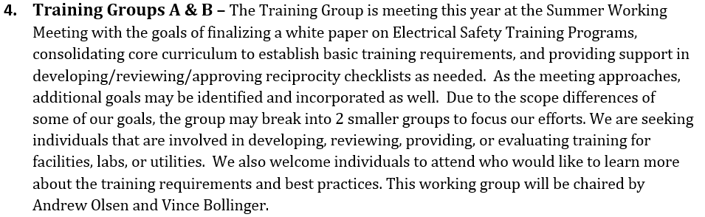
Working Group Descriptions
Leads: Andrew Olsen & Vince Bollinger

Slide 49

Electrical Training Subgroup
EFCOG promotes excellence in all aspects of the operation, management, and integration of DOE facilities in a safe, environmentally sound, efficient and cost-effective manner through the ongoing exchange of information on lessons learned.

Slide 50
Training Subgroup Contributors
Andrew Olsen – elecTrain
Vincent Bollinger – NREL
Leland Chandler – Savannah River
Richard Green – LLNL
Robert Weiss – LANL
Brad Stedem – Honeywell
Raymond Joggerst – LANL
Jacqueline Mirabal-Martinez – LANL
Gary Becken – WTP (Hanford Bechtel)

Slide 51
Deliverables
Training Model Best Practice
Electrical Safety GET Best Practice
Demonstration of Proficiency Best Practice

Slide 52
Electrical Safety Training Model Best Practice
EFCOG 2018

Slide 53











Facility Electrical Safety Training (FEST), for 2017 EFCOG
Step 1 -
General Employee Training (GET) – Electrical Safety Module
Step 2 - Personnel who may be in proximity to an electrical hazard, choose one of the following training paths:
Unqualified Person
For unqualified personnel subject to an elevated electrical shock risk (e.g. industrial machine operators, painters, welders,
janitorial staff, and some laboratorypersonnel).
Task Qualified Person
For personnel who supervise or perform any activity within a limited approach boundary. This does not qualify for entry into an arc flash boundary. These personnelare considered qualified for that specific activity or scope.
Qualified Arc Flash Person
For personnel who supervise or perform work in an arc flash boundary. These personnel also require training for entry into a limited approach boundary. Activities include a variety of tasks that expose them to electrical hazards.
Electrical Awareness Training for Unqualified Personnel
Shock Hazard Training
Limited NFPA 70E
Arc Flash Hazard Training NFPA 70E
One (or more) of the following as applicable:
First Responders
Equip. operation near overhead lines
Breaker operation
Blind penetration
Bench personnel & tool repair
Limited Personnel for R&D EX:
Equipment with shock hazards
Working in vicinity of shock hazards
Troubleshoot single phase equipment
Limited Personnel for facilities EX:
Electrical Safety for R&D work only EX:
Scientists
Engineers
Technologists
Electrical Safety for facilities and construction work EX:
Electricians
Operators
Technicians
Vendors
Activity-Specific Electrical Worker Qualification Document
Step 3 – Additional task or equipment specific training examples:
Breaker operation requires special training and approval
NEC, CPR, First Aid, Batteries, Capacitors, and Contact Release
Electrical Equipment Inspector

Slide 54
GET Electrical Safety Module Best Practice
EFCOG 2018

Slide 55
General Employee Training (GET) Best Practice
Why a GET Best Practice?
Reduce electrical shocks to administrative and non-electrical workers.
Previous GET Electrical Safety modules may be insufficient.

Slide 56
GET Topical Overview
Electrical Training
Check Listing (NRTL) for equipment you bring in
Equipment condition
Contacting energized components while plugging/unplugging
Extension Cords / Power Strips (RPT)
RPT allowable loads
Shock response
Who to call
Recap

Slide 57
Best Practice for Demonstration of Proficiency
EFCOG 2018

Slide 58
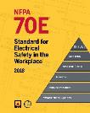
Regulatory Justification
NFPA 70E 2018 article 100 Qualified Person
  One who has demonstrated skills and knowledge related to the construction and operation of electrical equipment and installations and has received safety training to identify the hazards and reduce the associated risks.
NFPA 70E 2018 article 110.2(1)(4)(e) Training requirements for Qualified Persons
  Employees shall be trained to select an appropriate test instrument and shall demonstrate how to use a device to verify the absence of voltage, including interpreting indications provided by the device. The training shall include information that enables the employee to understand all limitations of each test instrument that might be used.

Slide 59

What does this mean?
You must demonstrate the selection and use of a meter for absence of voltage verification.
The use of a discharge stick in establishing an electrically safe work condition logically follows.
Demonstration of the use of appropriate insulating gloves is also necessary for the use of a meter.

Slide 60
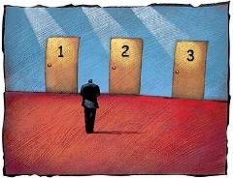
Why do all three?
All three may be necessary skills for establishing an electrically safe work condition.
Doing any of the three incorrectly presents a hazard.

Slide 61

Benefits
Enhanced screening workers for:
  Skills
  Knowledge
  Experience
  Competency
Compliance with NFPA 70E

Slide 62

Anticipated Problems
Identifying workers who need demonstration
Identifying workers who need early retraining
  Equipment/procedure change
  Over 1 year since last performed task
  Job tasks change
Identification and training of qualified evaluators
Additional training overhead

Slide 63

Metrics of success
Reduced severity of meter, glove, and discharge stick related incidents confirmed by analysis of EFCOGs Electrical Severity Index (ESI).

Slide 64
Where do we go from here?
What skills must be demonstrated?
Which evaluation method do we recommend?

Slide 65

Demonstration Best Practice Options
  Meters alone
  Meters, gloves, and sticks in live (non-hazardous) equipment
  Meters, gloves, and sticks without live equipment

Slide 66
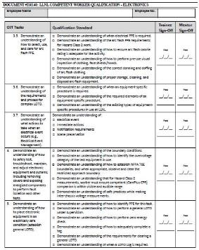
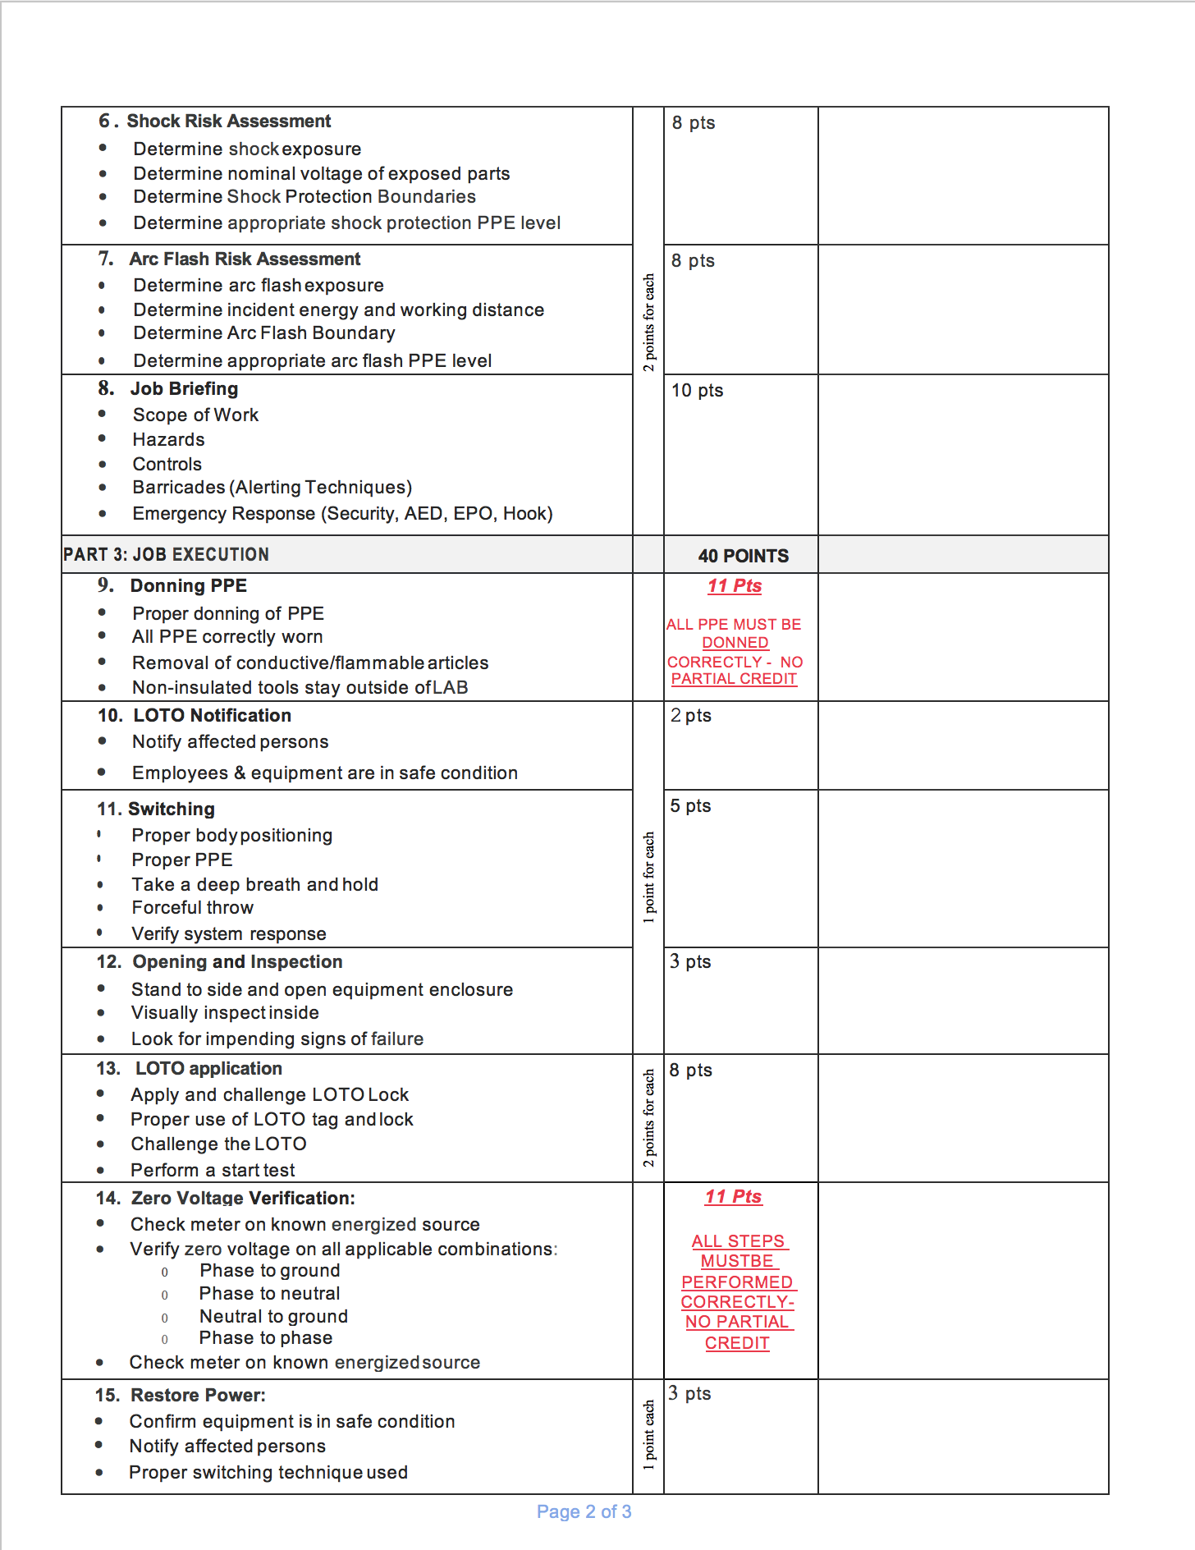
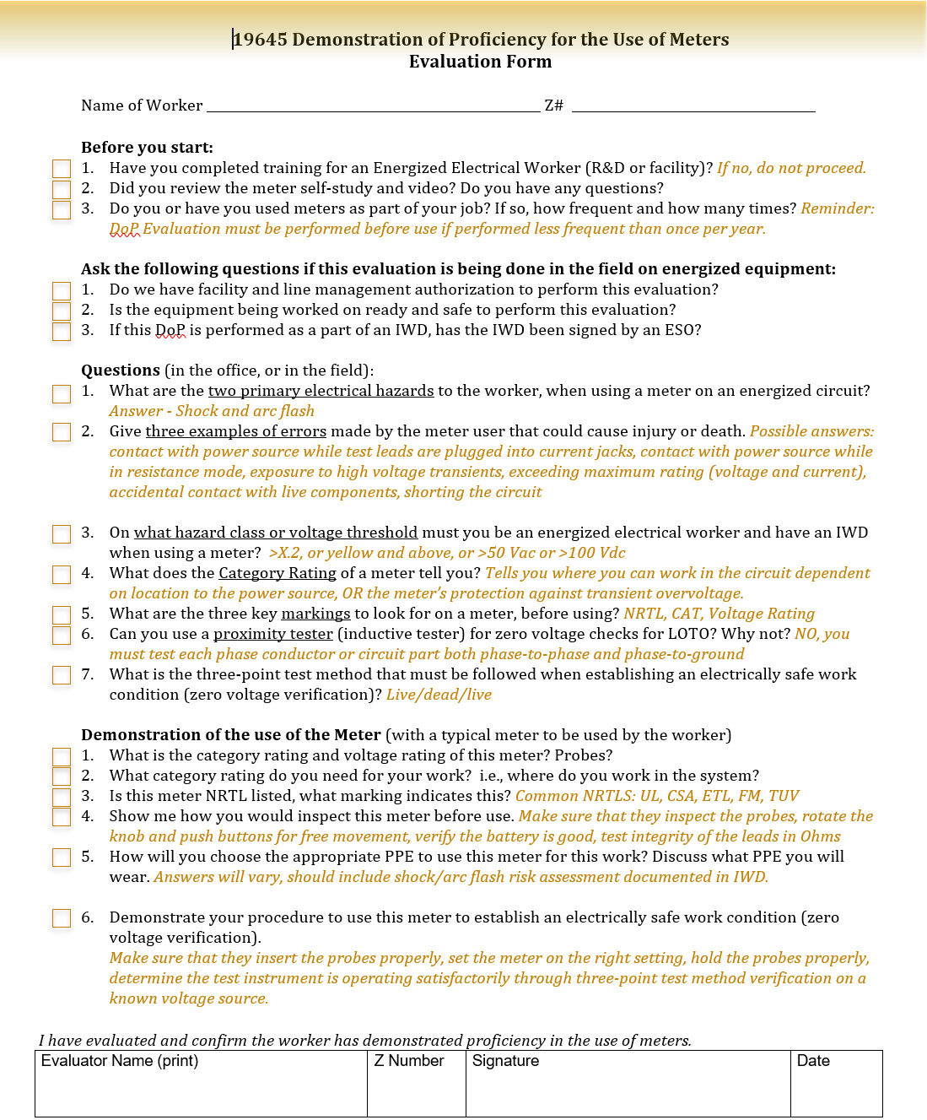
Evaluation Method Options

Slide 67
Electrical Training Subgroup Moving Forward…

Slide 68
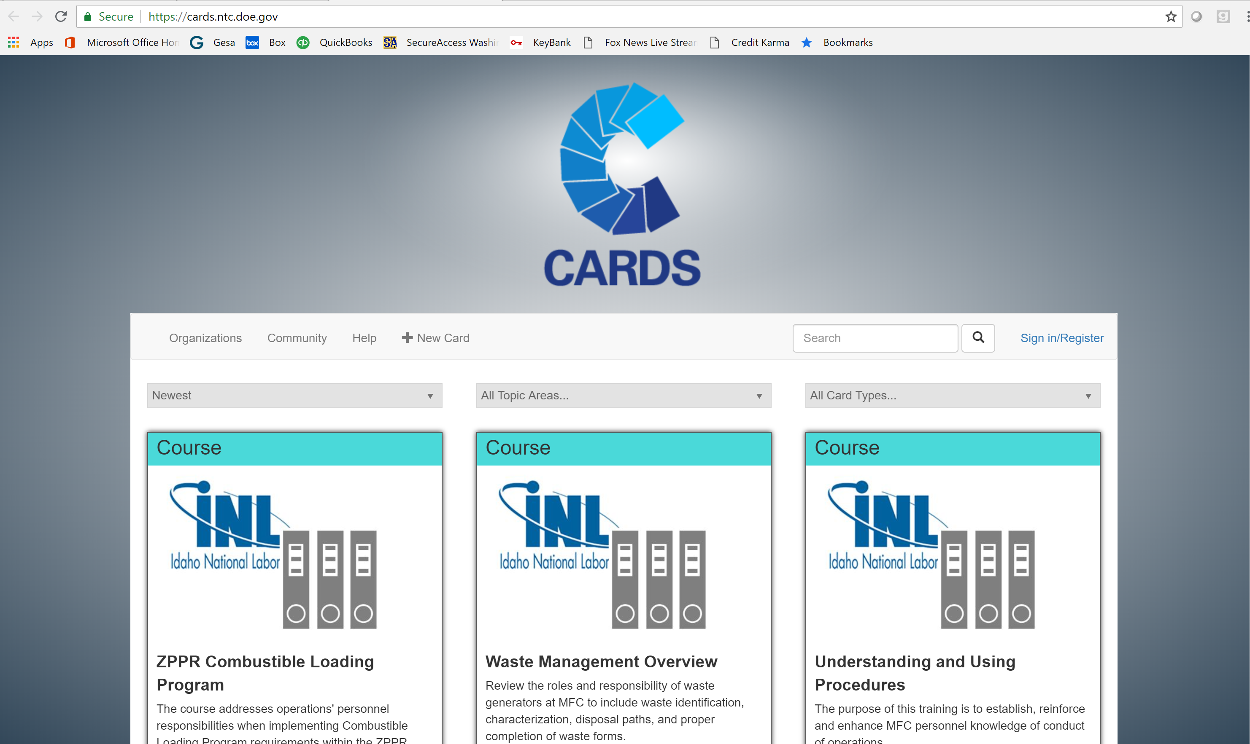
NTC CARDS Training Repository
For access, contact:
CARDS@ntc.doe.gov

Slide 69
Type of Training
NFPA 70E:
“The training required by this section shall be classroom, on-the-job, or a combination of the two. The type and extent of the training provided shall be determined by the risk to the employee.”
As this is laid out in NFPA 70E, it applies to both Qualified Persons and Unqualified Persons. (2015 and 2018 editions)

Slide 70
Moving Forward
Approve GET Best Practice
Development and approval of Demonstration of Proficiency Best Practice
Electrical Training Techniques
  Attributes of a good electrical instructor
  Innovative electrical training techniques
Support NTC for reciprocity checklist approvals
Risk Assessment / Human Performance reinforcement in the classroom
Core Training
  Electrical Safety Awareness for Unqualified Persons
  Capacitor Safety
  Breaker Operation Safety
Type of Training Position Paper for Unqualified Persons

Slide 71
Questions?

Slide 72
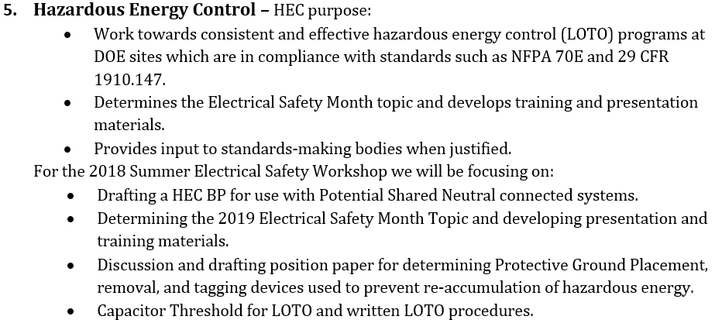
Working Group Descriptions
Leads: Stephanie Collins & Dave Lipinski

Slide 73
Hazardous Energy Control Working Group
Co-Chairs:
Stephanie Collins, Lab Deputy ESO, Lawrence Berkeley National Laboratory
Dave Lipinski, Electrical Safety & LOTO Program Manager, Portsmouth Site

Slide 74
2018 HEC Workshop Participants
Ronesha Brooks Greg Christiansen Stephanie Collins
Erroll Gillman Kevin Kennedy Jerald Kinz Todd Kujawa
Dave Lipinski Tommy Martinez Jackie McAlhaney
Dave Mertz Marler Reynolds Gary Sanchez
Scott Semanision Jonathan Sims Eric Stromberg
Trae Venerable Richard Waters
* 9 different sites represented

Slide 75
Open Working Group Tasks - HEC
LOTO Negative Trends (WSH/ES-18-01) Planned for HEC to establish a Negative Trends Focus Group during this workshop; Due October 1, 2018 for the development of tools and materials to assist sites by addressing the common causes. April - Turned over to Work Management Task Group (Marc Williams); HEC to assist if requested.
2019 ES Month Topic – (WSH/ES-18-02) Determine Topic and Develop materials for distribution across the complex; Due March 1, 2019. (Vice Chair has since taken this on).
Temporary Protective Grounds – Placement, Identification, and Handling (WSH/ES-18-03) Draft position paper; Due January 1, 2019.
Capacitive Stored Energy Thresholds requiring LOTO (WSH/ES-18-04) Develop Best Practice; Due March 1, 2019.
Multi-Wire Branch Circuit Best Practice Proposal (WSH/ES-18-05) –Posted July 2018.

Slide 76
Working Group Schedule
Tuesday (AM)
Tues (PM) – Wednesday
Brief new participants on objectives
Provide background information regarding challenges
Commit to groups
TPG –
Capacitor LOTO –
ES Month -
Do the work
Share site practices
Discuss how to meet objectives

Slide 77
Working Group Schedule
Thursday (AM)
Submit summary input for presentation
Commit to ongoing work & deadlines for submittals to consensus standards bodies & technical committees via EFCOG representatives in a timely manner

Slide 78
HEC Group
Topic for Electrical Safety Month: May 2019

Slide 79
Counter The Electrical Shock Trend
2017 increased trend on Electrical Shocks
Focus on the Non QEWs

Slide 80

Challenge – New Approach to Distribute Information
Past vehicles:
Safety Poster
Slides/Presentation
Can we present this information in a new way? More enticing, increase clicks, reach wider audience…

Slide 81

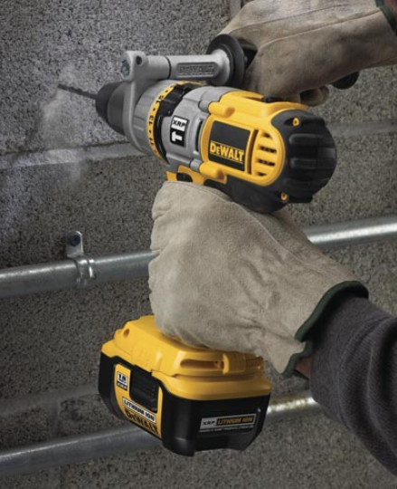
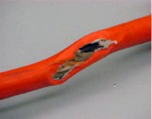
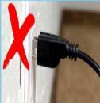
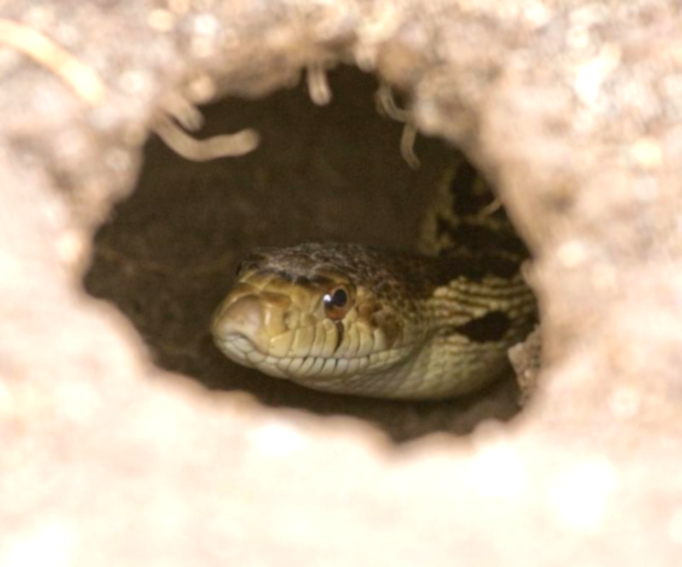
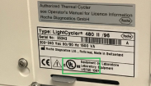
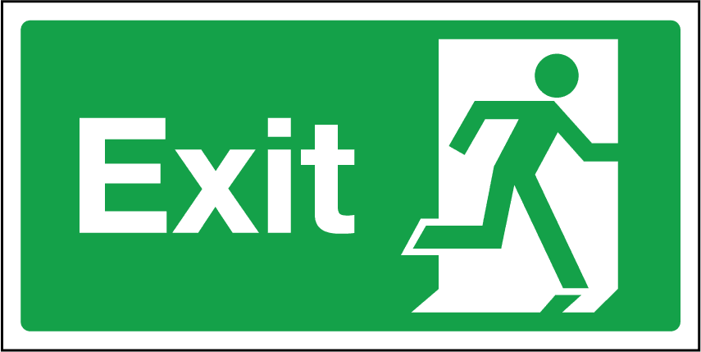
ELECTRICAL
SHOCK GANG
Inspection prior to Use
Hidden Hazards
Plug Insertion Safety
Overhead Power Line Hazards
Blind Reaching
Approved Equipment

Slide 82

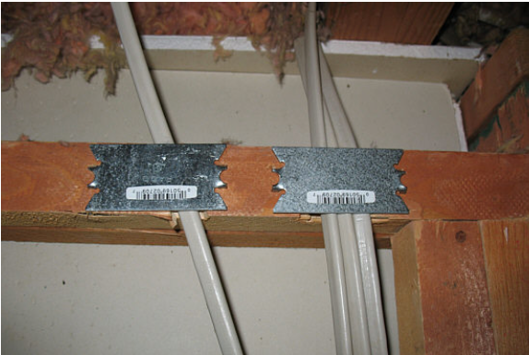
Hidden Hazards
Anyone can be exposed to these hazards when they are cutting, drilling, digging, or removing parts of an infrastructure
Hidden hazards need to be recognized and identified before performing work
There are multiple techniques for identifying and locating these hazards.
http://efcog.org//Electrical Safety Task Group/Documents/Hidden Hazards.pdf

Slide 83
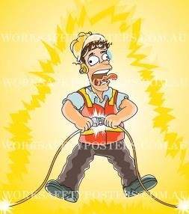
Blind Reaching
Don’t reach where you can’t see!
Shocks while plugging in equipment are far too common and can be prevented with education.
ESFI P.I. Plug's Home Safety Video

Slide 84
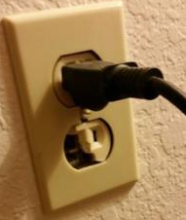
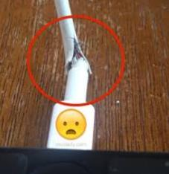
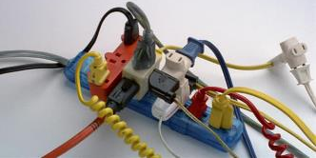

Inspecting Equipment prior to Use
Surge protectors, overloading them makes them a fire hazard or an electrical shock hazard.
Visually inspect equipment before use, look for:
  Loose parts and damaged outer jacket for cracks
  Discolor due to heat
  Pinched points
To see more information regarding equipment inspection click the link below
https://safetyculture.com/topics/electrical-hazards/

Slide 85
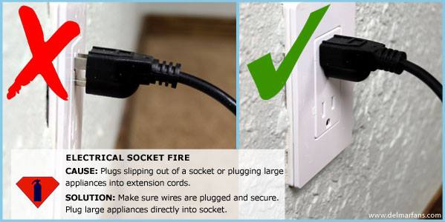
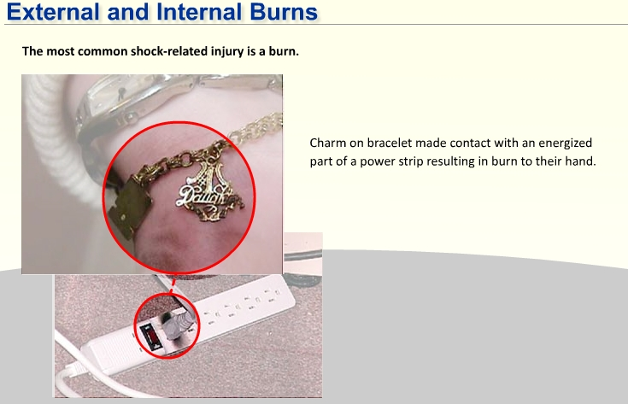
Plug Insertion Safety
Plugs not fully inserted into the receptacle can complete the electrical circuit causing:
  severe injury to people’s fingers/hands (also through conductive objects such as tape measure, jewelry, etc.
  2015, related to over 5,500 emergency room visits
  Since 2008 NFPA/NEC has been developing guidance
  thermal loads that can lead to fire
Prevention can include:
  Awareness training, for both work and home
    Fully insert plugs!
    Gripping the end by the plug grip, not cord or stress relief
    Not stressing the cord ends with sharp angles or hanging
    Using correct gauge and grounding for the job
https://www.nfpa.org/-/media/Files/Code-or-topic-fact-sheets/InjuriesElectricalOutletsFactSheet.pdf

Slide 86
Overhead Power Line Hazards
Contact can occur when lines are broken from their supports due to such things as vehicles striking poles/guy lines or extreme weather conditions
Injury can also occur when direct contact is made with equipment or objects such as cranes or ladders.
Step and touch potentials exist when higher voltages are introduced into the earth and a person is at a difference of potential.
Downed Power Line Safety Video

Slide 87
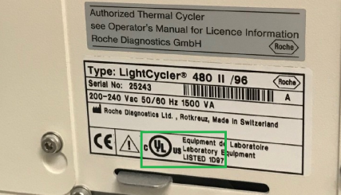





Approved Equipment
The approval process assures that electrical equipment does not present hazards to users, including shock, even under single-fault conditions.
  All equipment must be approved by one of three means.
  A NRTL listing seal is the preferred means.
  NRTL field inspections or AHJ inspections may be used when the needed equipment is not available with a NRTL listing.
https://www.osha.gov/dts/otpca/nrtl/nrtllist.html
Note: “CE” is not an NRTL.

Slide 88


Slide 89
Capacitors and HEC

Slide 90
Capacitive Stored Energy LOTO Thresholds
  Draft Best Practice addressing:
  Determining LOTO threshold
  Equipment ID & quantification of stored energy hazard and labels
  Determining discharge & prevention of re-accumulation of energy methods
  ID and verification that energy dissipation devices have been removed prior to re-energization
  Incorporating developed process for consistent application across sites within Complex

Slide 91
Areas to be Addressed
Worker Qualifications
LOTO
Hazard Thresholds
  >400V - 0.25J vs. 10J limit
Cord and plug equipment
  Lock vs. Exclusive control
DOE technical clarification
  1910.147 contrasted with 1910.333

Slide 92
Short Term Goals
Collect data from other sites
Worker qualifications
Current methods of energy control
Exclusive control definitions for cord-and-plug

Slide 93
Long Term Goals
Collaborate with DC Group
  Review materials and provide feedback
  Track IEEE 1584 progress

Slide 94
Hazardous Energy Control (HEC)
Breakout Group
Temporary Protective Grounding Q & A
Energized Electrical Work Permit use Q & A
Safety Related Maintenance Requirements per NFPA 70E-2018 (General Requirements)

Slide 95
Members
Richard Waters – INL
Jackie McAlhaney – SRS
Robert Hughey – Schneider
Greg Christensen – INL
Eric Stromberg – LANL
Dennis Neitzel – Eagle Research Group
Jerald Kinz – Hanford
Marler Reynolds – INL
Todd Kujawa – Jefferson Lab
Kevin Kennedy – Bechtel National

Slide 96
Temporary Protective Grounds
For Utilization Equipment

Slide 97
Position Paper #1
A position paper was developed based on questions arising from NFPA 70E -2018 Article 120.5(8). The questions and answers address the use of “grounding” versus “Temporary Protective Grounding” for utilization equipment.

Slide 98
Temporary Protective Ground Controls
  Future Work:
  ID and labeling indicating protective ground ratings proper use
  Indicating on LOTO procedures and other documents the location/placement of temporary protective grounds
  Sequence for removal and installation
  ID and verification that energy dissipation devices have been removed prior to re-energization

Slide 99
Energized Electrical Work Permit

Slide 100
Position Paper #2
A position paper was developed based on questions arising from the application of NFPA 70E -2018 130.2(B). The questions and answers address the use of an energized electrical work permit (EEWP) including the exceptions and scope of energized work.

Slide 101
Safety Related Maintenance Requirements

Slide 102
Best Practice
A best practice is being considered to address questions/concerns with applying the Safety Related Maintenance Requirements of NFPA 70E – 2018 Chapter 2.
The group reviewed a crosswalk of requirements from Chapter 2 and included a discussion on how these requirements may be met. Each requirement was reviewed to determine whether “Preventative” or “Corrective” maintenance is required.

Slide 103
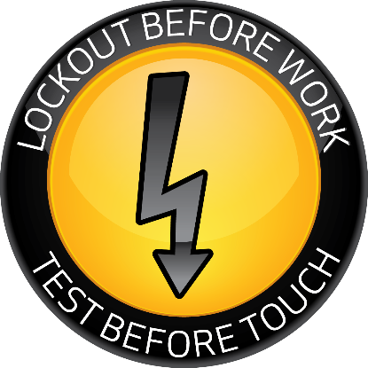
Two Habits That Work

Slide 104
Questions?

Slide 105
DOE Electrical Safety Handbook
Lloyd Gordon

Slide 106
ESTG Chair
Richard Waters

