Slide 1
ALARA Optimization Checklist
10 CFR 835 Subpart K Implementation
Cheré D. Morgan
INL Radiological Control Director
Dr. Bradley J Schrader PE CHP
INL Radiological Control SME

Slide 2
What is 10CFR835 Subpart K and why do we care
Subpart K is simple but far reaching
Contains 3 major requirements
  Design and Control
  Facility Design and Modifications
  Workplace Controls
The ALARA Optimization program is centered on these 3 requirements

Slide 3
What’s in it?
10 CFR 835 Subpart K requires formal plans and measures for maintaining occupational exposures ALARA as part of the documented radiation protection program (RPP).
  Measures include incorporating ALARA considerations into the design of new facilities and modifications of existing facilities, as well as activities that pose the potential for significant occupational dose.

Slide 4
What’s in It (cont)
Additionally, administrative controls are addressed as measures which supplement engineered controls and are integrated into the work planning process. Record keeping and training requirements related to ALARA are also specified.

Slide 5
Integration of RadCon in design and modifications
It was identified by BEA radiological control management that radiological control engineering was not being integrated into the facility design and modification process until late in the process.
  At the request of RadCon management, assessment IAS 14632 was performed by myself and the DOE-ID RP SME.

Slide 6
What was identified?
It was identified that, “although processes and procedures exist that require radiological engineering involvement, objective evidence did not exist to demonstrate involvement in establishing engineered and administrative controls, including application of the ALARA process and use of optimization methods to justify facility design and physical controls.”

Slide 7
Initial Characterization
During a 10CFR835 Subpart K assessment several examples of weaknesses in the integration of RadCon Engineering and planning with nuclear facility Design Engineering and Project Management were identified.
  A facility design was completed without important radiological safety and ALARA features incorporated into the design. construction stage the facility resulting in startup delays and added cost to the facility.

Slide 8
What did we do about it?
Reviewed applicable documentation and requirements.
Generated a Requirements Traceability Matrix
Determined that the requirements existed there just wasn’t a clear path due to cross organizational requirements.
Held discussions with all impacted organizations.
Design Engineering
Project Engineering and Management
System Engineering
Radiological Engineering
Generated a punch list of items needed to successfully implement Subpart K.

Slide 9
Punch List
1) Who do we contact when we have a facility change or project that may impact a nuclear facility
2) How do we communicate information and document discussions across multiple organizations.
3) How do we assure we have integrated both environmental and nuclear safety
4) Document and electronically store discussions and reviews.

Slide 10
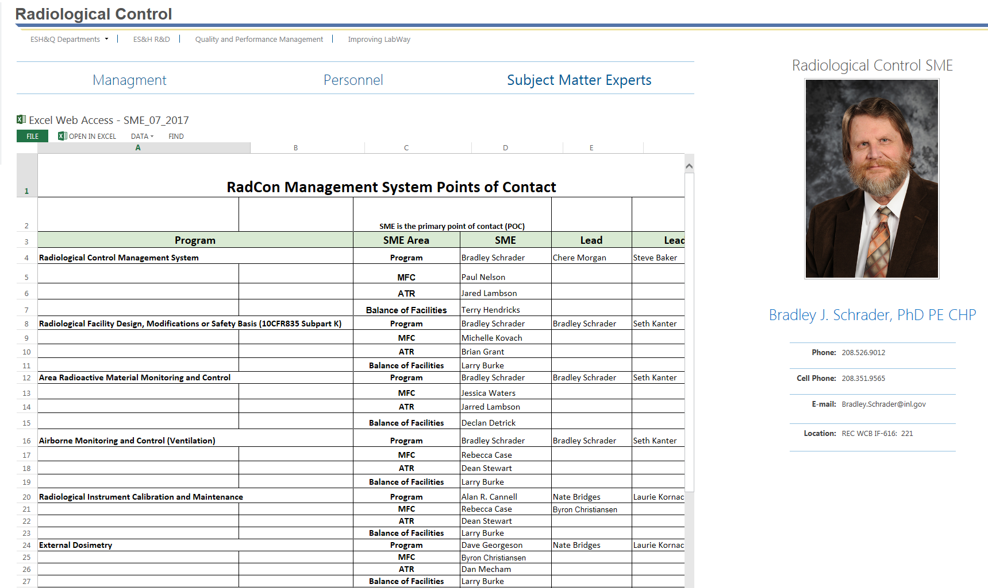
SMEs for Everyone
A radiological control SME for facility design, construction and/or modification processes was established. In addition, SMEs were established for all radiological program areas.

Slide 11
Who do we contact when we have a facility change or project that may impact a nuclear facility
How do we assure the right people are notified that a design change has been initiated?
  The electronic ALARA Optimization Checklist was born.

Slide 12
AOC Purpose
The as low as reasonably achievable (ALARA) process is used at the Idaho National Laboratory (INL) to manage radiation exposure and control releases of radioactive material in accordance with 10 CFR 835. The INL ALARA program is a logical process for managing projects, operations, and activities that defines a goal of attaining radiation doses as far below the applicable limit as is reasonably achievable.
ALARA optimization provides a method to assure that appropriate radiological control personnel and reviews occur. These reviews evaluate ways to reduce radiation exposures and minimize releases to the extent practical. That can only occur when radiological reviews and input are received at the earliest stage of the design or work activity.

Slide 13
Why the AOC?
Just our procedures alone may include but not limited to, (depending on the activity and the associated radiological hazards), the following reviews:
• ALARA Optimization Checklist (Form 441.B05)
• ALARA Design Review (Form 431.01),
• Optimization and Cost-Benefit Analysis – LWP-15021 (Form 441.A23)
• ALARA Radiological Engineering Review – LWP-15021 (Form 441.10A)
• ALARA Committee Review – LWP-15021 (Form 441.10)
• Radiation Shielding Design Form – LWP-15021 (Form 441.A70)

Slide 14
Why AOC
The final product of an ALARA optimization process is a preferred system of engineered and administrative controls (from among several candidate radiological protection alternatives) that provides maximum benefit at the lowest cost while maintaining radiation exposure ALARA. This process is documented through the ALARA Optimization Checklist (AOC). The AOC provides a way to assure that the ALARA program is integrated at the earliest stage of the activity and maintained integrated until completion. And the appropriate reviews are documented.
It also documents the decision process when radiological input to a design is not required.

Slide 15
AOC Process Challenges
The electronic form had to provide a location to upload and store information in a variety of formats. Project drawings to emails.
  Had to meet the requirements of long term storage.
  Reviews and input had to be documented. Along with the responses.
  The form had to nest into the other project and design electronic forms.
  Electronic signature approvals
  Everyone affected had to be trained.
  Documentation for software had to meet company standards.
  Interface between SharePoint and Documentation Storage Criteria.

Slide 20
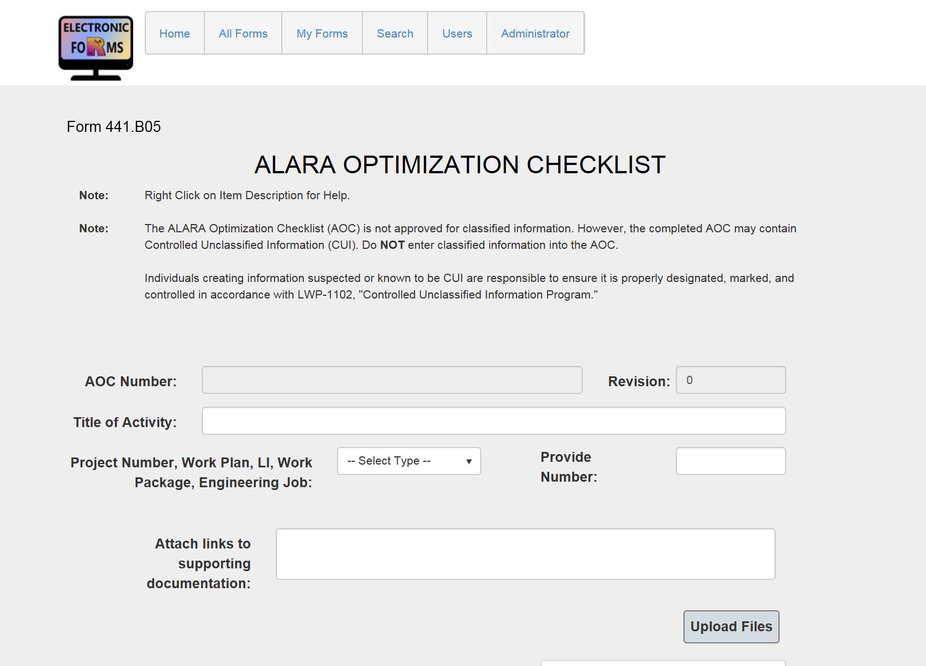
Electronic ALARA Optimization Checklist

Slide 21
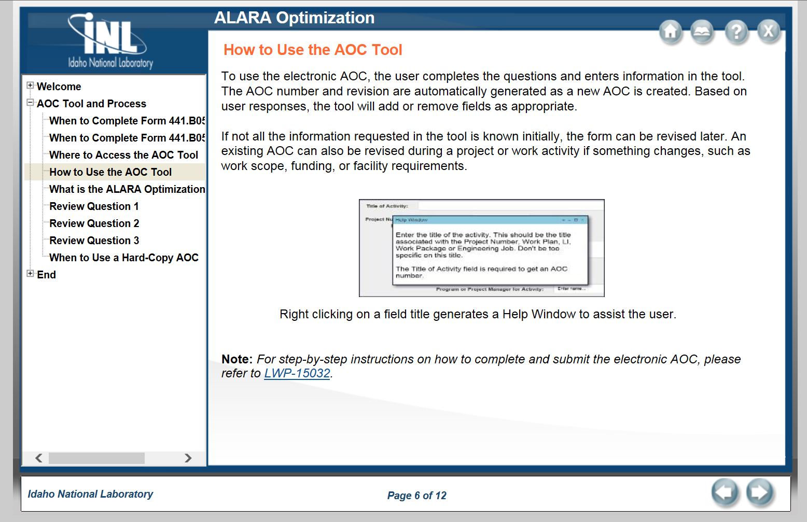
Training

Slide 22
Success Story - DOELAP Irradiator Facility
The DOELAP Irradiator Facility (RESL) pre-conceptual design was not identified by BEA during the assessment, but was part of the review performed concurrently by DOE-ID.
DOE-ID in their assessment report identified that radiological control design support was not integrated into the initial pre-conceptual design. It was determined that BEA had no contractual or requested design input to the pre-conceptual design. The design as it stood had been performed by a subcontractor for DOE-HQ.
BEA was requested to evaluate the facility design and provide input. That input was provided and as a result BEA was asked to function in the design engineering of the facility as it moved from pre-conceptual design through final construction.

Slide 23
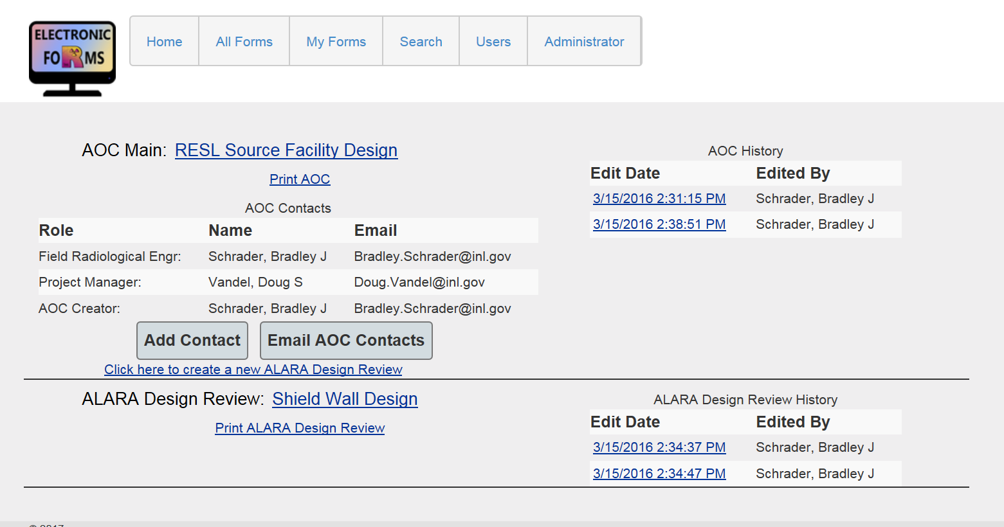

Slide 24
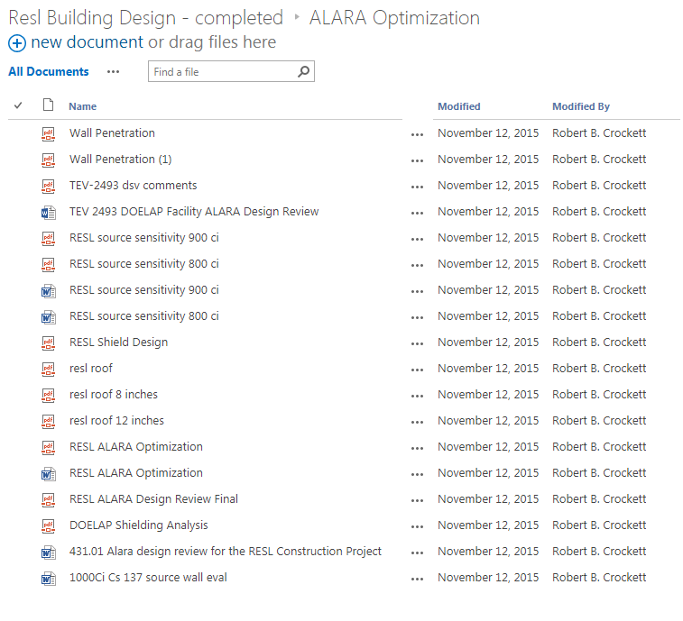

Slide 25
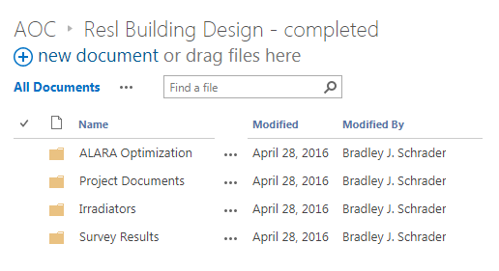
AOC and Design Input Documentation

Slide 26
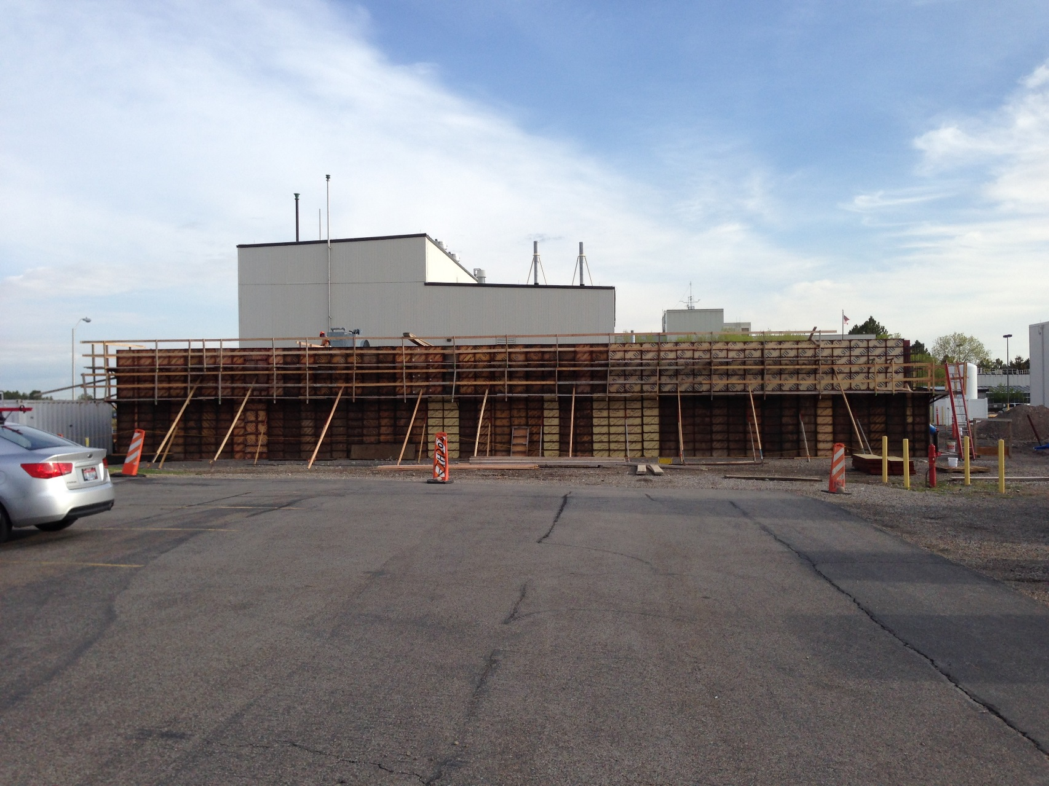

Slide 27
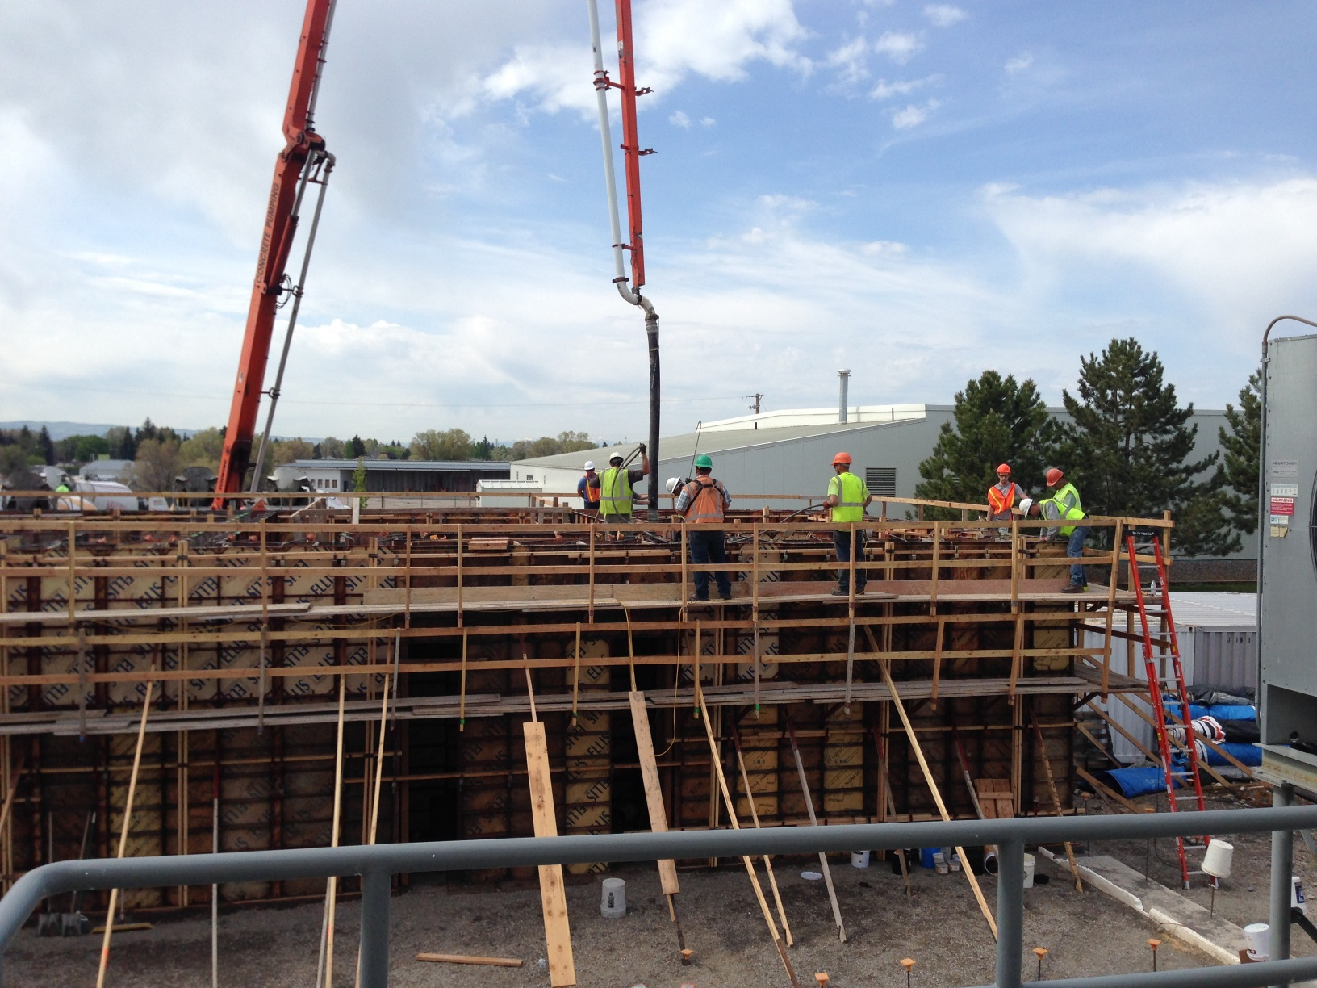

Slide 28
RHLLW Disposal Facility
The RHLLW disposal project is the laboratory’s first congressional line-item construction project of more than $20 million approved for final design/construction under the BEA contract and the first line-item construction project authorized to proceed to final design/construction by the Office of Nuclear Energy in 20+ years.

Slide 29
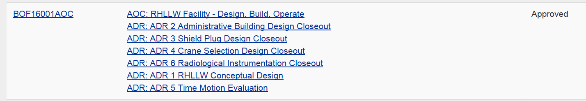
Another Success - RHLLW Crane
The remote handled low level waste storage facility was a 25 million dollar project that had a 1 million dollar budget for the crane.That 1 mil was compressed due to cost overruns down to 250k.
Subpart K AOC offered us an opportunity to justify the need for project funds for a crane that met the ALARA and operational needs. We could not buy it for the money the project had left.

Slide 30
Remote Handled Waste – Crane is the Key
The crane was the one item where operations – RadCon – projects all agreed we could reduce time, increase efficiency and significantly reduce worker exposure. But we didn’t have enough in the project budget to buy the RIGHT crane.
  Using the AOC and the project review process we were able to all demonstrate our needs, justify that need and get more funds to buy the crane we have. We had to establish a baseline needs and justify that need.
  .

Slide 31
RHLLW Crane Criteria
Outdoor crane operations to assist in manipulation have a long history at the INL. From that background there are a few design considerations that should be part of the criteria when selecting a crane to handle RH-LLW.

Slide 32
1. Remote Control:
Control of the crane should be capable of remote access. Either completely wireless operation or operation with a pendant that provide a standoff distance such that the operator is not in the radiation fields. A wireless remote control is preferred and will enhance radiation protection for the crane operator by allowing him to remain fully behind a shield wall all in-air waste handling.

Slide 33
2. Video:
Remote operation of the crane will require video systems and crane controls adequate to assure safe operation. The Savannah River Technology Center Remote and Specialty Equipment Systems Section developed multiple specialized video systems, monitoring/recording equipment, and fuel handling tools for detailed SNF inspections that may be of some help for the RH placement. Limited line of site operation of the crane will be available during open air transfers. Crane indexing and placement will need to consider that limitation.

Slide 34
3. Repair and Recovery during handling operation:
Crane recovery due to equipment failure during placement operations should be considered. How do we move a failed crane that requires repair to an area of lower radiation levels. Due to the high level of radiation and limited personnel accessibility, the crane should be able to remotely recover from a single random or common mode of failure. All loads should be removable and the crane shall be able to return to a crane maintenance area. To achieve this, any bridge, trolley, hoist, and slewing rotation, extension, and retraction drive trains must have recovery capability.

Slide 35
Crane Mockup
  We built a 3D printed mockup at 1/8 scale. The involved parties could literally pick up the cask place it on a centering device using our procedures for both the boom style and gantry cranes.
  Videos
  The new crane features include:
    Remote operation up to 300 ft away. Video cameras, gamma camera and remote pendant indexing allows us to place RH waste in a concrete tube with no hands on involvement of workers once the transfer process is initiated

Slide 36
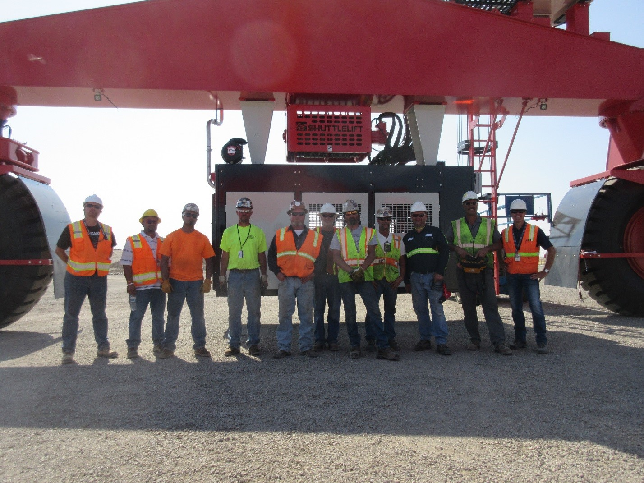

Slide 37
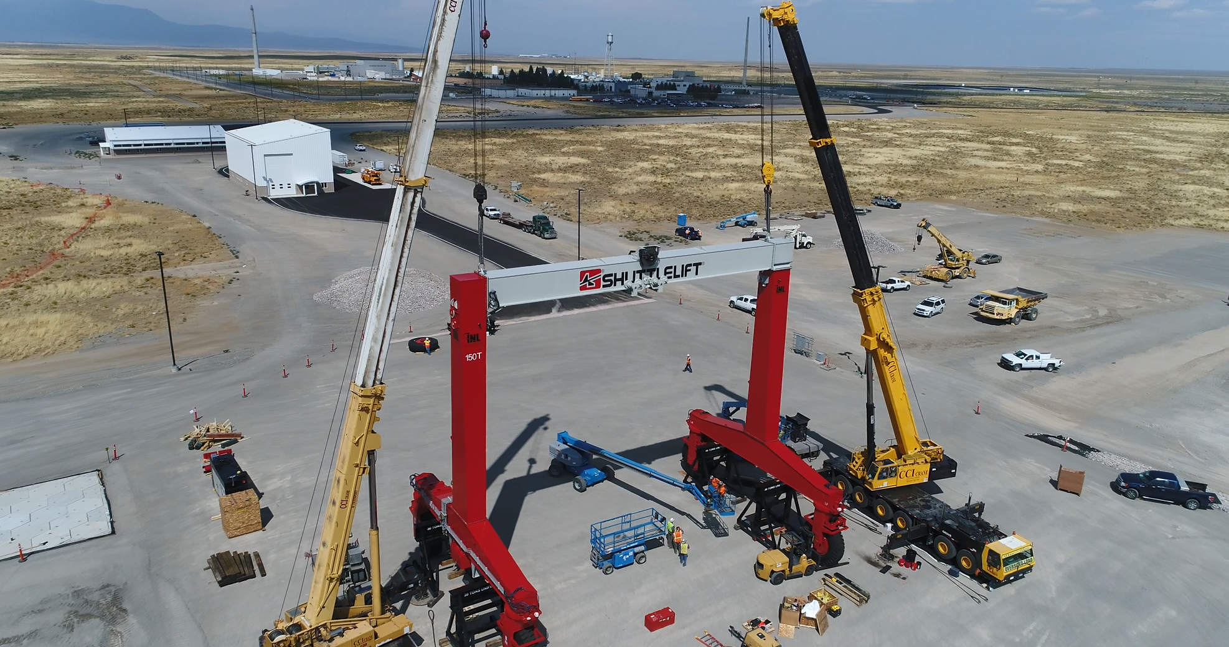

Slide 38
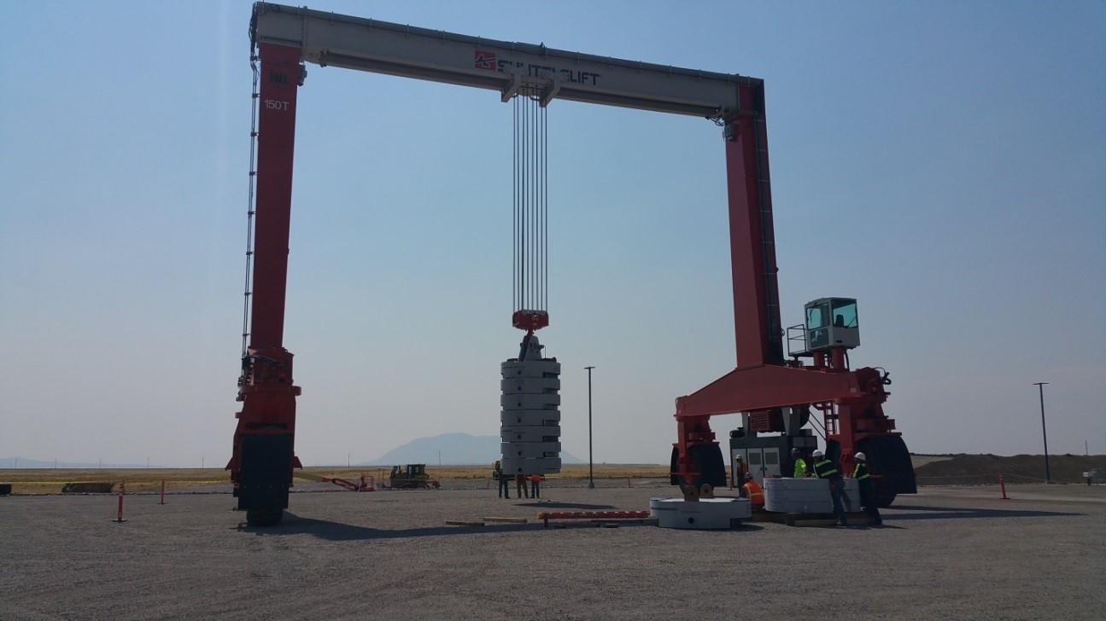

Slide 39
Another Challenge - LEED Priority
LEED Gold Status requirements were prioritized over radiological design critiera.
Leadership in Energy and Environmental Design (LEED) is the industry standard for Green Building validation.
  “We are thrilled that (building) is recognized with the building industry's highest level of energy-efficiency distinction,” said Chris Ischay, Sustainable INL program manager. “INL is committed to providing employees with the efficient, comfortable and safe facilities that come from LEED Gold certification, and the lab strives to ensure that at least Gold certification is obtained on major construction projects. A platinum certification is even better.”

Slide 40
Ongoing
The awareness to include radiological control early in designs and modifications is significantly elevated from the previous conditions.
One on one mentoring of facility radiological engineers and NFMs in addition to the project and design engineers has been ongoing. All have been very receptive.
This is not a fix and walk away problem.
We need to integrate the environmental and nuclear safety orgs

Slide 41

