Slide 1
EFCOG Fall 2017 Radiation Protection Technical Task Group
ORNL Remote Radiation Monitoring Capability
Mike Stafford
Oak Ridge National Laboratory

Slide 2
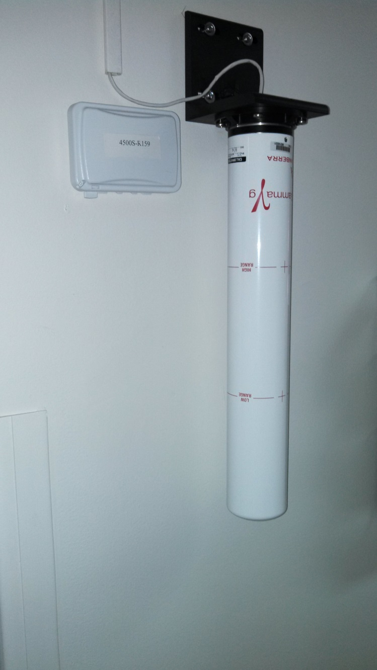
EcoGamma Area Monitoring
Originally deployed in conjunction with Horizon in late 2012 to support the TLD Reduction effort
Category 1, 2, and 3 Nuclear Facilities
Radiological Facilities
Accelerator Facilities
Guard Portals
Shipping and Receiving Facilities
Facilities occupied by large populations of non-radiological workers
Notes:
After deploying the EcoGammas it became apparent that the instrument was well-suited to ambient-level environmental monitoring.

Slide 3
Canberra EcoGamma Area Monitor
Dual energy-compensated GM detectors for extended range.
Time-to-count technique eliminates dead time losses and allows for an overall range of 10 μR/h to 1000 R/h.
Weather proof housing provides stable, reliable performance in demanding operating environments.
Built-in software application supports two-way communication via web or with Horizon.
Onboard data storage maintains 180 days of historical data in the event of a loss of communication.
May be powered over Ethernet or via mini USB port
Notes:
After deploying the EcoGammas it became apparent that the instrument was well-suited to ambient-level environmental monitoring.

Slide 4
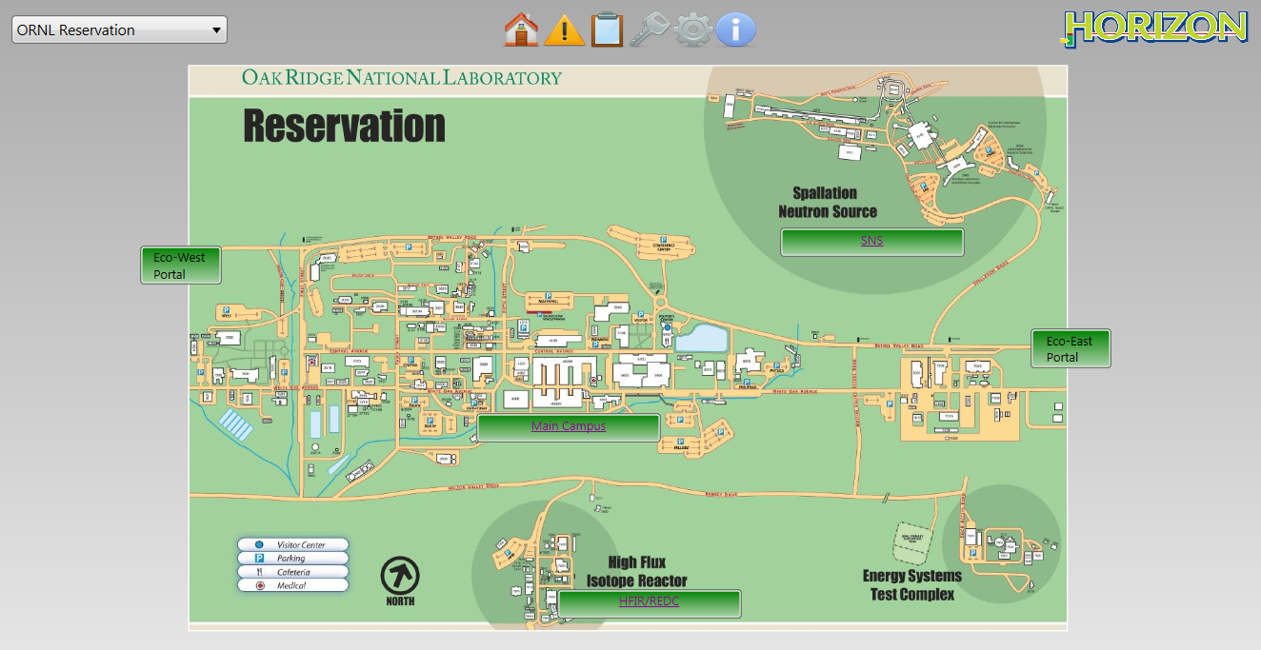
Horizon Console
Canberra’s Horizon Supervisory Software System provides:
Real-time data acquisition and control system
Supervisory oversight of radiological instruments
A bird’s eye view of instrument alarms and status indicators on a site-wide view

Slide 5
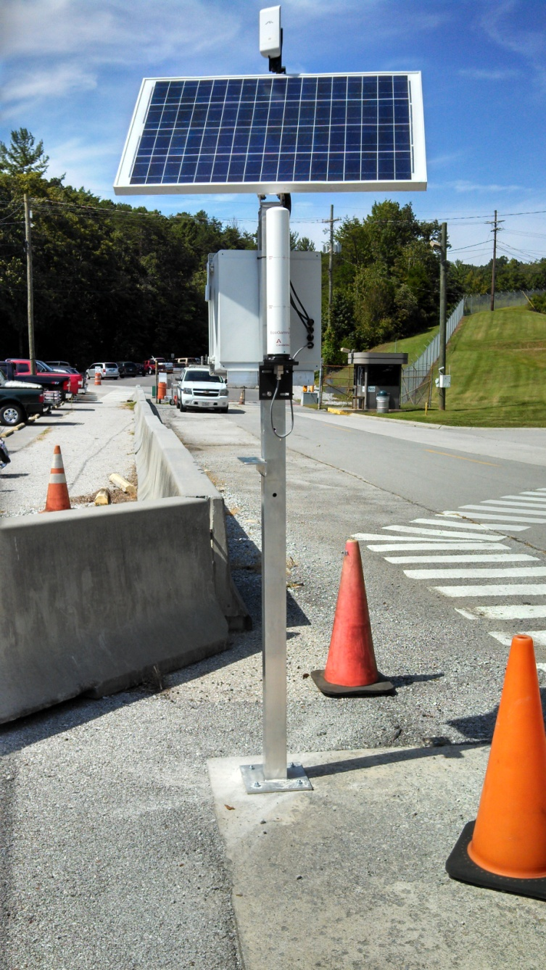
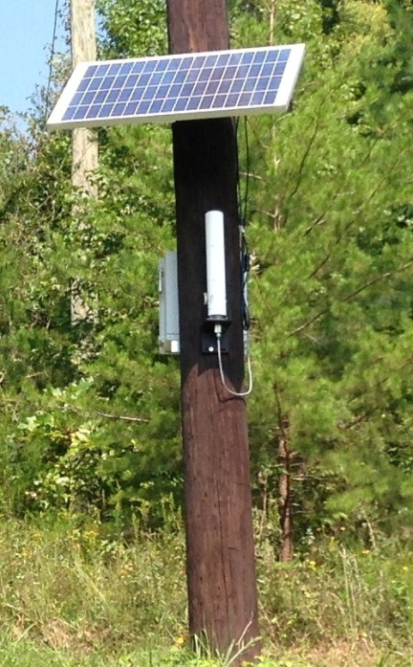
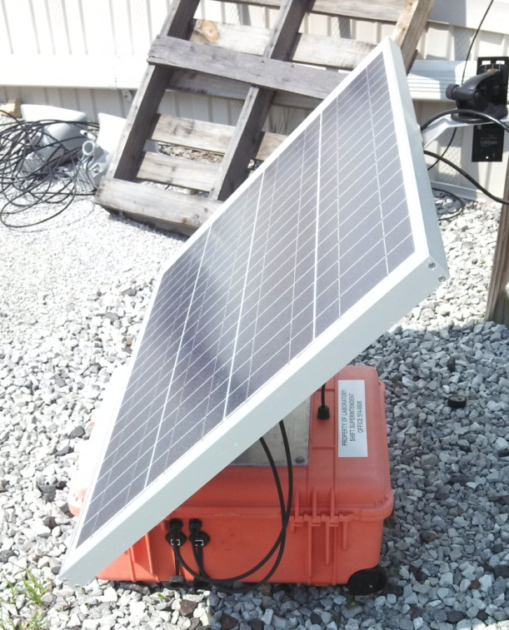
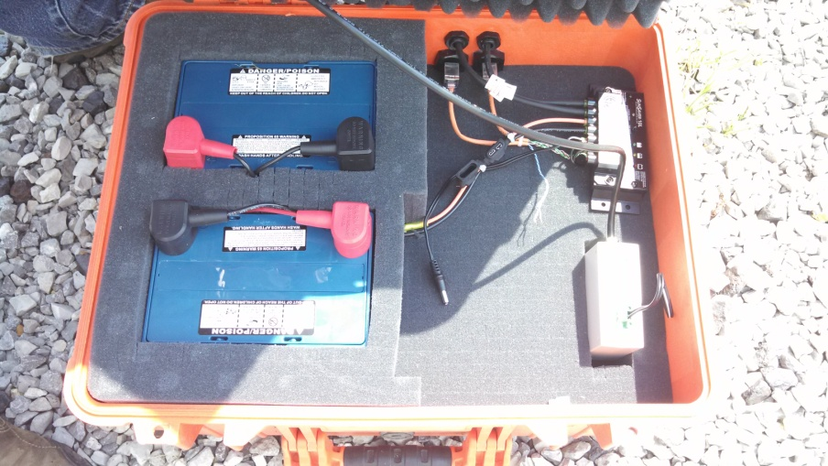
Remote Area Gamma Radiation Monitoring
Developed solar-powered, stand-alone Radiation monitoring stations in partnership with the LSS Department
Allow for remote monitoring of areas across the ORNL reservation
Do not require external power supply or Ethernet connection
Estimated 8-year battery life
Two-way wireless network communication with Horizon over the LSS long-range network
Can be re-positioned on relatively short notice for permanent or temporary deployment
Notes:
Working with Jim Johnson and Russ Henderson from the Lab Shift Superintendent’s office, we developed a variety of stand-alone EcoGamma monitoring stations that would:
Allow for remote monitoring of areas across the ORNL reservation
These stations
Do not require external power supply or Ethernet connection
Estimated 8-year battery
Communicate with Horizon over the LSS wireless network
We now had an ambient gamma monitor that:
Can be positioned on relatively short notice for permanent or temporary deployment
We then started looking into how best to deploy these instruments.

Slide 6
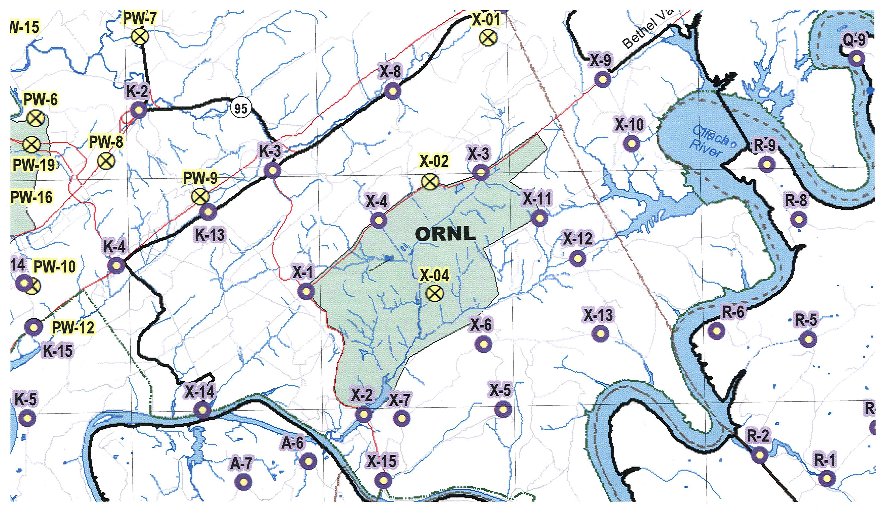
Remote Ambient Monitoring
ORNL’s Emergency Management Team has designated predefined monitoring locations in the event of a site-wide emergency.
NRPD wanted to use these designated monitoring locations to set up a network of real-time monitors.
Notes:
As you know…

Slide 7
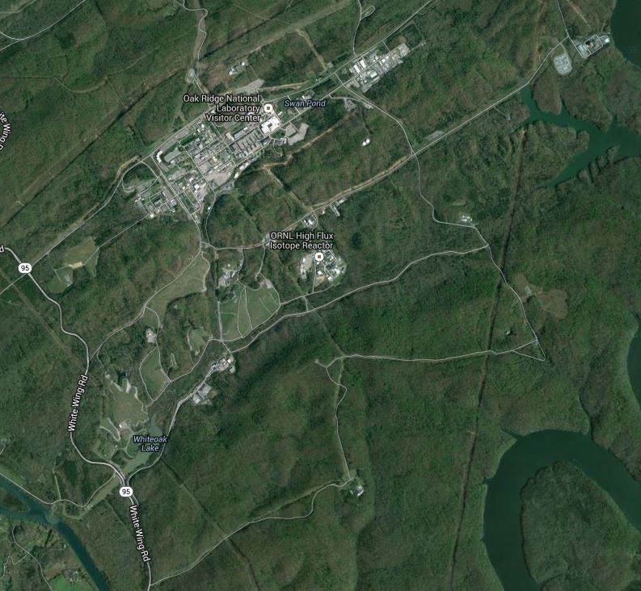
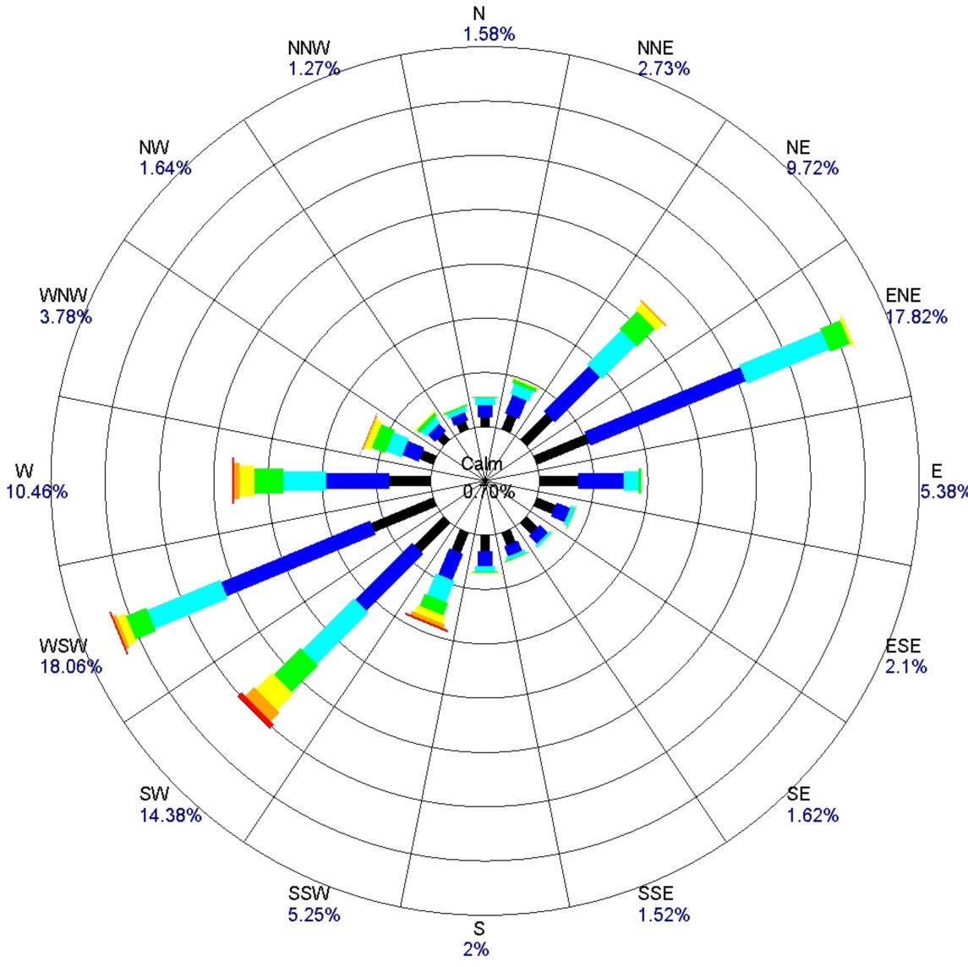
EGCR
X-3
3017
X-4
X-11
X-12
X-1
HFIR
X-13
Hwy 95
X-6
X-2
X-15
Notes:
We determined the most significant event location to be HFIR
Looking at the 10-year wind rose, it’s evident that the prevailing winds are out of either the southwest or northeast. Working with the Emergency Management Team we established two lines of monitors with the prevailing winds in mind.
One to the northeast along Melton Valley Access Road
One to the southwest along Highway 95
We then placed monitors at other key assembly points and FMT locations
SNS
3017/3019
EGCR

Slide 8
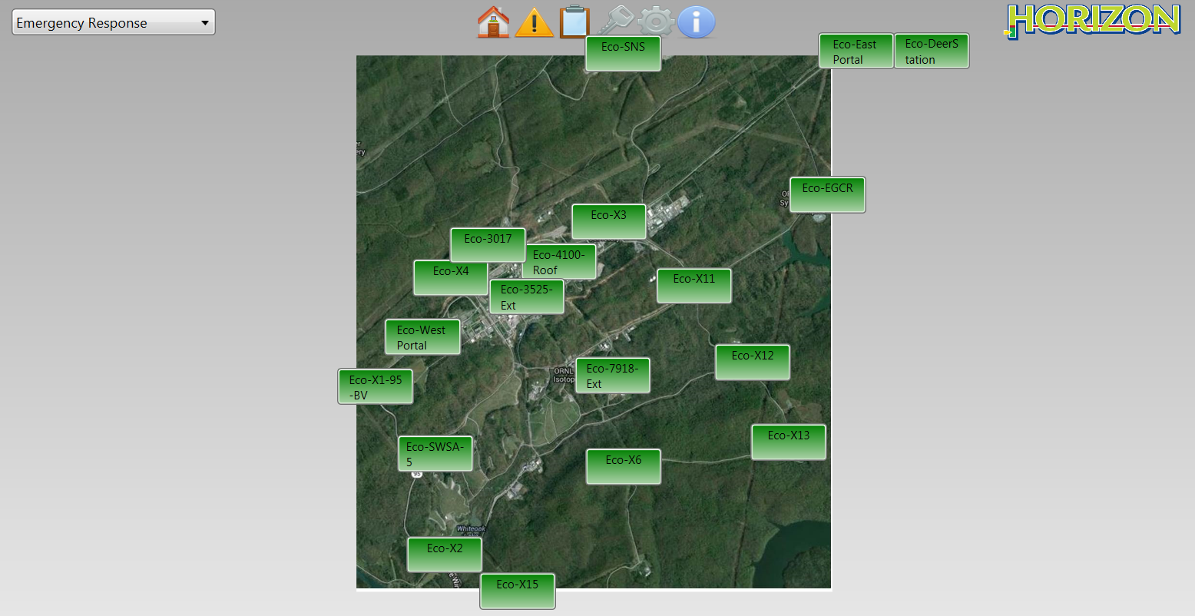
External EcoGamma Monitoring Sites as Viewed With Horizon

Slide 9
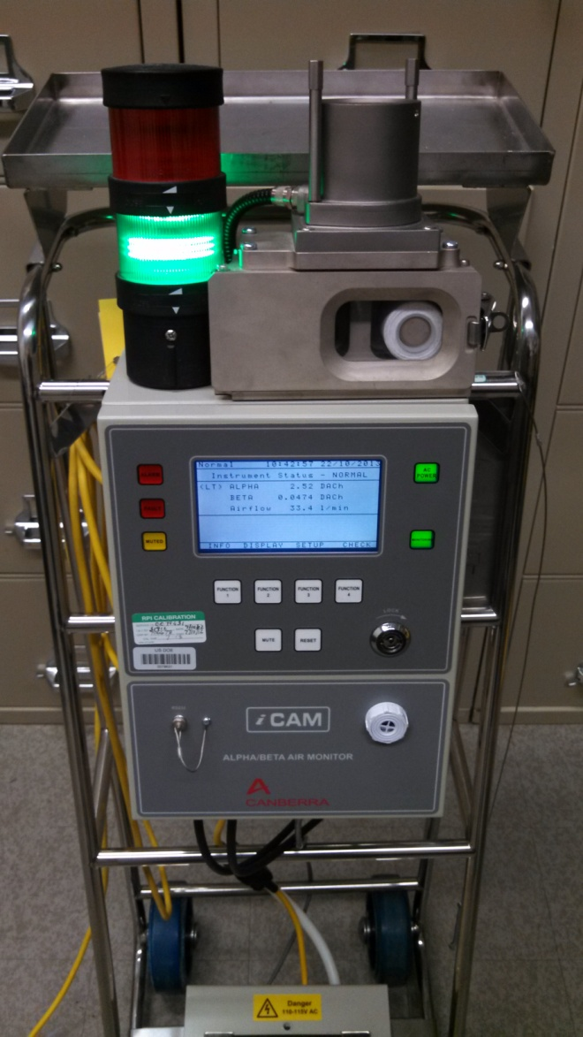
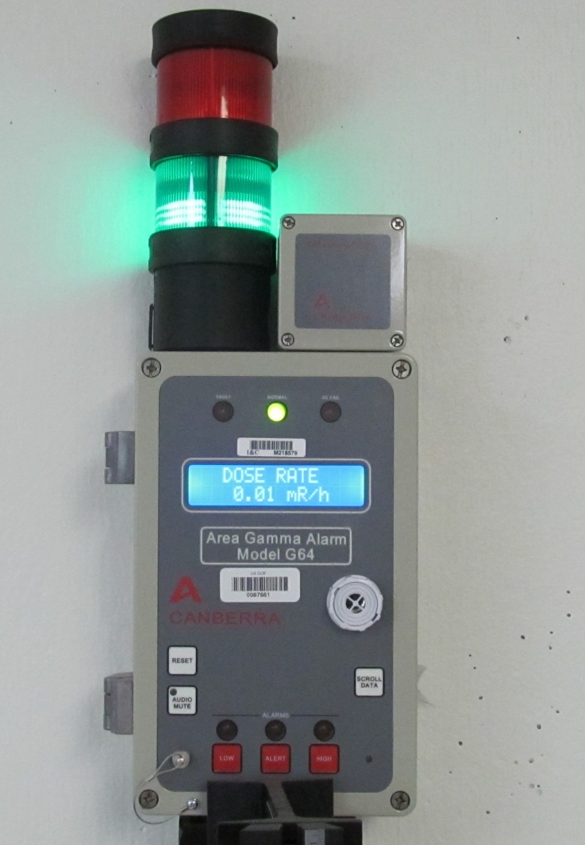
Other Instruments Monitored With Horizon
G64 Area Gamma Monitor
Canberra iCam Continuous Air Monitor

Slide 10
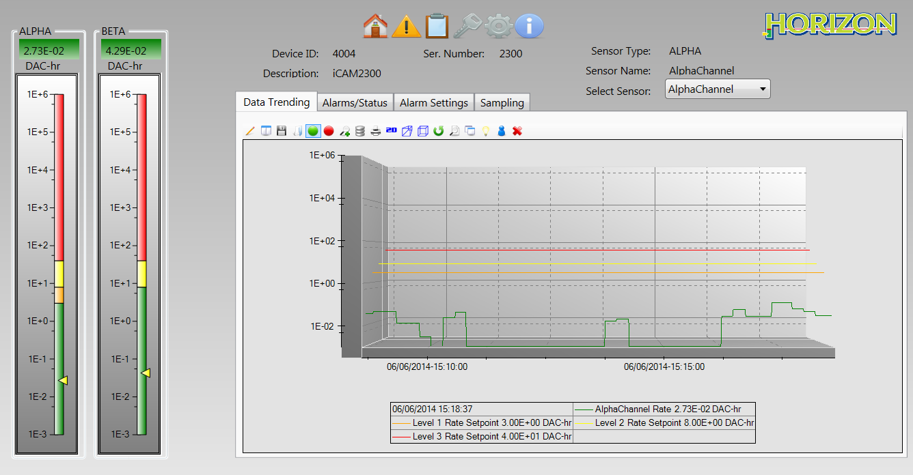
Horizon Screen Views
Site Map
Instrument Detail Screen

Slide 11
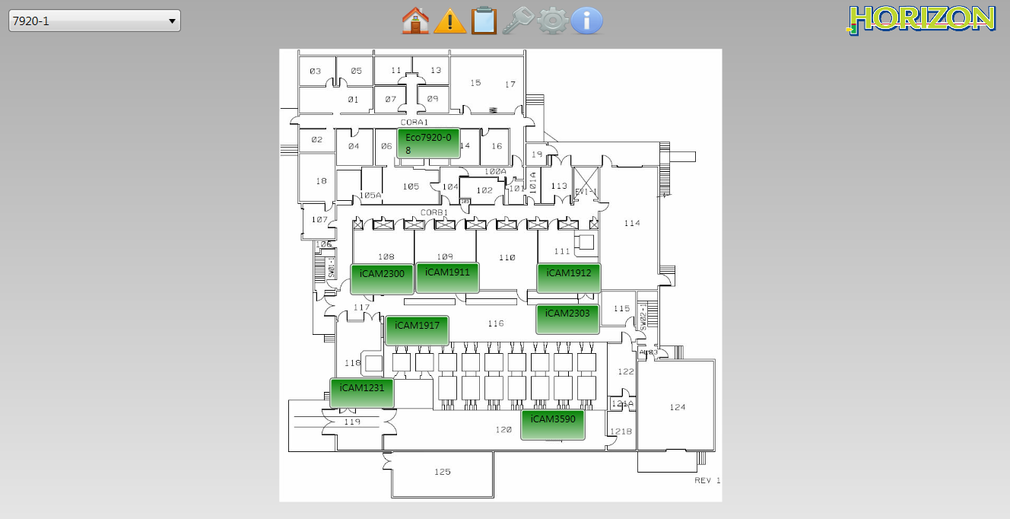
Site Maps - Facility Level View
Site maps consist of an image overlaid with icons for instruments or other site maps
Allow the user to drill down to facility level.

Slide 12
Instrument Detail
Select an individual instrument to view the instrument detail screen.
Instantaneous rate and alarm settings displayed on “sliders”
Most recent 10 minutes on graphical display.

Slide 13
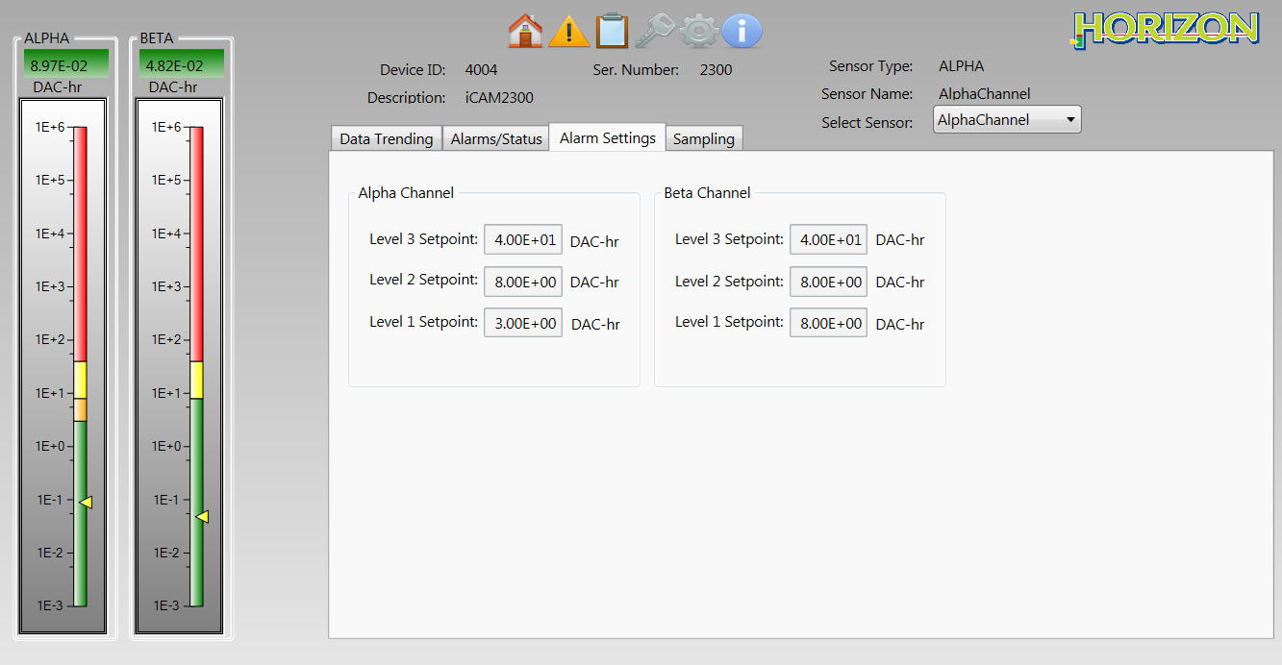
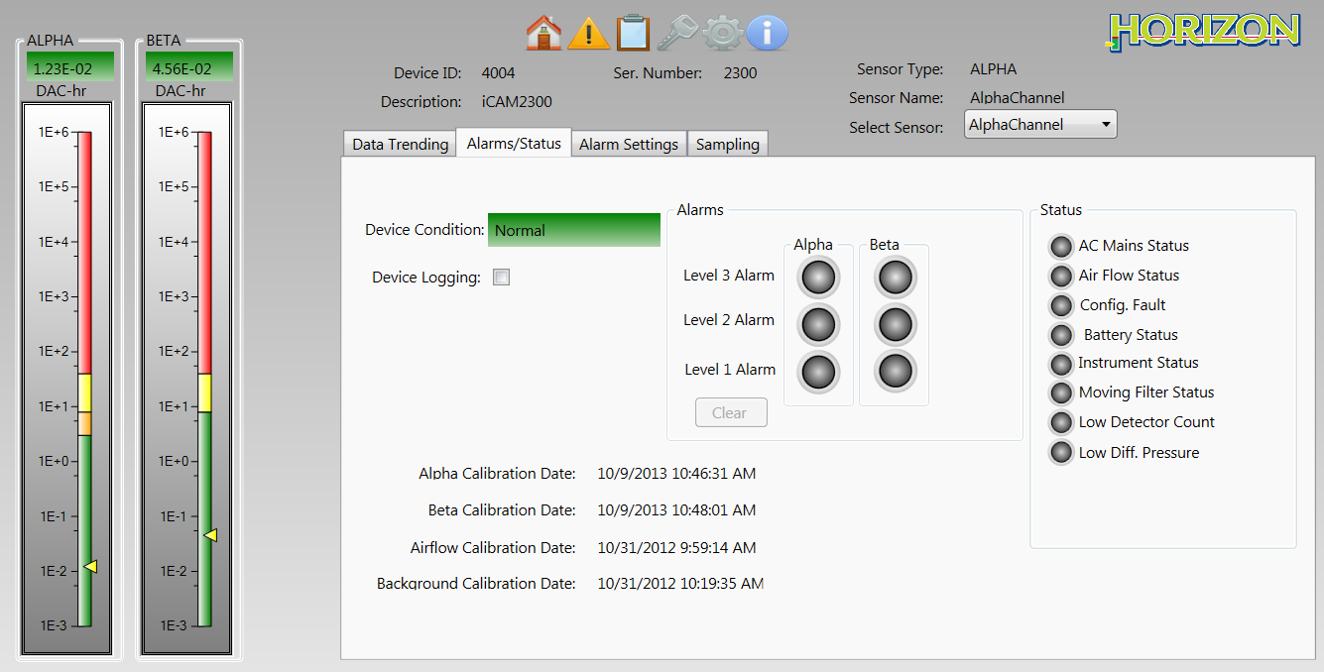
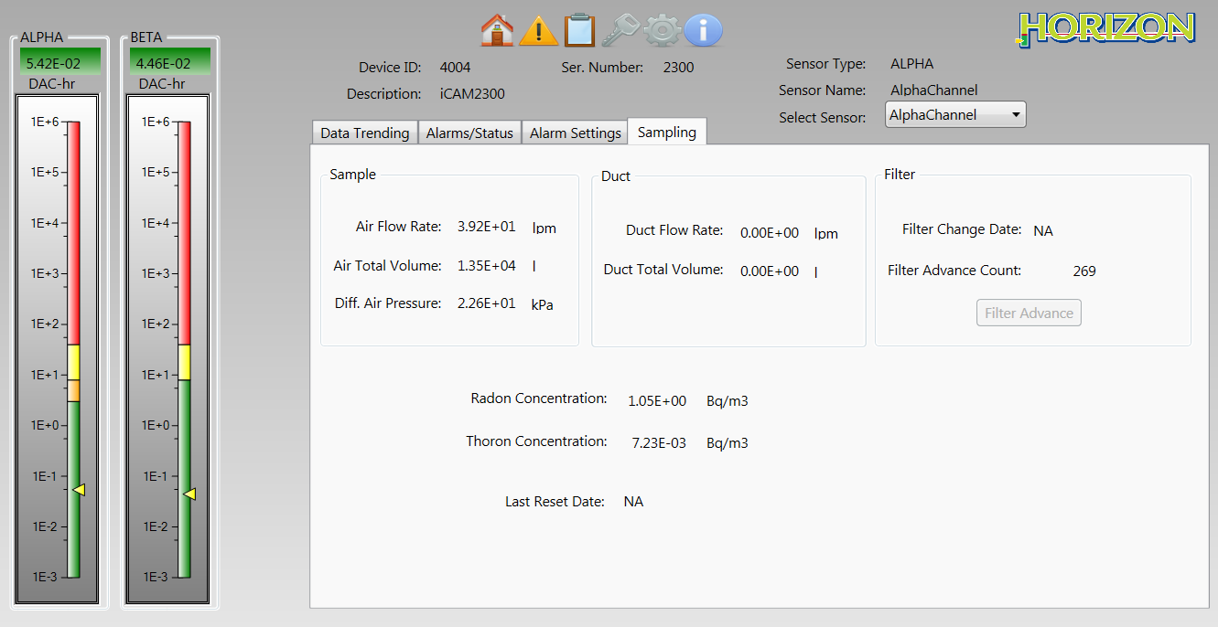
Instrument Detail
Alarm and Status Indication
Alarm Set Points
Remote filter advance for iCAM Air Monitors

Slide 14
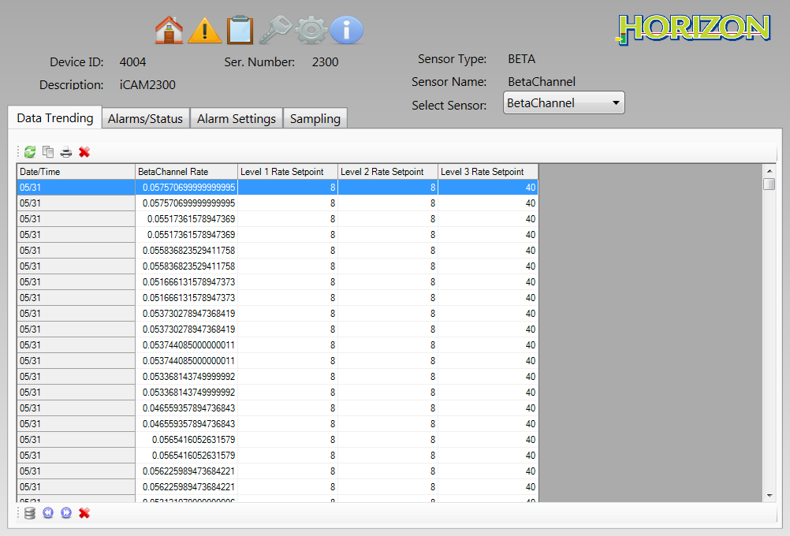
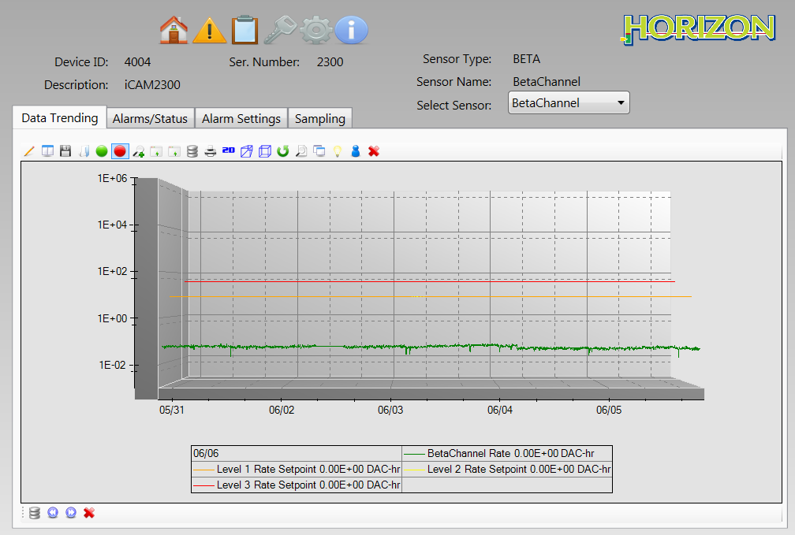
Instrument History
Instrument history can be viewed in either graphical or tabular format

Slide 15
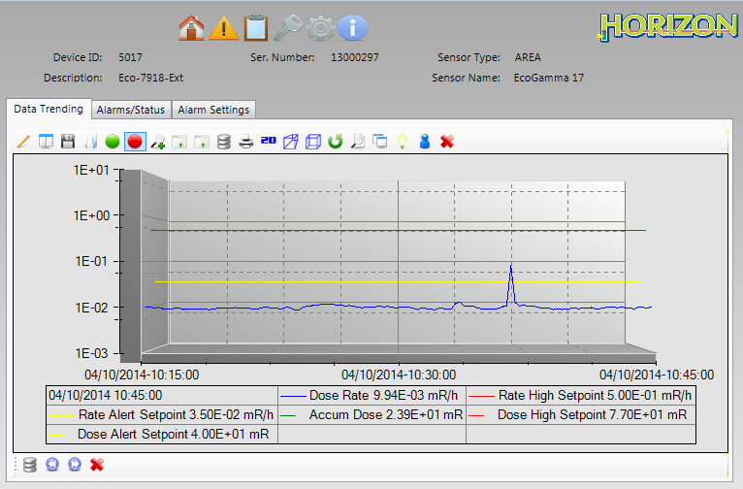
EcoGamma Alert at HFIR Portal

Slide 16
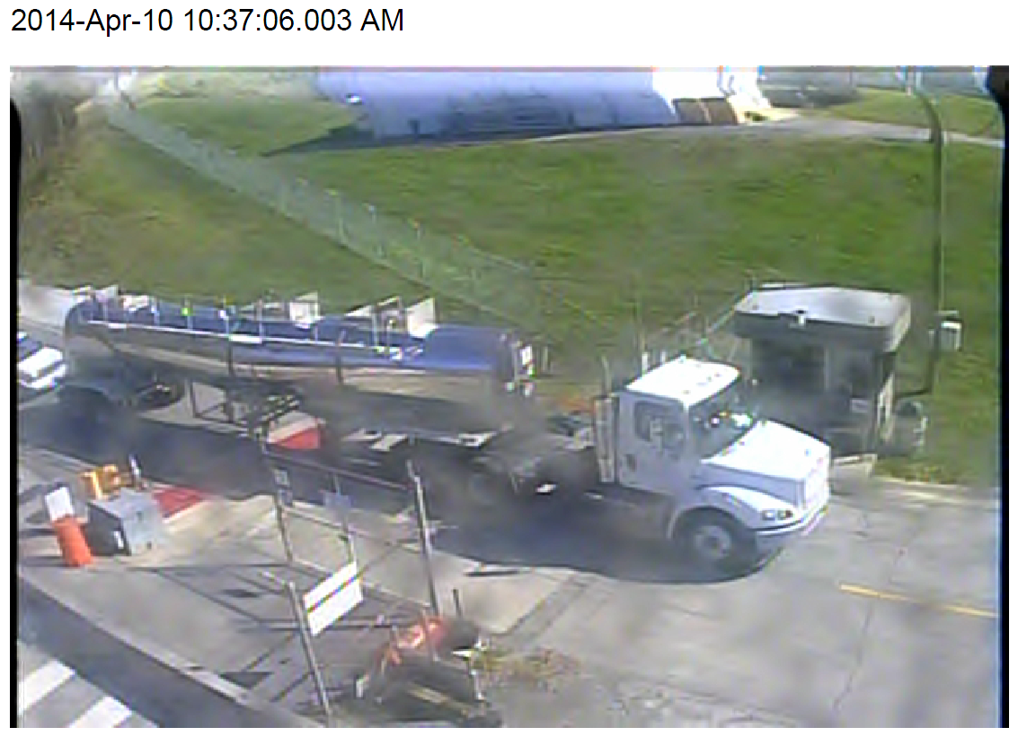
Liquid Waste Tanker

Slide 17
SNS Stack Exhaust Plume Characterization
4
2
5
1
0
3

Slide 18
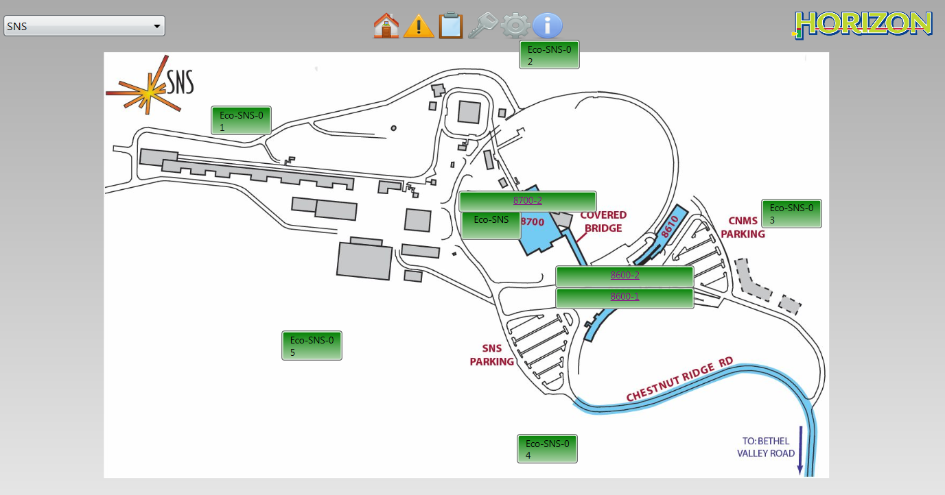
New Mobile Units at SNS
Five new mobile EcoGamma units have been built to help understand background fluctuations at the Spallation Neutron Source

Slide 19
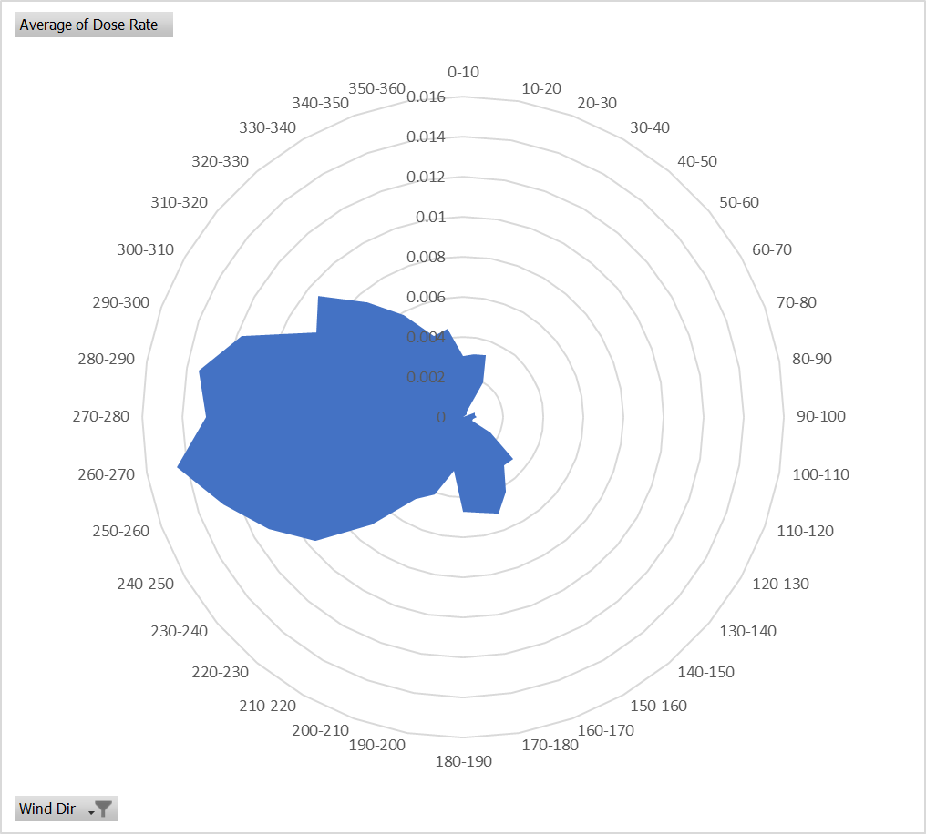

Slide 20
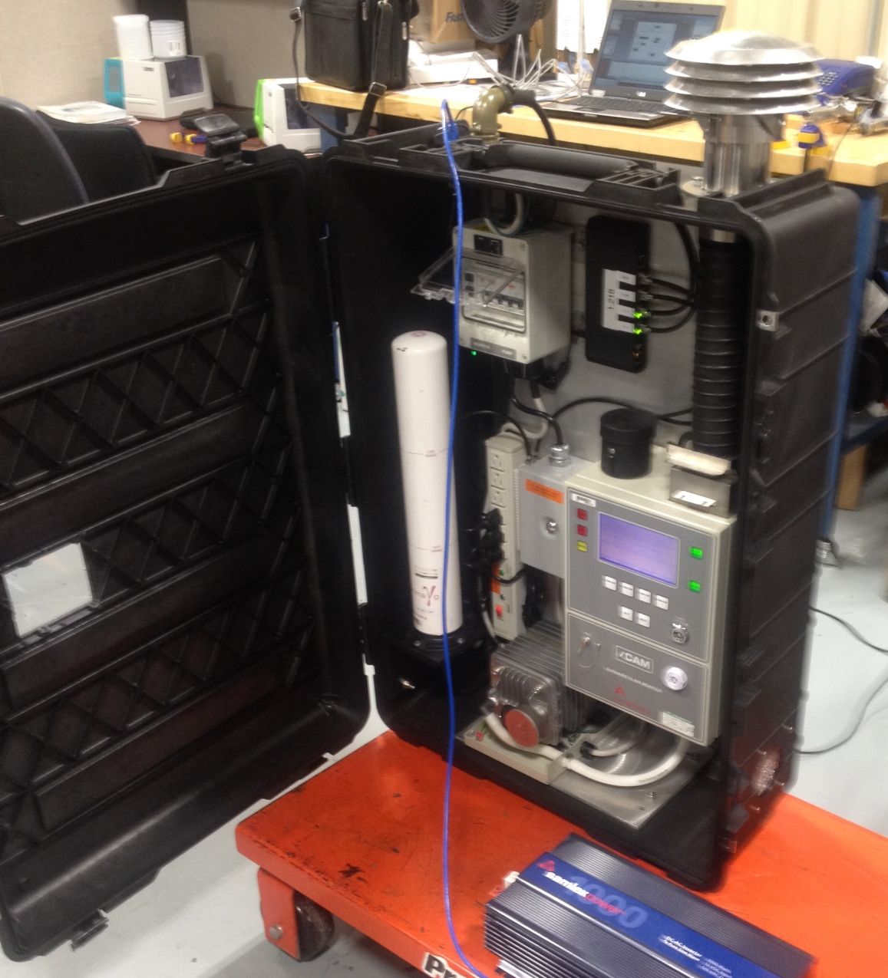
Field-deployed Incident Command Monitoring Station
“Portable” remote monitoring station with live-time readout
Canberra iCAM and EcoGamma to provide real-time monitoring data through Horizon output to emergency response RCT at the Incident Command Post
Live time feed to the Emergency Operations Center
May be deployed at strategic locations near an ongoing or potential release point to provide real-time updates of the situation and trending data
JPM and RCT training module is currently under development

